Slide 1
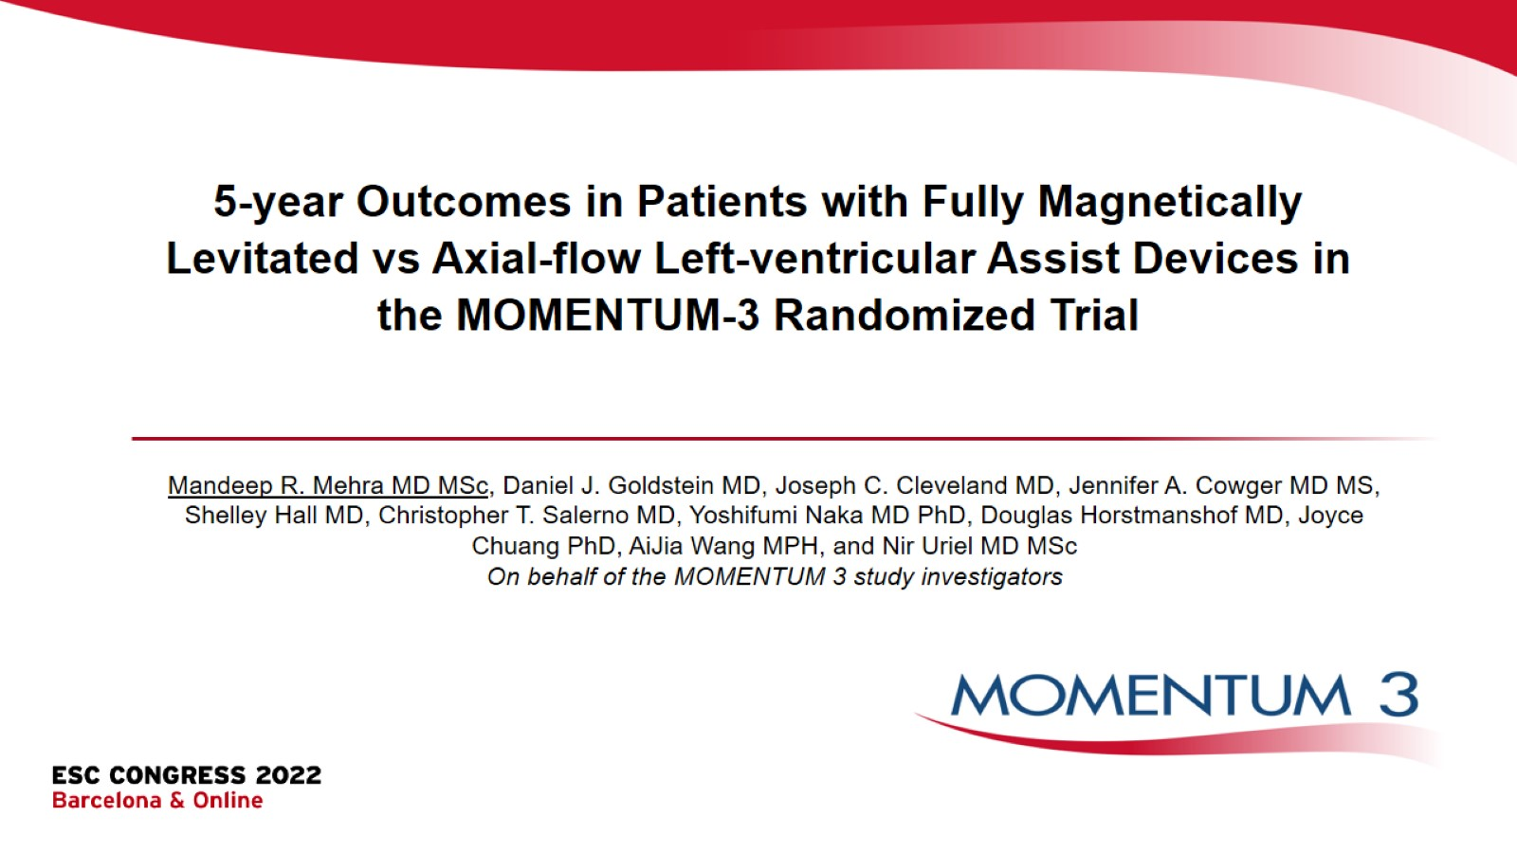

Slide 2
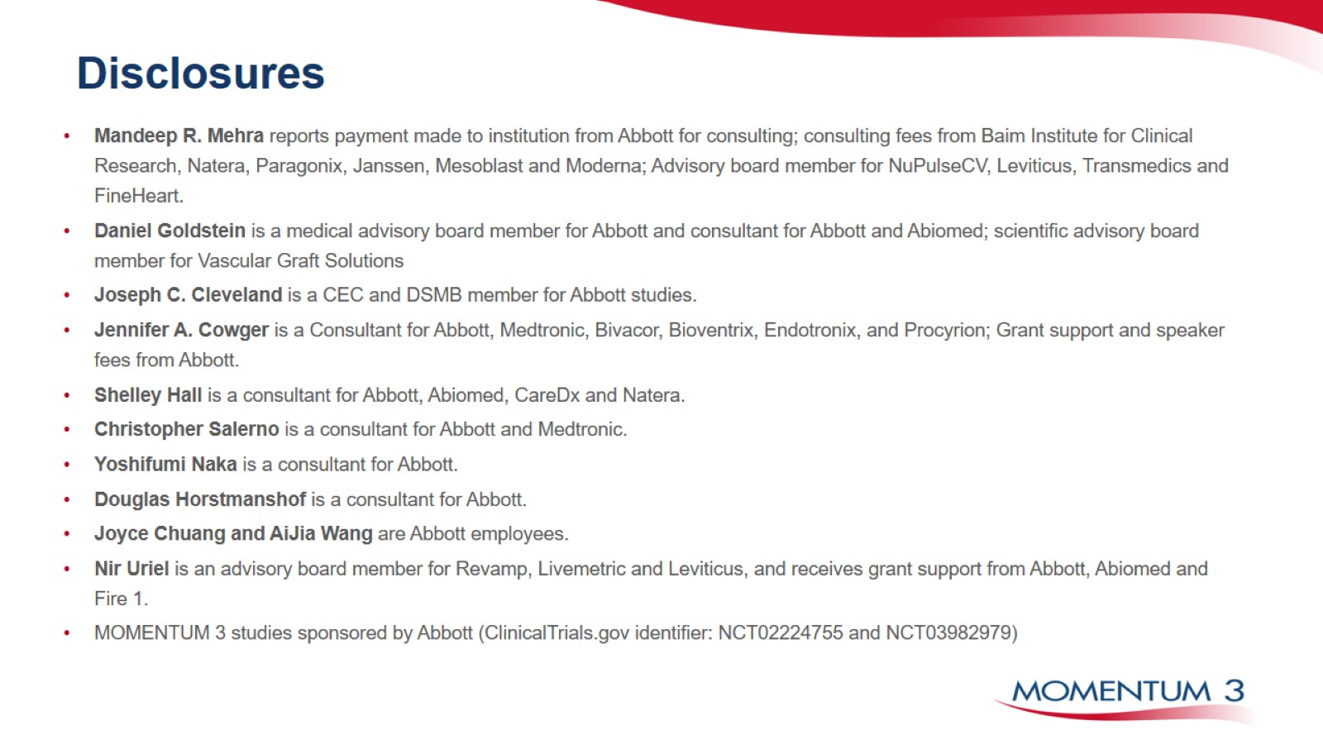
Disclosures

Slide 3
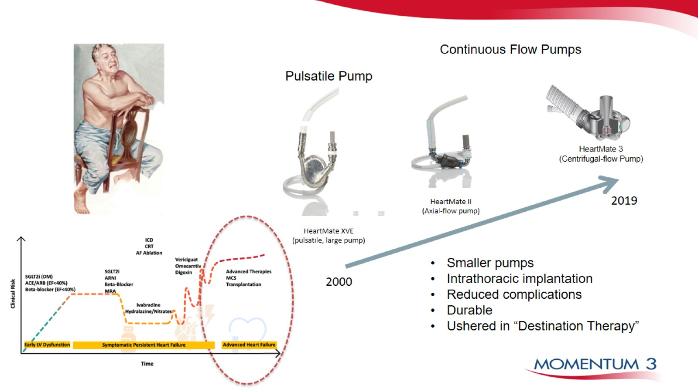

Slide 4
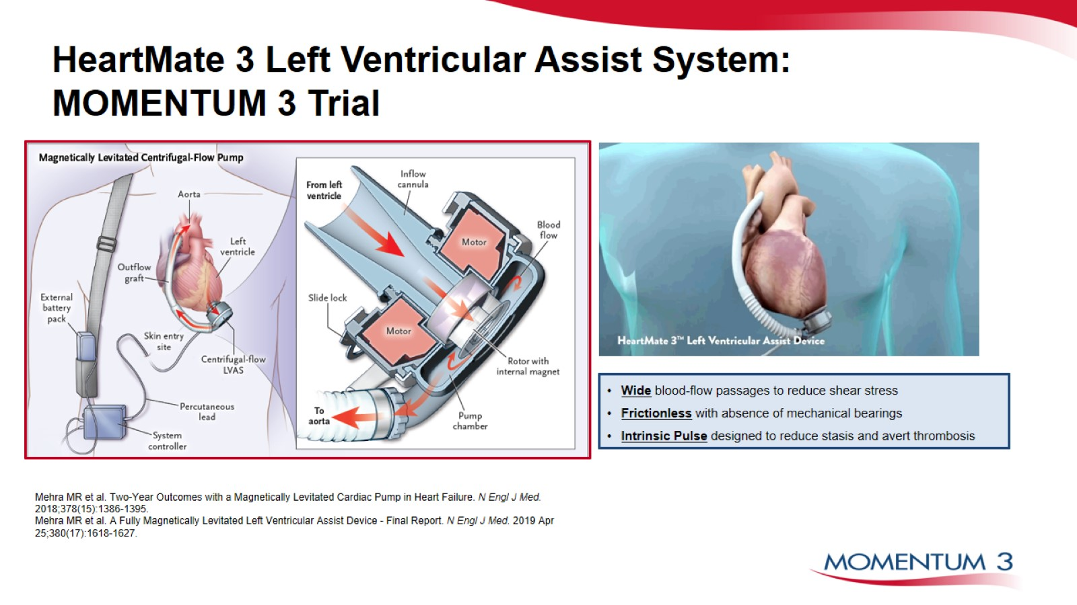
HeartMate 3 Left Ventricular Assist System: MOMENTUM 3 Trial

Slide 5
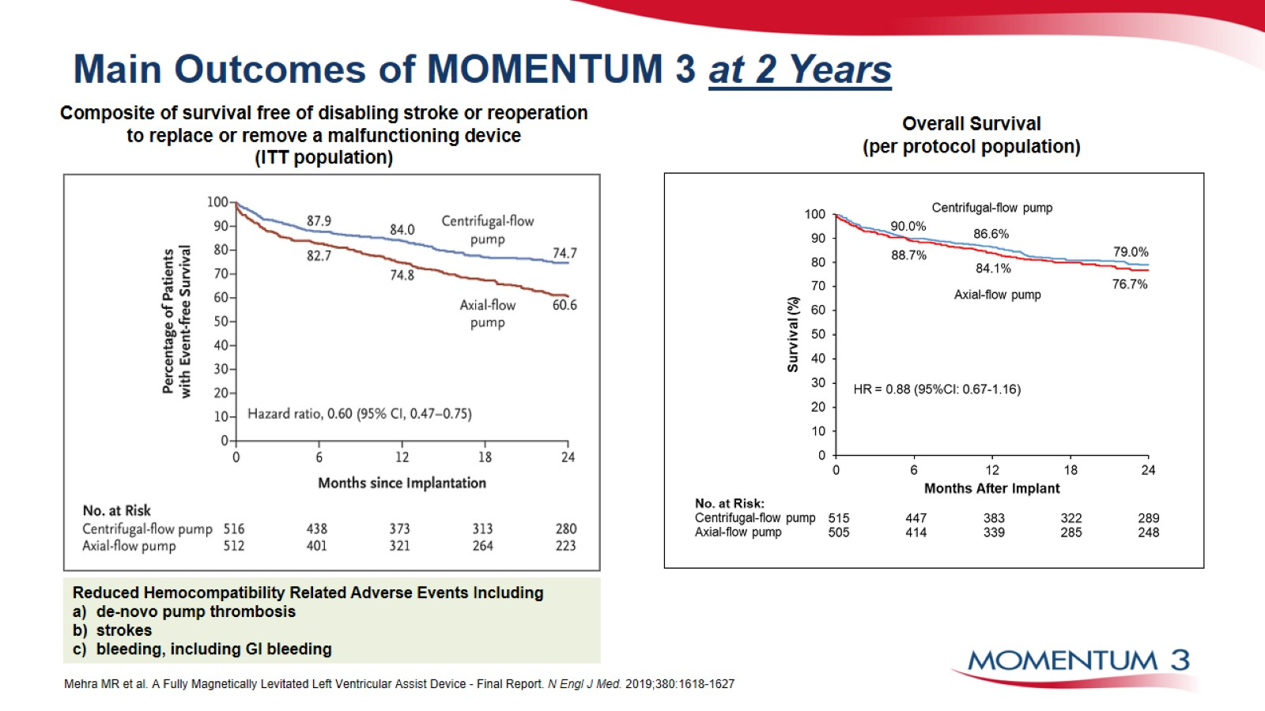
Main Outcomes of MOMENTUM 3 at 2 Years

Slide 6
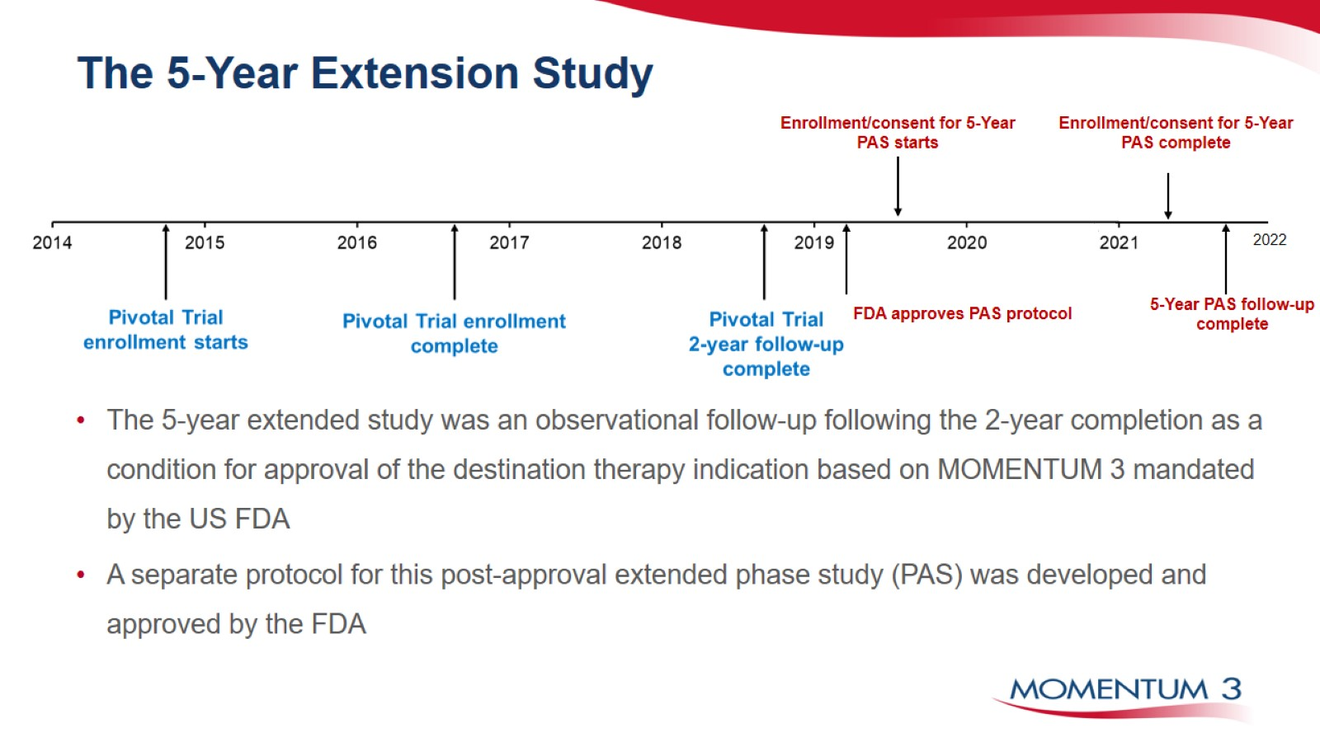
The 5-Year Extension Study

Slide 7
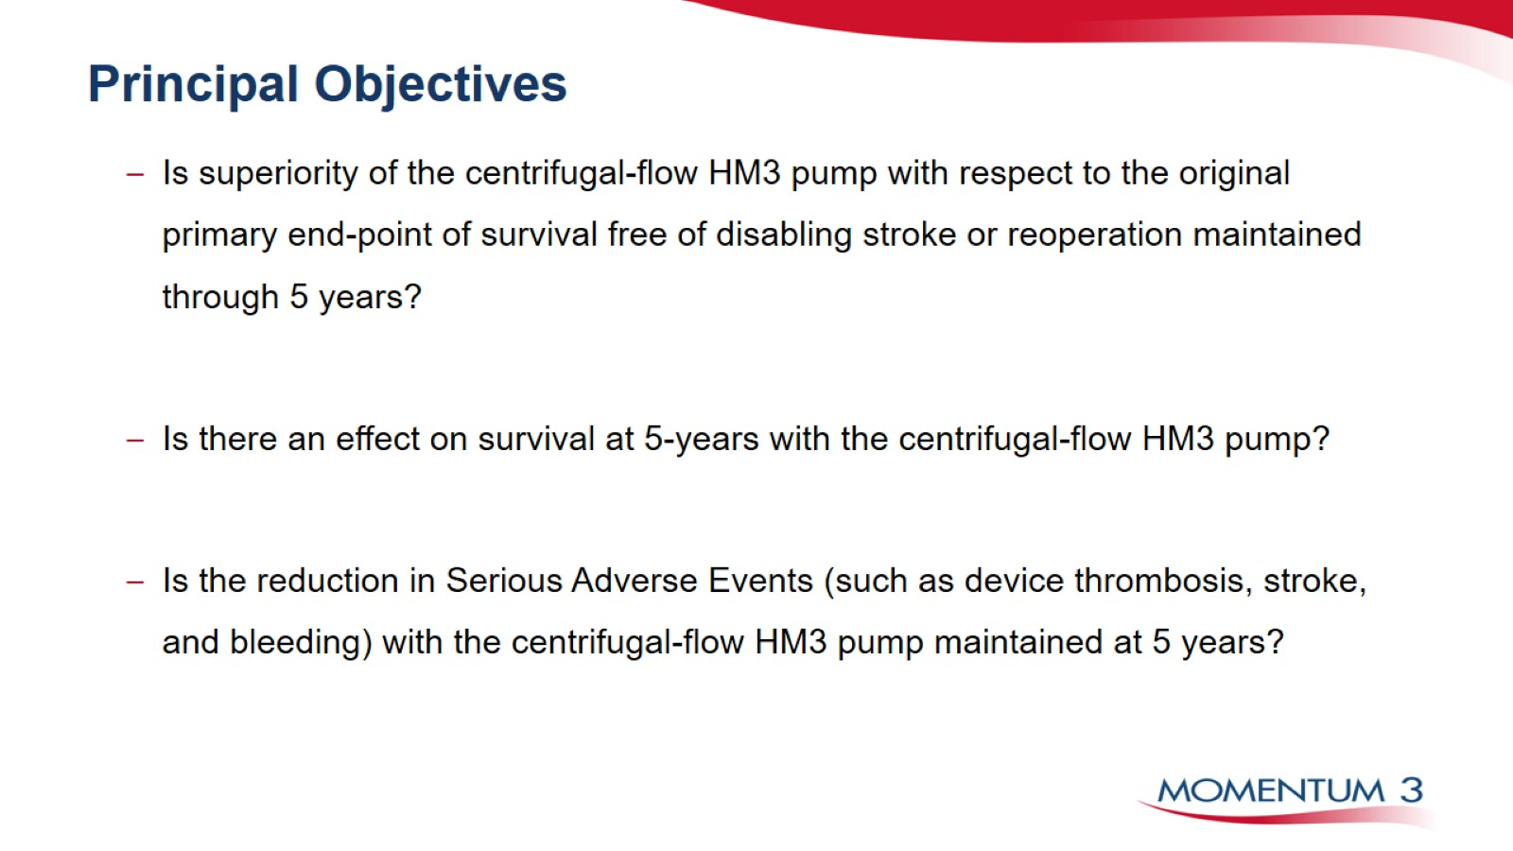
Principal Objectives

Slide 8
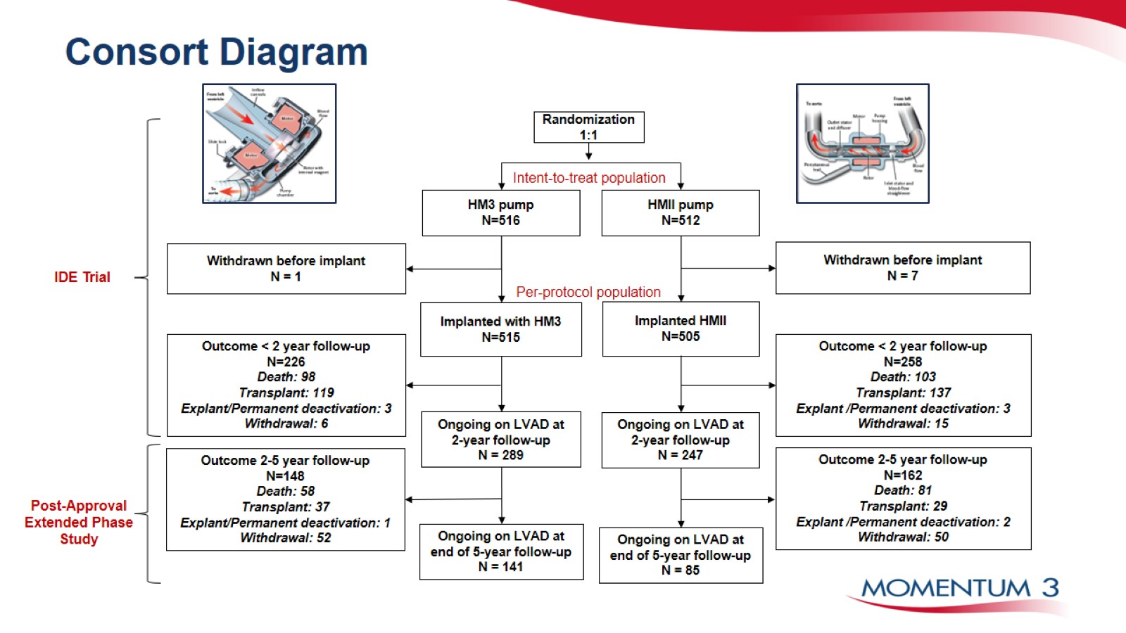
Consort Diagram

Slide 9
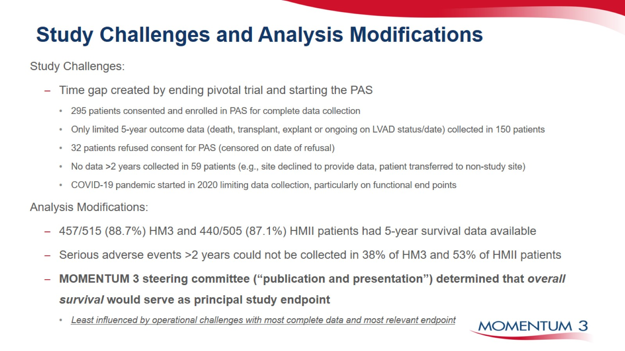
Study Challenges and Analysis Modifications

Slide 10
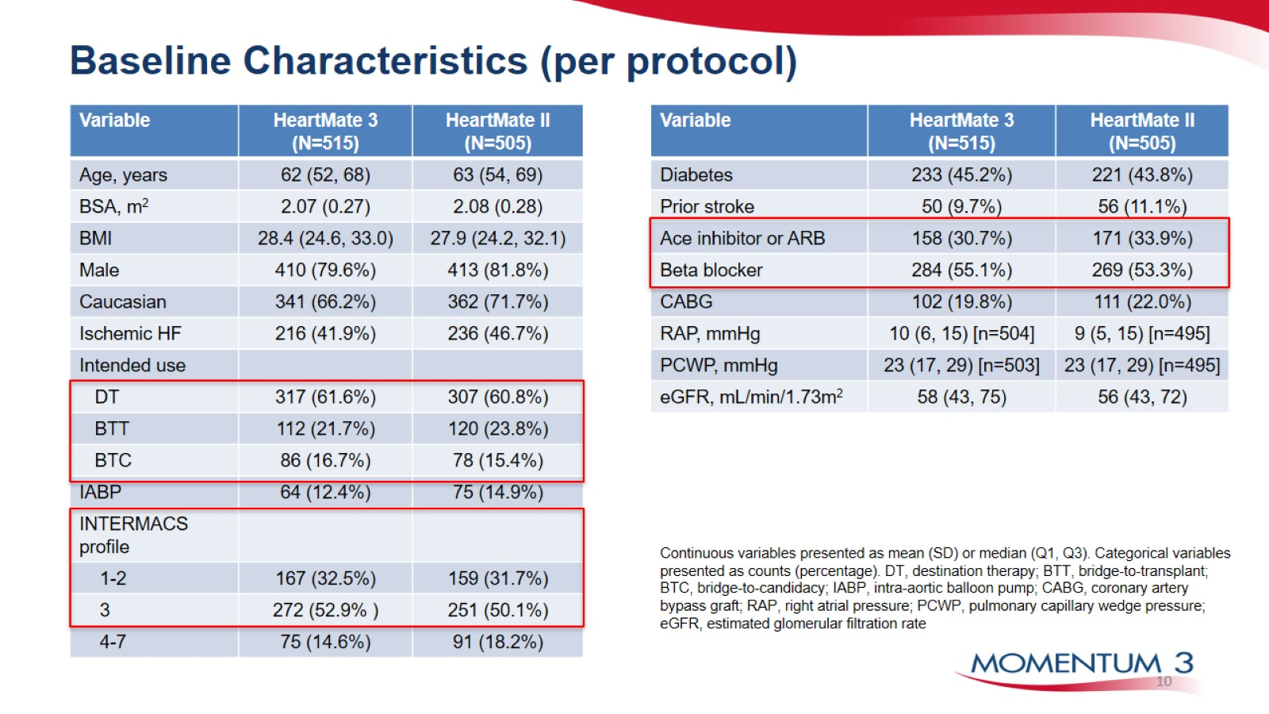
Baseline Characteristics (per protocol)

Slide 11
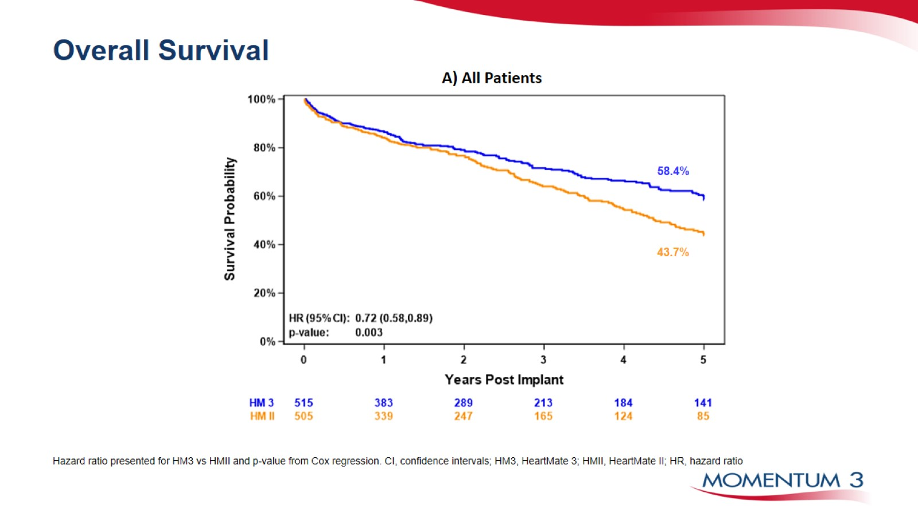
Overall Survival

Slide 12
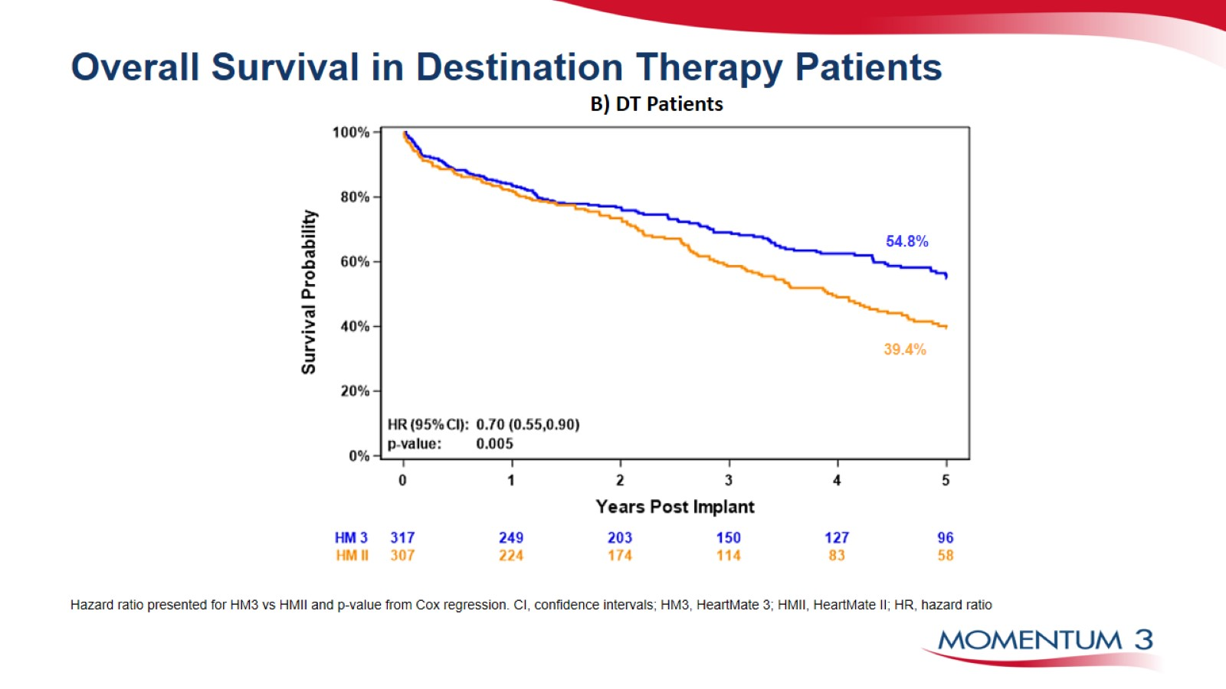
Overall Survival in Destination Therapy Patients

Slide 13
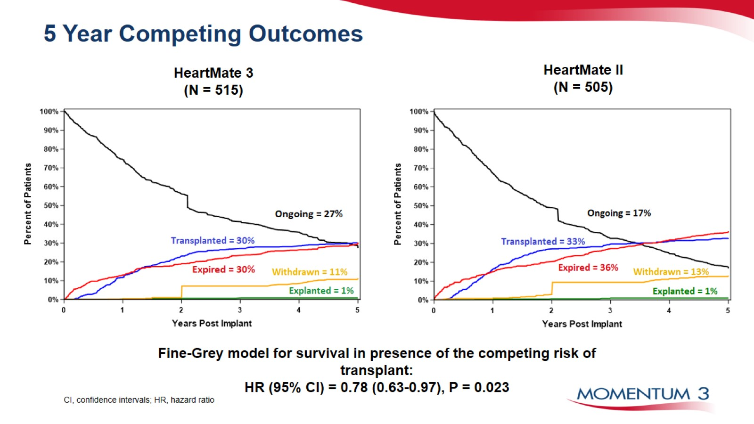
5 Year Competing Outcomes

Slide 14
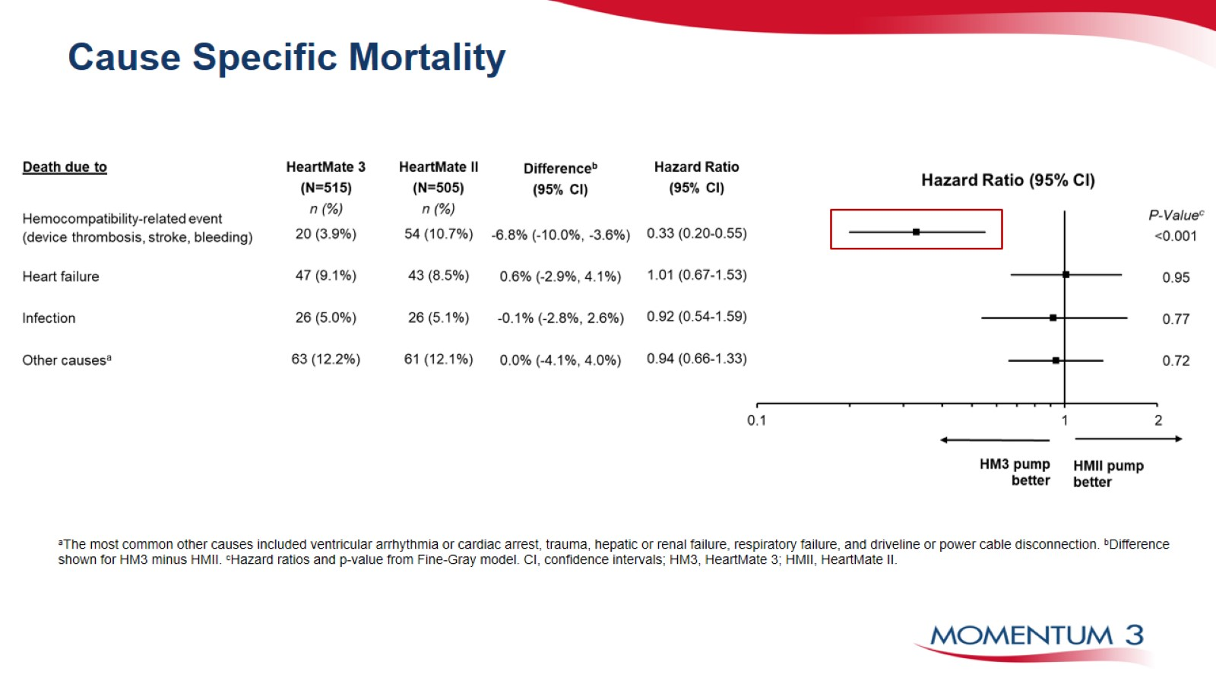
Cause Specific Mortality

Slide 15
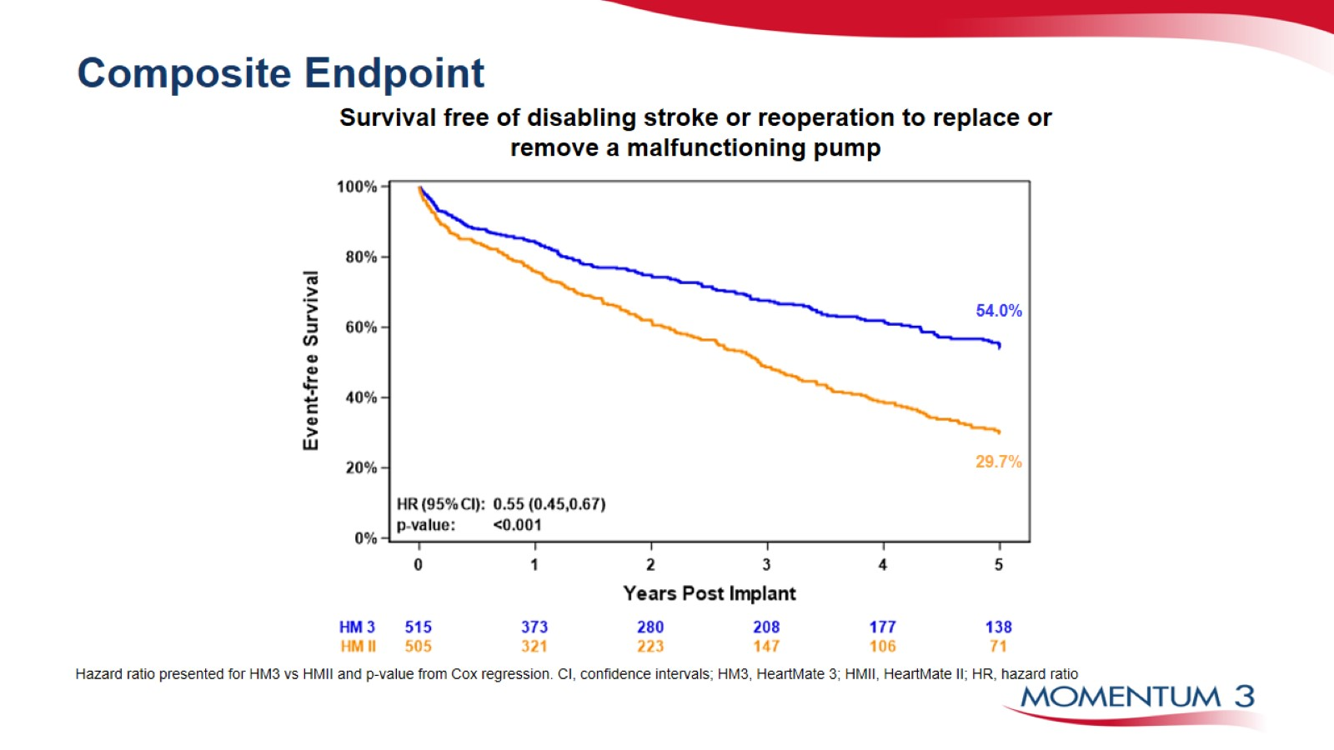
Composite Endpoint

Slide 16
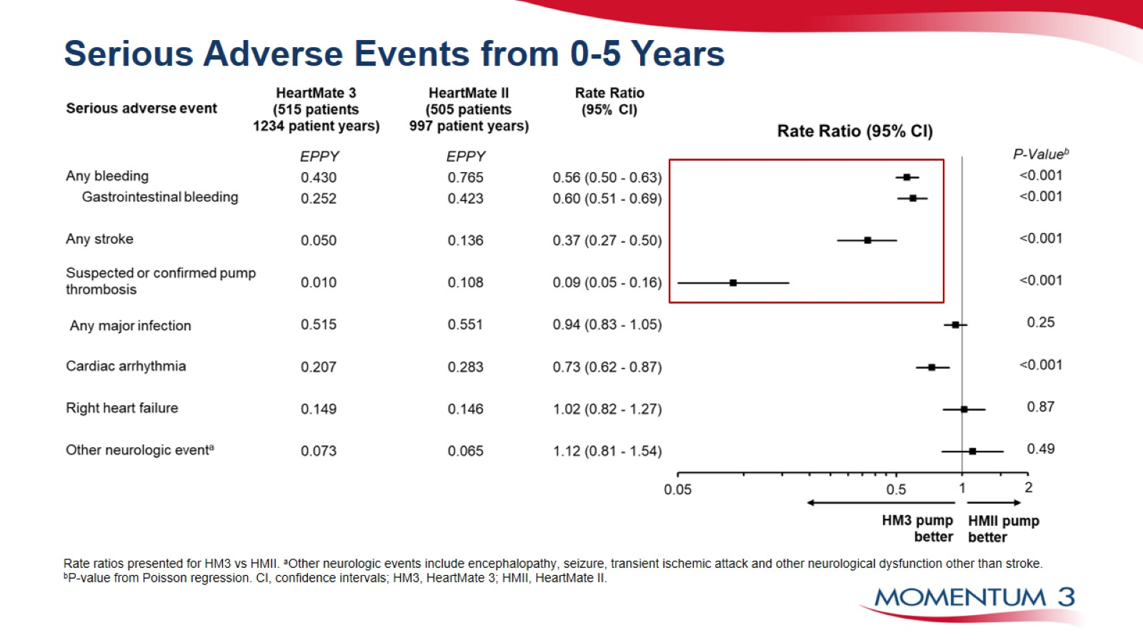
Serious Adverse Events from 0-5 Years

Slide 17
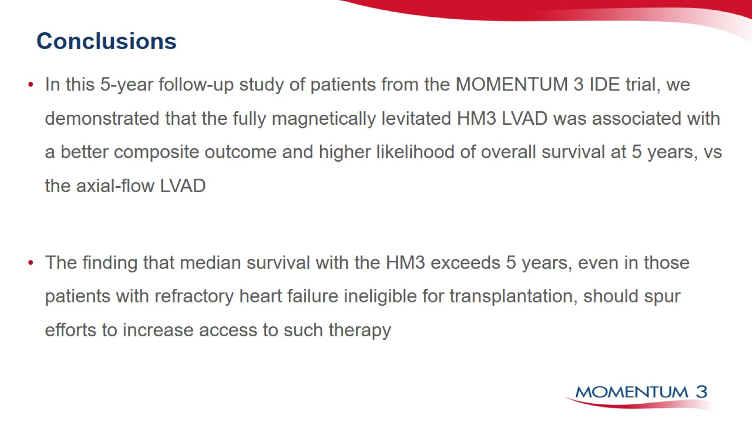
Conclusions

Slide 18
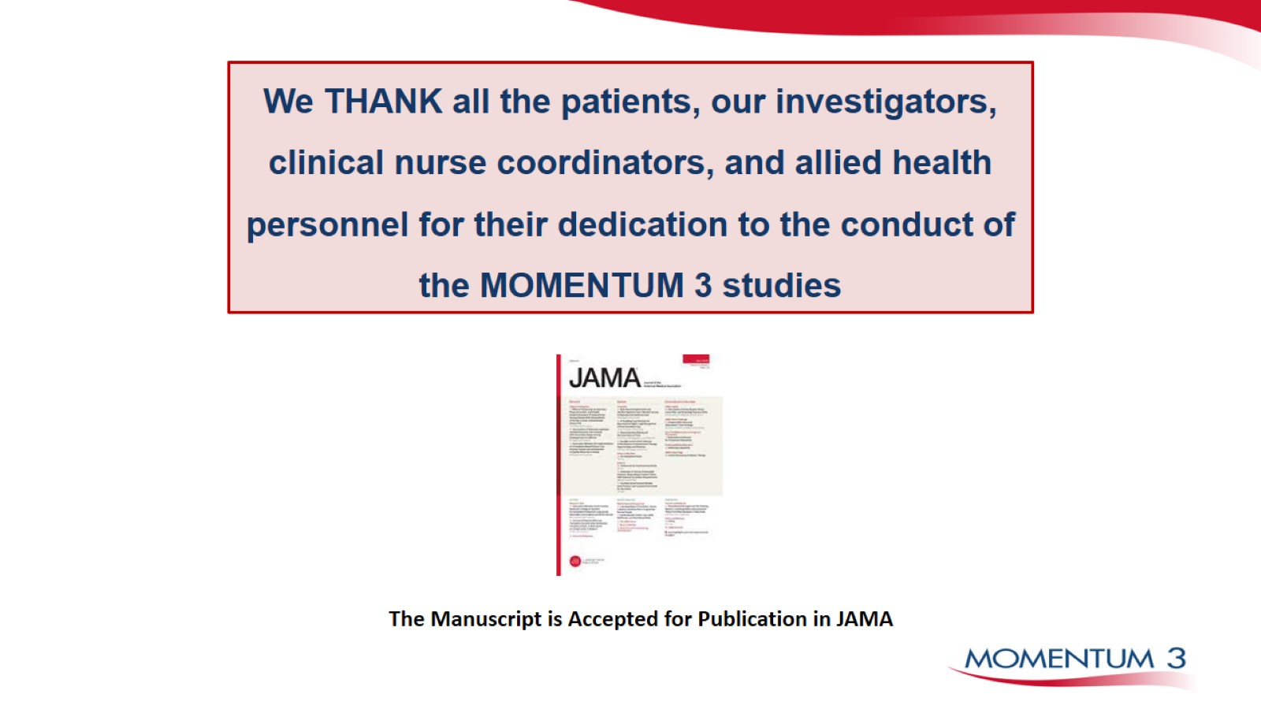
We THANK all the patients, our investigators, clinical nurse coordinators, and allied health personnel for their dedication to the conduct of the MOMENTUM 3 studies

Slide 19
