Slide 18
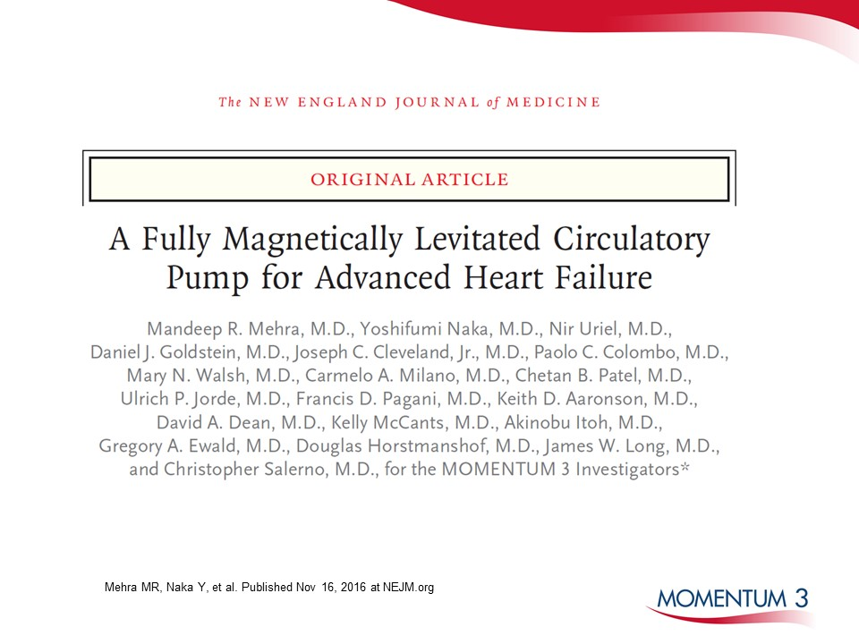

Slide 20
Abbott
One St. Jude Medical Dr., St. Paul, MN 55117 USA, Tel: 1 651 756 2000
cardiovascular.abbott
Rx Only
Important Safety Information
Brief Summary: Prior to using these devices, please review the Instructions for Use for a complete listing of indications, contraindications, warnings, precautions, potential adverse events and directions for use.
HeartMate 3™ LVAS Indications: The HeartMate 3 Left Ventricular Assist System is indicated for providing short- and long-term mechanical circulatory support (e.g., as bridge to transplant or myocardial recovery, or destination therapy) in patients with advanced refractory left ventricular heart failure.
HeartMate 3 LVAS Contraindications: The HeartMate 3 Left Ventricular Assist System is contraindicated for patients who cannot tolerate, or who are allergic to, anticoagulation therapy.
HeartMate 3 LVAS Adverse Events: Adverse events that may be associated with the use of the HeartMate 3 Left Ventricular Assist System are: death, bleeding, cardiac arrhythmia, localized infection, right heart failure, respiratory failure, device malfunctions, driveline infection, renal dysfunction, sepsis, stroke, other neurological event (not stroke-related), hepatic dysfunction, psychiatric episode, venous thromboembolism, hypertension, arterial non-central nervous system (CNS) thromboembolism, pericardial fluid collection, pump pocket or pseudo pocket infection, myocardial infarction, wound dehiscence, hemolysis (not associated with suspected device thrombosis) or pump thrombosis.
™ Indicates a trademark of the Abbott group of companies.
‡ Indicates a third party trademark, which is property of its respective owner.
© 2020 Abbott. All Rights Reserved.
MAT-2004342 v1.0 | Item approved for U.S. use only.

