Slide 1
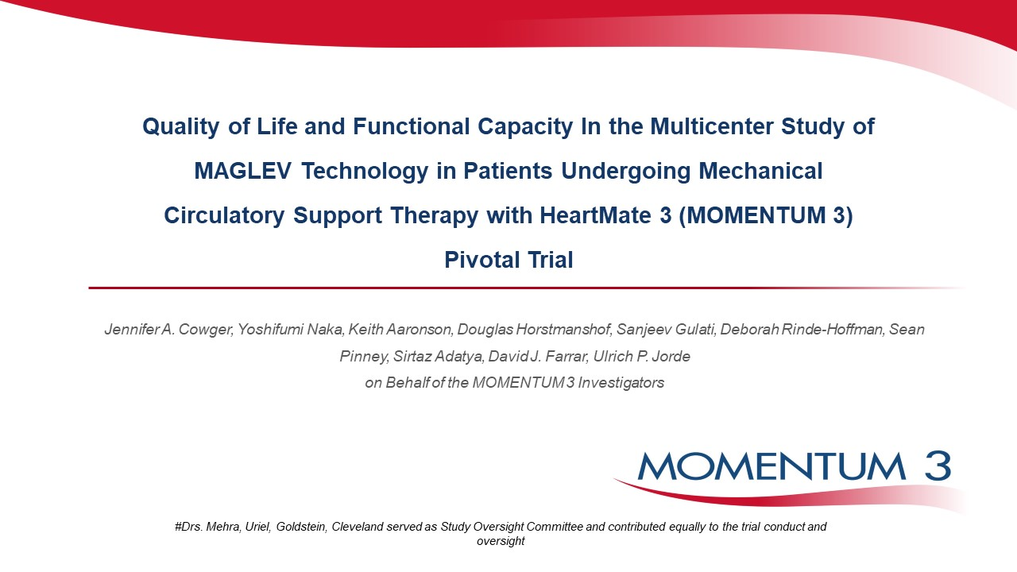

Slide 2
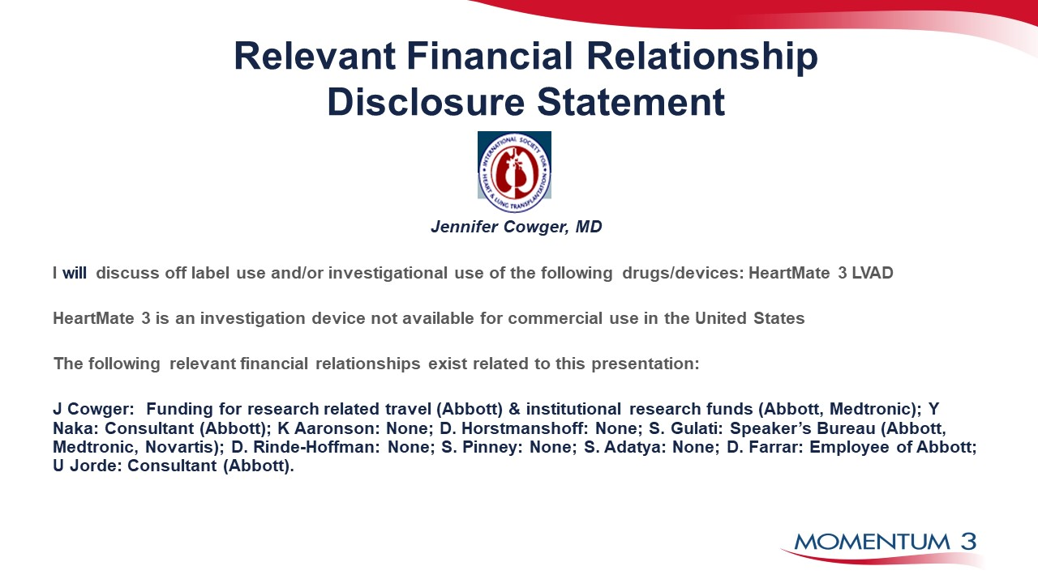

Slide 3
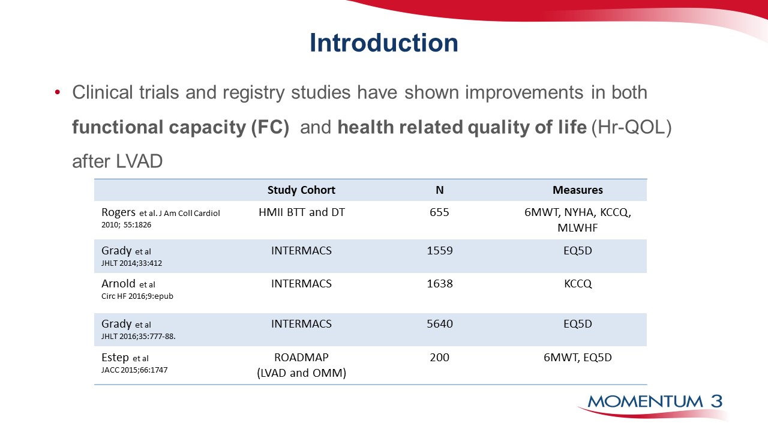

Slide 4
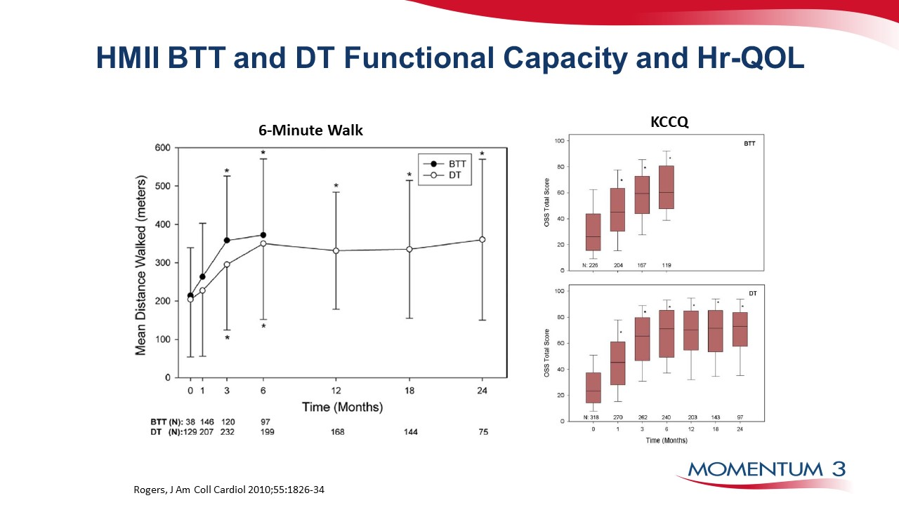

Slide 5
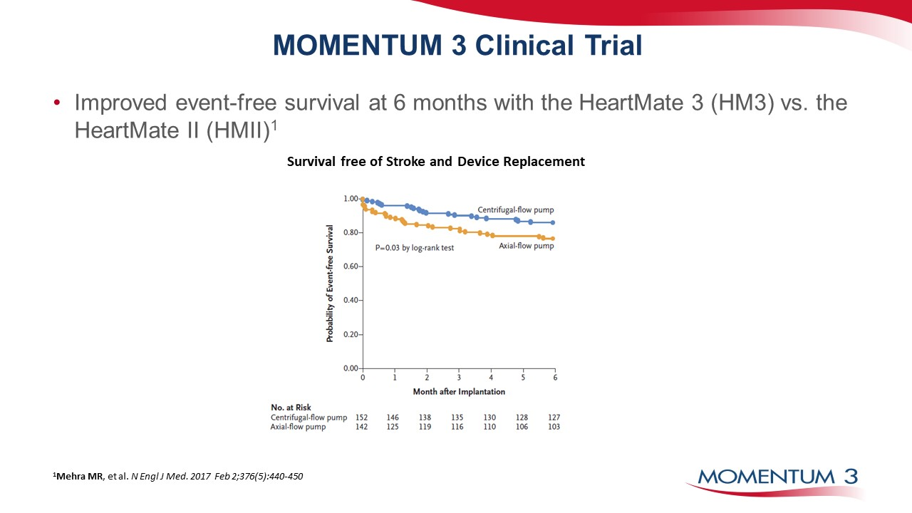

Slide 6
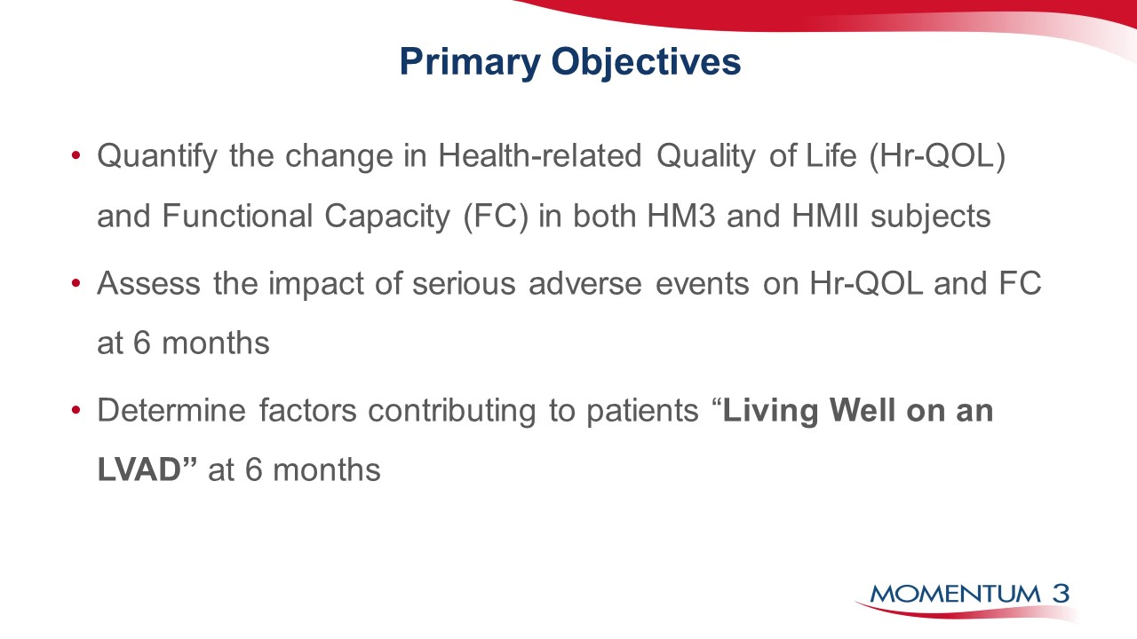

Slide 7
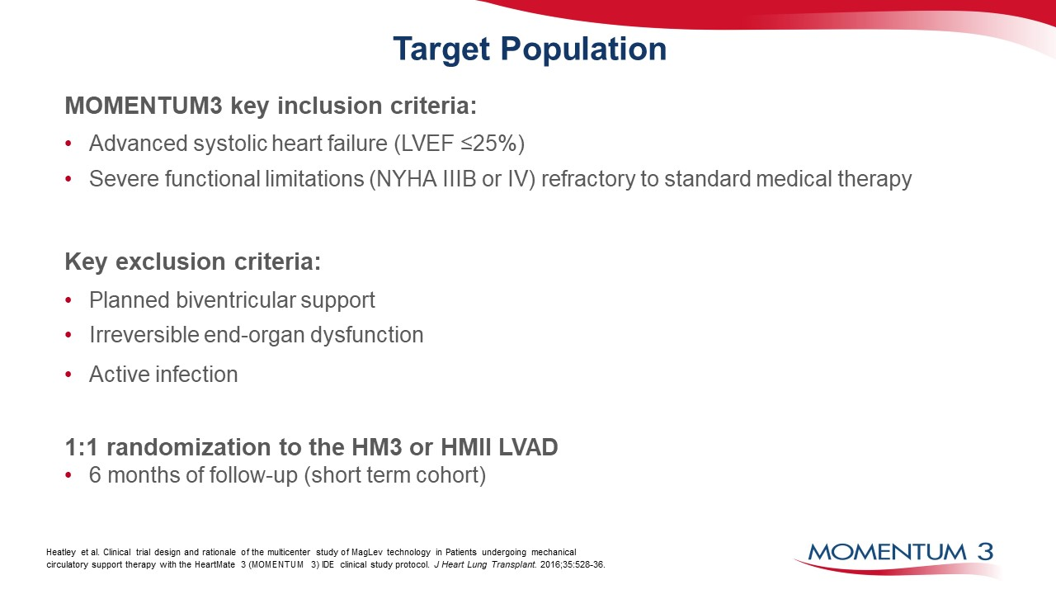

Slide 8
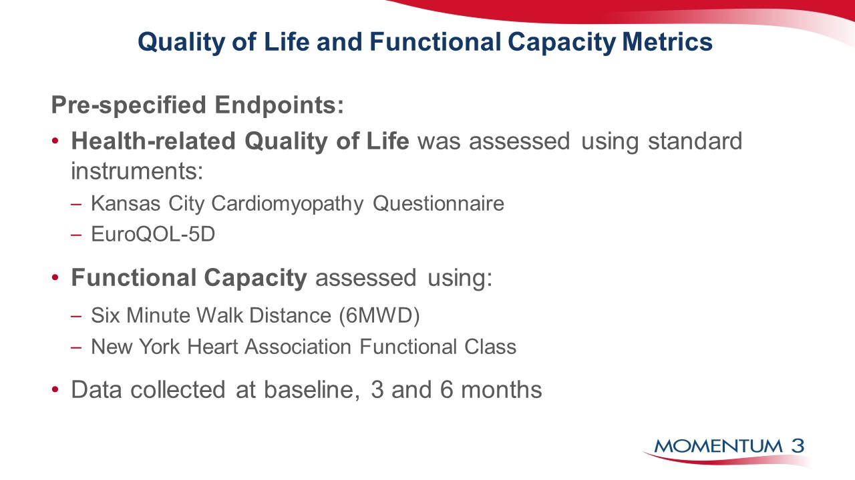

Slide 10
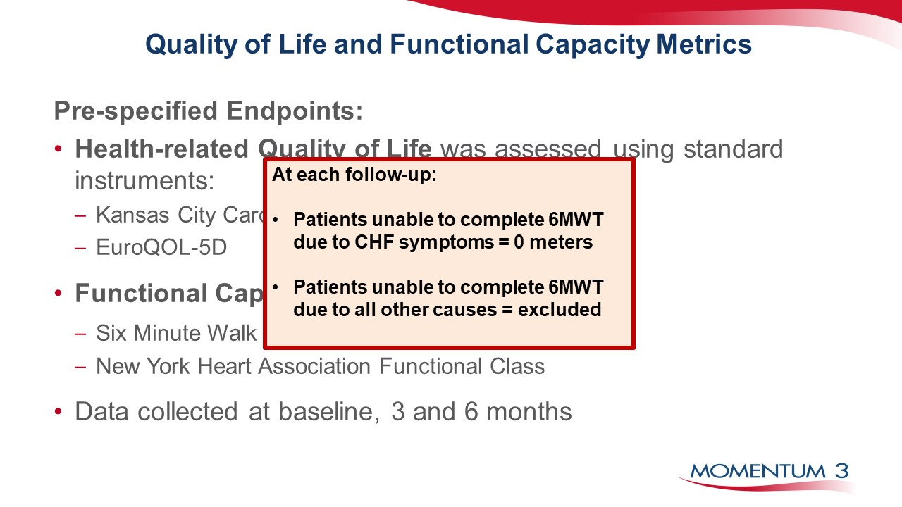

Slide 11
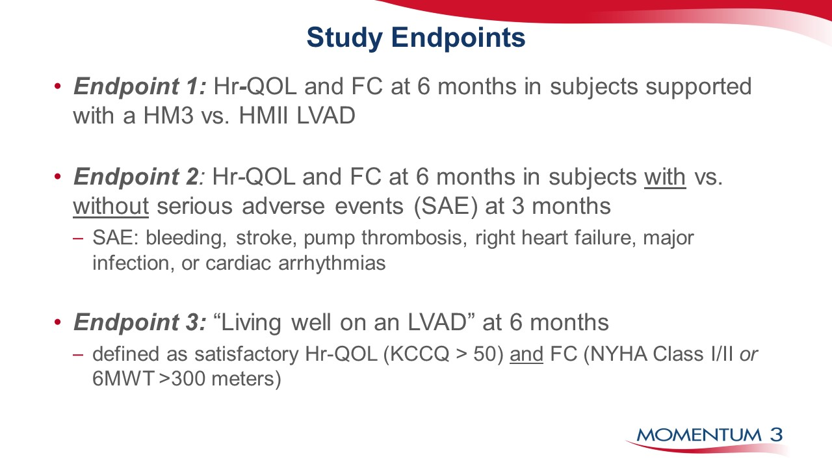

Slide 12
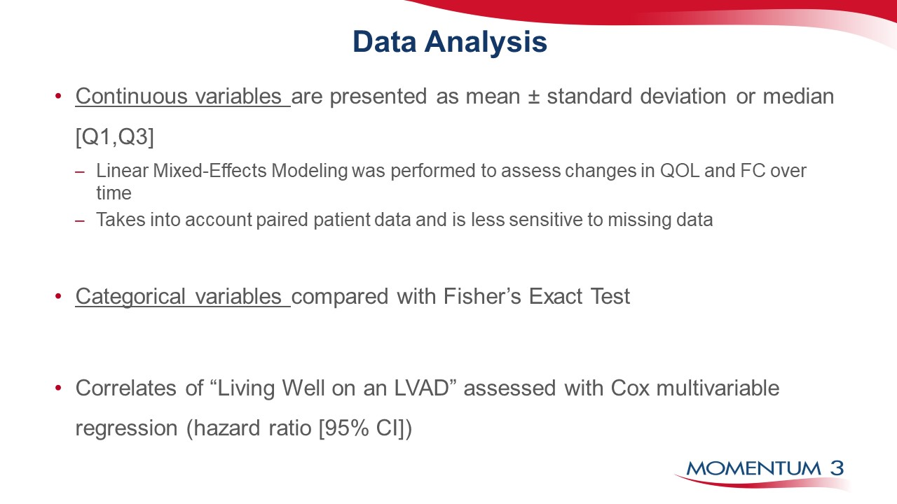

Slide 13


Slide 14
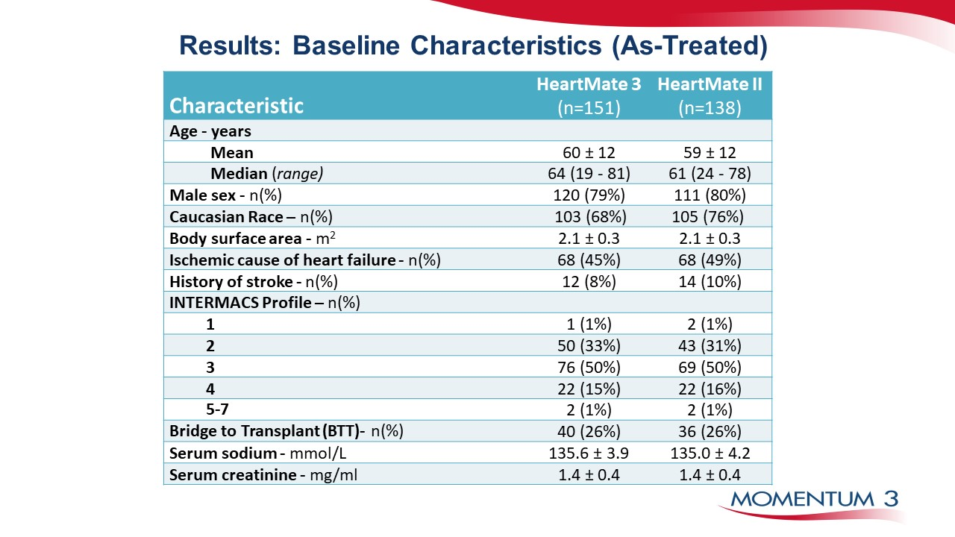

Slide 15
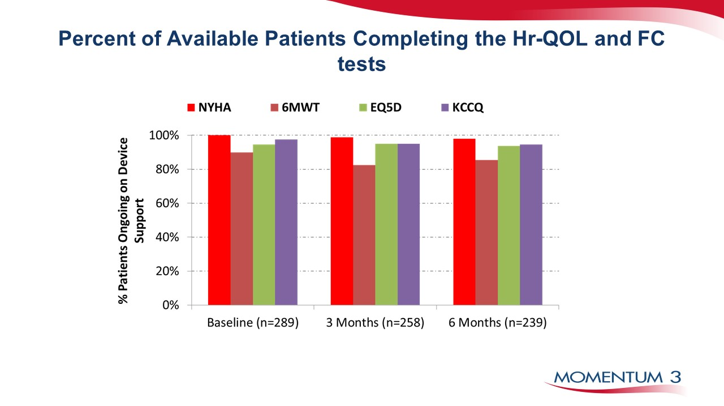

Slide 16
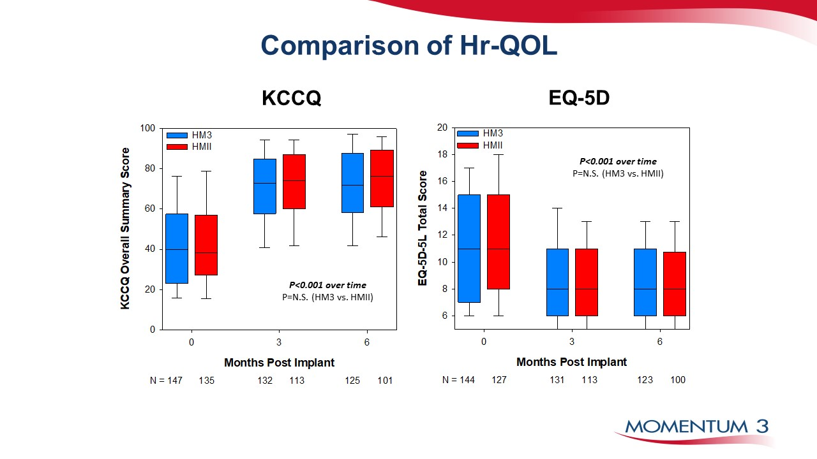

Slide 17
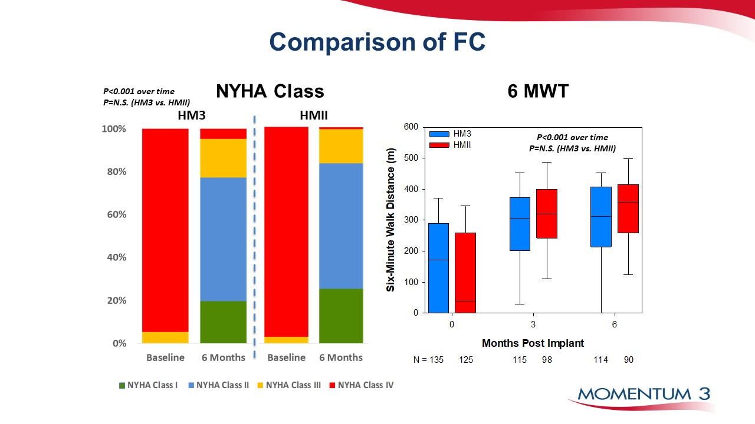

Slide 18
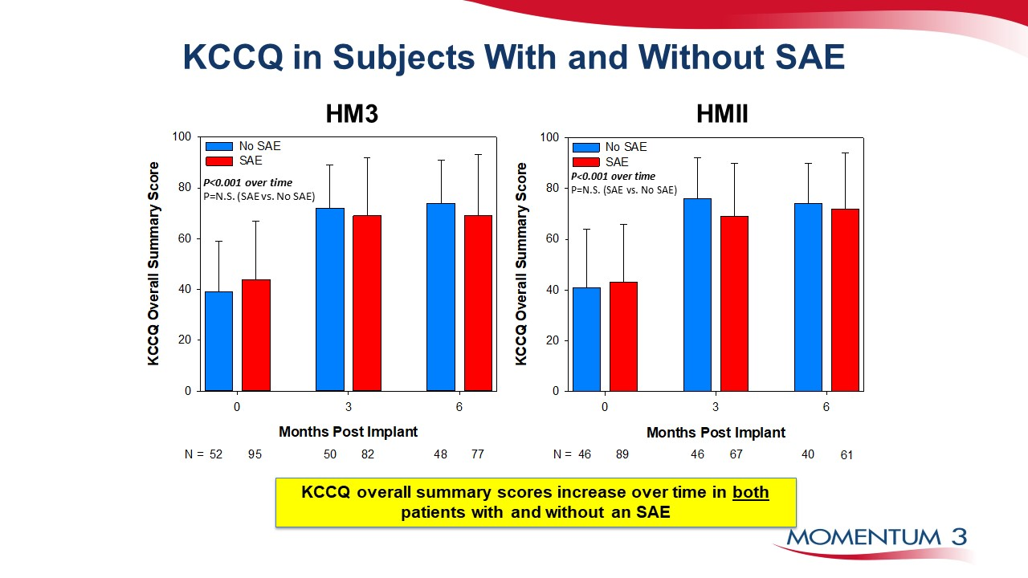

Slide 19
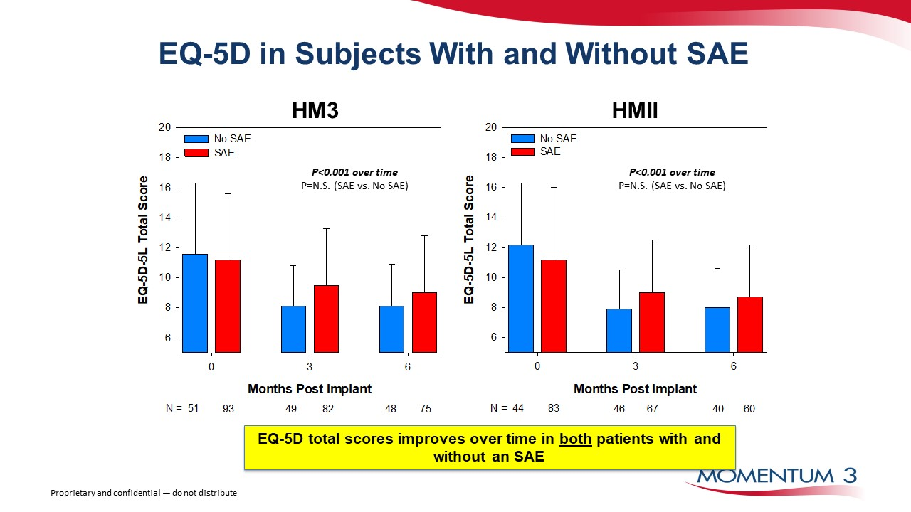

Slide 20
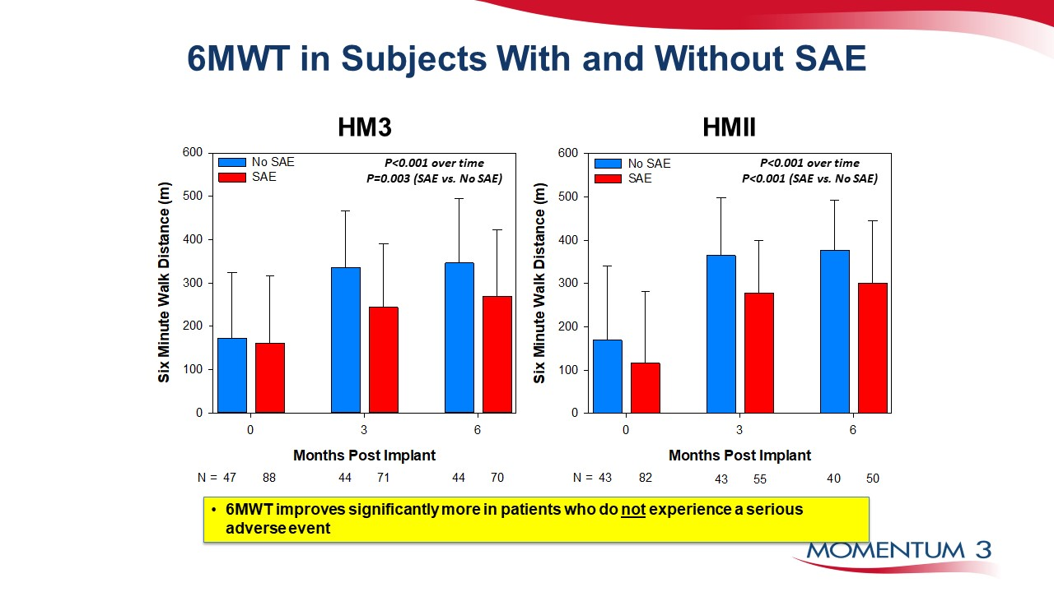

Slide 21
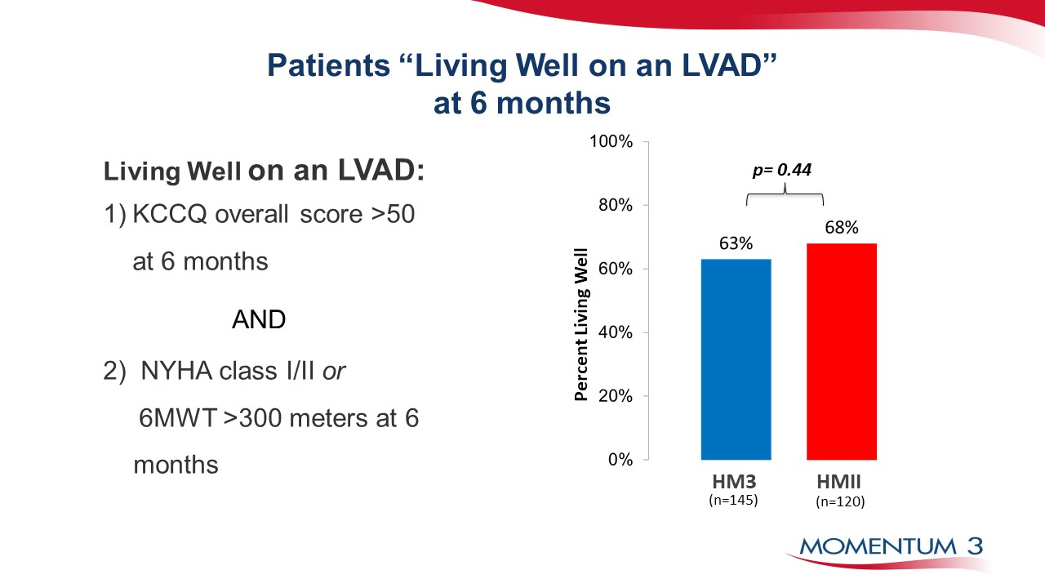

Slide 22
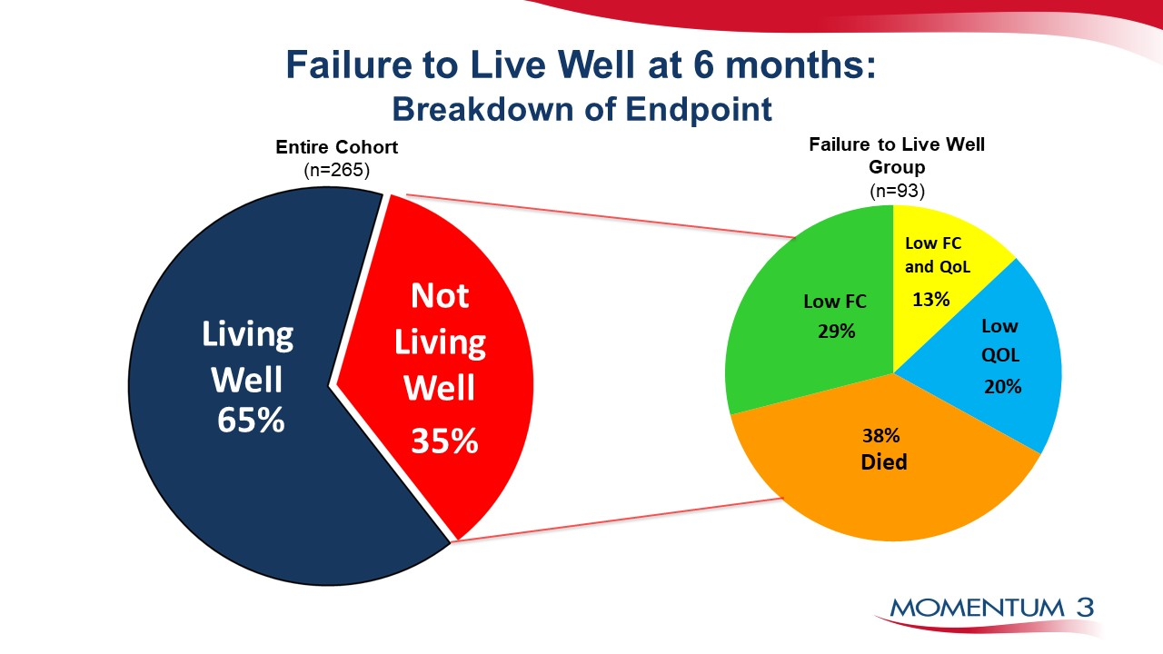

Slide 23
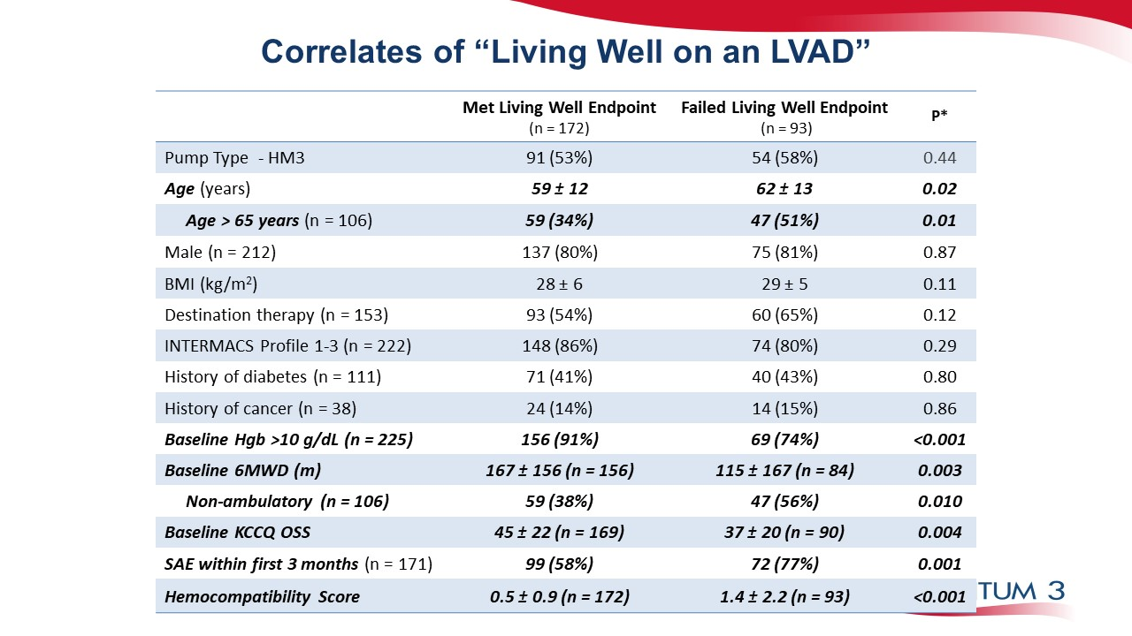

Slide 24
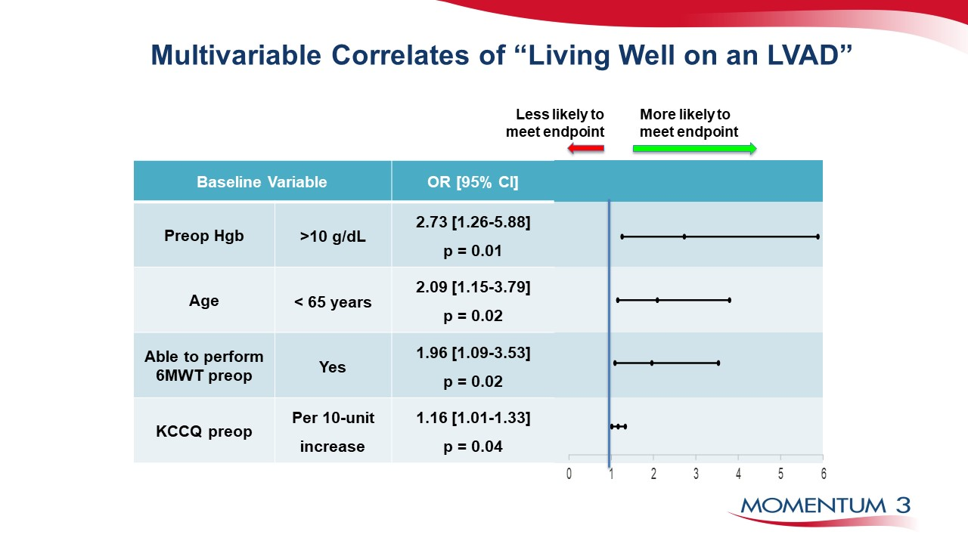

Slide 25
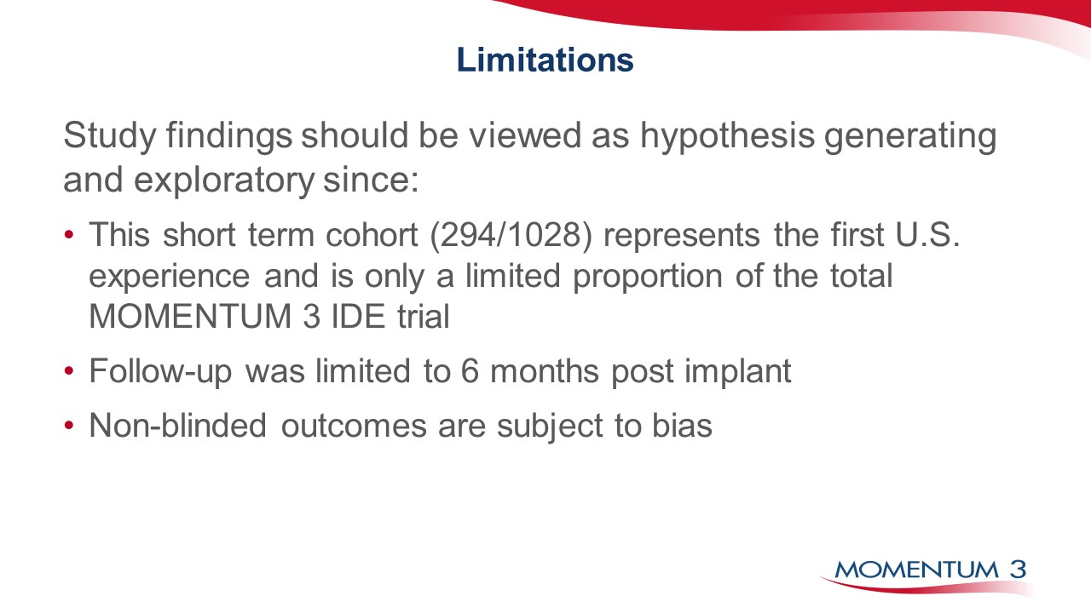

Slide 26
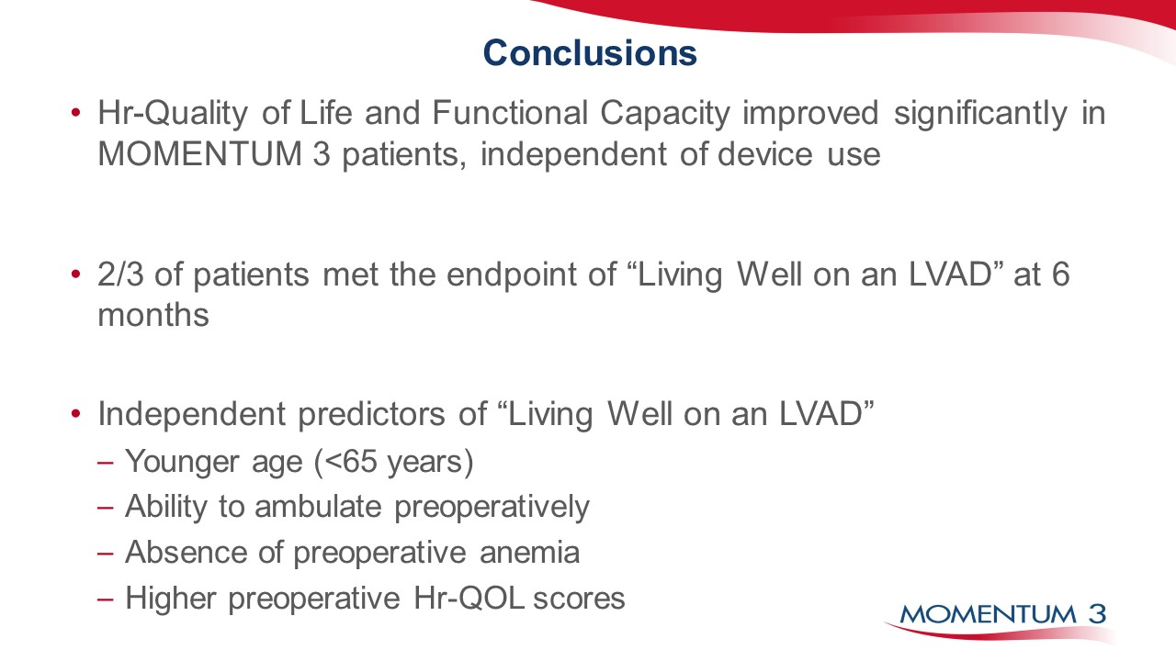

Slide 27
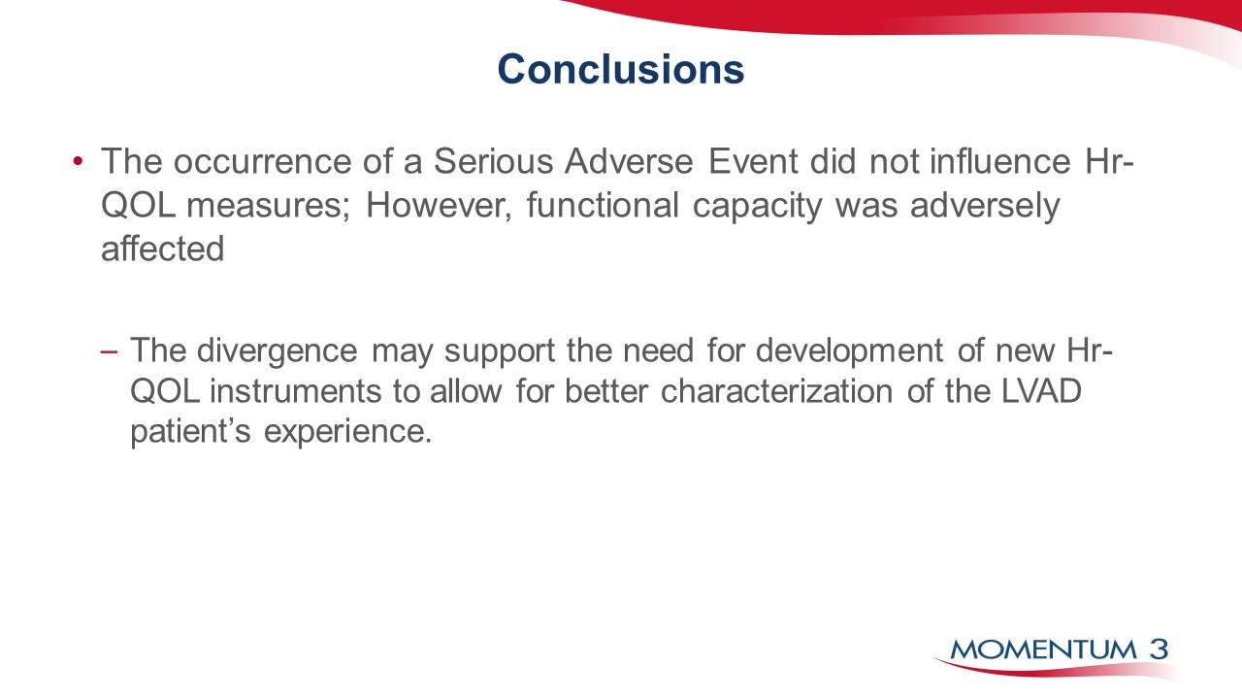

Slide 28


Slide 29
Abbott
6101 Stoneridge Dr., Pleasanton, CA 94588 USA, Tel: 1 925 847 8600
Cardiovascular.Abbott/HeartMate3
Rx Only
Brief Summary: Prior to using these devices, please review the Instructions for Use for a complete listing of indications, contraindications, warnings, precautions, potential adverse events and directions for use.
HeartMate 3™ LVAS Indications: The HeartMate 3™ Left Ventricular Assist System is indicated for providing short- and long-term mechanical circulatory support (e.g., as bridge to transplant or myocardial recovery, or destination therapy) in adult and pediatric patients with advanced refractory left ventricular heart failure and with an appropriate body surface area.
HeartMate 3™ LVAS Contraindications: The HeartMate 3 Left Ventricular Assist System is contraindicated for patients who cannot tolerate, or who are allergic to, anticoagulation therapy.
HeartMate 3™ LVAS Adverse Events: Adverse events that may be associated with the use of the HeartMate 3 Left Ventricular Assist System are: death, bleeding, cardiac arrhythmia, localized infection, right heart failure, respiratory failure, device malfunctions, driveline infection, renal dysfunction, sepsis, stroke, other neurological event (not stroke-related), hepatic dysfunction, psychiatric episode, venous thromboembolism, hypertension, arterial non-central nervous system (CNS) thromboembolism, pericardial fluid collection, pump pocket or pseudo pocket infection, myocardial infarction, wound dehiscence, hemolysis (not associated with suspected device thrombosis) or pump thrombosis.
™ Indicates a trademark of the Abbott group of companies.
‡ Indicates a third-party trademark, which is property of its respective owner.
© 2023 Abbott. All Rights Reserved. MAT-2004344 v2.0 | Item approved for U.S. use only.

