Slide 1
Advanced ablation catheters
Use of Peer-to-peer Slides
This collection of slides is intended as a resource from which individual or sets of slides may be excerpted and used on a stand-alone basis for peer-to-peer scientific education. It is not intended to be used as a full presentation. However, if any subset of these slides is distributed by Abbott to an external customer, you must include the required product brief summaries.
Clinical Evidence
December 2018
Notes:
This is a peer-to-peer presentation intended as a comprehensive clinical resource for summary data related to the TactiCath™ family of contact force catheters, FlexAbility™ ablation catheter, and Agilis™ NxT steerable introducer; individual slides or groups of slides may be used in scientific presentations.

Slide 2
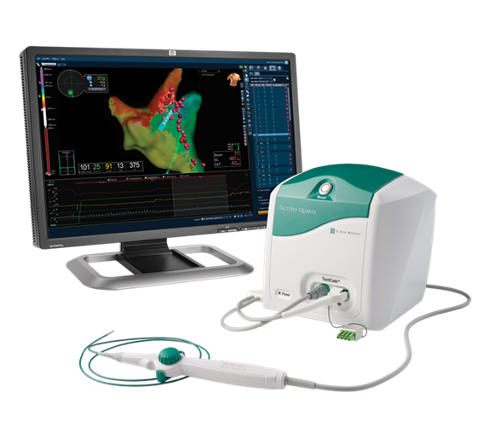
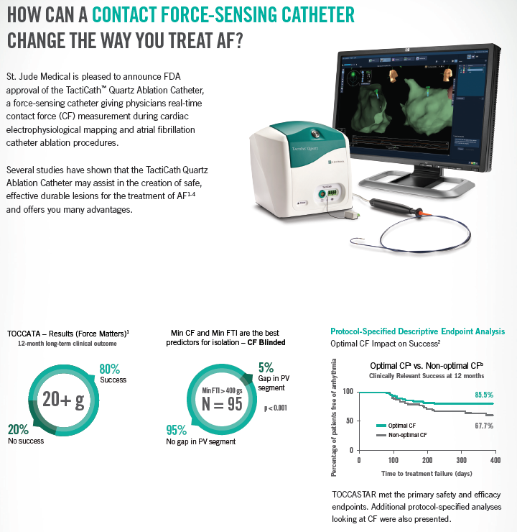
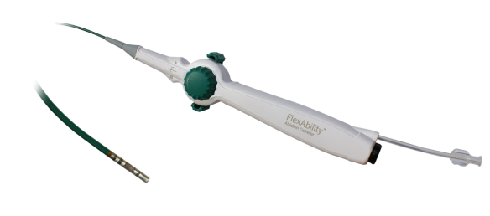
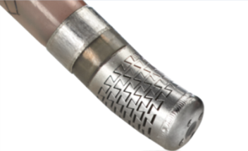
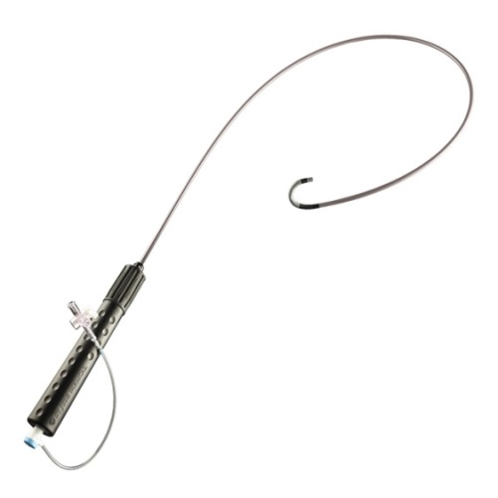
Contents
Contact force-guided RF ablation therapy
  The need for safe and effective lesion formation
  TactiCath™ contact force ablation catheter technology overview
  TactiCath™ catheter clinical evidence
Advanced RF ablation catheter design
  FlexAbility™ ablation catheter technology overview
  The need for reduced complication risk
  Flexible tip catheter clinical evidence
Ablation guidance using steerable sheath technology
  Agilis™ NxT Steerable introducer clinical evidence
Appendix
  FIRE & ICE cryoablation vs. RF ablation trial results

Slide 3
The Need for Safe and Effective
Lesion Formation

Slide 4
Rising global burden of atrial fibrillation
Prevalence and Morbidity
  Estimated 33.6 million (M) patients with atrial fibrillation (AF) worldwide in 2010¹
    U.S. prevalence estimated at ~2.7 to 6.1M patients in 2010, projected to exceed 12M by 2030²
    U.S. incidence estimated at 1.6M cases in 2010, projected to reach to 2.6M cases in 2030²
    EU prevalence estimated at 8.8M adults > 55 years in 2010, projected to reach 17.9M in 2060²
  Disability-adjusted life years increased 19% from 1990 to 2010¹
  Mortality increased ~2×from 1990 to 2010¹
  Associated with 4 to 5-fold increased stroke risk and responsible for ~1.5% (age 50–59) to 24%
  (age 80–89) of ischemic strokes²
Economic Burden
  Cost estimated at $16-26 billion in US annually by
  mid-2000s^{1,3–5}
  1% of the National Health Service budget in the
  United Kingdom^{3–5}
1. Chugh, et al. Circulation 2014;129(8):837–47.
2. AHA Heart Disease and Stroke Statistics 2016. Circulation 2016;133(4):447–54.
3. Stewart et al. Heart 2004;90(3):286–292.
4. Lee et al. J Med Econ 2008;11:281–298.
5. Kim et al. Circ Cardiovasc Qual Outcomes 2011;4:313–320.
Notes:
The burden of atrial fibrillation (AF) is rising globally. It is estimated that over 33 million patients had AF worldwide in 2010.1 In the U.S., ~2.7 million patients had AF in 2010 and AF is projected to exceed 12 million by 2050.²
The morbidity of AF has increased significantly. The burden associated with AF, measured as disability-adjusted life years, increased by 19% from 1990 to 2010.¹
Mortality of AF increased by ~2 fold during that time period1. AF independently increases the risk of stroke 4-5X, and is responsible for 15-20% of all ischemic stroke.²
AF accounted for $16-26 billion in annual U.S. expenses by mid 2000s, and 1% of the National Health Service budget in the United Kingdom.^{1,3-5}
References:
Chugh SS, Havmoeller R, Narayanan K, et al. Worldwide epidemiology of atrial fibrillation: a global burden of disease 2010 study. Circulation. 2014;129(8):837–47.
Writing Group Members, Mozaffarian D, Benjamin EJ, et al. Heart disease and stroke statistics—2016 update: A report from the American Heart Association. Circulation. 2016;133(4):447–54.
Stewart S, Murphy NF, Walker A, et al. Cost of an emerging epidemic: An economic analysis of atrial fibrillation in the UK. Heart. 2004;90(3):286–292.
Lee WC, Lamas GA, Balu S, et al. Direct treatment cost of atrial fibrillation in the elderly american population: A Medicare perspective. J Med Econ. 2008;11:281–298.
Kim MH, Johnston SS, ChuBC, et al. Estimation of total incremental health care costs in patients with atrial fibrillation in the United States. Circ Cardiovasc Qual Outcomes. 2011;4:313–320.

Slide 5
Total hospital costs up to 30% higher for cryoablation vs. RF¹
  Total variable (direct) and fixed (indirect) procedure costs for an AF ablation can exceed $21,000 for RF ablation and reach almost $28,000 for cryoablation.
  Premier Healthcare Database 2013–2014 records
  Hospitals using both RF and cryoablation for AF ablation
  (n = 13)
MEAN COST OF CARE IN PATIENTS WITH AND
WITHOUT REPEAT ABLATION³
Variable
30% higher total cost ($6,391)
Fixed
$27,954
14% higher total cost ($2,687)
$21,563
$22,537
$19,850
1. Hunter TD, et al. J Med Econ 2016 Oct;19(10):959–64.
Notes:
Data shown based on Premier Healthcare Database analysis of 2013-2014 records.
Included hospitals routinely using both RF and CRYO for AF ablation (13 hospitals).
Total unadjusted variable (direct) and fixed (indirect, eg, overhead) visit costs were compared for inpatient and outpatient CRYO vs. RF AF ablation procedures.
Included procedure visits with a primary diagnosis of AF (International Classification of Diseases, Ninth Revision [ICD-9] code 427.31) and either a CPT procedure code for AF catheter ablation (93651, 93656, and/or 93657) or an ICD-9 code 37.34 for catheter ablation without a non-AF CPT ablation code (93652–93655).
Reference:
1. Hunter TD, Palli SR, Rizzo JA. Cost comparison of radiofrequency catheter ablation versus cryoablation for atrial fibrillation in hospitals using both technologies. J Med Econ. 2016 Oct;19(10):959-64.

Slide 6
RF procedures less costly than cryoablation for AF
  An analysis of 2013–2014 records of hospitals routinely using both technologies show cyroablation procedure costs were 20–30% higher than RF procedures for AF.
  Primary endpoint: Total variable visit costs for AF ablation with cryoablation vs. RF adjusted for patient and hospital characteristics
    1261 RF procedures
    1276 cryoablation procedures, of which 500 (39%) used cryoablation with RF
VARIABLE (DIRECT) HOSPITAL AF ABLATION COSTS
RF
P < 0.0001
19.5% higher ($2,215)
CRYO
P < 0.0001
30% higher ($2,803)
$11,528
n = 293
n = 221
n = 968
n = 1055
Inpatient
Outpatient
1. Hunter TD, et al. J Med Econ 2016 Oct;19(10):959–64.
Notes:
This retrospective cohort study compared the cost of radiofrequency (RF) ablation vs cryoablation (CRYO) for atrial fibrillation (AF), using 2013–2014 adult records from the Premier Healthcare Database – after 2nd-generation cryoballoon introduction. Hospitals included performed at least 20 procedures using each technology. The primary analysis endpoint was total variable (direct) visit cost, modeled separately for inpatient and outpatient visits, and adjusted for patient and hospital characteristics.
Adjusted variable visit costs were $2803 (30.0%) higher for inpatient CRYO procedures, and $2215 (19.5%) higher for outpatient CRYO procedures when compared with RF procedures
For sensitivity analyses, CRYO was further divided into CRYO only and dual-technology CRYO with RF. Procedural complications were also compared.
A total of 1261 RF procedures and 1276 CRYO procedures (500 of them with RF) were analyzed. RF patients were slightly older and had more cardiovascular disease and additional arrhythmias. Adjusted inpatient costs were $2803 (30.0%) higher, and adjusted outpatient costs were $2215 (19.5%) higher for CRYO. Sensitivity models showed higher costs in both CRYO and CRYO with RF subgroups vs. RF. Complication rates were not significantly different between subgroups (inpatient p-value = 0.4888, outpatient p-value = 0.5072). Conclusion: AF ablation using RF results in significantly lower costs compared with CRYO, despite an RF population with more cardiovascular disease. This reduction could not be attributed to a difference in complication rates.
Reference:
Hunter TD, Palli SR, Rizzo JA. Cost comparison of radiofrequency catheter ablation versus cryoablation for atrial fibrillation in hospitals using both technologies. J Med Econ. 2016 Oct;19(10):959–64

Slide 7
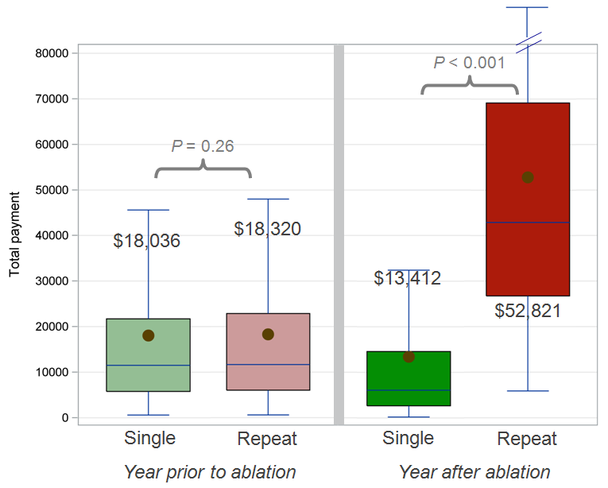
AF recurrence and cost of repeat ablations
  AF recurrences after conventional RF or cryoablation range from 16–62% — often leading to repeat ablation^{1,2}
  An economic analysis showed that cost of care increased ~4× to $52,821 in the year after initial AF ablation for patients with repeat ablations³
    Repeat ablation was needed in 17% of 12,027 patients in this U.S. claims dataset
    Even after excluding the repeat ablation procedure, cost was increased by 46% (mean increase of $6,209; p < 0.001)
MEAN COST OF CARE IN PATIENTS
WITH AND WITHOUT REPEAT ABLATION³
REPEAT NEEDED IN 17% OF PATIENTS
1. Shurrab, J Am Heart Assoc 2015 Sep 21;4(9):e002476.
2. Cheng, Int J Cardiol 2015;181:297–302.
3. Mansour, JACC Clin Electrophysiol. 2017 Feb;3(2):129-138.
Notes:
RF catheter ablation is currently second line treatment for AF. However, recurrence of AF after conventional irrigated RF or cryoablation ranges from 16-62%, despite achieving acute PV isolation.^{1,2}
According to an analysis of MarketScan US claims data (from April 2008 to March 2013), the cost of inpatient and outpatient care in the first year after index ablation was approximately 4 times higher in patients with repeat ablations compared with patients who did not have repeat ablations (mean costs $52,821 vs $13,412; p<0.001). Patients with a repeat ablation had higher cost, even after excluding the repeat ablation procedure-related cost (mean costs $19,621 vs $13,412 ; p<0.001).³
References:
Shurrab M, Di Biase L, Briceno DF, et al. Impact of contact force technology on atrial fibrillation ablation: a meta-analysis. J Am Heart Assoc. 2015 Sep 21;4(9):e002476.
Cheng X, Hu Q, Zhou C, et al. The long-term efficacy of cryoballoon vs irrigated radiofrequency ablation for the treatment of atrial fibrillation: A meta-analysis. Int J Cardiol. 2015;181:297–302.
Mansour M, Karst E, Heist EK, et al. The impact of first procedure success rate on the economics of atrial fibrillation ablation. JACC Clin Electrophysiol. 2017 Feb;3(2):129-138.

Slide 8
Role of lesion formation in AF recurrence
AF recurrence is usually due to PV re-conduction and indicates insufficient lesion formation during the initial procedure.
  Lesion formation parameters:
  Contact force (CF) between catheter tip and target tissue
  Power delivered
  Duration of energy application
  Temperature
  Tip orientation
Notes:
AF recurrence is usually due to PV re-conduction, and indicates insufficient lesion formation during the initial procedure
Lesion formation using RF depends on a mix of parameters, including:
Contact force (CF) between catheter tip and target tissue
Power delivered
Duration of energy application
Temperature
Tip orientation

Slide 9
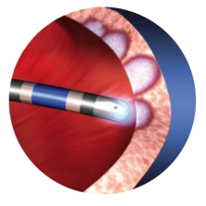
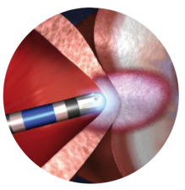
Why measure contact force?
Insufficient Contact
Lengthy procedure
Wide variability
Ineffective lesions
Excessive Contact
Risk of tamponade
Risk of esophageal injury
Risk of steam pops
Efficacy
Balancing Act
Safety
SAFELY CREATE DURABLE TRANSMURAL LESIONS
Ikeda et al. Circ Arrhythm Electrophysiol 2014;7(6):1174–80.
Notes:
The goal of every ablation procedure is to create effective lesions while minimizing patient safety risks. Preclinical research has shown that a key factor to effective lesion formation is the contact force (CF) between catheter tip and target tissue. Insufficient CF may result in an ineffective lesion, whereas excessive CF may result in complications such as heart wall perforation, steam pop, thrombus formation, or esophageal injury.¹
Contact force sensing is designed to help physicians utilize information about the catheter orientation and contact force to create effective transmural lesions while maintaining safety.
Reference:
Ikeda A, Nakagawa H, Lambert H, et al. Relationship between catheter contact force and radiofrequency lesion size and incidence of steam pop in the beating canine heart: electrode amplitude, impedance and electrode temperature are poor predictors of electrode-tissue contact force and lesion size. Circ Arrhythm Electrophysiol. 2014;7(6):1174–80.

Slide 10
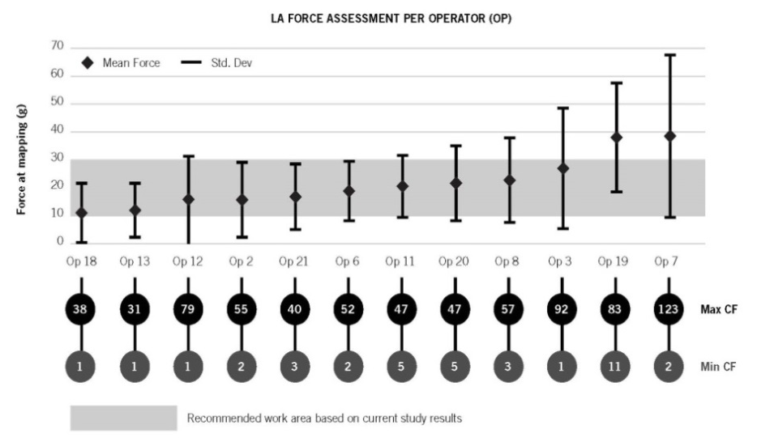
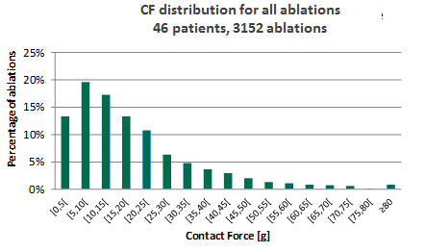
Why real-time contact force measurement?
  CF measurement can help guide physicians during mapping and ablation procedures to reduce procedural variability and safely create effective lesions.
  Without real-time CF measurements, there is significant inter and intra-operator variability in CF applied¹⁻²
    Physicians can only estimate the amount of force that is being applied.¹
P = 0.0001
1. Kuck et al, Heart Rhythm 2012;9(1):18–23.
2. Neuzil P, et al. Circ Arrhythm Electrophysiol 2012;9(11):1789–95.
Notes:
Without objective contact force measurements, operators can only estimate the amount of force that is being applied.¹ Having objective and reliable CF measurement may help guide physicians during mapping and ablation procedures to reduce procedural variability, and safely create effective lesions. Without CF measurements provided, there is significant variability in CF values for individual operators as well as between different operators. In the TOCCATA study, differences in forces applied during CF mapping in the left atrium between the 12 investigators were statistically significant (P = 0.0001), with mean values ranging from 12 to 39 g.¹
In another study, EFFICAS I, substantial variability in contact force was applied when operators were blinded from objective contact force measurements.^{2,3}
References:
Kuck KH, Reddy VY, Schmidt B, et al. A novel radiofrequency ablation catheter using contact force sensing: TOCCATA study. Heart Rhythm. 2012;9(1):18–23.
Neuzil P, Reddy VY, Kautzner J, et al. Electrical reconnection after pulmonary vein isolation is contingent on contact force during initial treatment: results from the EFFICAS I study. Circ Arrhythm Electrophysiol. 2013 Apr;6(2):327–33.
Reddy VY, Shah D, Kautzner J, et al. The relationship between contact force and clinical outcome during radiofrequency catheter ablation of atrial fibrillation in the TOCCATA study. Heart Rhythm. 2012;9(11):1789–95.

Slide 11
Reduction in AF recurrences with contact force¹
  A 2015 meta-analysis showed a significant reduction in AF recurrences with contact force compared with conventional RF ablation procedures
  Recurrence rates were reduced by 38% for CF ablation catheters when all 10 studies reporting this endpoint were included (n = 1378 patients)
  Recurrence rates were reduced by 52% in the studies including only paroxysmal AF patients
AF ABLATION META-ANALYSIS
P = 0.004
P = 0.007
$11,528
1. Shurrab, J Am Heart Assoc 2015; 21;4(9):e002476.
Notes:
A meta-analysis showed a 52% reduction in AF recurrences, from 31% with conventional ablation to 15% with contact force (Odds Ratio 0.38 [95% CI 0.19-0.76], p=0.007) based on 4 studies including only patients with paroxysmal AF. Recurrence rates were also reduced significantly by 38% for CF ablation catheters (35.1% vs. 45.5% for non-CF catheters, Odds ratio 0.62 [95% CI 0.45–0.86], p=0.004) when the 10 paroxysmal and persistent AF studies that reported this endpoint were included (representing a total of 1378 patients, 527 CF and 851 conventional RF).¹
Reference:
Shurrab M, Di Biase L, Briceno DF, et al. Impact of contact force technology on atrial fibrillation ablation: a meta-analysis. J Am Heart Assoc. 2015 Sep 21;4(9):e002476.

Slide 12
Shorter AF ablation procedures with contact force¹
  Reductions in AF ablation procedure times were reported for contact force procedures compared with conventional RF ablation in a 2015 meta-analysis
  Total procedure time was reduced by
  17 minutes (p = 0.009)
  Ablation time was reduced by 4 minutes
  (p = 0.007)
  Total fluoroscopic time was reduced by 8 minutes (p = 0.01)
  There was no significant difference in rates of major complications (1.3–1.9%) or cardiac tamponade (1.2–1.4%)
AF ABLATION META-ANALYSIS
P = 0.009
$11,528
P = 0.01
1. Shurrab, J Am Heart Assoc 2015; 21;4(9):e002476.
Notes:
In addition, this meta-analysis showed that contact force technology resulted in significant reductions in the following AF ablation procedural measures when compared with non-CF catheters:
Total procedure time (17-minute reduction, p=0.009, based on 7 studies including a total of 613 patients, 252 CF and 361 conventional RF)
Ablation time (4-minute reduction, p=0.007, based on 9 studies including a total of 1290 patients, 483 CF and 807 conventional RF)
Total fluoroscopic time (8-minute reduction, p=0.01, based on 8 studies including a total of 1235 patients, 463 CF and 772 conventional RF).
The rate of major complications (1.3% for CF vs. 1.9% for non-CF catheter ablations, p=0.45) and cardiac tamponade (1.2% for CF vs. 1.4% for non-CF catheter ablations, p=0.70) were not significantly different between the two technology groups in this meta-analysis.¹
Reference:
Shurrab M, Di Biase L, Briceno DF, et al. Impact of contact force technology on atrial fibrillation ablation: a meta-analysis. J Am Heart Assoc. 2015 Sep 21;4(9):e002476.

Slide 13
Technology Overview
Tacticath™ contact force sensing ablation catheter

Slide 14
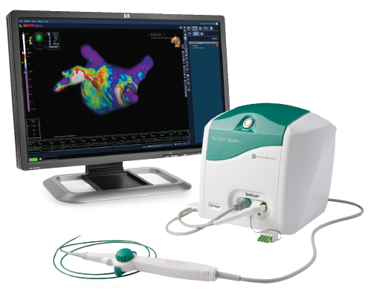
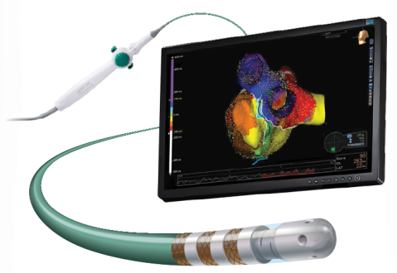
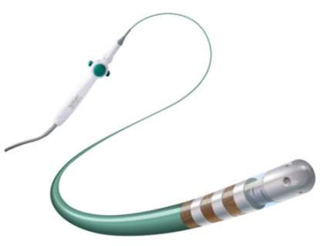

TactiCath™ contact force ablation catheter, Sensor Enabled™ and EnSite™ contact force module
TACTICATH™ CONTACT FORCE ABLATION CATHETER, SENSOR ENABLED™
TACTISYS™ QUARTZ EQUIPMENT
ENSITE™ CONTACT FORCE MODULE V.2
Unidirectional or bidirectional irrigated catheter with deflectable tip
Provides real-time contact
force measurement
Light source processing unit
TactiSys™ Quartz Equipment
Ampere RF cable connection
to RF ablation generator
(Ampere™ RF generator)
Contact force module
Fully integrated with the EnSite Precision™ cardiac mapping system v.2 with EnSite™ contact force module v.2
*The TactiCath™ Contact Force Ablation Catheter, Sensor Enabled™ is an update to the TactiCath™ Contact Force Catheter family using the FlexAbility™ Catheter family platform handle and shaft and a tip and force sensor derived from TactiCath Quartz. TactiCath™ and TactiCath™ Quartz Contact Force Ablation Catheter clinical data are applicable to the TactiCath Ablation Catheter, Sensor Enabled as mechanical/function testing and preclinical studies have demonstrated equivalent performance and safety profile. Abbott. Data on File. Report 90195941.
Notes:
The TactiCath™ Quartz Set consists of the TactiSys™Quartz and TactiCath Quartz catheter. The TactiSys Quartz is a non-sterile active signal and data processing unit that interconnects the TactiCath Quartz catheter to the St Jude Medical Ampere RF generator. Contact force is measured by an optical sensor at the TactiCath tip using light interferometry.
*The TactiCath™ Contact Force Ablation Catheter, Sensor Enabled™ is an update to the TactiCath™ Contact Force Catheter family using the FlexAbility™ Catheter family platform handle and shaft and a tip and force sensor derived from TactiCath Quartz. TactiCath™ and TactiCath™ Quartz Contact Force Ablation Catheter clinical data are applicable to the TactiCath Ablation Catheter, Sensor Enabled as mechanical/function testing and preclinical studies have demonstrated equivalent performance and safety profile. [Abbott. Data on File. Report 90195941.]

Slide 15
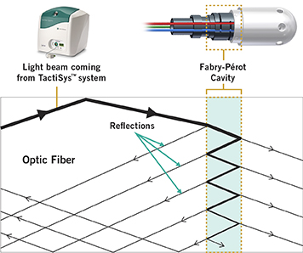
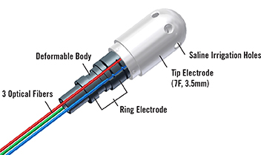
Measuring contact force: White light interferometry
The TactiCath™ Quartz catheter fiber optic sensor allows accurate contact force measurement close to the tip where power is applied
  Signals returned by three optic fibers connected to a titanium cylindrical deformable body are used to accurately compute both magnitude and orientation of contact force, with no calibration required
  Light emitted by the TactiSys™ system and passing through the cavity made of two semi-reflective mirrors in parallel is reflected back and forth many times (Fabry-Perot interferometer)

Slide 16
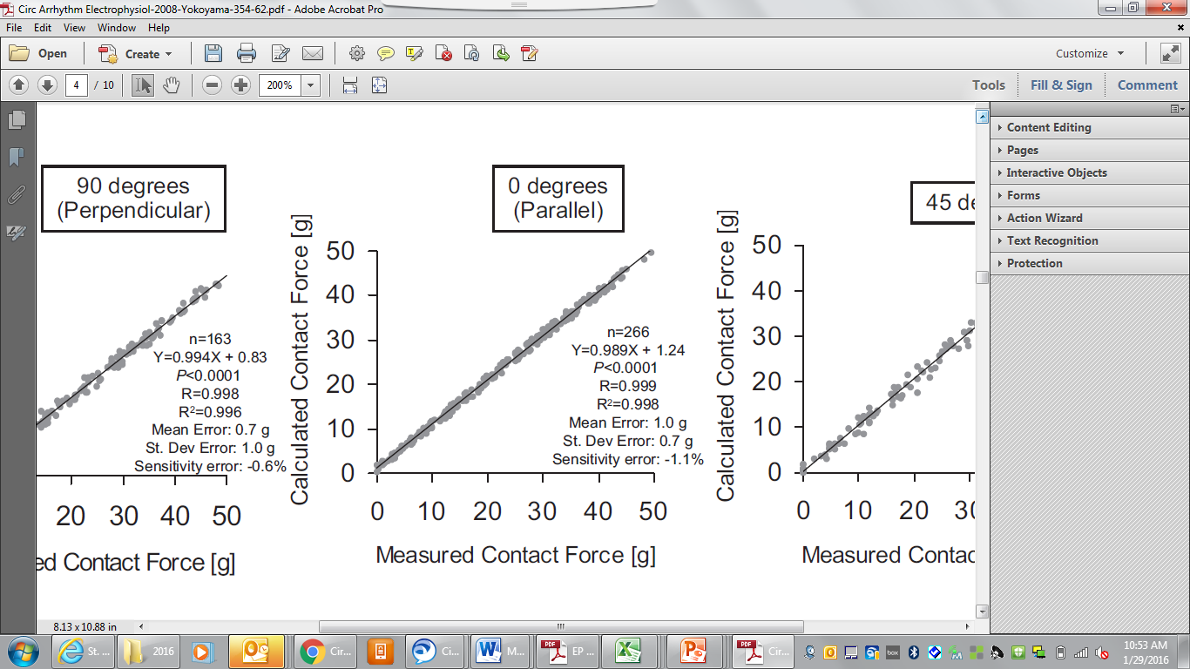
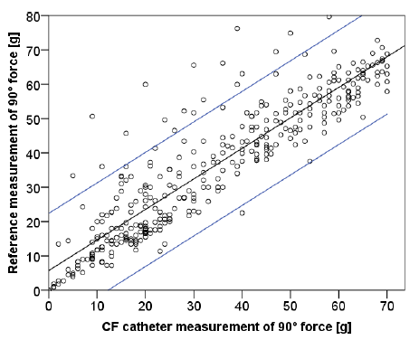
Contact force accuracy with TactiCath™ Quartz catheter^{1,2}
  An early bench study characterizing TactiCath™ catheter* accuracy showed ≤ 1.0 g mean error at all orientation angles tested between force sensed by the catheter and force measured with a certified balance¹
  A separate independent bench study testing the ThermoCool SmartTouch‡ SF catheter showed maximum error up to
  – 41.7 g in lateral orientation²
  Mean accuracy was 6.6 g with the catheter in lateral (parallel) orientation and 6.8 g with a steerable sheath advanced over two
  of the four catheter electrodes
  Actual lateral forces applied ranging from ~15 g to 60 g were measured by the catheter as 20 g of contact force
TACTICATH™ CATHETER¹
SMARTTOUCH‡ SF CATHETER²
* The force sensors used in TactiCath™ Quartz and TactiCath catheters both use optical technology. Data from the TactiCath catheter are applicable to the TactiCath Quartz catheter as the design modifications made to the TactiCath catheter are fully verifiable in bench testing.
1. Yokoyama Circ Arrhythmia Electrophysiol 2008;1:354–362.
2. Bourier J Cardiovasc Electrophysiol 2016;27(3):347–50.
‡ Indicates a third-party trademark, which is property of its respective owner
Notes:
A bench testing study published in 2008 characterized the contact force accuracy of the TactiCath catheter, and showed no significant difference in force sensor accuracy between two TactiCath catheters tested at three angles (90°- axial/perpendicular, 0° - lateral/parallel, 45°).1
The mean error between the force sensed by the TactiCath catheter and the force measured with a certified balance was ≤ 1.0g (SD error ≤1.5 g) at all angles tested.
A later in vitro study from researchers at the German Heart Center in Munich measured the contact force accuracy of the SmartTouch™ catheter using a reference force sensor.2
Accuracy, represented as mean absolute difference between SmartTouch catheter and reference measurements, was significantly lower in lateral/parallel contact force measurements (90°) when compared to non-parallel (0°, 30°, 60°) force measurements (p<0.0001).
Applied lateral forces ranging from approximately 15 g to as high as 60 g were measured by the SmartTouch SF catheter as 20 g of contact force. Lateral contact force was measured by the SmartTouch SF catheter by an absolute mean difference of 6.6 ±5.9 grams (accuracy) – underestimating actual force applied by up to a maximum error of 41.7 g.
When a steerable sheath was advanced proximal to electrode 2, lateral force accuracy measured by the catheter was 6.8 ±5.0 grams, with a maximum error of -18.3 g.
References:
Yokoyama K, Nakagawa H, Shah DC, et. al. Novel contact force sensor incorporated in irrigated radiofrequency ablation catheter predicts lesion size and incidence of steam pop and thrombus. Circ Arrhythmia Electrophysiol. 2008;1:354–362
Bourier F, Hessling G, Ammar-Busch S, et al. Electromagnetic contact-force sensing electrophysiological catheters: how accurate is the technology? J Cardiovasc Electrophysiol. 2016;27(3):347–50.
* The force sensors used in TactiCath™ Quartz and TactiCath catheters both use optical technology. Data from the TactiCath catheter are applicable to the TactiCath Quartz catheter as the design modifications made to the TactiCath catheter are fully verifiable in bench testing.

Slide 17
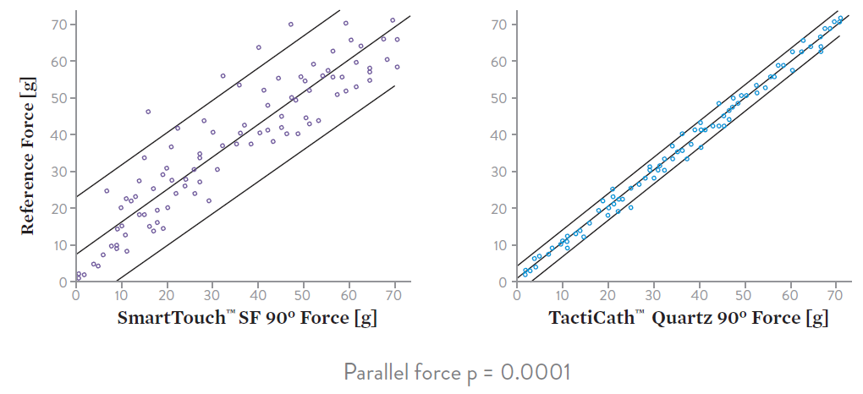
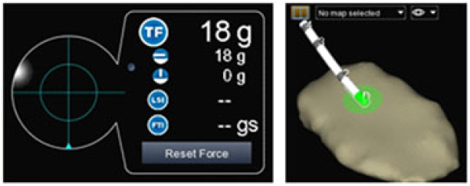
Higher contact force accuracy with TactiCath™ Quartz catheter¹
  TactiCath Quartz catheter accurately measured contact force^{1,2}
    Force measurement accuracy: ≤ 1.2 g
    Maximum error: 5 g
  ThermoCool SmartTouch‡ SF catheter underestimated actual force¹
    Force measurement accuracy: ≤ 6 g
    Maximum error: 30 g
    Parallel force accuracy: 1.2 g
    Parallel force accuracy: 6.0 G
47 g
actual force
26 g
actual force
Actual Measured Force [g]
Actual Measured Force [g]
21 g
per catheter
17 g
per catheter
Force (g) per TactiCath™ Quartz at 90°
Force (g) per SmartTouch‡ SF at 90°
Parallel force p = 0.0001¹
  Accuracy tested in independent head-to-head in vitro comparison in 100 measurements at each orientation: with catheter shaft perpendicular (axial/0° tip angle), 45°, and parallel (90° tip angle) to surface. Accuracy measured as mean absolute difference between contact force (CF) value measured by catheter and value measured using a calibrated, custom-made force sensor.^{1,2} TactiCath™ Quartz catheter CF accuracy was significantly higher than SmartTouch‡ SF in axial (perpendicular) and lateral (parallel) orientations.¹
1. Bourier F, et al. [Abstract P003-170]. Presented at HRS 2016, San Francisco, CA. Heart Rhythm. 2016;13(5 Suppl 1): S318-S319..
2. Bourier F, et al. J Cardiovasc Electrophysiol 2017;28:109–14.
‡ Indicates a third-party trademark, which is property of its respective owner
Notes:
An in vitro study from researchers at the German Heart Center in Munich and the Texas Cardiac Arrhythmia Institute in Austin directly compared contact force accuracy of TactiCath™ Quartz catheter and SmartTouch™ SF catheters with a reference force sensor.¹ TactiCath Quartz CF catheter measurements showed a high level of accuracy (≤ 1.2 g) at all orientations tested (table) in this study¹ – and in a more recent full report using the same in vitro model with additional testing of irrigation flow rates up to 30 mL/min and a steerable sheath advanced proximal to electrodes 2 and 4.²
Contact force accuracy results were significantly higher with TactiCath Quartz vs. SmartTouch SF catheters for both axial (perpendicular, p=0.0037) and lateral (parallel, p=0.0001) measurements (figure). The authors noted that underestimation of force by up to 30 grams with the SmartTouch SF contact force catheter in parallel orientation may be clinically important.¹
The clinical implications of these in vitro accuracy data have not been demonstrated in any published, peer-reviewed clinical studies directly comparing ablation outcomes for these two CF catheters.
References:
Bourier F, Deisenofer I, Hessling G, et al. Contact Force Sensing Electrophysiological Catheters. How Accurate is the Technology? [Abstract P003-170]. Presented at HRS 2016, San Francisco, CA. Heart Rhythm. 2016;13(5 Suppl 1): S318-S319.
Bourier F, Gianni C, Dare M, et al. Fiberoptic contact-force sensing electrophysiological catheters: how precise is the technology? J Cardiovasc Electrophysiol. 2017 Jan;28(1):109-114.

Slide 18
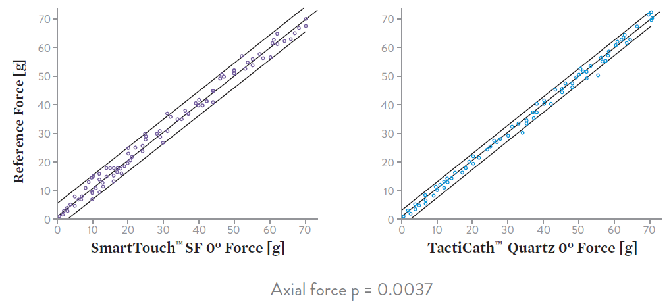
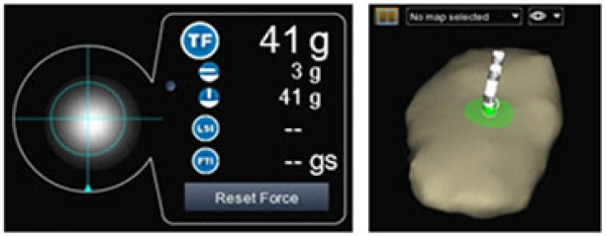
Higher contact force accuracy with TactiCath™ Quartz catheter¹
  TactiCath Quartz catheter accurately measured contact force^{1,2}
    Force measurement accuracy: ≤ 1.2 g
    Maximum error: 5 g (across orientations tested)
  ThermoCool SmartTouch‡ SF catheter underestimated actual force¹
    Force measurement accuracy: ≤ 6 g
    Maximum error: 30 g (across orientations tested)
    Axial force accuracy: 0.9 g
    Axial force accuracy: 1.5 G
Actual Measured Force [g]
Actual Measured Force [g]
Force (g) per TactiCath™ Quartz at 0°
Force (g) per SmartTouch‡ SF at 0°
Axial force p = 0.0037¹
  Accuracy tested in independent head-to-head in vitro comparison in 100 measurements at each orientation: with catheter shaft perpendicular (axial/0° tip angle), 45°, and parallel (90° tip angle) to surface. Accuracy measured as mean absolute difference between contact force (CF) value measured by catheter and value measured using a calibrated, custom-made force sensor.^{1,2} TactiCath™ Quartz catheter CF accuracy was significantly higher than SmartTouch‡ SF in axial (perpendicular) and lateral (parallel) orientations.¹
1. Bourier F, et al. [Abstract P003-170]. Presented at HRS 2016, San Francisco, CA. Heart Rhythm. 2016;13(5 Suppl 1): S318-S319.
2. Bourier F, et al. J Cardiovasc Electrophysiol 2017;28:109–14.
‡ Indicates a third-party trademark, which is property of its respective owner
Notes:
An in vitro study from researchers at the German Heart Center in Munich and the Texas Cardiac Arrhythmia Institute in Austin directly compared contact force accuracy of TactiCath™ Quartz catheter and SmartTouch™ SF catheters with a reference force sensor.¹ TactiCath Quartz CF catheter measurements showed a high level of accuracy (≤ 1.2 g) at all orientations tested (table) in this study¹ – and in a more recent full report using the same in vitro model with additional testing of irrigation flow rates up to 30 mL/min and a steerable sheath advanced proximal to electrodes 2 and 4.²
Contact force accuracy results were significantly higher with TactiCath Quartz vs. SmartTouch SF catheters for both axial (perpendicular, p=0.0037) and lateral (parallel, p=0.0001) measurements (figure). The authors noted that underestimation of force by up to 30 grams with the SmartTouch SF contact force catheter in parallel orientation may be clinically important.¹
The clinical implications of these in vitro accuracy data have not been demonstrated in any published, peer-reviewed clinical studies directly comparing ablation outcomes for these two CF catheters.
References:
Bourier F, Deisenofer I, Hessling G, et al. Contact-force sensing electrophysiological catheters: How accurate is the technology? [Abstract P003-170]. Presented at HRS 2016, San Francisco, CA. Heart Rhythm. 2016;13(5 Suppl 1): S318-S319.
Bourier F, Gianni C, Dare M, et al. Fiberoptic contact-force sensing electrophysiological catheters: how precise is the technology? J Cardiovasc Electrophysiol. 2017 Jan;28(1):109-114.

Slide 19
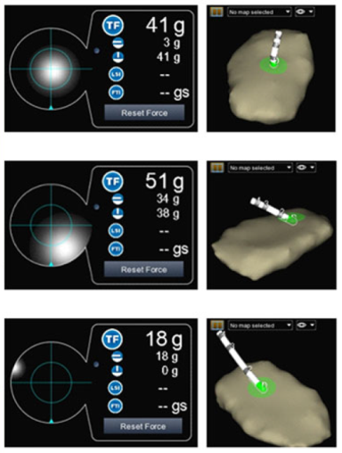
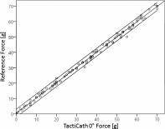
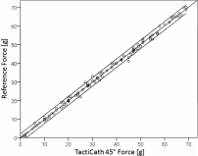
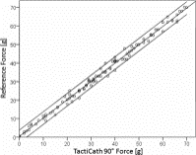
Fiberoptic force-sensing technology accurate and precise¹
TactiCath™ Quartz catheter fiberoptic contact force (CF) technology was confirmed to be highly accurate and precise across experimental conditions simulating clinical use:
  Contact force measurement accuracy: ≤ 1.2 g
  Mean error: ± 0.5 g
  Maximum error: ≤ 5.0 g
  Correlation between catheter measurement and reference force measurements: R2 ≥ 0.996
  Precision: within 3.8%
Image: Bourier F, et al. J Card Electrophysiol. 2017;28(1):109-114. Link. © 2017 by John Wiley & Sons, Inc.
  Based on independent expert bench testing. Accuracy tested in 100 measurements at each orientation: with catheter shaft perpendicular (axial/ 0° tip angle), 45°, 85° (nearly parallel) and parallel (90°tip angle) to surface; and 50 measurements each with irrigation, deflection, and sheath proximal to electrodes 2 and 4. Accuracy measured as mean absolute difference between contact force (CF) value measured by catheter and value measured using a calibrated, custom-made force sensor. Precision reflected by percentage variation between repeated catheter force measurements in each test scenario.¹ Authors noted SmartTouch‡ SF catheter with electromagnetic sensing technology was previously reported to display significantly lower accuracy with tip in parallel orientation (6.6 g vs ≤ 1.2 g, p < 0.01)^{1,2}
1. Bourier F, et al. J Cardiovasc Electrophysiol 2017;28:109–14.
2. Bourier F, et al. J Cardiovasc Electrophysiol. 2016;27(3):347–50.
‡ Indicates a third-party trademark, which is property of its respective owner
Notes:
An in vitro study from researchers at the German Heart Center in Munich and the Texas Cardiac Arrhythmia Institute in Austin published detailed data demonstrating the contact force accuracy and precision of TactiCath™ Quartz catheter¹ - using the same bench testing methodology previously reported for measuring the accuracy of the ThermoCool SmartTouch™ SF catheter.²
TactiCath Quartz CF catheter measurements showed a very high level of accuracy (< 1.2 g) and precision at all orientations tested, including testing with irrigation flow rates up to 30 mL/min, and with a steerable sheath advanced proximal to electrodes 2 and 4.¹
References:
Bourier F, Gianni C, Dare M, et al. Fiberoptic contact-force sensing electrophysiological catheters: how precise is the technology? J Cardiovasc Electrophysiol. 2017 Jan;28(1):109-114. Epub 2016 Sep 22.
Bourier F, Hessling G, Ammar-Busch S, et al. Electromagnetic contact-force sensing electrophysiological catheters: how accurate is the technology? J Cardiovasc Electrophysiol. 2016;27(3):347–50.

Slide 20
Fiber-optic Force-sensing Technology Accurate and Precise
Independent expert bench testing confirmed TactiCath™ Quartz catheter fiber-optic contact force (CF) technology is highly accurate and precise across all experimental conditions¹
TACTICATH™ QUARTZ CF CATHETER VS. REFERENCE FORCE SENSOR MEASUREMENTS¹
  Mean error ≤ 0.5 g in every test scenario — across angles, with irrigation, and in a sheath
  Very high correlation between catheter and reference force measurements (R² ≥ 0.996)
  TactiCath catheter force measurement accuracy was < 1.2 g in all orientations tested
Test Parameter | N | Correlation [R²] | Accuracy (mean absolute difference) [g] | Precision [%] | Mean Error [g] | Max. Error [g]
0° (perpendicular) | 100 | 0.998 | 0.9 ± 0.9 | 2.7 | –0.1 ± 1.3 | 5.0
45° | 100 | 0.998 | 0.8 ± 0.8 | 2.5 | 0.1 ± 1.2 | 4.0
85° (nearly parallel) | 100 | 0.998 | 1.0 ± 0.9 | 2.8 | –0.1 ± 1.4 | 4.6
90° (parallel) | 100 | 0.996 | 1.0 ± 1.3 | 3.8 | 0.0 ± 0.7 | 4.0
Irrigation (30 mL/min) | 50 | 0.999 | 0.8 ± 0.7 | 2.0 | 0.5 ± 0.9 | 3.0
Deflection | 50 | 0.999 | 0.8 ± 0.8 | 2.3 | 0.2 ± 1.1 | 3.0
Sheath proximal to electrode 4 | 50 | 0.999 | 0.8 ± 0.9 | 2.7 | –0.4 ± 1.2 | 3.0
Sheath proximal to electrode 2 | 50 | 0.997 | 1.1 ± 1.0 | 2.7 | 0.3 ± 1.4 | 4.3
Bourier F, Gianni C, Dare M, et al. Fiberoptic Contact-Force Sensing Electrophysiological Catheters: How Precise Is the Technology? J Cardiovasc Electrophysiol. 2017 Jan;28(1):109-114.
Notes:
An in vitro study from researchers at the German Heart Center in Munich and the Texas Cardiac Arrhythmia Institute in Austin published detailed data demonstrating the contact force accuracy and precision of TactiCath™ Quartz catheter¹ - using the same bench testing methodology previously reported for measuring the accuracy of the ThermoCool SmartTouch™ SF catheter.²
TactiCath Quartz CF catheter measurements showed a very high level of accuracy (< 1.2 g) and precision at all orientations tested, including testing with irrigation flow rates up to 30 mL/min, and with a steerable sheath advanced proximal to electrodes 2 and 4.¹
References:
Bourier F, Gianni C, Dare M, et al. Fiberoptic contact-force sensing electrophysiological catheters: how precise is the technology? J Cardiovasc Electrophysiol. 2017 Jan;28(1):109-114. Epub 2016 Sep 22.

Slide 21
Accuracy of RF power delivery with Ampere™ generator¹
Ampere™ generator shown in independent testing to deliver accurate RF power¹
Power delivery accurately reflected user-selected power (within 10%) for Ampere™ generator over full range of impedance values tested in technical experimental set-up
CLINICAL PRACTICE CONSIDERATIONS¹
Generator power delivery can impact steam pop incidence
Offset between actual and selected RF power delivery significantly influenced lesion volumes and steam pop incidence in porcine heart ex-vivo experiments
Accuracy of power delivery
of RF generators¹
Stockert EP Shuttle‡ generator
Ampere™ generator
SmartAblate‡ generator
Offset (%) between actual power delivered and power value selected for RF generators over range of electrical impedance values tested.
1. Bourier F, et al. J Cardiovasc Electrophysiol, 2018 Feb;29(2):330-334.
‡ Indicates a third-party trademark, which is property of its respective owner
Notes:
References:
1. Bourier F, Schwarz B, Brkic A, et al. EP radiofrequency generators: Significant offsets between selected and delivered power? J Cardiovasc Electrophysiol. 2018 Feb;29(2):330-334. doi: 10.1111/jce.13386. Epub 2017 Dec 7.

Slide 22
TactiCath™ Quartz set: Pioneering contact force technology
  Accurate and reliable contact force measurements
    Accurate axial and lateral force measurements with novel sensor design
      Sensitivity < 1 g
    Real-time force measurements due to high sampling rate (50 Hertz)
    No interference from other catheters
    No interference from neighboring electrodes due to optical
    measurement capabilities
    Accurate contact force measurements when sheath is proximal to 2nd electrode
  Clinical evidence from randomized, controlled trials in the treatment of paroxysmal AF*
  Seamless workflow with use of sheaths and calibration-free, ready-for-use system
  Unique FTI™ and LSI™ indices
* The force sensors used in TactiCath™ Quartz and TactiCath catheters both use optical technology. Data from the TactiCath catheter are applicable to the TactiCath Quartz catheter as the design modifications made to the TactiCath catheter are fully verifiable in bench testing.

Slide 23
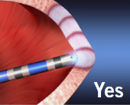
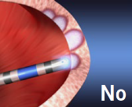

Unique contact force parameter: LSI™ (lesion index)
The TactiCath™ quartz set displays contact force (CF) parameters, including
FTI™ (force time integral) and LSI™ (lesion index)
LSI is a proprietary index combining contact force, radiofrequency (RF) application duration, and RF current.*
CF
FTI
TIME (S)
LSI
Force time integral
Lesion index*
POWER (V)
*This parameter was displayed during ablation procedures in a 31-patient supplemental study to the TOCCASTAR clinical trial. However, the clinical utility of this parameter has not been evaluated.
Notes:
In addition to providing contact force measurement, the TactiCath™ Quartz set provides unique contact force parameters: FTI™ (Force Time Integral) and LSI™ (Lesion Index).
FTI takes into account Contact Force and the duration of ablation.
LSI is an index of lesion assessment that takes into account Contact Force, Ablation duration, and RF current applied to the tissue.
Reference:
Kuck K, Reddy V, Schmidt B, et al. A novel radiofrequency ablation catheter using contact force sensing: TOCCATA study. Heart Rhythm. 2012;9(1):18–23.

Slide 24

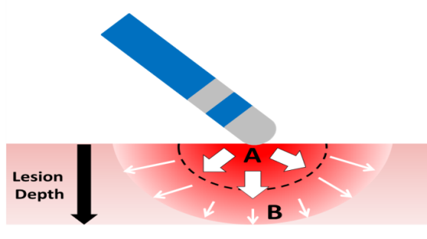
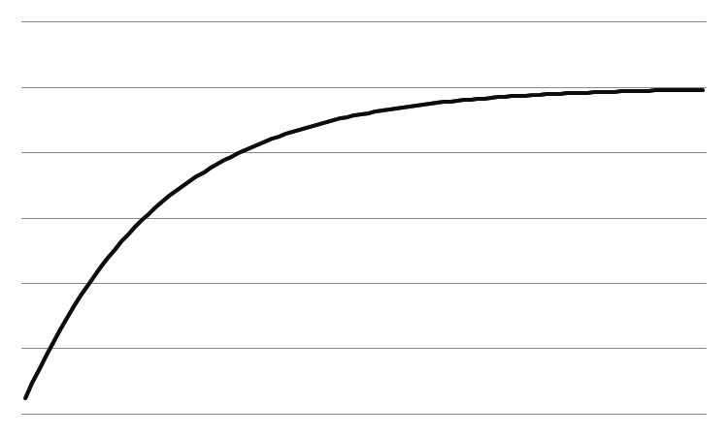

Future direction with CF technology: LSI™ index
The Lesion Index IS DESIGNED TO express the gradual growth of the lesion formation.
PROCESS OF LESION FORMATION¹
ALL 3 SUB-COMPONENTS ARE PROPORTIONAL TO:
~ $\left(1−e^{−t/τ}\right)$
CONTRIBUTION TO LSI
RESISTIVE HEATING
Fast process (2-3s)
Superficial / hot spot creation (2-3mm)
THERMAL CONDUCTION
Slower process (20-30s)
Deeper areas (4-8mm)
RESISTIVE
HEATING
THERMAL CONDUCTION
SLOWER INCREASE FOR HIGHER VALUES
TIME
1. Wittkampf FH, et al. Pacing Clin Electrophysiol. 2006;29(11):1285–97.
Notes:
The rationale for LSI index is the following:
During RF ablations, lesions are formed via two successive phenomena:
A fast initial process where tissue adjacent to the electrode is directly burnt by RF current (Resistive heating).
A slower process by which deeper tissue areas are burnt by progressive heat propagation (Thermal conduction).
The LSI index was designed to model both resistive heating and thermal conduction to give a dynamic description of lesion formation over time. LSI index is a multiplication of the 3 sub-components CF, Power and Ablation time, which all impact lesion formation. Each sub-component is non-linear, expressed as a negative exponential accounting for slower increase at higher values. This non-linearity models the transition from resistive heating to thermal conduction. As a result, a low sub-component can be compensated by increasing another one to create the same lesion. For example, using lower power can be compensated by applying higher CF.
Reference:
Wittkampf FH, Nakagawa H. RF catheter ablation: lessons on lesions. Pacing Clin Electrophysiol. 2006;29(11):1285–97.

Slide 25

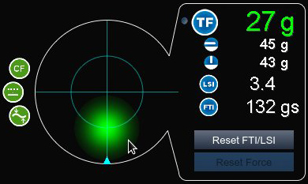
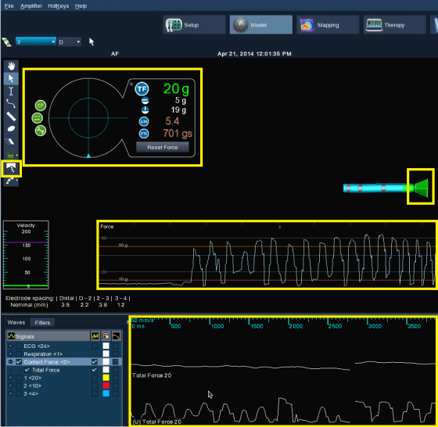
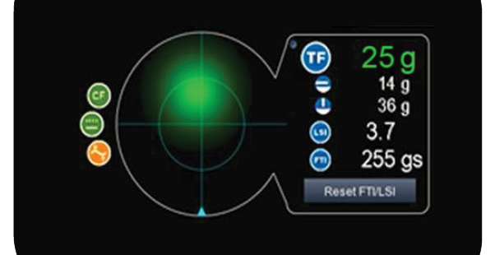







EnSite™ contact force module
The EnSite™ Velocity™ or EnSite Precision™ Cardiac Mapping System graphical user interface captures contact force information at a glance on a customizable display.
BALL INDICATOR FOR DIRECTIONALITY
TOTAL FORCE VALUE
LATERAL FORCE VALUE
STABILITY INDICATORS
AXIAL FORCE VALUE
TIP INDICATOR
LSI™ INDEX
VALUE
CONTACT FORCE HISTORY WINDOW
FTI™ INDEX
VALUE
Notes:
The contact force parameters are fully integrated and displayed on the EnSite™ Contact Force Module. This is an example of the user interface.

Slide 26
TactiCath™ Quartz system operating parameters
Maximum power setting of 30 W
  Recommended power range of 10–30 W
  Important to carefully titrate RF power in part by using impedance drops
  Application of higher power is associated with higher likelihood of audible
  steam pop occurrence
CF target 20 g with a recommended range of 10–30 g
  Do not increase power to compensate for poor contact, instead ensure the
  catheter tip has good contact with the tissue
  High power should only be used in special circumstances
Minimum Irrigation flow rate during RF energy Delivery
  Recommended minimum flow of 17 mL/min (power ≤30 W)
  Recommended minimum flow of 30 mL/min (ablation power >30 W)
Notes:
Every ablation technology (catheter) needs its own RF parameters to deliver optimal lesions and ensure safety. For the TactiCath™ Quartz Ablation Catheter, the IFU recommends:
Maximum power setting of 30W
Recommended power range of 10-30W
Important to carefully titrate RF power in part by using impedance drops
Application of higher power is associated with higher likelihood of audible steam pop occurrence
CF target 20g with a recommended range of [10g – 30g]
Do not increase power to compensate for poor contact, instead ensure the catheter tip has good contact with the tissue.
High power should only be used in special circumstances
Minimum irrigation flow rate recommendations:
2 mL/min (mapping and manipulation)
17mL/min (ablation power ≤30 W)
30 mL/min (ablation power >30 W)

Slide 27
TactiCath™ catheter posterior wall ablation considerations
For posterior wall ablations:
  Start energy delivery at a low power setting (15 W for example) and then
  slowly titrate power up if desired results aren’t achieved.
  It is not anticipated that the maximum setting of 30 W is required in this
  area of the heart.
  Additionally, start with minimal contact force (10 g) and evaluate catheter
  position, and power settings before increasing contact with the posterior wall.
  Always closely monitor contact force feedback.
Notes:
Considerations during RF energy delivery for posterior wall ablations:
For posterior wall ablations start energy delivery at a low power setting (15W for example) and then slowly titrate power up if desired results aren’t achieved. It is not anticipated that the maximum setting of 30W is required in this area of the heart. Additionally, start with minimal contact force (10g) and evaluate catheter position, and power settings before increasing contact with the posterior wall. Always closely monitor contact force feedback
The default temperature cutoff for the Ampere Generator is 40ºC when using the TactiCath Quartz Ablation Catheter. Changing this default parameter should be carefully evaluated.
The minimum Force Time Integral should be evaluated in association with other lesion assessment measures such as impedance drop, tip temperature, EGM disappearance, etc.

Slide 28
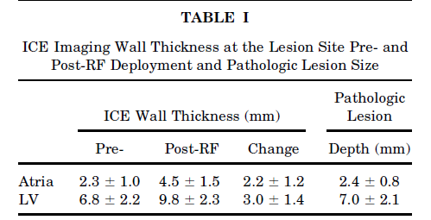
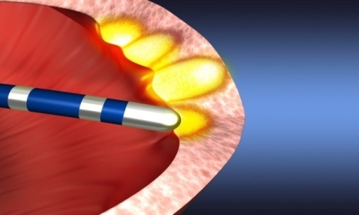
Edema formation doubles atrial wall thickness
Atrial wall thickness doubles after 1 minute after ablation due to tissue
edema formation
Ren JF, et al., Echocardiography 2001;18(6):503–7.
Notes:
It has been reported by Jian Fang Ren et al using ICE imaging that heart wall thickness can double after 1 minute of ablation because of tissue edema formation. Hence, a nontransmural first lesion may increase wall thickness, reducing the effect of tissue heating and making it difficult to achieve full transmurality with subsequent ablations.
Reference:
Ren JF, Callans DJ, Schwartzman D, et al. Changes in local wall thickness correlate with pathologic lesion size following radiofrequency catheter ablation: an intracardiac echocardiographic imaging study. Echocardiography. 2001;18(6):503–7.
28

Slide 29
Clinical Evidence
Tacticath™ contact force ablation catheter

Slide 30
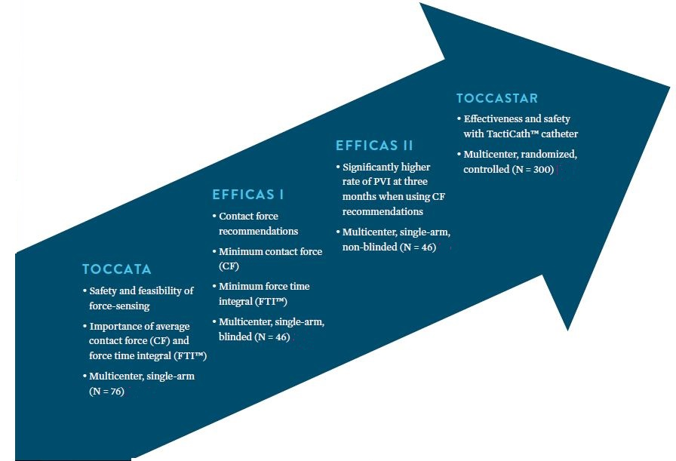

TactiCath™ contact force catheter clinical evidence
Peer-reviewed clinical evidence established through a series of methodically planned clinical trials, to develop and validate
contact force recommendations,
and to demonstrate clinical
safety and effectiveness
⁵
⁴
³
^{1,2}
1. Kuck et al. Heart Rhythm 2012;9(1):18–23. | 2. Reddy et al. Heart Rhythm 2012;9(11):1789–95. | 3. Neuzil et al, Circ Arrhythm Electrophysiol 2013;6(2):327–33. | 4. Kautzner et al. Europace 2015. | 5. Reddy, et al. Circulation 2015 Sep 8;132(10):907-15.
Notes:
The TOCCATA, EFFICAS I, EFFICAS II and TOCCASTAR studies enrolled a total of 464 patients to provide peer-reviewed clinical evidence demonstrating that the TactiCath™ contact force sensing ablation catheter is safe for use in pulmonary vein isolation (PVI).¹⁻⁵ Applying the optimal CF recommendations developed from these studies has been associated with successful ablation outcomes, including high rates of durable PVI^{3,4} and repeat ablation procedure rates of 7.2% in patients treated with optimal CF versus 16.1% with non-optimal CF, and 12.7% in control group patients treated with a non-CF catheter.⁵
References:
Kuck KH, Reddy VY, Schmidt B, et al. A novel radiofrequency ablation catheter using contact force sensing: TOCCATA study. Heart Rhythm. 2012 Jan;9(1):18–23.
Reddy VY, Shah D, Kautzner J, et al. The relationship between contact force and clinical outcome during radiofrequency catheter ablation of atrial fibrillation in the TOCCATA study. Heart Rhythm. 2012;9(11):1789–95.
Neuzil P, Reddy VY, Kautzner J, et al. Electrical reconnection after pulmonary vein isolation is contingent on contact force during initial treatment: results from the EFFICAS I study. Circ Arrhythm Electrophysiol. 2013;6(2):327–33.
Kautzner J, Neuzil P, Lambert H, et al. EFFICAS II: optimization of catheter contact force improves outcome of pulmonary vein isolation for paroxysmal atrial fibrillation. Europace. 2015;17(8):1229–35.
Reddy VY, Dukkipati SR, Neuzil P, et al. A randomized controlled trial of the safety and effectiveness of a contact force sensing irrigated catheter for ablation of paroxysmal atrial fibrillation: results of the TOCCASTAR study. Circulation. 2015 Sep 8;132(10):907–15.

Slide 31
TOCCATA
Safety and Feasibility of Force-sensing with
TactiCath™ Catheter

Slide 32

TOCCATA: Contact force for stable catheter contact^{1,2}
  At least 10 g of force was needed to provide sufficiently stable catheter tip contact²
  Intermittent contact was correlated with
  low CF (p < 0.001)²
  Safety and feasibility of contact force ablation
  72 patients (43 right-sided SVT, 34 paroxysmal AF)
    High contact force variability by individual operators and between different operators¹
P = 0.0001
RECOMMENDATION: MINIMUM 10 G CONTACT FORCE FOR ANY ABLATION POINTS
1. Kuck et al. Heart Rhythm 2012;9(1):18–23.
2. Reddy et al. Heart Rhythm 2012;9(11):1789–95.
Notes:
TOCCATA was the first multicenter clinical trial using a direct contact force catheter, the TactiCath catheter, in human subjects (n = 72) and evaluated the safety and feasibility of CF sensing during ablation procedures. Patients were divided into two groups: right-sided SVT (n=43) and paroxysmal AF (n=34). Investigators were blinded to CF values during mapping, but not the actual ablation procedure.
TOCCATA showed that intermittent contact was correlated with low CF and that a minimum CF of 10g was needed to provide sufficiently stable catheter tip contact.
Data evaluating safety of CF showed that, for right-sided SVT patients, the incidence of serious adverse events (SAEs) related to the device or procedure was 2%, well below the rate of 11.4% that was pre-specified for safety. For paroxysmal AF patients, the SAE rate was 12%, which was also below the pre-specified safety rate of 16.8%.
References:
Kuck K, Reddy V, Schmidt B, et al. A novel radiofrequency ablation catheter using contact force sensing: TOCCATA study. Heart Rhythm. 2012;9(1):18–23.
Reddy V, Shah D, Kautzner J, et al. The relationship between contact force and clinical outcome during radiofrequency catheter ablation of atrial fibrillation in the TOCCATA study. Heart Rhythm. 2012;9(11):1789–95.

Slide 33
TOCCATA: AF recurrence correlates with lower CF^{1,2}
TOCCATA was the first study to show that CF ≥ 20 g is most likely to result in durable PVI at 12 months, while contact force (CF) < 10 g is associated with unsuccessful durable PVI²
  34 paroxysmal AF patients^{1,2}
  Serious adverse events below pre-specified
  safety rate¹
  All patients (100%) with CF < 10 g had
  unsuccessful durable PVI at 1 year²
  With CF ≥ 20 g, 80% of patients had
  successful durable PVI at 1 year²
SUCCESS AND RECURRENCE RATES BY AVERAGE ABLATION CF
12-month long-term clinical outcomes
RECOMMENDATION:
TARGET 20 G CONTACT FORCE
FOR ANY ABLATION POINTS
1. Kuck et al. Heart Rhythm 2012;9(1):18–23.
2. Reddy et al. Heart Rhythm 2012;9(11):1789–95.
Notes:
Analysis of the AF subpopulation (n=34) in TOCCATA showed that AF recurrence is significantly higher in patients with lower CF. At 12 months, ALL (100%) patients with an average CF < 10 g were unsuccessful (had AF recurrences at any time during 12 month f/u) whereas 80% of patients treated with an average CF > 20 g were successful (no AF recurrence, or AF recurrence with durable PVI confirmed) (p = 0.01).
Recurrence of AF at 12 months was also significantly higher in patients who had two or more lesion applications with CF < 5 g vs. patients who had 0 to 1 lesion applications with CF < 5 g (75% vs. 40% respectively, p = 0.03).
For paroxysmal AF patients, the SAE rate was 12%, which was also below the pre-specified safety rate of 16.8%.¹
The authors concluded that CF may increase the safety and efficacy of RF ablation procedures by providing additional useful information for safe catheter manipulation, preventing the use of inappropriately high CF, and allowing better control of RF lesion size.
References:
Kuck K, Reddy V, Schmidt B, et al. A novel radiofrequency ablation catheter using contact force sensing: TOCCATA study. Heart Rhythm. 2012;9(1):18–23.
Reddy V, Shah D, Kautzner J, et al. The relationship between contact force and clinical outcome during radiofrequency catheter ablation of atrial fibrillation in the TOCCATA study. Heart Rhythm. 2012;9(11):1789–95.

Slide 34
EFFICAS I
Identifying Contact Force and FTI™ Recommendations with the TactiCath™ Catheter

Slide 35
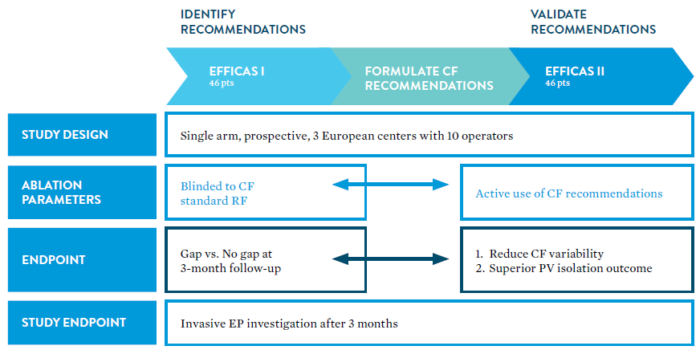
EFFICAS I: Identify contact force (CF) recommandations
EFFICAS I AND II STUDIES
1. Neuzil et al, Circ Arrhythm Electrophysiol 2013;6(2):327–33.
2. Kautzner et al. Europace 2015;17(8):1229–35.
Notes:
The aim of EFFICAS I was to study the correlation between CF parameters during the initial procedure and the existence of isolation gaps at 3-months post-procedure in patients with paroxysmal AF. Operators were blinded to CF information during the procedure and invasive diagnostic procedure was performed at follow-up. From EFFICAS I and TOCCATA, CF recommendations were identified. The recommendations were then validated in EFFICAS II.
References:
Neuzil P, Reddy VY, Kautzner J, et al. Electrical reconnection after pulmonary vein isolation is contingent on contact force during initial treatment: results from the EFFICAS I study. Circ Arrhythm Electrophysiol. 2013;6(2):327–33.
Kautzner J, Neuzil P, Lambert H, et al. EFFICAS II: optimization of catheter contact force improves outcome of pulmonary vein isolation for paroxysmal atrial fibrillation. Europace. 2015;17(8):1229–35.

Slide 36
EFFICAS I: Minimum CF and FTI™ predict PVI gaps
EFFICAS I researchers evaluated the association between contact force (CF) and force-time integral (FTI™) for the existence of gaps during PVI and at a three-month invasive follow-up
  The minimum FTI value was correlated
  to PV gap reconnection at three months
  post-procedure
  Minimum CF and FTI are stronger
  predictors of gaps than average CF
  or FTI
  The weakest lesions made are the
  largest determinants of success
Parameter (per segment) | Median (all segments) NO GAP N = 266 | Median (all segments) WITH GAPS N = 52 | P-value
Average CF | 19.5 g | 15.5 g | p = 0.022
Average FTI | 708 gs | 627 gs | P = 0.090
Total # of ablations | 6 | 9 | P < 0.001
Min CF | 8.1 | 3.6 | P < 0.001
Min FTI | 232 gs | 118 gs | P < 0.001
(N = 40 patients completing 3-month invasive EP follow-up procedure)
Neuzil et al, Circ Arrhythm Electrophysiol 2013;6(2):327–33.
Notes:
The aim of EFFICAS I was to study the correlation between CF parameters during the initial procedure and the existence of isolation gaps at 3-months post-procedure in patients with paroxysmal AF. Operators were blinded to CF information during the procedure and invasive diagnostic procedure was performed at follow-up. From EFFICAS I and TOCCATA, CF recommendations are identified. The recommendations were then validated in EFFICAS II.
EFFICAS I results showed appropriate use of Contact Force during PVI ablation increases the probability of PV isolation at 3M follow-up. This study showed that it is not simply the average Contact Force and Force-Time Integral that predict whether or not a gap is present, but rather that the minimum CF and minimum Force-Time Integral (FTI)™ are the stronger predictors of isolation effectiveness. The greatest significance was seen when comparing the minimum CF (8.1g vs. 3.6g respectively, p = 0.0001) and the minimum FTI (232 vs 118 gs, p=0.0007) between segments with no gap vs gap.
One may observe that ablations in any given segment are only as effective as the worst ablation performed in that segment, quantified by the minimum FTI. Consecutive segments with low-minimum FTI may considerably decrease the likelihood for successful outcome.
Reference:
Neuzil P, Reddy VY, Kautzner J, et al. Electrical reconnection after pulmonary vein isolation is contingent on contact force during initial treatment: results from the EFFICAS I study. Circ Arrhythm Electrophysiol. 2013;6(2):327–33.

Slide 37
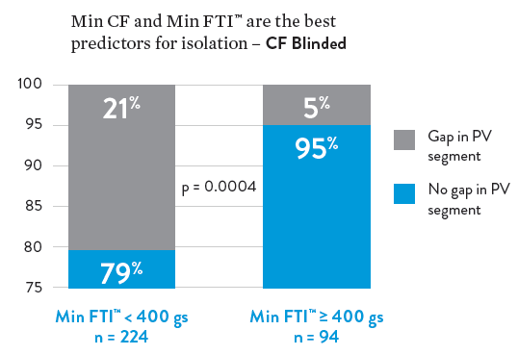
EFFICAS I: Minimum FTI™ predicts PV isolation success
  Once an ablation with FTI < 400 gs
  was made, the risk of gap increased
  Ablations with minimum FTI ≥ 400 gs,
  at 24.4 W average power, were associated with significantly higher PVI success
  p = 0.0004, OR = 0.21)
EFFICAS I: PVI SUCCESS RATES AT 3 MONTHS BY MIN FTI
RECOMMENDATION: MINIMUM FTI ≥ 400 GS FOR ANY ABLATION POINTS
Neuzil et al, Circ Arrhythm Electrophysiol 2013;6(2):327–33.
Notes:
In EFFICAS I, ablation segments with minimum FTI < 400 gs had a probability of isolation of only 79%, but the probability increased to 95% with minimum FTI ≥ 400 gs (p = 0.0004, OR=0.21).
Reference:
Neuzil P, Reddy VY, Kautzner J, et al. Electrical reconnection after pulmonary vein isolation is contingent on contact force during initial treatment: results from the EFFICAS I study. Circ Arrhythm Electrophysiol. 2013;6(2):327–33.

Slide 38
EFFICAS I: PVI success with fewer, efficient lesions
  Creating fewer lesions, efficiently,
  was associated with higher probability of PVI success
  The total number of ablations per segment was inversely correlated to isolation (median 6 for isolated PV segments vs. 9 for segments with gaps,
  p < 0.001)
Parameter (per segment) | Median (all segments) NO GAP N = 266 | Median (all segments) WITH GAPS N = 52 | P-value
Average CF | 19.5 g | 15.5 g | p = 0.022
Average FTI | 708 gs | 627 gs | P = 0.090
Total # of ablations | 6 | 9 | P < 0.001
Min CF | 8.1 | 3.6 | P < 0.001
Min FTI | 232 gs | 118 gs | P < 0.001
(N = 40 patients completing 3-month invasive EP follow-up procedure)
RECOMMENDATION: ACHIEVE TRANSMURALITY IN ONE SHOT
Neuzil, et al, Circ Arrhythm Electrophysiol 2013;6(2):327–33.
Notes:
Another important finding from the EFFICAS I study is that the average number of ablations per segment is inversely correlated to isolation. There were 9 lesions in segments with gap versus 6 in segments with no gap (p < 0.001). Once an ablation with FTI < 400 gs was made, the risk of gap increased. Thus, EFFICAS I data suggested that successful transmural lesions achieved without gaps do not require subsequent corrections. Hence, the authors made an additional recommendation to achieve transmurality in “one-shot”.
The authors discussed that there may be several reasons why the worst ablation, defined as ablation with minimum FTI at a given site, was a strong predictor for electric reconnection of a PV. One is that the tissue surface is altered because of initial RF current, making subsequent ablations more difficult to penetrate deep in the tissue. A more plausible explanation is that creation of a nontransmural lesion results in edema.
Reference:
Neuzil P, Reddy VY, Kautzner J, et al. Electrical reconnection after pulmonary vein isolation is contingent on contact force during initial treatment: results from the EFFICAS I study. Circ Arrhythm Electrophysiol. 2013;6(2):327–33.

Slide 39
EFFICAS II
Validating Contact Force Recommendations with the TactiCath™ Catheter

Slide 40
EFFICAS I: Identify contact force (CF) recommandations
EFFICAS I AND II STUDIES
1. Neuzil et al, Circ Arrhythm Electrophysiol 2013;6(2):327–33.
2. Kautzner et al. Europace 2015;17(8):1229–35.
Notes:
The aim of EFFICAS II was to validate the active use of CF recommendations identified in EFFICAS I. Unlike operators who were blinded to CF values in EFFICAS I, operators in EFFICAS II were allowed and encouraged to utilize CF and FTI information to optimize lesion creation. An invasive diagnostic EP procedure was performed at 3 months post-ablation to assess durable PV isolation success.
References:
Neuzil P, Reddy VY, Kautzner J, et al. Electrical reconnection after pulmonary vein isolation is contingent on contact force during initial treatment: results from the EFFICAS I study. Circ Arrhythm Electrophysiol. 2013;6(2):327–33.
Kautzner J, Neuzil P, Lambert H, et al. EFFICAS II: optimization of catheter contact force improves outcome of pulmonary vein isolation for paroxysmal atrial fibrillation. Europace. 2015;17(8):1229–35.

Slide 41
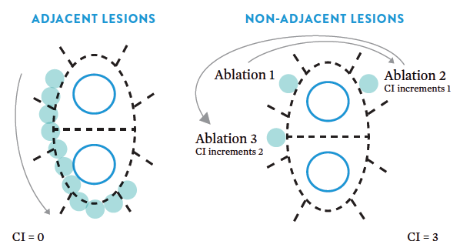
EFFICAS II: Continuity Index™ (CI) for contiguous lesions
Creating contiguous lesions with a low CI significantly increased the number of PVs isolated to 98%, compared to 62% for PVs isolated with a high CI (p < 0.001)
  PVI lesion lines were quantified using a Continuity Index™ (CI)
    CI calculates how often the catheter is moved for ablation to noncontiguous locations
    Each gap between non-adjacent lesion points increases the CI for the lesion line by one
    A low CI (CI < 6) is associated with good continuity and a high CI (CI ≥ 6) with
    poor continuity
EFFICAS II: CONTINUITY INDEX (CI)
Kautzner et al. Europace 2015;17(8):1229–35.
Notes:
The EFFICAS II study was designed to validate that contiguous lesions created following the CF recommendations identified in EFFICAS I (Min CF > 10 g and Min FTI > 400 gs) resulted in improved ablation outcomes.
Continuity of each PVI lesion line was quantified using a Continuity Index™ (CI) that calculates how often the catheter is moved for ablation to noncontiguous locations (Figure). Each gap between non-adjacent lesion points increases the CI for the lesion line by one. A low CI (CI < 6) is associated with good continuity and a high CI (CI ≥ 6) with poor continuity.
In EFFICAS II, creating contiguous lesions with a low Continuity Index (CI < 6) significantly increased the number of PVs isolated when compared to PVs isolated with a high Continuity Index (CI ≥ 6) (98% vs. 62%, p < 0.001).
Reference:
Kautzner J, Neuzil P, Lambert H, et al. EFFICAS II: optimization of catheter contact force improves outcome of pulmonary vein isolation for paroxysmal atrial fibrillation. Europace. 2015;17(8):1229–35.

Slide 42
EFFICAS II: Durable PVI improved with contiguous ablation²
  Using contiguous ablation lines (CI < 6) resulted in durable isolation without gaps at three months in 81% of PVs isolated in EFFICAS I, and in 98% of PVs isolated in EFFICAS II with the added use of CF recommendations (p = 0.005)^{1,2}
  EFFICAS II showed that creating contiguous lesions with a low Continuity Index™ (CI < 6) significantly reduced the number of PVs with gaps to 62% when compared to PVs isolated with a high continuity index (CI ≥ 6, 98% with gaps, p < 0.001)²
% OF VEINS WITH GAPS AFTER PVI
WITH CONTIGUOUS ABLATION LINES²
–90%
p = 0.005
EFFICAS I
(blinded to CF)
N = 48 PV
EFFICAS II
(with CF guidelines)
N = 57 PV
1. Neuzil et al, Circ Arrhythm Electrophysiol 2013;6(2):327–33.
2. Kautzner et al. Europace 2015;17(8):1229–35.
Notes:
EFFICAS II validated the CF recommendations derived from EFFICAS I and TOCCATA. Unlike operators who were blinded to CF values in EFFICAS I, operators in EFFICAS II were allowed and encouraged to utilize CF and FTI information to optimize lesion creation.
Within EFFICAS II, creating contiguous lesions with a low Continuity Index (CI < 6) significantly increased the number of PVs isolated to 98% (56/57 PVs) compared to 62% (39/48) for PVs isolated with a high Continuity Index (CI ≥ 6) (p < 0.001).
When comparing EFFICAS II results to EFFICAS I, the number of PVs with gaps was significantly reduced in EFFICAS II in PVs isolated with contiguous ablation lines (Continuity Index™ (CI) <6), (19% vs. 1.8%, respectively, p = 0.005).
References:
Neuzil P, Reddy VY, Kautzner J, et al. Electrical reconnection after pulmonary vein isolation is contingent on contact force during initial treatment: results from the EFFICAS I study. Circ Arrhythm Electrophysiol. 2013;6(2):327–33.
Kautzner J, Neuzil P, Lambert H, et al. EFFICAS II: optimization of catheter contact force improves outcome of pulmonary vein isolation for paroxysmal atrial fibrillation. Europace. 2015;17(8):1229–35.

Slide 43
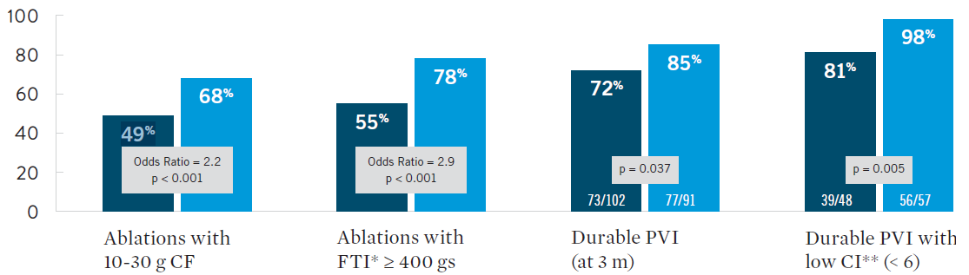
EFFICAS II validated use of contact force recommendations
Rate of durable PVI significantly higher at 3 mos when CF recommendations were used with TactiCath™ catheter
  Durable PV isolation at three months improved from 72% in EFFICAS I to 85% in EFFICAS II (p = 0.037)
  Procedural efficiency also improved
    Total number of ablations significantly reduced by 15%
    No increase in average RF power
EFFICAS I AND EFFICAS II CLINICAL COMPARISON^{1,2}
EFFICAS I (26 patients)
n = 1818 ablations
24.4 W avg. power
EFFICAS II (24 patients)
n = 1372 ablations
15% reduction, p = 0.05)
23.3 W avg. power (p = NS)
1. Neuzil et al, Circ Arrhythm Electrophysiol 2013;6(2):327–33.
2. Kautzner et al. Europace 2015;17(8):1229–35.
*FTI™ = Force Time Integral | **CI = Continuity Index
Notes:
EFFICAS II validated the CF recommendations derived from EFFICAS I and TOCCATA. Unlike operators who were blinded to CF values in EFFICAS I, operators in EFFICAS II were allowed and encouraged to utilize CF and FTI information to optimize lesion creation. Comparing the two studies showed that the increased use of CF recommendations in EFFICAS II resulted in higher rates of durable PV isolation at 3 months, which was further improved when contiguous ablation lesions were created with a low Continuity Index™ (CI).^{1,2}
Durable PV isolation at three months improved from 72% in EFFICAS I where operators were blinded to CF, to 85% in EFFICAS II (p = 0.037) with the added use of CF recommendations.
Using contiguous ablation lines improved durable PVI without gaps at three months to 98% for PVs isolated in EFFICAS II with CI < 6, compared with 81% for PVs isolated in EFFICAS I with CI < 6 (p = 0.005).
References:
Neuzil P, Reddy VY, Kautzner J, et al. Electrical reconnection after pulmonary vein isolation is contingent on contact force during initial treatment: results from the EFFICAS I study. Circ Arrhythm Electrophysiol. 2013;6(2):327–33.
Kautzner J, Neuzil P, Lambert H, et al. EFFICAS II: optimization of catheter contact force improves outcome of pulmonary vein isolation for paroxysmal atrial fibrillation. Europace. 2015;17(8):1229–35.

Slide 44
Contact force recommendations aimed at increasing long-term clinical success
Formulated from the EFFICAS I¹ study and validated in the EFFICAS II² study
TARGET 20 g with range (10 g, 30 g)^{1,2}
Min 10 g for any ablation points^{1,2}
Min 400 gs for any ablation points²
ONE SHOT: Transmurality should be achieved in one shot²
CF
CF
FTI
1. Neuzil et al, Circ Arrhythm Electrophysiol 2013;6(2):327–33.
2. Kautzner et al. Europace 2015;17(8):1229–35.
Notes:
The TactiCath™ Quartz ablation catheter with contact force (CF) measuring capability is the first to provide recommendations for CF sensing during pulmonary vein isolation (PVI) procedures. Measurement of CF between the catheter tip and the target tissue can help further guide physicians during mapping and ablation procedures. Data from EFFICAS I and EFFICAS II show that CF sensing is not only safe for use in PVI but also associated with lower rates of gap and atrial fibrillation (AF) recurrence.^{1,2}
Applying the optimal CF recommendations developed from these studies has been associated with successful ablation outcomes, including high rates of durable PVI.^{1,2}
References:
Neuzil P, Reddy VY, Kautzner J, et al. Electrical reconnection after pulmonary vein isolation is contingent on contact force during initial treatment: results from the EFFICAS I study. Circ Arrhythm Electrophysiol. 2013;6(2):327–33.
Kautzner J, Neuzil P, Lambert H, et al. EFFICAS II: optimization of catheter contact force improves outcome of pulmonary vein isolation for paroxysmal atrial fibrillation. Europace. 2015;17(8):1229–35.

Slide 45
TOCCASTAR
Effectiveness and Safety with the TactiCath™ Catheter

Slide 46
TOCCASTAR trial design
TactiCath™ Contact Force Ablation Catheter Study for Atrial Fibrillation
Design
  Prospective, 1:1 randomized, multicenter Investigational Device Exemption (IDE) study evaluating the safety and effectiveness of a Contact Force (CF) sensing RF ablation catheter for the treatment of symptomatic paroxysmal AF
  Non-inferiority comparison
    Test device (CF) –TactiCath™ Contact Force sensing ablation catheter (St. Jude Medical)
      CF target guidelines were not specified in the study protocol — physicians applied CF based on clinical experience
    Control device (non-CF) – Navistar‡ ThermoCool‡ irrigated ablation catheter (Biosense Webster)
  Sample size: 300 randomized subjects enrolled at 17 sites
  (10 US, 7 EU)
  Study duration: 3-month blanking period, 12 months
  total follow-up
Endpoints
  Primary Effectiveness: no documented, symptomatic recurrence of atrial arrhythmia > 30 seconds (off drug success)
    Use of any class I or II anti-arrhythmia drug (AAD) after the 3-month blanking period was considered a treatment failure
    Any transtelephonic monitoring (TTM) transmission
    or ECG indicating AF, AFL or AT >30 seconds was a treatment failure
  Clinically Relevant Success : no documented, symptomatic recurrence of atrial arrhyhmia >30 seconds (patient could use an AAD)
  Primary Safety: freedom from device-related serious
  adverse events
  Pre-specified secondary endpoint analyses: effectiveness
  for Optimal CF vs. Non-optimal CF subgroups
Sponsor
  Abbott, St. Paul, MN (study initiated under Endosense,
  Geneva, Switzerland)
Reddy VY, et al. Circulation 2015;132(10):907–15.
‡ Indicates a third-party trademark, which is property of its respective owner
Notes:
Conducted under Investigational Device Exemption (IDE)
12 month follow-up complete June 2013
FDA PMA approval received in October 2014
Reference:
ClinicalTrials.gov Identifier: NCT01278953
Reddy VY, Dukkipati SR, Neuzil P, et al. A randomized controlled trial of the safety and effectiveness of a contact force sensing irrigated catheter for ablation of paroxysmal atrial fibrillation: results of the TOCCASTAR study. Circulation. 2015 Sep 8;132(10):907–15.

Slide 47
TOCCASTAR study analysis populations
Randomized
(N = 300 Patients with PAF)
TactiCath™ catheter contact force
(N = 155)
ThermoCool‡ catheter non-CF control
(N = 145)
Ablation catheter introduced
CF safety population
(N =152)
Non-CF safety population
(N =143)
Follow-up office visits at 7 days and 3, 6, and 12 months after PV isolation procedure
completedwith no major protocol deviations (per-protocol)
CF effectiveness population
(N =146)
Non-CF effectiveness population
(N =134)
Optimal CFª
(N = 83)
Non-optimal CF^{b,c}
(N = 62)
Optimal CF defined as those patients where ≥ 90% lesions ≥ 10 g.
Non-optimal CF defined as those patients where < 90% lesions ≥ 10 g.
Contact Force data was unavailable for 1 patient.
Reddy VY, et al. Circulation 2015;132(10):907–15.
‡ Indicates a third-party trademark, which is property of its respective owner
Notes:
Reference:
Reddy VY, Dukkipati SR, Neuzil P, et al. A randomized controlled trial of the safety and effectiveness of a contact force sensing irrigated catheter for ablation of paroxysmal atrial fibrillation: results of the TOCCASTAR study. Circulation. 2015 Sep 8;132(10):907–15.
ClinicalTrials.gov Identifier: NCT01278953

Slide 48
TOCCASTAR met primary safety endpoint
  Non-inferiority was demonstrated, as the 95% UCB for the difference in primary device-related SAE rates between the TactiCath™ catheter and Control (3.6%) was greater than the predefined non-inferiority margin of 9%
Absolute rate difference:
0.6%
95% upper
confidence bound:
3.6%
Non-inferiority limit:
9%
-3%
0%
3%
6%
9%
DIFFERENCES IN DEVICE RELATED SAES (TACTICATH™ CATHETER VERSUS CONTROL)
SERIOUS ADVERSE EVENTS, n (%) OF PATIENTS | TACTICATH (n = 152) | CONTROL (n = 143)
Device-related SAEs (primary) | 3 (1.97%) | 2 (1.4%)
Cardiac tamponade / perforation | 1 (0.66%) | 1 (0.70%)
Pericarditis | 2 (1.32%) | 0 (0.0%)
Pulmonary vein stenosis | 0 (0.0%) | 1 (0.70%)
Reddy VY, et al. Circulation 2015;132(10):907–15.
Notes:
TOCCASTAR met its primary safety and effectiveness endpoints by showing TactiCath catheter non-inferiority to Control in both areas at 12 months post-ablation.
TactiCath ablation catheter safety results were excellent with 0.7% tamponade.
There were no deaths, strokes, transient ischemic attacks or atrioesophageal fistulas in either group.
Reference:
Reddy VY, Dukkipati SR, Neuzil P, et al. A randomized controlled trial of the safety and effectiveness of a contact force sensing irrigated catheter for ablation of paroxysmal atrial fibrillation: results of the TOCCASTAR study. Circulation. 2015 Sep 8;132(10):907–15.

Slide 49
TOCCASTAR met primary effectiveness endpoint
  Non-inferiority was demonstrated, as the 95% LCB for the difference in primary effectiveness rates between the TactiCath™ catheter and Control
  (–10.7%) was greater than the predefined
  non-inferiority margin of –15%
Non-inferiority limit:
-15%
95% Lower
confidence bound:
-10.7%
Absolute Rate Difference:
-1.6%
-15%
-10%
-5%
0%
5%
DIFFERENCE IN PRIMARY EFFECTIVENESS RATES (TACTICATH™ CATHETER VERSUS CONTROL)
12-MONTH ENDPOINT | TACTICATH CATHETER (n = 146) | CONTROL (n = 134) | DIFFERENCE [95% LCB]
Primary effectiveness* | 99 (67.8%) | 93 (69.4%) | –1.6% [–10.7%]
Clinically relevant success** | 78.1% | 80.6% | —
*Primary effectiveness: no documented, symptomatic recurrence of atrial arrhythmia > 30 s (of all AADs after 3-mo blanking)
**Clinically relevant success: no documented, symptomatic recurrence of atrial arrhythmia > 30 s (patient could be on an AAD)
Reddy VY, et al. Circulation 2015;132(10):907–15.
Notes:
Acute procedural success (isolation of all targeted PVs) was achieved in all patients (100%) in both groups.
Radiofrequency ablation times were 46.5 vs. 53.0 minutes, and fluoroscopy times were 27.0 vs. 23.0 minutes, for the TactiCath catheter and non-CF catheter Control groups, respectively.
TOCCASTAR met its primary safety and effectiveness endpoints by showing TactiCath catheter non-inferiority to Control in both areas at 12 months post-ablation.
Reference:
Reddy VY, Dukkipati SR, Neuzil P, et al. A randomized controlled trial of the safety and effectiveness of a contact force sensing irrigated catheter for ablation of paroxysmal atrial fibrillation: results of the TOCCASTAR study. Circulation. 2015 Sep 8;132(10):907–15.

Slide 50
Pre-specified secondary analysis: Use of optimal CF
  Per TOCCASTAR protocol, physicians were not required to target a specific
  amount of contact force (CF).
  Within the TactiCath™ catheter group, protocol-specified secondary effectiveness
  analysis was performed based on prospectively collected contact force data.
  Optimal CF was defined as patients with ≥ 90% of lesions delivered using
  ≥ 10g of force
  Non-optimal CF was defined as patients with < 90% of lesions delivered using ≥ 10 g of force
  CF data were unavailable for one patient
Primary effectiveness: No documented, symptomatic recurrence of atrial arrhythmia > 30 s (off all AADs after 3-mo blanking)
Clinically relevant success: No documented, symptomatic recurrence of atrial arrhythmia > 30 s (patient could be on an AAD)
12-MONTH OUTCOMES (%) OF PATIENTS | OPTIMAL CF (n = 83) | NON-OPTIMAL CF (n = 62)
Primary effectiveness (off drug) | 75.9% | 58.1%
Clinically relevant success | 85.5% | 67.7%
Reddy VY, et al. Circulation 2015;132(10):907–15.
Notes:
Optimal CF definition for TOCCASTAR¹ was derived from findings of other previous and ongoing studies.
Reference:
Reddy VY, Dukkipati SR, Neuzil P, et al. A randomized controlled trial of the safety and effectiveness of a contact force sensing irrigated catheter for ablation of paroxysmal atrial fibrillation: results of the TOCCASTAR study. Circulation. 2015 Sep 8;132(10):907–15.

Slide 51
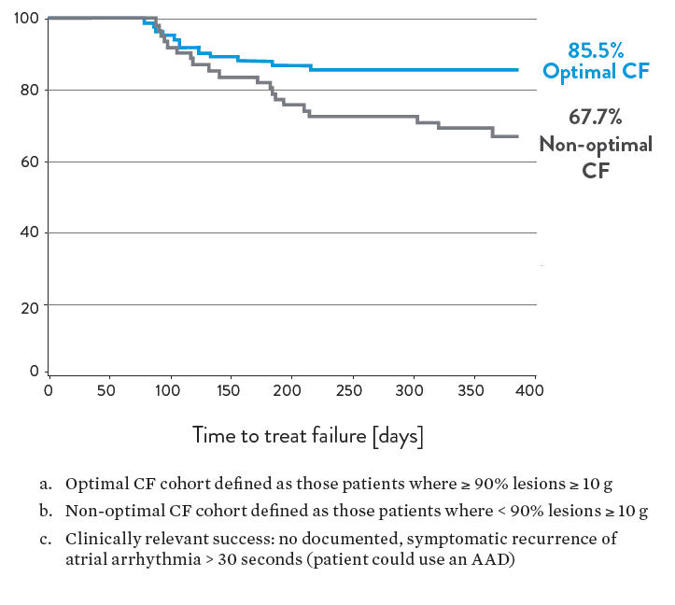
TOCCASTAR: Optimal CF for clinical success
Pre-specified retrospective analyses demonstrated the impact of using
optimal contact force
  Using the TactiCath™ catheter with optimal CF provided an arrthymia-free clinical success rate of 85.5% at 12 months vs. 67.7% with non-optimal CF:
    The primary effectiveness (off drug) rate was 67.8%
    at 12 months for the TactiCath catheter group overall
      75.9% with optimal CF and 58.1% with
      non-optimal CF
  Optimal CF procedures were also associated with
  RF power < 27W and a tamponade rate < 1%.
OPTIMAL CFª VS NON-OPTIMAL CF^{b}
CLINICALLY RELEVANT SUCCESS^{c} AT 12 MONTHS
Reddy VY, et al. Circulation 2015;132(10):907–15.
Notes:
Retrospective secondary analysis of the 146 patients in the TactiCath CF effectiveness analysis cohort demonstrated the impact of optimal CF on success
83 (57%) of 146 CF catheter patients had their lesions created with Optimal CF
62 (42%) of CF catheter patients had their lesions created with Non-optimal CF
Contact force information was unavailable for one patient
Using the TactiCath™ catheter with optimal CF provided an arrthymia-free clinical success rate of 85.5% at 12 months vs. 67.7% with non-optimal CF.
Clinically relevant success rates were 78.1% for TactiCath catheter group overall vs. 80.6% for non-CF control group.
The primary effectiveness (off drug) rate was 67.8% at 12 months for the TactiCath catheter group overall (75.9% with optimal CF and 58.1% with non-optimal CF) vs. 69.4% for non-CF control (-1.6% absolute difference, -10.7% lower limit of 95% confidence interval).
Reference:
Reddy VY, Dukkipati SR, Neuzil P, et al. A randomized controlled trial of the safety and effectiveness of a contact force sensing irrigated catheter for ablation of paroxysmal atrial fibrillation: results of the TOCCASTAR study. Circulation. 2015 Sep 8;132(10):907–15.

Slide 52
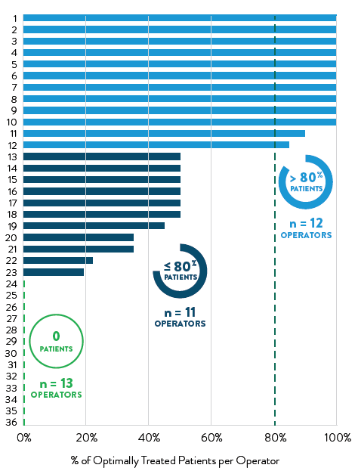
TOCCASTAR: Operator variability in CF delivery
With no target CF recommendations provided
at study onset, CF delivery varied widely
  Optimal CF operators were retrospectively defined as those who delivered optimal CF
  (≥ 90% of lesions created at CF ≥ 10 g) in > 80% of their patients
    Optimal CF operators required mean RF power < 27 W and
    26.5 g CF to achieve a 79.1% primary (off-drug) success rate
  Non-optimal CF operators were defined as those who delivered optimal CF in ≤ 80% of their patients
    Non-optimal CF operators used mean 28.0 W RF power and
    19.2 g CF to achieve a 58.2% off-drug success rate
  The serious adverse event rate was 6.0% in optimal CF operators’ patients vs. 6.3% for non-optimal CF operators
OPERATORS DELIVERING OPTIMAL CONTACT FORCE
IN TOCCASTAR PATIENTS
10 OF 36 OPERATORS DELIVERED OPTIMAL CF IN ALL (100%) OF THEIR PATIENTS
13 OPERATORS DELIVERED OPTIMAL CF IN NONE (0)
OF THEIR PATIENTS
Reddy VY, et al. Circulation 2015;132(10):907–15.
Notes:
Data from the TOCCATA and EFFICAS I trials that demonstrated a high percentage of PV isolation lesions were ineffective when generated using a low CF (<10 g) while the TOCCASTAR study was ongoing, so not all of the participating physicians delivered optimal CF. Analysis of 36 individual operators illustrated the wide variability in their selection of optimal CF for PV isolation procedures
Analysis of individual operator impact on CF procedures looked at CF, RF power and clinical outcomes for operators who delivered an optimal CF in > 80% of their patients versus those delivering an optimal CF in ≤ 80% of their patients.
Reference:
Reddy VY, Dukkipati SR, Neuzil P, et al. A randomized controlled trial of the safety and effectiveness of a contact force sensing irrigated catheter for ablation of paroxysmal atrial fibrillation: results of the TOCCASTAR study. Circulation. 2015 Sep 8;132(10):907–15.

Slide 53
TOCCASTAR: Impact of operator CF delivery
  Optimal CF operators (n = 12) required mean
  RF power < 27 W and 26.5 g CF to achieve
    79.1% primary success rate (off-drug) with
    6.0% serious adverse events
  Non-optimal CF operators (n = 24) used mean
  RF power 28.0 W and 19.2 g CF to achieve
    58.2% primary (off-drug) success with
    6.3% serious adverse events
  Optimal CF operators defined as those with optimal
  CF achieved in > 80% of their procedures.
  Non-optimal CF operators defined as those with
  optimal CF achieved in ≤ 80% of their procedures.
  Optimal CF defined as patients where ≥ 90% lesions ≥ 10 g CF.
ANALYSIS OF OPTIMAL VS NON-OPTIMAL CF OPERATORS
n=4520
n=3036
n=4520
n=3036
4/67
5/79
Reddy VY, et al. Circulation 2015;132(10):907–15.
Notes:
Mean CF parameters and treatment outcomes achieved by operators with optimal CF in >80% of their patients’ procedures compared with other operators. Both CF and power variables were significantly different between the 2 operator groups. Treatment success rates achieved by operators with optimal CF in >80% of their patients were significantly different compared with operators achieving optimal CF in ≤ 80% of their patients.
Reference:
Reddy VY, Dukkipati SR, Neuzil P, et al. A randomized controlled trial of the safety and effectiveness of a contact force sensing irrigated catheter for ablation of paroxysmal atrial fibrillation: results of the TOCCASTAR study. Circulation. 2015 Sep 8;132(10):907–15.

Slide 54
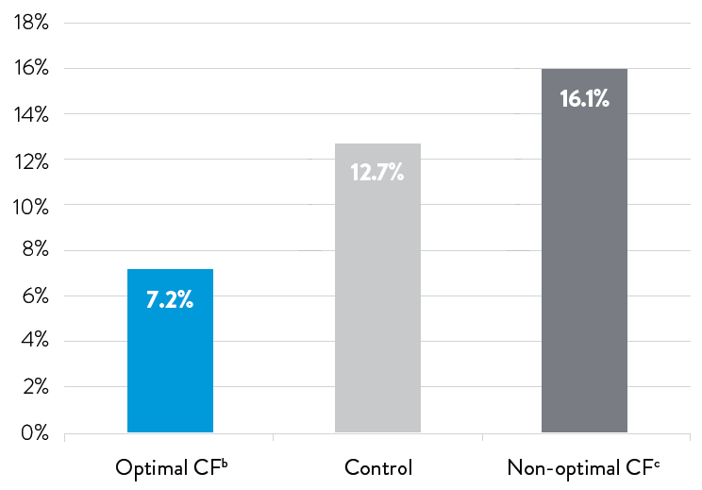
Repeat ablations after index procedure
Repeat ablation was needed in 7.2% of TOCCASTAR patients with optimal CF vs. 16.1% with non-optimal CF and vs. 12.7% in non-CF control patients¹
RATE OF REPEAT ABLATIONª
  Repeat ablation after protocol-defined 3-month blanking period.
  Optimal CF defined as those patients where ≥ 90% lesions ≥ 10 g.
  Non-optimal CF defined as those patients where < 90% lesions ≥ 10 g.
1. Reddy VY, et al. Circulation 2015;132(10):907–15.
Notes:
Repeat ablation was needed in 7.2% of TOCCASTAR patients with optimal CF vs. 16.1% with non-optimal CF and vs. 12.7% in non-CF control patients¹
References:
Reddy VY, Dukkipati SR, Neuzil P, et al. Randomized, controlled trial of the safety and effectiveness of a contact force-sensing irrigated catheter for ablation of paroxysmal atrial fibrillation: Results of the TOCCASTAR study. Circulation. 2015 Sep 8;132(10):907–15.

Slide 55
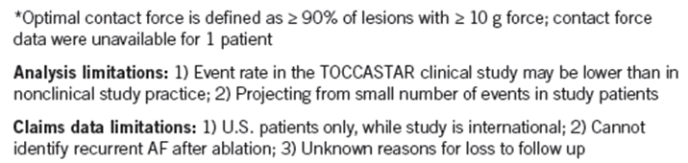
Economic analysis showed reduced post-ablation costs*
  Post-ablation management costs were reduced 15% in the year after ablation in patients treated with optimal CF-guided AF ablation using the TactiCath™ catheter (over $3,000 savings per patient) when compared with patients treated with a non-CF ablation catheter in a healthcare economic analysis of US claims and TOCCASTAR trial data*¹
  Optimal CF-guided AF ablation was associated with fewer post-ablation clinical events including repeat ablations and other cost drivers
TOTAL CARE MANAGEMENT COST PER PATIENT
IN YEAR AFTER ABLATION^{*1}
Non-CF Control Catheter
(134 pts)
TactiCath™ catheter with optimal CF*
(83 pts)
1. Mansour M, et al. Heart Rhythm, 2016;13(5 Suppl 1):S227.
Notes:
An economic analysis of TOCCASTAR study and Truven MarketScan™ data compared post-ablation costs for patients treated with the TactiCath™ catheter and with the non-contact force sensing ThermoCool™ catheter.
This analysis retrospectively identified clinical events in the year after ablation for TOCCASTAR study patients, including 83 treated with TactiCath catheter using optimal CF and 62 with non-optimal CF (CF information was not available for 1 patient treated with the TactiCath catheter), and 134 treated with the non-CF control catheter.
- Clinical events included any complications after ablation, repeat ablations and use of antiarrhythmic drugs, and were matched to patients with AF catheter ablation and identical events from the MarketScan claims database to derive event costs.
- Total mean costs per patient in the year after ablation were $19,271 for patients ablated with the TactiCath catheter using optimal CF vs. $22,673 for patients treated with the non-CF ThermoCool catheter ($3402 savings per patient, translating to a 15% reduction, p < 0.001) and vs. $24,093 with non-optimal CF (6% reduction, p < 0.001).
- Post-ablation costs were lower, with mean savings reaching 15% for ablation with the TactiCath catheter using optimal contact force when compared with non-CF catheter ablation.¹
Reference:
Mansour M, Reddy VY, Karst E, et al. Contact force sensing on AF ablation catheter: A health-economic analysis [Abstract PO02-155]. Heart Rhythm, 2016;13(5 Suppl 1):S227.

Slide 56
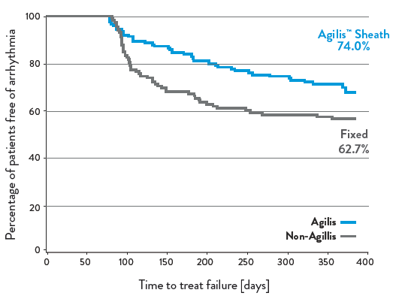
TOCCASTAR: Impact of deflectable sheath use
Protocol-defined exploratory analysis compared treatment success for procedures with either catheter using the Agilis™ NxT steerable sheath vs.
a fixed sheath
Within the TactiCath™ catheter group, median CF
was higher using the Agilis™ NxT steerable sheath vs. treatment with a fixed sheath
PRIMARY EFFECTIVENESS BY SHEATH USAGE
(ALL TOCCASTAR SUBJECTS)¹
AVERAGE CF BY SHEATH USAGE
(TACTICATH™ CATHETER GROUP*)^{1,2}
Agilis™ NxT Sheath
74.0%
Agilis™ NxT
Fixed
Agilis™ NxT Sheath
*CF data unavailable on one patient
1. Mansour, AF Summit at HRS 2014.
2. Cuoco, et al. Heart Rhythm, 2014;11(5 Suppl 1):S518
Notes:
In addition, protocol-specified descriptive endpoint analyses of TOCCASTAR data were performed post hoc comparing contact force and treatment success between use of a deflectable Agilis™ sheath vs. a fixed sheath.^{1,2}
When considering all enrolled subjects treated with either the TactiCath™ catheter or the non-CF control catheter, patients in whom the Agilis sheath was used had a protocol-defined treatment success rate of 74.0% vs. 62.7% for those treated with a fixed sheath.¹
Within the TactiCath catheter contact force group only, cases that used Agilis sheath had higher average contact force, than cases that used a fixed sheath (median 23.4 grams vs. 14.6 grams, respectively).²
References:
Mansour, M. ToccaStar data as presented during “Force Sensing Ablation Catheters: Have our Hopes Been Realized” at the 2014 AF Summit at HRS, San Francisco, CA.
Cuoco F, Michaud GF, Shah DC, et al. Steerable sheath promotes improved contact force parameters during pulmonary vein isolation [Abstract PO06-61]. Heart Rhythm, 2014;11(5 Suppl 1):S518.

Slide 57
TactiCath™ catheter clinical data summary
  TactiCath catheter contact force technology can safely guide physicians to create effective lesions for the treatment of AF¹
  Following TactiCath catheter CF recommendations is
  associated with with successful outcomes demonstrated
  in multiple clinical studies
    Lower risk of AF recurrence¹
    Improved durable pulmonary vein isolatio ^{2,3}
  The randomized TOCCASTAR clinical trial proved the safety and effectiveness of the TactiCath ablation catheter for paroxysmal AF treatment⁴
  TactiCath catheter with optimal CF provided 85.5% clinical success* at 12 months⁴
  Repeat ablation rate at 12 months was 7.2% in patients treated with optimal CF vs. 16.1% with non-optimal CF, and 12.7% for non-CF control⁴
TARGET 20 g with range (10 g, 30 g)^{1,2}
Min 10 g for any ablation points^{1,2}
Min 400 gs for any ablation points²
ONE SHOT: Transmurality should be achieved in one shot²
CF
CF
FTI
  *Primary effectiveness (off drug) was 67.8% at 12 months for TactiCath catheter group overall (75.9% with optimal CF; 58.1% with non-optimal CF)
1. Reddy VY, et al. Heart Rhythm 2012;9(11):1789–95.
2. Neuzil P, et al. Circ Arrhythm Electrophysiol. 2013;6(2):327–33.
3. Kautzner J, et al. Europace 2015;17(8):1229–35.
4. Reddy VY, et al. Circulation 2015;132(10):907–15.
Notes:
Using the TactiCath™ catheter with optimal CF provided an arrthymia-free clinical success rate of 85.5% at 12 months vs. 67.7% with non-optimal CF.
Clinically relevant success rates were 78.1% for TactiCath catheter group overall vs. 80.6% for non-CF control group.
The primary effectiveness (off drug) rate was 67.8% at 12 months for the TactiCath catheter group overall (75.9% with optimal CF and 58.1% with non-optimal CF) vs. 69.4% for non-CF control; -1.6% absolute difference, -10.7% lower limit of 95% confidence interval.
References:
1. Reddy VY, Shah D, Kautzner J, et al. The relationship between contact force and clinical outcome during radiofrequency catheter ablation of atrial fibrillation in the TOCCATA study. Heart Rhythm, 2012 Nov;9(11):1789–95.
2. Neuzil P, Reddy VY, Kautzner J, et al. Electrical reconnection after pulmonary vein isolation is contingent on contact force during initial treatment: results from the EFFICAS I study. Circ Arrhythm Electrophysiol. 2013 Apr;6(2):327–33.
3. Kautzner J, Neuzil P, Lambert H, et al. EFFICAS II: optimization of catheter contact force improves outcome of pulmonary vein isolation for paroxysmal atrial fibrillation. Europace. 2015 Aug;17(8):1229–35.
4. Reddy VY, Dukkipati SR, Neuzil P, et al. Randomized, controlled trial of the safety and effectiveness of a contact force-sensing irrigated catheter for ablation of paroxysmal atrial fibrillation: Results of the TactiCath contact force ablation catheter study for atrial fibrillation (TOCCASTAR) study. Circulation. 2015 Sep 8;132(10):907–15.

Slide 58
Clinical Study Summary
TactiCath™ Contact Force Ablation Catheter, Sensor Enabled™

Slide 59
TactiSense IDE
TactiCath™ Catheter, Sensor Enabled™ SAFETY and effectiveness
Two clinical studies support TCSE. The TOCCASTAR clinical study conducted for the TactiCath™ Set, which also supports the TactiCath™ Quartz Set. These clinical data are also applicable to the TactiCath™ Contact Force Ablation Catheter, Sensor Enabled™ as mechanical/functional testing and preclinical studies have demonstrated equivalent performance and safety to the TactiCath™ Quartz Contact Force Ablation Catheter. The TactiSense study was conducted to demonstrate the acute safety and effectiveness of ablation with the TactiCath™ Contact Force Ablation Catheter, Sensor Enabled™, for the treatment of drug refractory recurrent symptomatic paroxysmal atrial fibrillation
1. TactiSense IDE study. TactiCath SE IFU #ARTEN600049107 A, Dec 2018.
Notes:
Reference: TactiSense IDE study. TactiCath SE IFU #ARTEN600049107 A, Dec 2018.

Slide 60
TactiSense IDE trial design
Multi-Center Acute Safety Trial of TactiCath™ Contact Force Ablation Catheter, Sensor Enabled™ (TactiCath SE) for the Treatment of Drug Refractory Recurrent Symptomatic Paroxysmal Atrial Fibrillation
Objective
  The objective of this study was to demonstrate the acute safety and effectiveness of ablation with the TactiCath™ Contact Force Ablation Catheter, Sensor Enabled™, for the treatment of drug refractory recurrent symptomatic PAF.
  Study Design
  Prospective, multi-center, single-arm clinical trial to demonstrate the acute safety and effectiveness of the TactiCath™ Contact Force Ablation Catheter, Sensor Enabled™, for the treatment of PAF against a performance goal.
  Sample size: hundred fifty six (156) subjects were enrolled at 19 investigational sites in the US, Europe, and Australia.
  Study duration: 30 days (primary safety), 12 months total follow-up including 3-month blanking period (ongoing)
Sponsor
  Abbott, St. Paul, MN (formerly St. Jude Medical)
Endpoints
  There are two primary endpoints and ten descriptive endpoints. Results of the primary endpoints and first three descriptive endpoints were analyzed for this primary analysis. The remaining endpoints will be reported after 1-year follow up results are available.
  Primary Safety: the rate of primary device or procedure-related serious adverse events (SAEs) occurring within 7 days of the index procedure. Atrial-esophageal fistula, cardiac perforation/tamponade, and pulmonary vein stenosis that occur >7 days post procedure through 30 days also contributed to the primary endpoint. Primary event criteria were prespecified.
  Primary Effectiveness: acute procedural success, defined as confirmation of entrance block in all pulmonary veins.
  Descriptive endpoints:
    Ablation data collected during the procedure, including: Power, Temperature, Irrigation flow rate, Contact Force, Procedure time, Total ablation time, Total fluoroscopy time, Total RF application time, Use of AutoMark
    Proportion of index cases achieving ≥90% lesions with ≥10 g contact force
    SAEs and adverse events related to the procedure and/or ablation catheter through 30 days
1. TactiSense IDE study. TactiCath SE IFU #ARTEN600049107 A, Dec 2018.
Notes:
Following FDA approval on Dec 27, 2018, the TactiSense IDE study is summarized in the IFU for the TactiCath™ Contact Force Ablation Catheter, Sensor Enabled™ (after the TOCCASTAR study summary). The study is a prospective, multi-center, single-arm clinical trial to demonstrate the acute safety and effectiveness of the TactiCath™ Contact Force Ablation Catheter, Sensor Enabled™, for the treatment of PAF against a performance goal. One hundred fifty six (156) subjects were enrolled at 19 investigational sites in the US, Europe, and Australia.
There are two primary endpoints and ten descriptive endpoints for this study. Results of the primary endpoints and first three descriptive endpoints were analyzed for this primary analysis. The remaining endpoints will be reported after 1-year follow up results are available.
ClinicalTrials.gov Identifier: NCT03354663
Conducted under Investigational Device Exemption (IDE)
Enrollment was completed in July 2018.
FDA PMA approval received in 27 Dec 2018.
Reference:
1. TactiSense IDE study. TactiCath SE IFU #ARTEN600049107 A, Dec 2018.

Slide 61
TactiSense IDE primary safety and effectiveness analysis populations
Subjects Enrolled
Patients with PAF at 19 sites in US, Europe, and Australia
N = 156
Excluded or aborted procedure prior to device insertion (n = 5)
Effectiveness Population (EFF)
TactiCath SE Ablation Catheter device introduced
N = 151
Withdrawn prior to RF energy delivery
(n = 1)
Radiofrequency Delivered (RF)
Radiofrequency energy was delivered
N = 150
Did not complete 30-day follow-up visit
(n = 1)
Safety population (SAF)
Device introduced and had 30 days of follow-up or primary safety endpoint event
N = 149
One-year follow-up
(pending)
1. TactiSense IDE study. TactiCath SE IFU #ARTEN600049107 A, Dec 2018.
Notes:
Reference:
1. TactiSense IDE study. TactiCath SE IFU #ARTEN600049107 A, Dec 2018.

Slide 62
TactiSense met primary safety endpoint
  The observed rate of primary safety endpoint events was 4.7% (one-sided 95% upper confidence limit: 8.64%) and was statistically significantly lower than the predetermined performance goal of 16.2% (p<0.0001) for the TactiCath™ Ablation Catheter, Sensor Enabled™
Primary safety endpoint event rate:
4.7%
Upper 95%
confidence limit:
8.64%
Performance Goal:
16.2%
0%
5%
10%
15%
20%
PRIMARY SAFETY ENDPOINT ANALYSIS (TactiCath™ Ablation Catheter, Sensor Enabled™)
PRIMARY SAFETY ENDPOINT (SAF population) | TactiCath SE (N = 149) | Upper One-Sided 95% CL | Performance Goal¹ | P-Value²
Subject experienced primary safety endpoint event (Device or Procedure-related primary SAE) | 7 (4.7%) | (8.64%) | 16.2% | <0.0001
¹ One-sided upper 95% confidence limit by Clopper Pearson Method. ² One-sided p-value by using Binomial Exact Test against the performance goal of 16.2%, to be compared with one-sided significance level of 0.05.
1. TactiSense IDE study. TactiCath SE IFU #ARTEN600049107 A, Dec 2018.
Notes:
TactiSense met its primary safety endpoint. The Primary Safety endpoint was the rate of primary device or procedure-related serious adverse events (SAEs) occurring within 7 days of the index procedure. Atrial-esophageal fistula, cardiac perforation/tamponade, and pulmonary vein stenosis that occurred >7 days post procedure through 30 days also contributed to the primary endpoint. Primary safety event criteria were prespecified and are listed in the IFU.
Reference:
TactiSense IDE study. TactiCath SE IFU #ARTEN600049107 A, Dec 2018.

Slide 63
TactiSense primary safety endpoint events
TactiSense IDE Primary Safety Endpoint Events (SAF population) | n (%) Subjects, N = 149
Atrial-esophageal fistula | 1 (0.7%)
AV block | 0 (0.0%)
Cardiac perforation / tamponade | 3 (2.0%)
Death | 0 (0.0%)
Diaphragmatic paralysis | 0 (0.0%)
Gastroparesis | 0 (0.0%)
Hospitalization | 0 (0.0%)
Myocardial infarction | 0 (0.0%)
Pericarditis | 1 (0.7%)
Pneumothorax | 0 (0.0%)
Pulmonary edema | 0 (0.0%)
Pulmonary vein stenosis | 0 (0.0%)
Stroke | 0 (0.0%)
Thromboembolism | 1 (0.7%)
Transient ischemic attack | 0 (0.0%)
Vascular Access Complication | 2 (1.3%)
Total Device or Procedure-related Primary SAEs | 7 (4.7%)
Note: Some subjects may have experienced more than one event. Therefore, the total number of subjects may be fewer than the total number of events.
1. TactiSense IDE study. TactiCath SE IFU #ARTEN600049107 A, Dec 2018.
Notes:
TactiSense met its primary safety endpoint. The Primary Safety endpoint was the rate of primary device or procedure-related serious adverse events (SAEs) occurring within 7 days of the index procedure. Atrial-esophageal fistula, cardiac perforation/tamponade, and pulmonary vein stenosis that occurred >7 days post procedure through 30 days also contributed to the primary endpoint. Primary safety event criteria were prespecified and are listed in the IFU.
Reference:
TactiSense IDE study. TactiCath SE IFU #ARTEN600049107 A, Dec 2018.

Slide 64
TactiSense met primary effectiveness endpoint
  Acute procedural success was achieved in 98.0% (148/151) subjects who had the TactiCath™ Ablation Catheter, Sensor Enabled™ inserted into the vasculature.
  The lower bound of the one-sided 95% confidence interval was 94.95%, which is greater than the performance goal of 90%.
  Therefore, the null hypothesis was rejected and the primary effectiveness endpoint passed.
Performance goal:
90%
Lower 95%
confidence limit:
94.95%
Acute Procedure Success Rate:
98.0%
90%
92%
94%
96%
98%
100%
PRIMARY EFFECTIVENESS RESULTS (TactiCath™ Ablation Catheter, Sensor Enabled™)
PRIMARY EFFECTIVENESS ENDPOINT (EFF Population) | TACTICATH SE (N = 151) | LOWER ONE-SIDED 95% CL¹ | PERFORMANCE GOAL | P-VALUE²
Acute Procedure Success* | 98.0 (148/151) | 94.95% | 90% | 0.0001
¹ One-sided lower 95% confidence limit by Clopper Pearson Method. ² One-sided p-value by using Binomial Exact Test against the performance goal of 90% to be compared with a one-sided significance level of 0.05.
* The primary effectiveness endpoint was acute procedure success, defined as confirmation of entrance block at least 30 minutes after the last ablation in each pulmonary vein.
1. TactiSense IDE study. TactiCath SE IFU #ARTEN600049107 A, Dec 2018.
Notes:
TactiCath also met its primary effectiveness endpoint. Acute procedural success (isolation of all PVs) was achieved in 98.0% of subjects. The primary effectiveness endpoint analysis population included all subjects who had the device introduced into their vasculature (EFF Population, 151 subjects).
Reference:
TactiSense IDE study. TactiCath SE IFU #ARTEN600049107 A, Dec 2018.

Slide 65
TactiSense IDE: Key Procedural Results
TactiSense IDE Descriptive Endpoints Procedural Characteristics | (EFF Population) Total N=150
Was the recommended power of 10-30W used? (% Yes) | 58.7% (88/150)
Average RF power (W) | Median (Q1, Q3): 29.0 (26.0, 32.0) (n=149)
Average contact force (g) per subject | Mean ± SD: 12.1 ± 4.7 Median (Q1, Q3): 11.2 (8.5, 14.3) Range (min, max): (5.0, 32.0) (n=149)
% of patients achieving ≥ 90% lesions with ≥10 g contact force | 3.4% (5/149)
Total procedure time (min) | Median (Q1, Q3): 159.5 (123.0, 206.0) (n=150)
Total RF time (entire case in min) | Median (Q1, Q3): 35.7 (28.9, 51.9) (n=149)
Fluoroscopy time (min) | Median (Q1, Q3): 9.0 (5.0, 16.0) (n=150)
AutoMark turned on for procedure? (Yes) | 99.3% (149/150)
Was AutoMark used to guide therapy? (Yes) | 92.6% (125/135)
CF range consistent with 2017 HRS Consensus Statement
Procedure time includes 30-min wait after last lesion
Q&A
Median fluoroscopy time: 9 minutes
1. TactiSense IDE study. TactiCath SE IFU #ARTEN600049107 A, Dec 2018.
Notes:
Key procedural characteristics reported as initial descriptive endpoints in TactiSense are shown here. Investigators were asked if the recommended power of 10-30W was used, and 59% said yes. Average RF power was 29 W.
Average contact force per subject was 11-12 g, and the minimum average of 5 g was consistent with 2017 HRS Consensus Statement recommendations. Thus, “Optimal CF” as defined in TOCCASTAR was used in only < 4% of TactiSense cases.
Total procedure time included the 30-minute wait period prior to PV isolation confirmation. Meidan total RF time in TactiSense was ~36 minutes, and fluoroscopy time was 9 min. And the EnSite AutoMark module was used to guide > 90% of procedures in the TactiSense trial.
Additional descriptive endpoints will be reported when the 1-year follow-up results are available.
Reference:
TactiSense IDE study. TactiCath SE IFU #ARTEN600049107 A, Dec 2018.

Slide 66
TactiSense IDE study conclusion
TactiSense IDE
Prospective, multi-center, single-arm clinical trial to demonstrate acute safety and effectiveness of TCSE for treatment of PAF
Study met primary endpoints
  Safety: rate of device or procedure-related primary SAEs within 7 days
  Effectiveness: acute procedural success, defined as confirmation of entrance block in all pulmonary veins
Study Conclusion
  The TactiSense IDE results through 30 days demonstrate that the TactiCath™ Contact Force Ablation Catheter, Sensor Enabled™, is safe and effective for the treatment of paroxysmal atrial fibrillation.
1. TactiSense IDE study. TactiCath SE IFU #ARTEN600049107 A, Dec 2018.
Notes:
Following the FDA approval on Dec 27, 2018, the TactiSense IDE study is summarized in the IFU for the TactiCath™ Contact Force Ablation Catheter, Sensor Enabled™ (after the TOCCASTAR study summary). The results through 30 days demonstrate that the TactiCath SE catheter is safe and effective for the treatment of PAF. The remaining endpoints will be reported after 1-year follow up results are available.
Reference:
TactiSense IDE study. TactiCath SE IFU #ARTEN600049107 A, Dec 2018.

Slide 67
Additional Clinical Data
Additional Published Studies Using the TactiCath™ Catheter
with Contact Force

Slide 68
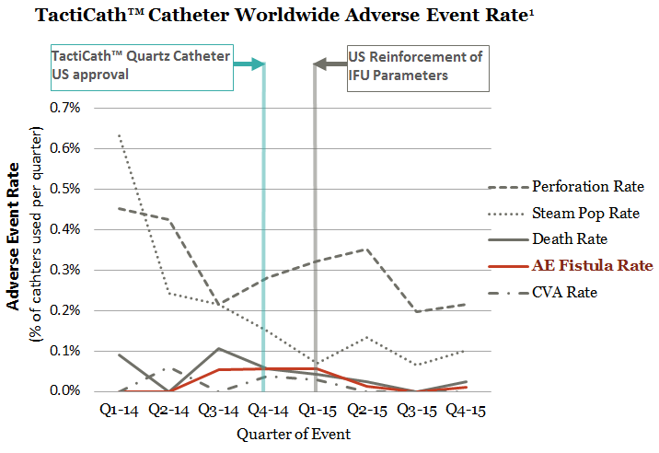
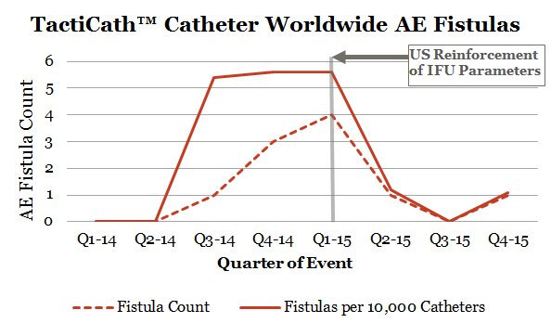
TactiCath™ Quartz contact force catheter safety¹
  Worldwide safety analysis showed excellent safety profile of TactiCath™ catheters
  Low rate of major complications (0.427%) including cardiac perforations (0.281%)
  AE Fistula rate ≤ 1 in 10,000 (0.01%) after US release and reinforcement of catheter operating parameters in 2015
    Incidence was 0.024% over full 2-year period
  Mansour M, et al. Heart Rhythm. 2017;14(11):1631–6.
Notes:
This paper reported real-world safety data showing very low incidence rates of atrioesophageal fistula (AEF) and other major complications for TactiCath™ Quartz contact force (CF) catheters – based on standard analysis of worldwide manufacturer’s (Abbott) data from over 40,000 catheter uses between 2014-2015 including all global adverse event reports (not limited to US MAUDE reports).
Reference:
1. Mansour M, Lakkireddy D, Packer D, et al. Safety of catheter ablation of atrial fibrillation using fiber optic-based contact force sensing. Heart Rhythm. 2017 Nov;14(11):1631–6.

Slide 69
Real-world Efficiency with TactiCath™ Quartz Catheters
Median RF and fluoroscopy times in the prospective, real-world ABLATOR cohort were 18 and 14 minutes shorter than in TOCCASTAR
ABLATOR Registry de novo PAF subgroup (N=473) vs. TOCCASTAR TactiCath™ catheter subgroup (N=152), respectively
Similar success and repeat ablation rates*:
  Clinically relevant freedom from AF/AFL/AT at 1 year (on or off AADs, Kaplan-Meier estimates): 76.9% vs. 78.3%
  Off-drug freedom from AF/AFL/AT at 1 year (Kaplan-Meier estimates): 71.6% vs. 68.0%
  Repeat ablations through 12m (after blanking period): 9.9% vs. 11.0%
  Procedure/device-related serious adverse event rate within 7 days: 3.2% vs. 7.2%
18 min. shorter total RF time
28.0 min
46.5 min
ABLATOR
TOCCASTAR
14 min. shorter fluoroscopy time
13.0min
27.0 min
ABLATOR
TOCCASTAR
*Based on retrospective analysis of prospective study data
Verma A, et al. Fiber optic contact force catheter efficiency and effectiveness in paroxysmal AF ablation from a large, multi-national, prospective registry (ABLATOR). Presentation at ESC Congress 2018, Munich, Germany. Abstract FP Nr 466.
Notes:
ABLATOR PAF data showed improved real-world efficiency with TactiCath™ Quartz catheters.¹
ABLATOR de novo PAF subgroup (N=473) median values vs. TOCCASTAR CF subgroup (N=152), respectively:
Acute Clinical Success: 97.5% vs. 100%
Procedure time: 150.0 min (not reported in TOCCASTAR)
RF time: 28.0 min vs. 46.5 min
Fluoroscopy time: 13.0 min vs. 27.0 min
Conclusions:
Median RF and fluoroscopy times in the ABLATOR cohort were 18 and 14 minutes shorter than the respective times reported in TOCCASTAR, with similar success and repeat ablation rates.
“Real-world prospective data confirm that de novo PAF ablation can be performed efficiently and effectively by a broad range of operators using the TactiCath Quartz CF ablation catheter”.
References:
1. Verma A, et al. Fiber optic contact force catheter efficiency and effectiveness in paroxysmal AF ablation from a large, multi-national, prospective registry (ABLATOR). European Heart Journal, 1 August 2018;39(Suppl 1):59. Presentation at ESC Congress 2018, 25 August 2018, Munich, Germany. Abstract FP Nr 466.

Slide 70
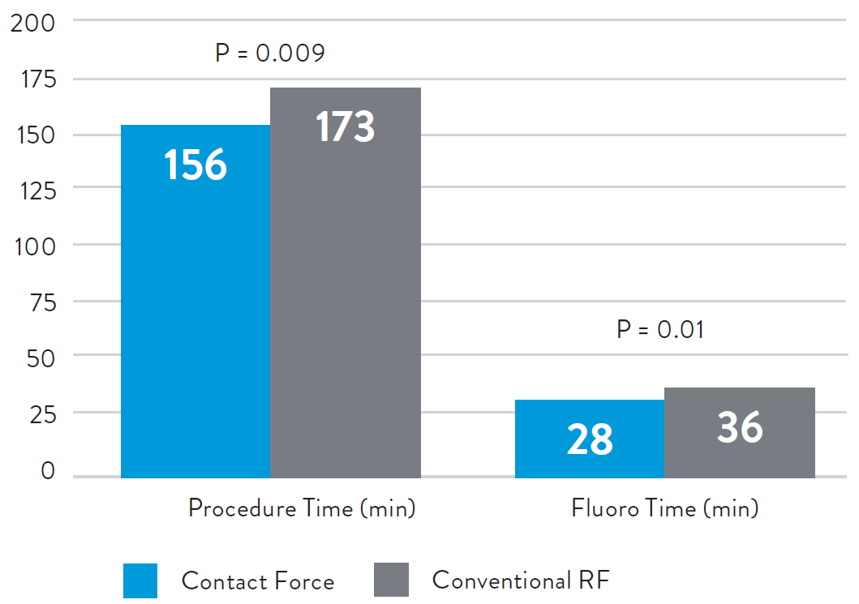
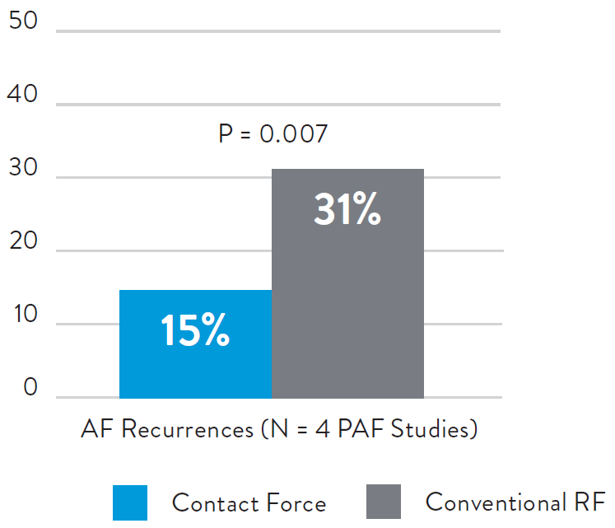
Shorter procedures and fewer recurrences with CF
Meta-analysis of contact force technology including, but not limited to, TactiCath™ catheter
An independent meta-analysis showed that AF ablation procedure and fluoroscopy times were significantly shorter for Contact Force (CF) procedures compared with conventional RF ablation.
AF recurrence rates were also lower for contact force, with similar complication rates.
CONTACT FORCE IMPACT ON AF ABLATION PROCEDURES AND RECURRENCES
$11,528
Shurrab, J Am Heart Assoc 2015;4(9) :e002476.
Notes:
An independent meta-analysis showed a 52% reduction in AF recurrences, from 31% with conventional ablation to 15% with contact force (Odds Ratio 0.38 [95% CI 0.19-0.76], p=0.007) based on 4 studies including only patients with paroxysmal AF.
Recurrence rates were also reduced significantly by 38% for CF ablation catheters (35.1% vs. 45.5% for non-CF catheters, Odds ratio 0.62 [95% CI 0.45–0.86], p=0.004) when the 10 paroxysmal and persistent AF studies that reported this endpoint were included (representing a total of 1378 patients, 527 CF and 851 conventional RF).¹
This meta-analysis also showed that contact force technology resulted in significant reductions in the following AF ablation procedural measures when compared with non-CF catheters:
Total procedure time (17-minute reduction, p=0.009, based on 7 studies including a total of 613 patients, 252 CF and 361 conventional RF)
Ablation time (4-minute reduction, p=0.007, based on 9 studies including a total of 1290 patients, 483 CF and 807 conventional RF)
Total fluoroscopic time (8-minute reduction, p=0.01, based on 8 studies including a total of 1235 patients, 463 CF and 772 conventional RF).
The rate of major complications (1.3% for CF vs. 1.9% for non-CF catheter ablations, p=0.45) and cardiac tamponade (1.2% for CF vs. 1.4% for non-CF catheter ablations, p=0.70) were not significantly different between the two technology groups in this meta-analysis.¹
Reference:
Shurrab M, Di Biase L, Briceno DF, et al. Impact of contact force technology on atrial fibrillation ablation: a meta-analysis. J Am Heart Assoc. 2015 Sep 21;4(9):e002476.

Slide 71
TactiCath™ Catheter, Sensor Enabled™ early European experience¹
  MAGNETIC SENSOR ENABLED CONTACT FORCE CATHETER PROCEDURAL DATA¹
    Paroxysmal atrial fibrillation (PAF, de novo) ablation was the most common indication for ablation across 38 European centers (63.0% of 208 total cases)
    Bidirectional catheters were utilized in 64.3% of cases (207/208 reporting)
    Steerable sheath was used in 73.1% of cases (197/208 reporting)
    In de novo PAF ablation, mean procedure and RF times were 144.9 ± 57.7 and 33.2 ± 15.6 minutes, respectively
1. JL Lloret, S James, S Trines, RA Dehnavi, JL Merino, D Raine, N Clappers, D Jones, A Pisapia, P Gora. Early European experience with a magnetic sensor enabled contact force-sensing catheter. Poster presentation at EHRA 2018, March 18, 2018, Barcelona, Spain. Abstract P367. EP Europace 1 Mar 2018;20(suppl 1):i63-64.
Notes:
TACTICATH™ CATHETER, SENSOR ENABLED™ EARLY EUROPEAN POPULATION¹
Procedural characteristics recorded from a total of 208 left or right atrial ablation procedures across 38 European centers during initial commercial use of new TactiCath™ contact force ablation catheter, Sensor Enabled™.¹
Paroxysmal atrial fibrillation (PAF, de novo) ablation was the most common indication for ablation (63.0% of 208 total cases).
Conclusions from TactiCath™ Catheter, Sensor Enabled™ early European experience poster:
Initial European experience with the new TactiCath™ catheter, Sensor Enabled™ included use for multiple left and right atrial ablation indications, including PAF
The majority of cases utilized a steerable sheath, and the bidirectional CF catheter was more commonly used than the unidirectional version
Procedure and RF times associated with de novo PAF ablation were in line with values previously reported for CF catheters
References:
JL Lloret, S James, S Trines, RA Dehnavi, JL Merino, D Raine, N Clappers, D Jones, A Pisapia, P Gora. Early European experience with a magnetic sensor enabled contact force-sensing catheter. Poster presentation at EHRA 2018, March 18, 2018, Barcelona, Spain. Abstract P367. EP Europace 1 Mar 2018;20(suppl 1):i63-64. Available at: https://doi.org/10.1093/europace/euy015.178. .

Slide 72
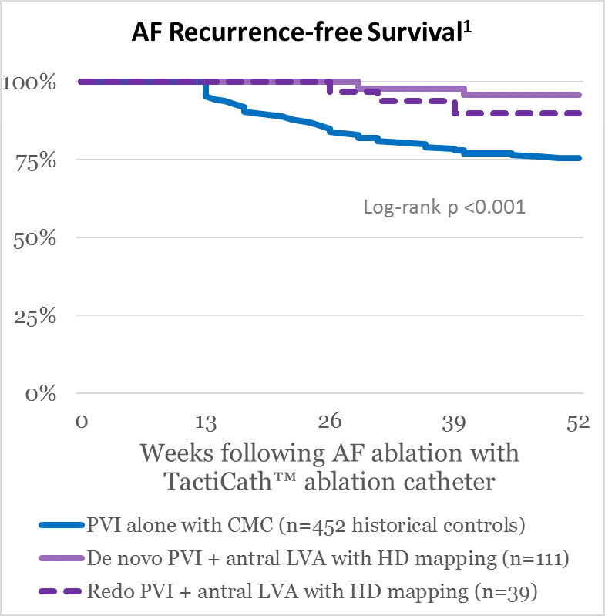
AF ablation using TactiCath™ catheter and HD mapping
Study showed improved freedom from AF following HD mapping and ablation of PVI plus low voltage signals (LVS) vs. PVI alone
Single center case control comparison study using TactiCath™ ablation catheter for AF ablation:
  150 patients underwent HD mapping-guided PVI plus LVS ablation
    Bidirectional PVI confirmed in 149; low-voltage activation mapping identified residual LVS (<0.5 mV) in PV antra for further ablation in 31 cases
    AF recurrence in 9.3% (n=14, after 298 ± 275 days)
  452 historical controls underwent circular mapping catheter-guided PVI alone
    Bidirectional PVI confirmed in all 452 cases
    AF recurrence in 26.1% (n=118, after 542 ± 884 days)
1. Segerson, et al. Heart Rhythm. 2018 Aug;15(8):1158-64.
Notes:
Single-center case control study compared 150 patients undergoing PVI plus ablation of concealed low voltage signals (LVS) versus a historical control group of 452 patients who underwent PVI ablation alone with TactiCath™ catheters guided by a circular mapping catheter. In the study group, concealed LVS were identified post-PVI using HD mapping (Rhythmia‡ HDx mapping system was used with an IntellaMap‡ Orion basket catheter for HD mapping in these cases). PVI was performed similarly with no differences between groups in ablation catheters; wide-area PV antral encirclement or pharmacologic testing and pacing maneuvers performed to confirm bidirectional block.
Mean follow-up was 298 ± 275 days in study group, and 542 ± 884 days in control group. Complications were not reported in this case series.
‡ Indicates a third-party trademark, which is property of its respective owner.
References:
1. Segerson NM, Lynch B, Mozes J, Marks MM, Noonan DK, Gordon D, Jais P, Daccarett M. High-density mapping and ablation of concealed low-voltage activity within pulmonary vein antra results in improved freedom from atrial fibrillation compared to pulmonary vein isolation alone. Heart Rhythm. 2018 Aug;15(8):1158-64. Epub 2018 May 3. Available at: https://doi.org/10.1016/j.hrthm.2018.04.035.

Slide 73
TactiCath™ catheter independent procedural data (1 of 2)
  Clinical procedural data summary from 12 independent studies including more than 400 patients undergoing ablation with the TactiCath catheter, and additional patients treated with other contact force sensing catheters or with non-CF ablation.
Lead Author, Year | Ablation procedures | Number of patients per ablation catheter type |  |  | Procedure / Ablation / Fluoroscopy Duration (min.) / [Fluoro Dose]
 |  | TactiCath cath. | Other CF | Non-CF cath. | TactiCath catheter | Other CF | Non-CF catheter
Casella, 2014¹ | PVI (100% PAF) | 20 | NA | 35 (RF) | Mean: NR / 34.5 / NR / [NR] | NA | Mean: NR / 51.0 / NR / [NR]
Wakili, 2014² | PVI (58% PAF) | 32 | NA | 35 (RF) | Mean: 78.1 (LA) / 30.8 / 33.0 / [NR] | NA | Mean: 95.5 (LA) / 31.7 / 51.4 / [NR]
Wutzler, 2014³ | PVI (73% PAF) | 31 | NA | 112 (RF) | Mean: 128.4 / NR / 39.7 / [NR] | NA | Mean: 157.7 / NR / 43.8 / [NR]
le Polain deWaroux, 2015⁴ | PVI (100% PAF) | 34 | NA | NA | NR / 66-77 (range) / NR [NR] | NA | NA
Matsuda, 2015⁵ | PVI (60% PAF) | 25 | NA | NA | Mean: 142 / 30.2 / NR [NR] | NA | NA
Providencia, 2015⁶ | AF (55.5% PAF) | 110 | 253 | 358 (RF) | NR | NR | NR / NR / (6-7 min longer than CF) / [NR]
Squara, 2015⁷ | PVI (100% PAF) | 39 | 159 | 178 (CB2) | Mean: 122.5 / NR / 19.3 / [4273 cGy·cm²] |  | Mean: 109.6 / NR / 17.6 / [4853 cGy·cm²]
Anter, 2016⁸ | PVI (100% AF) | 250 |  | 65 (RF) | NR |  | NR
Notes:
The 12 independent studies summarized in this table included more than 400 patients undergoing ablation with the TactiCath catheter, as well as additional patients treated with other contact force sensing catheters or with non-CF ablation.¹⁻¹²
AADs = anti-arrhythmic drugs; AF = atrial fibrillation; CB1 = first-generation cryoballoon; CB2 = second-generation cryoballoon; Conv/(RF) = conventional irrigated radiofrequency ablation catheters; CF = contact force; Flex = open-irrigated flexible tip ablation catheter; LA = left atrial NA = not applicable; NR = not reported; PAF = paroxysmal AF; PNP = phrenic nerve palsy; PVI = pulmonary vein isolation; SAE = serious adverse event.
References:
Casella M, Dello Russo A, Russo E, et al. Biomarkers of myocardial injury with different energy sources for atrial fibrillation catheter ablation. Cardiol J. 2014;21(5):516–23.
Wakili R, Clauss S, Schmidt V, et al. Impact of real-time contact force and impedance measurement in pulmonary vein isolation procedures for treatment of atrial fibrillation. Clin Res Cardiol. 2014;103(2):97–106.
Wutzler A, Huemer M, Parwani AS, Blaschke F, Haverkamp W, Boldt LH. Contact force mapping during catheter ablation for atrial fibrillation: procedural data and one-year follow-up. Arch Med Sci. 2014;10(2):266–72.
le Polain de Waroux JB, Weerasooriya R, Anvardeen K, et al. Low contact force and force-time integral predict early recovery and dormant conduction revealed by adenosine after pulmonary vein isolation. Europace. 2015;17(6):877–83.
Matsuda H, Parwani AS, Attanasio P, et al. Atrial rhythm influences catheter tissue contact during radiofrequency catheter ablation of atrial fibrillation: comparison of contact force between sinus rhythm and atrial fibrillation. Heart Vessels. 2015;31(9):1544–52.
Providencia R, Khoueiry Z, Bouzeman A, et al. Contact- force sensing using the smarttouch and tacticath catheter: Head-to-head comparison and benefit on catheter ablation of paroxysmal and persistent atrial fibrillation. Heart Rhythm. 2015;12(5 Suppl 1):S66. Abstract AB29-03.
Squara F, Zhao A, Marijon E, et al. Comparison between radiofrequency with contact force-sensing and second-generation cryoballoon for paroxysmal atrial fibrillation catheter ablation: a multicentre European evaluation. Europace. 2015;17(5):718–24.
Anter E, Di Biase L, Contreras-Valdes F, et al. The effect of contract force sensing catheters on long-term durability of pulmonary vein isolation: A multi-center experience [Abstract Poo4-97]. Heart Rhythm. 2016;13(5 Suppl 1):S377.

Slide 74
TactiCath™ catheter independent procedural data (2 of 2)
  Clinical procedural data summary from 12 independent studies including more than 400 patients undergoing ablation with the TactiCath catheter, and additional patients treated with other contact force sensing catheters or with non-CF ablation.
Lead Author, Year | Ablation procedures | Number of patients per ablation catheter type |  |  | Procedure / Ablation / Fluoroscopy Duration (min.) / [Fluoro Dose]
 |  | TactiCath cath. | Other CF | Non-CF cath. | TactiCath catheter | Other CF | Non-CF catheter
Deubner, 2016⁹ | PVI (18% PAF) | 37 | 59 | 50 Flex vs. 122 Conv (RF) | Median: 228 / NR / 24 / [NR] |  | Flex median: 210 / NR / 31 / [NR] Conv median: 258 / NR / 41 / [NR]
Khoueiry, 2016¹⁰ | PVI (100% PAF) | 63 | 159 | 154 (RF) vs. 311 (CB1/CB2) | Mean (CF/RF, n = 376): 114.2 / NR / 23.8 [NR] |  | Mean (CB1/CB2): 132.8 / NR / 26.1 / [NR]
Leo, 2016¹¹ | PVI (100% PAF) | 50 |  | 50 (CB2) | Mean: NR / NR / 15.4 / [NR] |  | Mean: NR / NR / 23.8 / [NR]
Mantovan, 2016¹² | PVI (100% PAF) | 47 | NA | 40 (RF) | Median: 179 / 31 / 20 / [NR] | NA | Median: 181 / 36 / 28 / [NR]
Notes:
The 12 independent studies summarized in this table included more than 400 patients undergoing ablation with the TactiCath catheter, as well as additional patients treated with other contact force sensing catheters or with non-CF ablation.¹⁻¹²
AADs = anti-arrhythmic drugs; AF = atrial fibrillation; CB1 = first-generation cryoballoon; CB2 = second-generation cryoballoon; Conv/(RF) = conventional irrigated radiofrequency ablation catheters; CF = contact force; Flex = open-irrigated flexible tip ablation catheter; LA = left atrial NA = not applicable; NR = not reported; PAF = paroxysmal AF; PNP = phrenic nerve palsy; PVI = pulmonary vein isolation; SAE = serious adverse event.
References:
Deubner N, Greiss H, Akkaya E, et al. Clinical experience with contact-force and flexible-tip ablation catheter designs. J Interv Card Electrophysiol. 2016;47(1):75–82.
Khoueiry Z, Albenque JP, Providencia R, et al. Outcomes after cryoablation vs. radiofrequency in patients with paroxysmal atrial fibrillation: impact of pulmonary veins anatomy. Europace. 2016;18(9):1343–51.
Leo M, Pedersen M, Kalla M, et al. Catheter ablation for paroxysmal atrial fibrillation ablation in the modern era: Comparison between current technologies [Abstract PO05-95]. Heart Rhythm. 2016;13(5 Suppl 1):S464–5.
Mantovan R, Sabbatani P, Garaffoni C, et al. Procedural usefulness of a contact force-sensing irrigated catheter for ablation of paroxysmal atrial fibrillation: A randomized, controlled study. Heart Rhythm. 2016;13(5 Suppl 1):S121.

Slide 75
TactiCath™ catheter independent outcomes data (1 of 2)
  Clinical outcomes summary from 12 independent studies including more than 400 patients undergoing ablation with the TactiCath catheter, and additional patients treated with other contact force sensing catheters or with non-CF ablation.
Lead Author, Year | Ablation procedures | Follow-up duration | Freedom from AF Recurrence, rate (no. of patients) |  |  | Complications
 |  |  | TactiCath Catheter | Other CF | Non-CF Catheter
Casella, 2014¹ | PVI (100% PAF) | 12 mos. | 85% (17/20) | NA | RF: 80% (28/35) | No major complications
Wakili, 2014² | PVI (58% PAF) | 12 mos. | PAF: 72.2% (13/18) Overall: 59.4 % (19/32) (off AADs) | NA | RF: PAF: 71.4% (15/21) PeAF: 50.0% (7/14) Overall: 62.9% (22/35) (off AADs) | No severe complications; Total: 6.3% CF vs 5.7% RF; Pericardial effusion: 3.1% CF vs 3.1% RF; Femoral AV fistula: 3.1% CF vs 3.1% RF
Wutzler, 2014³ | PVI (73% PAF) | 12 mos. | 83.9% (26/31) | NA | RF: 63.4% (71/112) | Major - Pericardial effusion: 0 CF vs 0.9% RF; Minor - Femoral hematoma: 3.2% CF vs 2.7% RF
le Polain deWaroux, 2015⁴ | PVI (100% PAF) | 60 min. | NR (n = 34) (35% no dormant conduction) | NA | NA | NR (only assessed dormant conduction based on applied CF and FTI™ values per PV segment 1 hour after successful PVI)
Matsuda, 2015⁵ | PVI (60% PAF) | Procedure only | NR (100%, 25/25 successful PVI) | NA | NA | NR (CF parameters only by anatomical location during AF and sinus rhythm)
Providencia, 2015 [abstract]⁶ | AF (55.5% PAF) | 12 mos. | PAF: 87.9% PeAF: 72.7% (n = 110) | PAF: 89.3% PeAF: 73.4% ( n= 253) | RF: PAF: 81.5% PeAF: 58.7% (n = 358) | NR (only assessed predictors of success; using CF catheters was an independent predictor of procedural success [HR=0.58, 95% CI 0.42-0.79)]
Squara, 2015⁷ | PVI (100% PAF) | 12 mos. | 81.3% (n = 198) |  | CB2: 80.9% (n = 178) | Total: 7.1% CF vs 7.3% CB2; Transient PNP: 0 CF vs 5.6% CB2; Embolism: 1% CF vs 0 CB2; Tamponade: 1% CF vs 0 CB2; Esophageal injury: 0.5% CF vs 0 CB2
Notes:
The 12 independent studies summarized in this table included more than 400 patients undergoing ablation with the TactiCath catheter, as well as additional patients treated with other contact force sensing catheters or with non-CF ablation.¹⁻¹²
Freedom from AF after ablation (following blanking period of 1-3 months in some studies) with or without the use of previous AADs except as noted. Mean values are provided for outcomes except as noted.
AADs = anti-arrhythmic drugs; AF = atrial fibrillation; CB1 = first-generation cryoballoon; CB2 = second-generation cryoballoon; Conv/(RF) = conventional irrigated radiofrequency ablation catheters; CF = contact force; Flex = open-irrigated flexible tip ablation catheter; LA = left atrial NA = not applicable; NR = not reported; PAF = paroxysmal AF; PNP = phrenic nerve palsy; PVI = pulmonary vein isolation; SAE = serious adverse event.
References:
Casella M, Dello Russo A, Russo E, et al. Biomarkers of myocardial injury with different energy sources for atrial fibrillation catheter ablation. Cardiol J. 2014;21(5):516–23.
Wakili R, Clauss S, Schmidt V, et al. Impact of real-time contact force and impedance measurement in pulmonary vein isolation procedures for treatment of atrial fibrillation. Clin Res Cardiol. 2014;103(2):97–106.
Wutzler A, Huemer M, Parwani AS, Blaschke F, Haverkamp W, Boldt LH. Contact force mapping during catheter ablation for atrial fibrillation: procedural data and one-year follow-up. Arch Med Sci. 2014;10(2):266–72.
le Polain de Waroux JB, Weerasooriya R, Anvardeen K, et al. Low contact force and force-time integral predict early recovery and dormant conduction revealed by adenosine after pulmonary vein isolation. Europace. 2015;17(6):877–83.
Matsuda H, Parwani AS, Attanasio P, et al. Atrial rhythm influences catheter tissue contact during radiofrequency catheter ablation of atrial fibrillation: comparison of contact force between sinus rhythm and atrial fibrillation. Heart Vessels. 2015;31(9):1544–52.
Providencia R, Khoueiry Z, Bouzeman A, et al. Contact- force sensing using the smarttouch and tacticath catheter: Head-to-head comparison and benefit on catheter ablation of paroxysmal and persistent atrial fibrillation. Heart Rhythm. 2015;12(5 Suppl 1):S66. Abstract AB29-03.
Squara F, Zhao A, Marijon E, et al. Comparison between radiofrequency with contact force-sensing and second-generation cryoballoon for paroxysmal atrial fibrillation catheter ablation: a multicentre European evaluation. Europace. 2015;17(5):718–24.

Slide 76
TactiCath™ catheter independent outcomes data (2 of 2)
  Clinical outcomes summary from 12 independent studies including more than 400 patients undergoing ablation with the TactiCath catheter, and additional patients treated with other contact force sensing catheters or with non-CF ablation.
Lead Author, Year | Ablation procedures | Follow-up duration | Freedom from AF Recurrence, rate (no. of patients) |  |  | Complications
 |  |  | TactiCath Catheter | Other CF | Non-CF Catheter
Anter, 2016 [abstract]⁸ | PVI (100% AF) | 12 mos. | ≥ 74% (185/250 no redos for recurrence) (80% of 65 no PV reconnection at redo) |  | RF: NR (50.8% of 65 no PV reconnection at redo) | Perforation: 1.5% (n = 1 each group)
Deubner, 2016⁹ | PVI (18% PAF) | 14 mos. | ~67% at 12m, ~62% at 24m (n = 96) (Kaplan-Meier estimates) |  | Flex: ~75% at 12m, ~72% at 24m (n = 50) Conv: ~47% at 12m, ~41% at 24m (n=122) | Cardiac tamponade: 1% CF vs 2% Flex vs. 0 Conv; Stroke: 0 CF vs. 2% Flex vs. 0 Conv; PNP: 0 CF vs. 0 Flex vs. 0.8% Conv; Sinus arrest 0 CF vs. 0 Flex vs. 0.8% Conv; No TIA, peri-procedural death or atrioesophageal fistula.
Khoueiry, 2016¹⁰ | PVI (100% PAF) | 14 mos. | CF (n = 222) pooled with RF (n=154): 85.9% (323/376) |  | CB1/CB2: 83.0% (258/311) | Procedural complications: 6.6% RF vs 6.4% CB; Pericarditis/tamponade: 1.6% RF vs 0.3% CB; Thromboembolic events: 0.3% RF vs 0.3% CB; Transient PNP: 0.3% RF vs 2.3% CB; Vascular/bleeding: 3.2% RF vs 2.3% CB; Other: 1.3% RF vs 1.3% CB
Leo, 2016 [abstract]¹¹ | PVI (100% PAF) | 9 mos. | 80% (40/50) |  | CB2: 76% (38/50) | Major complications: 4% CF vs 4% CB2; TIA: 2% CF vs 0 CB2; Vascular: 2% CF vs 0 CB2; Transient PNP: 0 CF vs. 4% CB2
Mantovan, 2016 [abstract]¹² | PVI (100% PAF) | 9 mos. (interim) | 89.3% (25/28) | NA | RF: 84.4% (27/32) | Total: 4.2% CF vs. 2.5% RF; Hematoma: 2.1% CF vs 0 RF; PV stenosis: 2.1% CF vs 0 RF; Pericardial effusion: 0 CF vs 2.5% RF
Notes:
The 12 independent studies summarized in this table included more than 400 patients undergoing ablation with the TactiCath catheter, as well as additional patients treated with other contact force sensing catheters or with non-CF ablation.¹⁻¹²
Freedom from AF after ablation (following blanking period of 1-3 months in some studies) with or without the use of previous AADs except as noted. Mean values are provided for outcomes except as noted.
AADs = anti-arrhythmic drugs; AF = atrial fibrillation; CB1 = first-generation cryoballoon; CB2 = second-generation cryoballoon; Conv/(RF) = conventional irrigated radiofrequency ablation catheters; CF = contact force; Flex = open-irrigated flexible tip ablation catheter; LA = left atrial NA = not applicable; NR = not reported; PAF = paroxysmal AF; PNP = phrenic nerve palsy; PVI = pulmonary vein isolation; SAE = serious adverse event.
References:
Anter E, Di Biase L, Contreras-Valdes F, et al. The effect of contract force sensing catheters on long-term durability of pulmonary vein isolation: A multi-center experience [Abstract Poo4-97]. Heart Rhythm. 2016;13(5 Suppl 1):S377.
Deubner N, Greiss H, Akkaya E, et al. Clinical experience with contact-force and flexible-tip ablation catheter designs. J Interv Card Electrophysiol. 2016;47(1):75–82.
Khoueiry Z, Albenque JP, Providencia R, et al. Outcomes after cryoablation vs. radiofrequency in patients with paroxysmal atrial fibrillation: impact of pulmonary veins anatomy. Europace. 2016;18(9):1343–51.
Leo M, Pedersen M, Kalla M, et al. Catheter ablation for paroxysmal atrial fibrillation ablation in the modern era: Comparison between current technologies [Abstract PO05-95]. Heart Rhythm. 2016;13(5 Suppl 1):S464–5.
Mantovan R, Sabbatani P, Garaffoni C, et al. Procedural usefulness of a contact force-sensing irrigated catheter for ablation of paroxysmal atrial fibrillation: A randomized, controlled study. Heart Rhythm. 2016;13(5 Suppl 1):S121.

Slide 77
Abbott
One St. Jude Medical Dr., St. Paul, MN 55117 USA
Tel: 1.651.756.2000
Abbott.com
™ Indicates a trademark of the Abbott group of companies.
‡ Indicates a third party trademark, which is property of its respective owner.
© 2019 Abbott. All Rights Reserved.

Slide 78
Technology Overview
Flexability™ ablation catheter

Slide 79
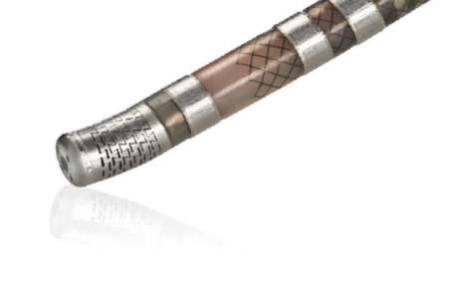

FlexAbility™ ablation catheter design
  Unique flexible tip: effective lesion formation with potentially fewer risks^{1, 3-4}
  A temperature-sensitive thermocouple, located 0.3 mm
  from the distal tip, serves as an important indicator for monitoring tip temperature⁴
  1 mm distal tip spacing optimizes signal quality⁵
  Shaft technology: designed for accuracy and consistent performance⁶
1. Peichl P, et al., Recent Patents on Cardiovascular Drug Discovery, 2013;8(1):10-6.
2. Abbott data on file. Report 90058001.
3. Abbott data on file. Report 90122753.
4. Winterfield JR, et al., J Cardiovasc Electrophysiol, 2016;27(1):102–9.
5. Abbott data on file. Report 90139188.
6. Abbott data on file. Report 90168493.
Notes:
The FlexAbility™ irrigated ablation catheter has a unique flexible tip for effective lesion formation with potentially fewer risks, provides excellent signal clarity, and optimal handling and comfort.^{1,3-5} It was designed with extensive physician input and comprised of three components: flex tip, redesigned shaft, and ergonomic handle.⁶
The flex tip employs a novel design element to account for differences in cardiac anatomy. The electrode design of the FlexAbility tip allows the ablation tip to flex and compress to the motion of the heart and better adapt to cardiac tissue anatomy. Irrigation is provided through dozens of slits that are uniformly spread throughout the electrode providing radial cooling, bathing the entire tip in saline. There are 4 distal ports at the tip to enhance cooling when the catheter is in a perpendicular orientation. The dovetail pattern creates preferential flow that directs the saline toward the tissue when the catheter is flexed.^{1–2} One millimeter distal tip spacing optimizes signal quality.⁵
The shaft is designed with a unique braiding structure at the distal end to increase pliability and with a robust pull wire structure for increased torque response along the proximal portion.⁶
The handle is available in either uni- or bi-directional form to allow for more options in catheter deflection ability.
References:
Peichl P, Kautzner J. Advances in irrigated tip catheter technology for treatment of cardiac arrhythmias. Recent Pat Cardiovasc Drug Discov. 2013;8(1):10-6.
Abbott data on file. Report 90058001.
Abbott data on file. Report 90122753.
Winterfield JR, Jensen J, Gilbert T, et al. Lesion size and safety comparison between the novel flex tip on the FlexAbility ablation catheter and the solid tips on the ThermoCool and ThermoCool SF ablation catheters. J Cardiovasc Electrophysiol. 2016;27(1):102–9.
Abbott data on file. Report 90139188.
Abbott data on file. Report 90115246.

Slide 80

FlexAbility™ ablation catheter tip design features
Unique, laser-cut tip for optimal irrigation flow profile and radial tip cooling^{1,3}
1 mm distal tip spacing optimizes signal quality⁴
Flexible tip to conform to tissue and reduce operator transmitted force into tissue^{1,2}
Four distal irrigation ports for cooling the distal portion of the tip
1. Peichl P, et al. Recent Pat Cardiovasc Drug Discov. 2013;8(1):10–6.
2. Abbott. Data on file. Report 90042968.
3. Abbott. Data on file. Report 90058001.
4. Abbott. Data on file. Report 90139188.
Notes:
The novel design of the FlexAbility catheter tip allows the ablation tip to flex and compress to the motion of the heart and better adapt to cardiac tissue anatomy.^{1,2} One millimeter distal tip spacing optimizes signal quality.⁴
Irrigation is provided through dozens of slits that are uniformly spread throughout the electrode providing radial cooling, bathing the entire tip in saline. There are 4 distal ports at the tip to enhance cooling when the catheter is in a perpendicular orientation. The dovetail pattern creates preferential flow that directs the saline toward the tissue when the catheter is flexed.^{1,3}
References:
Peichl P, Kautzner J. Advances in irrigated tip catheter technology for treatment of cardiac arrhythmias. Recent Pat Cardiovasc Drug Discov. 2013;8(1):10-6.
Abbott. Data on file. Report 90042968.
Abbott. Data on file. Report 90058001.
Abbott. Data on file. Report 90139188.

Slide 81

Need for reduced complications with ablation therapy
  Risk of complications during catheter ablation
  increases after electrode-tissue interface temperature
  reaches 100˚C¹
    Char and coagulum formation
    Steam pops
  Conventional irrigated tip designs can result in
  different cooling patterns from proximal to distal
  ends of the electrode and cause char formation¹
    One strategy to reducing the risk is to cool the electrode tip with saline
    New irrigation designs seek to improve delivery of saline and catheter tip cooling
1. Peichl P, et al. Recent Pat Cardiovasc Drug Discov. 2013;8(1):10–6.
Notes:
Catheter ablation of cardiac arrhythmias operates on the mechanism of passing RF current through the myocardium and consequently heating cardiac tissue. However, it is well known that when the catheter electrode-tissue interface reaches a temperature above 100 ˚C, the potential for complications such as char and coagulum formation or steam pop increases¹. One strategy to reduce the risk of these complications is to cool the tip of the electrode using saline delivered through a novel irrigation design. Active electrode tip cooling with saline irrigation during RF lesion creation allows the operator to increase power without concern for the surface temperature exceeding 100 ˚C and potential coagulum formation.¹
Conventional irrigated electrode tips designs can include a number of irrigation holes distributed in various configurations. However, these designs can result in different cooling patterns from the proximal to distal ends of the electrode and thus cause further char formation.¹
Reference:
Peichl P, Kautzner J. Advances in irrigated tip catheter technology for treatment of cardiac arrhythmias. Recent Pat Cardiovasc Drug Discov. 2013;8(1):10-6.

Slide 82

Flexible tip catheter directed flow
  FlexAbility™ ablation catheter directed flow and tip temperature provides effective lesions with potentially reduced procedural risk.^{1–4}
  The flexible tip provides directed flow to the tip to tissue interface where it is needed most.²
1. Peichl P, et al. Recent Pat Cardiovasc Drug Discov. 2013;8(1):10–6.
2. Abbott data on file. Report 90058001.
3. Abbott data on file. Report 90122753.
4. Winterfield JR, et al. J Cardiovasc Electrophysiol, 2016;27(1):102–9.
Notes:
Reference:
Peichl P, Kautzner J. Advances in irrigated tip catheter technology for treatment of cardiac arrhythmias. Recent Pat Cardiovasc Drug Discov. 2013;8(1):10-6.
Abbott data on file. Report 90058001.
Abbott data on file. Report 90122753.
Winterfield JR, Jensen J, Gilbert T, et al. Lesion size and safety comparison between the novel flex tip on the FlexAbility ablation catheter and the solid tips on the ThermoCool and ThermoCool SF ablation catheters. J Cardiovasc Electrophysiol. 2016;27(1):102–9.

Slide 83

Lesion Size and Safety in Canine Model¹
  The FlexAbility catheter’s unique design was shown to provide comparable lesions with significantly fewer steam pops in an in vivo canine model compared with ThermoCool‡ SF ablation catheters.
  This study also showed that lesion sizes were comparable between catheters.
Lesion Dimensions (Steam Pop Lesions Excluded)¹
1. Winterfield JR, et al. J Cardiovasc Electrophysiol, 2016;27(1):102–9.
‡ Indicates a third-party trademark, which is property of its respective owner
Notes:
The Winterfield, et al, canine study showed that lesion dimensions were comparable between the three catheters.
Reference:
Winterfield JR, Jensen J, Gilbert T, et al. Lesion size and safety comparison between the novel flex tip on the FlexAbility ablation catheter and the solid tips on the ThermoCool and ThermoCool SF ablation catheters. J Cardiovasc Electrophysiol. 2016 Jan;27(1):102–9.

Slide 84

FlexAbility™ ablation catheter flexible tip safety profile
The flexible tip demonstrated no instances of char in a 179 patient multicenter trial.¹
  THERMOCOUPLE LOCATION IN CATHETER TIPS²
The ThermoCool‡ SF catheter’s thermocouple is located 6.6 mm from the tip of the catheter, which may limit temperature response, inhibiting an indicator of a potential steam pop.^{2,3}
MAXIMUM TIP TEMPERATURE BY CATHETER TYPE (measured by RF ablation generator)
Set Power (W)
Atrium/Ventricle | Atrium | Ventricle | Atrium | Ventricle | Atrium | Ventricle
Catheter | FlexAbility™ catheter |  | TC 6-hole |  | TC SF
1. Abbott data on file. Report 90122753, based on Therapy™ Cool Flex™ ablation catheter tip.
2. Winterfield JR, et al. J Cardiovasc Electrophysiol, 2016;27(1):102–9.
3. Theis C, et al. J Cardiovasc Electrophysiol, 2015;26:956–62.
‡ Indicates a third-party trademark, which is property of its respective owner
Notes:
Data from the FLEXION-AFL study (ClinicalTrials.gov Identifier: NCT01185613), using the Therapy™ Cool Flex™ ablation catheter, provided clinical evidence supporting the approval of the FlexAbility™ catheter. In this study the tip showed no instances of charring.¹
In the Winterfield canine study, location of the thermocouple was examined for both the FlexAbility catheter and the ThermoCool™ SF catheter, as illustrated. Temperature feedback is potentially important in the prevention of steam pops. Variability in sensed temperature was seen with the FlexAbility catheter between chambers and with increasing power; but the ThermoCool SF catheter showed little variation.²
References:
Abbott data on file. Report 90122753, based on Therapy™ Cool Flex™ ablation catheter tip.
Winterfield JR, Jensen J, Gilbert T, et al. Lesion size and safety comparison between the novel flex tip on the FlexAbility ablation catheter and the solid tips on the ThermoCool and ThermoCool SF ablation catheters. J Cardiovasc Electrophysiol. 2016 Jan;27(1):102–9.
Theis C, Rostock T, Mollnau H, et al. The incidence of audible steam pops is increased and unpredictable with the Thermocool™ surround flow catheter during left atrial catheter ablation: a prospective observational study. J Cardiovasc Electrophysiol. 2015;26:956–62.

Slide 85

FlexAbility™ Ablation Catheter Low Risk of Steam Pops¹
IN AN IN VIVO CANINE STUDY FOCUSED ON COMPARING SAFETY AND LESION SIZES OF THE FLEXABILITY™ ABLATION CATHETER, THERMOCOOL‡ ABLATION CATHETER, AND THERMOCOOL SF‡ ABLATION CATHETER, THE FLEXABILITY CATHETER DEMONSTRATED THE LOWEST RATE OF STEAM POP.¹
  Generator was set on power control mode,
  RF was automatically shut down when
  temperature listed in the IFU was reached.
  Larger impedance drops were seen with the
  FlexAbility catheter for steam pop lesions
  compared to ThermoCool SF catheter
  FlexAbility ablation catheter demonstrated a lower risk a lower risk of steam pops relative to
  ThermoCool SF catheter despite equal mean
  power and RF time
  Steam pops occurred with Thermocool SF
  catheter in powers as low as 20 W.
IN VIVO CANINE STEAM POP TEST RESULTS¹
1. Winterfield JR, et al. J Cardiovasc Electrophysiol, 2016;27(1):102–9.
‡ Indicates a third-party trademark, which is property of its respective owner
Notes:
In this comparative in vivo canine study the rate of steam pops was lower with the FlexAbility™ ablation catheter than either of the Biosense Webster catheters tested.
Reference:
Winterfield JR, Jensen J, Gilbert T, et al. Lesion size and safety comparison between the novel flex tip on the FlexAbility ablation catheter and the solid tips on the ThermoCool and ThermoCool SF ablation catheters. J Cardiovasc Electrophysiol. 2016 Jan;27(1):102–9.

Slide 86

Flex tip flow is distributed where cooling is most needed
  Flow distribution analysis of irrigation exits from the ‘expanded’ side of flexed catheter tip where cooling is most needed and effective
Abbott. Data on file. Report 90058001.
Notes:
A flow distribution analysis was performed using software specifically developed to estimate the flow area and distribution of fluid output of the flex tip. The physical dimensions and mechanical properties of the flexible catheter tip were used to develop the simulation model for this analysis. The computation method used for this test generated the mesh for the purposes of the structural simulation, which was then applied to identify the flow surfaces of the Flex tip.
Results of the flow distribution analysis showed that up to 70% of flow exits from ‘expanded’ side of flexed catheter tip. This means that the design of the catheter tip accommodates the direction of the fluid flow in a flexed position toward the tip-to-tissue interface where cooling is most needed and most effective.
Reference:
Abbott. Data on File. Report 90058001.

Slide 87
Clinical Evidence
Flexible tip catheter

Slide 88
FLEXION-AFL
SAFETY AND EFFECTIVENESS WITH THERAPY™ COOL FLEX™ IRRIGATED ABLATION CATHETER
The FlexAbility™ ablation catheter was developed based on the Therapy™ Cool Flex™ ablation catheter. The clinical use of the FlexAbility™ ablation catheter is supported by the Abbott ablation clinical study using the Therapy™ Cool Flex™ ablation catheter.
Notes:
ClinicalTrials.gov Identifier:
NCT01185613
(results posted)
The following information describes a clinical study conducted for the Therapy™ Cool Flex™ Ablation Catheter. The FlexAbility™ Ablation Catheter was developed based on the Therapy™ Cool Flex™ Ablation Catheter. The clinical use of the FlexAbility™ Ablation Catheter is supported by the St. Jude Medical electrophysiologic mapping and ablation clinical study using the Therapy™ Cool Flex™ Ablation Catheter.
Reference: Abbott data on file. Report 90122753, based on Therapy™ Cool Flex™ ablation catheter tip.

Slide 89
FLEXION-AFL study design
Clinical Evaluation of Therapy™ Cool Flex™ Irrigated Ablation Catheter System for the Treatment of Typical Atrial Flutter
DESIGN | Prospective, non-randomized, multicenter study of the safety and effectiveness of the use of the Therapy Cool Flex cardiac ablation system for the treatment of typical atrial flutter (cavotricuspid isthmus-dependent) Designed to demonstrate that the use of the Therapy™ Cool Flex™ Cardiac Ablation System for the treatment of typical atrial flutter did not result in unacceptable risk of intra-procedural composite serious adverse events and did not affect efficacy of the ablation procedure Historical data from combined published atrial flutter studies (PMA P060019 Therapy™ Cool Path™ and PMA P110016 Therapy™ Cool Path™ Duo catheters) were used to determine performance goals for the study endpoints Sample size: 200 subjects enrolled at 24 sites (22 US, 2 Canada) Study duration: 3-month post-ablation follow-up
ENDPOINTS | Primary Safety was defined as the incidence of composite, serious adverse events (SAEs) within 7 days post-procedure, regardless of whether a determination could be made regarding device relatedness Primary Efficacy, or acute success ,was defined as the achievement of bi-directional block in the cavo-tricuspid isthmus and non-inducibility of typical atrial flutter at least 30 minutes following the last RF application with the system Secondary Efficacy, or chronic success, was defined as freedom from recurrence of typical atrial flutter three months post ablation Repeat ablations and new or increased dosage of existing anti-arrhythmic medication (Class Ia, Ic, or III) during the three month follow-up were considered chronic failures
SPONSOR | Abbott, St. Paul, MN
FLEXION-AFL clinical study.
Abbott data on file. Report 90122753, based on Therapy™ Cool Flex™ ablation catheter tip.
Notes:
Reference:
FLEXION-AFL clinical study, based on Therapy™ Cool Flex™ ablation catheter tip (NCT01185613). FlexAbility™ Ablation Catheter Instructions for Use, ARTEN100097717 E (2014-12). Abbott. Data on File. Report 90122753, based on Therapy™ Cool Flex™ ablation catheter tip.

Slide 90
FLEXION-AFL study population and procedures
A total of 179 subjects were treated in the FLEXION-AFL study
  The most commonly reported cardiac history
  for subjects treated were hypertension (61%), atrial fibrillation (46%) and coronary artery disease (28%)
Ablation procedure parameters were collected during a total of 2,220 RF applications delivered in 179 subjects
  There were 11 incidences of steam pop
  reported in 9 (5.0%) subjects
  There was no incidence of charring or
  coagulum formation in the study
Subject Disposition and Characteristics | Therapy™ Cool Flex™ Ablation Catheter
Subjects enrolled (consented) | N = 200
Subjects withdrawn prior to device introduction | N = 21
Subjects treated | N = 179
Male | 143 (79.9%)
Age (mean) | 66.3 years
Weight (mean) | 211.6 pounds
Procedural Parameters (mean)
Procedure Time per Patient | 98.73 minutes
RF Applications per Procedure (number) | 12.40
RF Time per Application | 85.98 seconds
RF Time per Procedure | 17.71 minutes
Power per Application | 31.78 Watts
Impedance per Application | 93.64 Ohms
Temperature per Application | 28.35˚ C
FLEXION-AFL clinical study.
Abbott data on file. Report 90122753, based on Therapy™ Cool Flex™ ablation catheter tip.
Notes:
FLEXION-AFL was a prospective, non-randomized, multi-center trial designed to demonstrate the safety and efficacy of the Therapy™ Cool Flex™ irrigated ablation catheter system during typical atrial flutter ablation. The primary safety endpoint was defined as the incidence of composite, serious adverse events (SAEs) within 7 days post-procedure, while the primary efficacy endpoint was defined as the achievement of bi-directional block in the cavo-tricuspid isthmus and non-inducibility of typical atrial flutter at least 30 minutes following the last RF application with the Therapy Cool Flex system. A secondary efficacy endpoint of chronic success was defined as freedom from recurrence of typical atrial flutter three months post-ablation.
A total of 179 subjects were treated. There was no incidence of charring or coagulum formation in the study¹.
Reference:
FLEXION-AFL clinical study, based on Therapy™ Cool Flex™ ablation catheter tip (NCT01185613). FlexAbility™ Ablation Catheter Instructions for Use, ARTEN100097717 E (2014-12). Abbott data on file. Report 90122753, based on Therapy™ Cool Flex™ ablation catheter tip.

Slide 91
FLEXION-AFL met primary safety and effectiveness endpoints
  All performance goals were met in prospective, non-randomized trial to demonstrate the safety and effectiveness of the Therapy™ Cool Flex™ ablation catheter flex tip technology in typical atrial flutter (n = 179).
ENDPOINT MEASURES | PRE-DEFINED PERFORMANCE GOAL | STUDY RESULT (95% CONFIDENCE LIMIT)
Primary safety (major complication rate of composite serious adverse events within 7 days) | 14% | 2.79% (5/179) [5.78%]
Primary effectiveness (acute procedural success rate) | 88% | 98.88 (177/179) [96.52%]
Secondary effectiveness (chronic procedural success rate at 3 months) | 72% | 85.47% (150/175) [81.10%]
FLEXION-AFL clinical study.
Abbott data on file. Report 90122753, based on Therapy™ Cool Flex™ ablation catheter tip.
Notes:
FLEXION-AFL met its primary safety and effectiveness endpoints. A total of 179 subjects were treated. The pre-defined parameters for each endpoint were met, as shown in the table above. Thus, this pivotal study demonstrated safety and efficacy of the Flex Tip technology during typical atrial flutter ablation. In addition, there was no incidence of charring or coagulum formation in the study.¹
Reference:
FLEXION-AFL clinical study, based on Therapy™ Cool Flex™ ablation catheter tip (NCT01185613). FlexAbility™ Ablation Catheter Instructions for Use, ARTEN100097717 E (2014-12). Abbott data on file. Report 90122753, based on Therapy™ Cool Flex™ ablation catheter tip.

Slide 92
Additional Clinical Data
Independent Clinical Evidence Supporting the FlexAbility™ Ablation Catheter

Slide 93
Flexible tip effectiveness in atrial flutter ablation
  In a single-center study, consecutive patients with typical atrial flutter undergoing CTI ablation were prospectively randomized to compare short-term procedural outcomes between two catheter types:
    4 mm tip fully irrigated Cool Flex™ ablation catheter
    3.5 mm tip ablation catheter with six distal irrigation channels (Conv)
  All procedures were successful, with no significant differences between catheter types
Typical Atrial Flutter Procedure Outcomes | Cool Flex™ Catheter (n = 30) | Conv Catheter (n = 30) | P-value
Procedure duration (min) | 47 ± 25 | 47 ± 24 | 0.865
RF duration (sec) | 720 ± 488 | 690 ± 512 | 0.787
Fluoroscopy duration (min) | 5 | 7 | 0.128
Total Irrigation (mL) | 147 ± 93 | 176 ± 136 | 0.484
Power (W) | 35 | 35 | ---
Bidirectional block across CTI, n (% of patients) | 30 (100%) | 30 (100%) | ---
Steam pop, n | 3 | 2 | 0.493
Char or coagulum on catheter, n | 0 | 0 | ---
Peri-procedural complications or sequelae | 0 | 0 | ---
Ramoul K, et al. Europace 2015;17(2):295–9.
Notes:
Reference:
Ramoul K, Wright M, Sohal M, et al. Does diffuse irrigation result in improved radiofrequency catheter ablation? A prospective randomized study of right atrial typical flutter ablation. Europace. 2015;17(2):295–9.

Slide 94
Higher Acute CTI Ablation Success Rate with FlexAbility™ Catheter
  Single-center study compared procedural outcomes in a total of 100 consecutive patients undergoing CTI ablation with three different irrigated tip catheters
  Successful CTI block rate and other procedural parameters were significantly different between catheters
CTI Ablation Procedural Performance Parameters | FlexAbility™ Catheter (Flex, n = 32) | ThermoCool‡ SurroundFlow Catheter (SF, n = 34) | ThermoCool‡ SmartTouch SF Catheter (STSF, n = 34) | P-value
Total Procedure time (min) | 16.5 (10–21) | 20.5 (14–34.8) | 20 (12.8–35.5) | 0.036
Total RF duration (min) | 6 (5.1–10.6) | 10.2 (7.8–14.2) | 8.7 (6.1–12.6) | 0.005
Fluoroscopy duration (min) | 5.5 (3.3–9.8) | 6.5 (3.8–9) | 4.5 (2–8) | 0.32
Average temperature (°C) | 34.9 (33.7–36.1) | 32 (31–33.2) | 33( 31.1–34.1) | <0.001
Average power (W) | 28.6 (27.6–30.6) | 30.4 (29.2–31.7) | 30.8 (29.5–34.5) | <0.001
Audible steam pop, n | 0 | 0 | 1 | 0.33
CTI block with irrigated catheter, n (% of patients) | 32 (100%) | 30 (88%) | 27 (79%) | 0.006
Crossover to 8 mm tip, n (%) | 0 | 4 (12%) | 7 (21%) | 0.006
‡ Indicates a third-party trademark, which is property of its respective owner.
Hamaya R, et al. J Cardiol 2018 May;71(5):513-16.
Notes:
This non-randomized study published in 2018 reported significantly higher success rates in achieving cavo-tricuspid isthmus (CTI) block using FlexAbility™ ablation catheters when compared with ThermoCool‡ SurroundFlow (SF) and ThermoCool‡ SmartTouch‡ SF (STSF) catheters, as well as significantly fewer RF applications, shorter total RF time to achieve block, and lower average power. The maximum tip temperature setting was reached in 15/295 (5.1%) flex catheter applications among 11 patients (34.3%), and in 0/521 (0%) ST applications, and 0/448 (0%) STSF applications.
Performance between the three irrigated catheters was compared across 100 consecutive patients undergoing CTI ablation at a single hospital in Japan, with the ablation catheter selected by the operator. When CTI block could not be created by the initial irrigated catheter, additional RF applications were applied using an 8-mm tip catheter until block was achieved.
‡ Indicates a third-party trademark, which is property of its respective owner.
Reference:
Hamaya R, Miyazaki S, Kajiyama T, Watanabe T, Kusa S, Nakamura H, Hachiya H, Iesaka Y. Efficacy and safety comparison between different types of novel design enhanced open-irrigated ablation catheters in creating cavo-tricuspid isthmus block. J Cardiol. 2018 May;71(5):513-516. doi: 10.1016/j.jjcc.2017.10.015.

Slide 95
Cool Flex™/FlexAbility™ catheter published clinical data
Devices are CE marked and are not indicated or available for commercial use in all countries.
  Summary outcomes from 3 clinical publications including 63 patients undergoing ablation with the FlexAbility™ or Therapy™ Cool Flex™ ablation catheter (Flex).
Author, Year | Ablation Procedures | Procedure / RF/ Fluoro Duration (minutes) | Clinical Success Reported by Ablation Catheter Type (n/N = number of patients per catheter type) |  |  | Follow-up Duration | Complications
 |  |  | FlexAbility | Cool Flex | Other
Pappone, 2010² | SVTs: AFL (N=3) | NR / ~40m for AFL case / NR | NA | 100% successful ablation of anatomical targets (N=3) | NA | Up to 6 months | No complications, no steam pops, no charring in the three representative right atrial/CTI ablation procedures described
Ramoul, 2015¹ | Typical AFL (N = 60) | Cool Flex: 47m / 12m / 5m Conv: 47m / 11.5m / 7m | NA | 100% Bidirectional block across CTI (30/30) | Conv: 100% Bidirectional block across CTI (30/30) | Procedure | Steam pops: 10% (3/30) Flex vs 7% (2/30) Conv – no sequelae; no peri-procedural complications; no char or coagulum on catheter
Hamaya, 2018³ | CTI ablation (AFL) (N = 100) | Flex: 16.5m / 6m / 5.5m Conv: 20.5m / 10.2m / 6.5m CF: 20m / 8.7m / 4.5m | 100% CTI block (N = 32) | NA | Conv: 88% CTI block (N = 34) CF: 79% CTI block (N = 34) | Procedure | Audible steam pop: 0 Flex, 0 Conv, 1 with contact force (CF) catheter; no other complications reported
1. Pappone C, et al. European Cardiol. 2010;6(3):66–70.
2. Ramoul K, et al. Europace. 2015;17(2):295–9.
3. Hamaya R, et al. J Cardiol 2018 May;71(5):513-16.
Notes:
The clinical publications summarized in this table include patients who underwent ablation with the FlexAbility™ Ablation catheter or the Cool Flex™ ablation catheter.¹⁻³
Mean values are provided for outcomes except as noted.
AFL = atrial flutter;; Conv = conventional irrigated ablation catheters; CTI = cavotricuspid isthmus; NA = not applicable; NR = not reported; CF = irrigated contact force RF ablation catheter.
References:
Pappone C, Gianelli L, Santinelli V. Clinical experience with a novel, irrigated, flexible tip ablation catheter to optimise therapy delivery. European Cardiol. 2010;6(3):66–70.
Ramoul K, Wright M, Sohal M, et al. Does diffuse irrigation result in improved radiofrequency catheter ablation? A prospective randomized study of right atrial typical flutter ablation. Europace. 2015;17(2):295–9.
Hamaya R, Miyazaki S, Kajiyama T, Watanabe T, Kusa S, Nakamura H, Hachiya H, Iesaka Y. Efficacy and safety comparison between different types of novel design enhanced open-irrigated ablation catheters in creating cavo-tricuspid isthmus block. J Cardiol. 2018 May;71(5):513-516.
*Indication: The FlexAbility™ Ablation Catheter is intended for use with the compatible irrigation pump and a compatible RF cardiac ablation generator. The catheter is intended for creating endocardial lesions during cardiac ablation procedures (mapping, stimulation, and ablation) for the treatment of typical atrial flutter.

Slide 96
Abbott
One St. Jude Medical Dr., St. Paul, MN 55117 USA
Tel: 1.651.756.2000
Abbott.com
™ Indicates a trademark of the Abbott group of companies.
‡ Indicates a third party trademark, which is property of its respective owner.
© 2019 Abbott. All Rights Reserved.

Slide 97
Clinical Evidence
Af ablation guided by
Agilis™ NXT Steerable Sheath technology

Slide 98


Agilis™ NxT steerable introducer
Used by physicians in more than 600,000 procedures, the Agilis™ NxT introducer
is the introducer of choice for a growing number of physicians.¹
Key Benefits
  Rely on consistent support for your catheter from standard to complex
  procedures with a proprietary shaft designed to provide a unique
  combination of torquability, pushability and kink resistance.
  Steer confidently in hard-to-reach areas where you need it
  most with enhanced mobility using the Dual-Reach™
  bi-directional deflection.
  Achieve precise and stable positioning with minute tip
  movements and auto-lock to support your ablation catheter
  during challenging procedures.
  Keep effective hemostasis for your guidewire and catheter
  from start to finish with the proven Ultimum™ valve.
1. Abbott. Data on file, 90119641.

Slide 99
TOCCASTAR: Impact of deflectable sheath use
Protocol-defined exploratory analysis compared treatment success for procedures with either catheter using the Agilis™ NxT steerable sheath vs. a fixed sheath
Within the TactiCath™ catheter group, median CF
was higher using the Agilis™ NxT steerable sheath vs. treatment with a fixed sheath
PRIMARY EFFECTIVENESS BY SHEATH USAGE
(ALL TOCCASTAR SUBJECTS)¹
AVERAGE CF BY SHEATH USAGE
(TACTICATH™ CATHETER GROUP*)^{1,2}
Agilis™ NxT Sheath
74.0%
Agilis™ NxT
Fixed
Agilis™ NxT Sheath
*CF data unavailable on one patient
1. Mansour M, et al. AF Summit, HRS, 2014.
2. Cuoco F, et al. Heart Rhythm, 2014;11(5 Suppl 1):S518.
Notes:
In addition, protocol-specified descriptive endpoint analyses of TOCCASTAR data were performed post hoc comparing contact force and treatment success between use of a deflectable Agilis™ sheath vs. a fixed sheath.^{1,2}
When considering all enrolled subjects treated with either the TactiCath™ catheter or the non-CF control catheter, patients in whom the Agilis sheath was used had a protocol-defined treatment success rate of 74.0% vs. 62.7% for those treated with a fixed sheath.¹
Within the TactiCath catheter contact force group only, cases that used Agilis sheath had higher average contact force, than cases that used a fixed sheath (median 23.4 grams vs. 14.6 grams, respectively.²
References:
Mansour, M. ToccaStar data as presented during “Force Sensing Ablation Catheters: Have our Hopes Been Realized” at the 2014 AF Summit at HRS, San Francisco, CA.
Cuoco F, Michaud GF, Shah DC, et al. Steerable sheath promotes improved contact force parameters during pulmonary vein isolation [Abstract PO06-61]. Heart Rhythm, 2014;11(5 Suppl 1):S518.

Slide 100
Improved AF ablation success with steerable sheath
  Significantly higher single-procedure success achieved using the Agilis™ NxT steerable sheath technology to guide AF ablation catheters in a prospective, randomized study versus a fixed sheath
  Fluoroscopy time reduced by a mean of 12 minutes in group using the steerable sheath (p<0.001)
  No significant differences between groups
  in complication rate, mean procedure time or RF application time
  Standard irrigated non-contact force RF ablation catheters (Therapy™ Cool Path™ and NaviStar‡ ThermoCool‡ catheters) were used in this study.
SINGLE-PROCEDURE SUCCESS BY SHEATH USAGE
(Freedom from AF and atrial macroreentrant tachycardia)¹
1. Piorkowski C, et al. Circ Arrhythm Electrophysiol, 2011;4(2):157–65.
‡ Indicates a third-party trademark, which is property of its respective owner
Notes:
This prospective study randomized 130 patients with AF undergoing first ablation procedures to catheter ablation supported by a steerable sheath vs. a nonsteerable sheath. Type of sheath was the only statistically significant predictor for freedom from AF and/or atrial macroreentrant tachycardia after 6 months as shown in multivariate analysis.
Fluoroscopy time was lower in the steerable sheath group (33±14 minutes) when compared with the nonsteerable group (45±17 minutes, P<0.001). No significant differences between groups were found in other parameters, including complication rate, mean procedure time and RF application time.
The Biosense Webster NaviStar™ ThermoCool™ catheter and St. Jude Medical Therapy™ Cool Path™ catheter were used for ablation procedures in this study.¹ (Study supported by a research grant from St. Jude Medical.)
Reference:
1. Piorkowski C, Eitel C, Rolf S, et al. Steerable versus nonsteerable sheath technology in atrial fibrillation ablation: a prospective, randomized study. Circ Arrhythm Electrophysiol. 2011;4(2):157–65.

Slide 101
Abbott
One St. Jude Medical Dr., St. Paul, MN 55117 USA
Tel: 1.651.756.2000
Abbott.com
™ Indicates a trademark of the Abbott group of companies.
‡ Indicates a third party trademark, which is property of its respective owner.
© 2019 Abbott. All Rights Reserved.

Slide 102
References

Slide 103
References (listed alphabetically)
Anter E, Di Biase L, Contreras-Valdes F, et al. The effect of contract force sensing catheters on long-term durability of pulmonary vein isolation: A multi-center experience [Abstract Poo4-97]. Heart Rhythm. 2016;13(5 Suppl 1):S377.
Bourier F, Deisenofer I, Hessling G, et al. Contact-force sensing electrophysiological catheters: How accurate is the technology? [Abstract PO03-170]. Presented at HRS 2016, San Francisco, CA. Heart Rhythm. 2016;13(5 Suppl 1):S318-S319.
Bourier F, Gianni C, Dare M, et al. Fiberoptic contact-force sensing electrophysiological catheters: how precise is the technology? J Cardiovasc Electrophysiol. 2017 Jan;28(1):109–114.
Bourier F, Hessling G, Ammar-Busch S, et al. Electromagnetic contact-force sensing electrophysiological catheters: how accurate is the technology? J Cardiovasc Electrophysiol. 2016;27(3):347–50.
Bourier F, Schwarz B, Brkic A, et al. EP radiofrequency generators: Significant offsets between selected and delivered power? J Cardiovasc Electrophysiol. 2018 Feb;29(2):330-334.
Casella M, Dello Russo A, Russo E, et al. Biomarkers of myocardial injury with different energy sources for atrial fibrillation catheter ablation. Cardiol J. 2014;21(5):516–23.
Cheng X, Hu Q, Zhou C, et al. The long-term efficacy of cryoballoon vs irrigated radiofrequency ablation for the treatment of atrial fibrillation: A meta-analysis. Int J Cardiol. 2015;181:297–302.
Chugh SS, Havmoeller R, Narayanan K, et al. Worldwide epidemiology of atrial fibrillation: a global burden of disease 2010 study. Circulation. 2014;129(8):837–47.
Cuoco F, Michaud GF, Shah DC, et al. Steerable sheath promotes improved contact force parameters during pulmonary vein isolation [Abstract PO06-61]. Heart Rhythm, 2014;11(5 Suppl 1):S518.
Hamaya R, Miyazaki S, Kajiyama T, et al. Efficacy and safety comparison between different types of novel design enhanced open-irrigated ablation catheters in creating cavo-tricuspid isthmus block. J Cardiol. 2018 May;71(5):513-516.
Hunter TD, Palli SR, Rizzo JA. Cost comparison of radiofrequency catheter ablation versus cryoablation for atrial fibrillation in hospitals using both technologies. J Med Econ. 2016 Oct;19(10):959–64
Ikeda A, Nakagawa H, Lambert H, et al. Relationship between catheter contact force and radiofrequency lesion size and incidence of steam pop in the beating canine heart: electrode amplitude, impedance and electrode temperature are poor predictors of electrode-tissue contact force and lesion size. Circ Arrhythm Electrophysiol. 2014;7(6):1174–80.
Kautzner J, Neuzil P, Lambert H, et al. EFFICAS II: optimization of catheter contact force improves outcome of pulmonary vein isolation for paroxysmal atrial fibrillation. Europace. 2015;17(8):1229–35.
Khoueiry Z, Albenque JP, Providencia R, et al. Outcomes after cryoablation vs. radiofrequency in patients with paroxysmal atrial fibrillation: impact of pulmonary veins anatomy. Europace. 2016;18(9):1343–51.
Kim MH, Johnston SS, ChuBC, et al. Estimation of total incremental health care costs in patients with atrial fibrillation in the United States. Circ Cardiovasc Qual Outcomes. 2011;4:313–320.
Kuck KH, Reddy VY, Schmidt B, et al. A novel radiofrequency ablation catheter using contact force sensing: TOCCATA study. Heart Rhythm. 2012;9(1):18–23.
Lee WC, Lamas GA, Balu S, et al. Direct treatment cost of atrial fibrillation in the elderly american population: A Medicare perspective. J Med Econ. 2008;11:281–298.
Leo M, Pedersen M, Kalla M, et al. Catheter ablation for paroxysmal atrial fibrillation ablation in the modern era: Comparison between current technologies [Abstract PO05-95]. Presented at HRS 2016, San Francisco, CA. Heart Rhythm. 2016;13(5 Suppl 1):S464–5.

Slide 104
References (listed alphabetically)
le Polain de Waroux JB, Weerasooriya R, Anvardeen K, et al. Low contact force and force-time integral predict early recovery and dormant conduction revealed by adenosine after pulmonary vein isolation. Europace. 2015;17(6):877–83.
JL Lloret, S James, S Trines, et al. Early European experience with a magnetic sensor enabled contact force-sensing catheter. Poster presentation at EHRA 2018, March 18, 2018, Barcelona, Spain. Abstract P367. EP Europace 1 Mar 2018;20(suppl 1):i63-64.
Mansour, M. ToccaStar data as presented during “Force Sensing Ablation Catheters: Have our Hopes Been Realized” at the 2014 AF Summit at HRS, San Francisco, CA.
Mansour M, Karst E, Heist EK, et al. The impact of first procedure success rate on the economics of atrial fibrillation ablation. JACC Clin Electrophysiol. 2017 Feb;3(2):129-138.
Mansour M, Lakkireddy D, Packer D, et al. Safety of catheter ablation of atrial fibrillation using fiber optic-based contact force sensing. Heart Rhythm. 2017;14(11):1631–6.
Mansour M, Reddy VY, Karst E, et al. Contact force sensing on AF ablation catheter: A health-economic analysis [Abstract PO02-155]. Heart Rhythm, 2016;13(5 Suppl 1):S227.
Mantovan R, Sabbatani P, Garaffoni C, et al. Procedural usefulness of a contact force-sensing irrigated catheter for ablation of paroxysmal atrial fibrillation: A randomized, controlled study. Heart Rhythm. 2016;13(5 Suppl 1):S121.
Matsuda H, Parwani AS, Attanasio P, et al. Atrial rhythm influences catheter tissue contact during radiofrequency catheter ablation of atrial fibrillation: comparison of contact force between sinus rhythm and atrial fibrillation. Heart Vessels. 2015;31(9):1544–52.
Neuzil P, Reddy VY, Kautzner J, et al. Electrical reconnection after pulmonary vein isolation is contingent on contact force during initial treatment: results from the EFFICAS I study. Circ Arrhythm Electrophysiol. 2013 Apr;6(2):327–33.
O Olusesi, I Woollett, V Iyer, J Grammes, P Lorvidhaya, J Wilson. Quantifying Lateral And Axial Force Contribution To Total Contact Force During Cardiac Radiofrequency Ablation. Poster presentation at HRS 2018, May 10, 2018, Boston, MA, USA. Abstract B-PO02-127.
Pappone C, Gianelli L, Santinelli V. Clinical experience with a novel, irrigated, flexible tip ablation catheter to optimise therapy delivery. European Cardiol. 2010;6(3):66–70.
Peichl P, Kautzner J. Advances in irrigated tip catheter technology for treatment of cardiac arrhythmias. Recent Pat Cardiovasc Drug Discov. 2013;8(1):10-6.
Piorkowski C, Eitel C, Rolf S, et al. Steerable versus nonsteerable sheath technology in atrial fibrillation ablation: a prospective, randomized study. Circ Arrhythm Electrophysiol. 2011;4(2):157–65.
Providencia R, Khoueiry Z, Bouzeman A, et al. Contact- force sensing using the smarttouch and tacticath catheter: Head-to-head comparison and benefit on catheter ablation of paroxysmal and persistent atrial fibrillation. Heart Rhythm. 2015;12(5 Suppl 1):S66. Abstract AB29-03.
Ramoul K, Wright M, Sohal M, et al. Does diffuse irrigation result in improved radiofrequency catheter ablation? A prospective randomized study of right atrial typical flutter ablation. Europace. 2015;17(2):295–9.
Reddy VY, Dukkipati SR, Neuzil P, et al. Randomized, controlled trial of the safety and effectiveness of a contact force-sensing irrigated catheter for ablation of paroxysmal atrial fibrillation: Results of the TOCCASTAR study. Circulation. 2015 Sep 8;132(10):907–15.
Reddy VY, Shah D, Kautzner J, et al. The relationship between contact force and clinical outcome during radiofrequency catheter ablation of atrial fibrillation in the TOCCATA study. Heart Rhythm. 2012;9(11):1789–95.

Slide 105
References (listed alphabetically)
Ren JF, Callans DJ, Schwartzman D, et al. Changes in local wall thickness correlate with pathologic lesion size following radiofrequency catheter ablation: an intracardiac echocardiographic imaging study. Echocardiography. 2001;18(6):503–7.
Segerson NM, Lynch B, Mozes J, et al. High-density mapping and ablation of concealed low-voltage activity within pulmonary vein antra results in improved freedom from atrial fibrillation compared to pulmonary vein isolation alone. Heart Rhythm. 2018 Aug;15(8):1158-64.
Shurrab M, Di Biase L, Briceno DF, et al. Impact of contact force technology on atrial fibrillation ablation: a meta-analysis. J Am Heart Assoc. 2015 Sep 21;4(9):e002476.
Squara F, Zhao A, Marijon E, et al. Comparison between radiofrequency with contact force-sensing and second-generation cryoballoon for paroxysmal atrial fibrillation catheter ablation: a multicentre European evaluation. Europace. 2015;17(5):718–24.
Stewart S, Murphy NF, Walker A, et al. Cost of an emerging epidemic: An economic analysis of atrial fibrillation in the UK. Heart. 2004;90(3):286–292.
TactiSense IDE study. TactiCath SE IFU #ARTEN600049107 A, Dec 2018.
Theis C, Rostock T, Mollnau H, et al. The incidence of audible steam pops is increased and unpredictable with the Thermocool™ surround flow catheter during left atrial catheter ablation: a prospective observational study. J Cardiovasc Electrophysiol. 2015;26:956–62.
Verma A, et al. Fiber optic contact force catheter efficiency and effectiveness in paroxysmal AF ablation from a large, multi-national, prospective registry (ABLATOR). European Heart Journal, 1 August 2018;39(Suppl 1):59. Presentation at ESC Congress 2018, 25 August 2018, Munich, Germany. Abstract FP Nr 466.
Wakili R, Clauss S, Schmidt V, et al. Impact of real-time contact force and impedance measurement in pulmonary vein isolation procedures for treatment of atrial fibrillation. Clin Res Cardiol. 2014;103(2):97–106.
Winterfield JR, Jensen J, Gilbert T, et al. Lesion size and safety comparison between the novel flex tip on the FlexAbility ablation catheter and the solid tips on the ThermoCool and ThermoCool SF ablation catheters. J Cardiovasc Electrophysiol. 2016;27(1):102–9.
Wittkampf FH, Nakagawa H. RF catheter ablation: lessons on lesions. Pacing Clin Electrophysiol. 2006;29(11):1285–97.
Writing Group Members, Mozaffarian D, Benjamin EJ, et al. Heart disease and stroke statistics—2016 update: A report from the American Heart Association. Circulation. 2016;133(4):
447–54.
Wutzler A, Huemer M, Parwani AS, Blaschke F, Haverkamp W, Boldt LH. Contact force mapping during catheter ablation for atrial fibrillation: procedural data and one-year follow-up. Arch Med Sci. 2014;10(2):266–72.
Yokoyama K, Nakagawa H, Shah DC, et. al. Novel contact force sensor incorporated in irrigated radiofrequency ablation catheter predicts lesion size and incidence of steam pop and thrombus. Circ Arrhythmia Electrophysiol. 2008;1:354–362.

Slide 106
Abbott
One St. Jude Medical Dr., St. Paul, MN 55117 USA
Tel: 1.651.756.2000
Abbott.com
™ Indicates a trademark of the Abbott group of companies.
‡ Indicates a third party trademark, which is property of its respective owner.
© 2019 Abbott. All Rights Reserved.

Slide 107
FIRE & ICE Cryoablation vs.
RF Ablation Trial Results
appendix

Slide 108
FIRE & ICE
TRIAL RESULTS AND ABBOTT RESPONSE

Slide 109
Cryoballoon vs. RF by the numbers
p = 0.74
The p-value of cryoballoon compared to standard RF PVI efficacy¹
No difference in efficacy
37%
Percentage of patients treated with advanced cryoballoon¹
17 min
Minutes shorter cryoballoon procedures were compared with RF in Fire & Ice¹
0%
Percentage of patients treated with defined CF guidelines¹
31%
The increased use of fluoroscopy time in the CB arm compared to RF¹
(p < 0.001)
12%
Percentage of patients treated with contact force RF¹
17 min
Minutes shorter CF RF ablation procedures were compared with non-CF
RF in a meta analysis
(7 studies, 613 patients)²
85.5%
Rate of freedom from AF recurrence at 12 mo in the TOCCASTAR trial when using the TactiCath™ catheter with optimal CF*³
  *TactiCath™ catheter primary effectiveness rate (off-drug) was 67.8% at 12 months.
1. Kuck KH, et al., NEJM 2016;374, 2235–2245.
2. Shurrab M, et al., J American Heart Assoc 2015;4(9):e002476.
3. Reddy VY, et al., Circulation 2015 Sep 8;132(10):907–15.
Notes:
References
Kuck KH, Brugada J, Fürnkranz A, et al. for the FIRE AND ICE Investigators. Cryoballoon or radiofrequency ablation for paroxysmal atrial fibrillation. NEJM. 2016:374, 2235–45.
Shurrab M, Di Biase L, Briceno DF, et al. Impact of contact force technology on atrial fibrillation ablation: a metaanalysis. J Am Heart Assoc. 2015 Sep 21;4(9):e002476.
Reddy VY, Dukkipati SR, Neuzil P, et al. A randomized controlled trial of the safety and effectiveness of a contact force sensing irrigated catheter for ablation of paroxysmal atrial fibrillation: results of the TOCCASTAR study. Circulation. 2015 Sep 8;132(10):907–15.

Slide 110

FIRE & ICE study design and primary efficacy^{1,2}
Informed Consent and Enrollment
(N = 769)
CRYO met primary efficacy endpoint
test for noninferiority vs. RF – but
Failed to show superiority vs. RF
Primary efficacy endpoint = time to failure
(first recurrence or AAD Rx after 3-month
blanking period)
Randomization to Treatment* (1:1)
(N = 750)
CRYO Modified Intent-to-treat Cohort
(N = 374)
primary endpoint analysis
RF Modified Intent-to-treat Cohort
(N = 376)
primary endpoint analysis
‡ Indicates a third-party trademark, which is property of its respective owner
CRYO As-treated Cohort
(N = 369)
secondary catheter comparison analysis
RF As-treated Cohort
(N=377)
secondary catheter comparison analysis
Superiority test (p = 0.74)
Non-randomized Subgroups
Arctic
Front
(n = 90)
Arctic Front
Advance
(n = 279)
ThermoCool‡ /
ThermoCool SF‡
(n = 284)
ThermoCool SmartTouch‡
(n = 93)
*Treatment Limited to PVI
1. Kuck KH, et al., NEJM 2016;374, 2235–45.
2. Fürnkranz A, et al., J Cardiovasc Electrophysiol 2014;25(12):1314–20.
Notes:
References:
Kuck KH, Brugada J, Fürnkranz A, et al. for the FIRE AND ICE Investigators. Cryoballoon or radiofrequency ablation for paroxysmal atrial fibrillation. NEJM. 2016:374, 2235–45.
Fürnkranz A, Brugada J, Albenque J, et al. (2014, December). Rationale and design of FIRE AND ICE: a multicenter randomized trial comparing efficacy and safety of pulmonary vein isolation using a cryoballoon versus radiofrequency ablation with 3D-reconstruction. J Cardiovasc Electrophysiol. 2014 Dec;25(12):1314–20.

Slide 111

FIRE & ICE secondary endpoints: Fluoro & procedure times¹⁻³
Fluoroscopy time was 31% longer in Cryo arm vs. RF arm
Total procedure time* was significantly shorter for CRYO vs. RF groups
  Only 12% of RF group incorporated CF ablation catheters. No procedure time data
  for catheter subgroups have been reported from FIRE & ICE.
    Contact force resulted in 17 min shorter procedure time than non-CF in an independent meta-analysis of 613 patients and 7 studies⁴
*Protocol required 30-min waiting period after last application to assess PV isolation.
1. Kuck KH, et al., NEJM 2016;374, 2235–45.
2. Kuck KH, ACC Scientific Sessions 2016.
3. Fürnkranz A, et al., J Cardiovasc Electrophysiol 2014;25(12), 1314–1320.
4. Shurrab M, et al., J American Heart Assoc 2015 Sep 21;4(9):e002476.
Notes:
References:
Kuck KH, Brugada J, Fürnkranz A, et al. for the FIRE AND ICE Investigators. Cryoballoon or radiofrequency ablation for paroxysmal atrial fibrillation. NEJM. 2016:374, 2235–45.
Kuck KH. Largest randomized trial demonstrates an effective ablation of atrial fibrillation: the FIRE AND ICE trial (NCT01490814). ACC Scientific Sessions, Chicago, IL, April 4, 2016. Presentation 410–10.
Fürnkranz A, Brugada J, Albenque J, et al. (2014, December). Rationale and design of FIRE AND ICE: a multicenter randomized trial comparing efficacy and safety of pulmonary vein isolation using a cryoballoon versus radiofrequency ablation with 3D-reconstruction. J Cardiovasc Electrophysiol. 2014 Dec;25(12):1314–20.
Shurrab M, Di Biase L, Briceno DF, et al. Impact of contact force technology on atrial fibrillation ablation: a metaanalysis. J Am Heart Assoc. 2015 Sep 21;4(9):e002476.

Slide 112
FIRE & ICE study design & observations
Study compared multi-generation CB to
a mix of RF technologies, primarily non-contact force^{1,2,3}
  Only 12% of total patients were treated with contact force (93 RF patients or 25% of RF group)
    No CF recommendations provided for the
    CF catheters
  37% of total patients treated with advanced second generation balloon (279 Cryo patients or 75% of
  Cryo group)
Selected trial population³
  Patients with right PV diameter > 26-mm excluded
  Limited to patients with PAF
  No linear LA or CFAE ablation
Key Observations
  No Abbott ablation or mapping technology
  used in RF group:^{1,2,3}
    NO TactiCath™ catheters
    NO validated optimal CF guidelines
    NO EnSite™ Velocity™ 3D mapping system
  75% of CB group patients were treated
  with CB2^{1,2,3}
    Improved clinical success for CB2 compared to
    CB1 shown in previous studies4
  Only 25% of RF group patients were
  treated with CF^{1,2,3}
    Improved clinical success with CF compared with conventional RF shown in previous studies⁵
1. Kuck KH, et al., NEJM 2016;374, 2235–45.
2. Kuck KH, ACC Scientific Sessions 2016.
3. Fürnkranz A, et al., J Cardiovasc Electrophysiol 2014;25(12), 1314–1320.
4. Pandya B, et al., J Interv Card Electrophysiol 2015;45(1), 49–56.
5. Reddy VY, et al., Circulation 2015;132, 907–15.
Notes:
References:
Kuck KH, Brugada J, Fürnkranz A, et al. for the FIRE AND ICE Investigators. Cryoballoon or radiofrequency ablation for paroxysmal atrial fibrillation. NEJM. 2016:374, 2235–45.
Kuck KH. Largest randomized trial demonstrates an effective ablation of atrial fibrillation: the FIRE AND ICE trial (NCT01490814). ACC Scientific Sessions, Chicago, IL, April 4, 2016. Presentation 410–10.
Fürnkranz A, Brugada J, Albenque J, et al. (2014, December). Rationale and design of FIRE AND ICE: a multicenter randomized trial comparing efficacy and safety of pulmonary vein isolation using a cryoballoon versus radiofrequency ablation with 3D-reconstruction. J Cardiovasc Electrophysiol. 2014 Dec;25(12):1314–20.
Pandya B, Sheikh A, Spagnola J, Bekheit S, Lafferty J, Kowalski M. Safety and efficacy of second-generation versus first-generation cryoballoons for treatment of atrial fibrillation: A meta-analysis of current evidence. J Interv Card Electrophysiol. 2016 Jan;45(1):49–56.
Reddy VY, Dukkipati SR, Neuzil P, et al. A randomized controlled trial of the safety and effectiveness of a contact force sensing irrigated catheter for ablation of paroxysmal atrial fibrillation: results of the TOCCASTAR study. Circulation. 2015 Sep 8;132(10):907–15.

Slide 113

Unbalanced representation of advanced catheters¹
Advanced Cryoballoon
n = 279
Non-Contact
Force RF
n = 284
(p = 0.25)
Gen1 Cryoballoon
n = 90
Contact Force RF
n = 93
SECONDARY EFFICACY ANALYSIS SHOWED NO SIGNIFICANT
DIFFERENCE IN FAILURE RATES BETWEEN CATHETERS
1. Kuck KH, et al., NEJM 2016;374, 2235–45.
Notes:
Reference:
Kuck KH, Brugada J, Fürnkranz A, et al. for the FIRE AND ICE Investigators. Cryoballoon or radiofrequency ablation for paroxysmal atrial fibrillation. NEJM. 2016:374, 2235–45.

Slide 114

Significant serious adverse events
Phrenic nerve injurya (PNI) was the only statistically significant SAE¹
  10 (2.7%) patients in CRYO group suffered
  PNIª vs. 0 patients in RF group
    2 (0.5%) unresolved at 3 months; 1 (0.3%) unresolved at > 12 months
ªUnresolved at discharge.
1. Kuck KH, et al., NEJM 2016;374, 2235–45.
Notes:
Reference:
Kuck KH, Brugada J, Fürnkranz A, et al. for the FIRE AND ICE Investigators. Cryoballoon or radiofrequency ablation for paroxysmal atrial fibrillation. NEJM. 2016:374, 2235–45.

Slide 115



FIRE & ICE efficacy and CF technology context
No CF guidance was provided for the SmartTouch catheters used^{1,2}
  Only Abbott provides CF guidelines. And these guidelines can only be applied to the TactiCath™ catheter!^{3,4}
  TOCCASTAR showed 85.5% clinical success when the TactiCath catheter was used with optimal CF vs. 67.7% non-optimal CF*⁵
  Independent meta-analysis validated use of CF results in lower AF recurrence rates, 15 % vs. 31% for conventional RF catheter ablation in PAF (p = 0.007)⁶
TOCCASTAR
Clinical Success*
85.5%
67.7%
*TactiCath™ catheter primary effectiveness rate (off-drug) was 67.8% at 12 months.⁵
1. Kuck KH, et al., NEJM 2016;374, 2235–45.
2. Kuck KH, ACC Scientific Sessions 2016.
3. Neuzil P, et al., Circ Arrhythm Electrophysiol. 2013;6(2):327–33.
4. Kautzner J, et al., Europace 2015;17(8):1229–35..
5. Reddy VY, et al., Circulation 2015;132(10):907–15.
6. Shurrab M, et al., J American Heart Assoc 2015;4(9).
Notes:
References:
Kuck KH, Brugada J, Fürnkranz A, et al. for the FIRE AND ICE Investigators. Cryoballoon or radiofrequency ablation for paroxysmal atrial fibrillation. NEJM. 2016:374, 2235–45.
Kuck KH. Largest randomized trial demonstrates an effective ablation of atrial fibrillation: the FIRE AND ICE trial (NCT01490814). ACC Scientific Sessions, Chicago, IL, April 4, 2016. Presentation 410–10.
Neuzil P, Reddy VY, Kautzner J, et al. Electrical reconnection after pulmonary vein isolation is contingent on contact force during initial treatment: results from the EFFICAS I study. Circ Arrhythm Electrophysiol. 2013 Apr;6(2):327–33.
Kautzner J, Neuzil P, Lambert H, et al. EFFICAS II: optimization of catheter contact force improves outcome of pulmonary vein isolation for paroxysmal atrial fibrillation. Europace. 2015 Aug;17(8):1229–35.
Reddy VY, Dukkipati SR, Neuzil P, et al. A randomized controlled trial of the safety and effectiveness of a contact force sensing irrigated catheter for ablation of paroxysmal atrial fibrillation: results of the TOCCASTAR study. Circulation. 2015 Sep 8;132(10):907–15.
Shurrab M, Di Biase L, Briceno DF, et al. Impact of contact force technology on atrial fibrillation ablation: a metaanalysis. J Am Heart Assoc. 2015 Sep 21;4(9):e002476.

Slide 116

TactiCath™ Quartz catheter achieves significantly higher accuracy results than SmartTouch‡ SF catheter in independent head-to-head study¹
Correlation Between Contact Force Catheter and Reference Sensor Measurements
  TactiCath™ Quartz catheter showed significantly higher accuracy in both axial (perpendicular) and parallel (lateral) orientations in an independent head-to-head bench study.¹
  SmartTouch‡ SF catheter underestimated force measurements by up to 30 g error.
  TactiCath Quartz catheter maximum force measurement error was 5 g.
SMARTTOUCH‡
SF CATHETER
TACTICATH™
QUARTZ
CATHETER
(Axial Force, p = 0.0037
1. Bourier F, et al., J Cardiovasc Electrophysiol 2016;27(3):347–50.
‡ Indicates a third-party trademark, which is property of its respective owner
(Parallel Force, p = 0.0001
Notes:
Reference:
Bourier F, Hessling G, Ammar-Busch S, et al. Electromagnetic contact-force sensing electrophysiological catheters: how accurate is the technology? J Cardiovasc Electrophysiol. 2016 Mar;27(3):347–50.

Slide 117

Choose consistent accuracy. Choose TactiCath™ Quartz catheter.
  A separate earlier bench study characterizing TactiCath™ catheter* CF accuracy also showed ≤ 1g mean error in each orientation¹
  SAE results per tamponade rate
    TactiCath catheter 0.66% (per TOCCASTAR²)
    SmartTouch 2.5% (per SMART-AF results³)
  Direct comparisons between studies are
  not possible due to differences between
  study methodology
  ThermoCool SmartTouch‡ SF catheter lateral contact force measurements⁴
    Another independent study showed error up to 41.7 g in lateral orientation
    Showed 20 g while actual force ranged from ~15 g to 60 g
TACTICATH™ CATHETER¹
SMARTTOUCH‡ SF CATHETER⁴
The force sensors used in TactiCath™ Quartz and TactiCath catheters both use optical technology. Data from the TactiCath catheter are applicable to the TactiCath Quartz catheter as the design modifications made to the TactiCath catheter are fully verifiable in bench testing.
1. Yokoyama K, et al. Circ Arrhythm Electrophysiol. 2008;1(5):354–62.
2. Reddy VY, et al., Circulation 2015;132(10):907–15.
3. Natala A, et al., J of American College of Cardiol 2014;64(7), 647–56.
4. Bourier F, et al., J Cardiovasc Electrophysiol 2016;27(3):347–50.
‡ Indicates a third-party trademark, which is property of its respective owner
Notes:
References:
Yokoyama K, Nakagawa H, Shah DC, et al. Novel contact force sensor incorporated in irrigated radiofrequency ablation catheter predicts lesion size and incidence of steam pop and thrombus. Circ Arrhythm Electrophysiol. 2008 Dec;1(5):354–62.
Reddy VY, Dukkipati SR, Neuzil P, et al. A randomized controlled trial of the safety and effectiveness of a contact force sensing irrigated catheter for ablation of paroxysmal atrial fibrillation: results of the TOCCASTAR study. Circulation. 2015 Sep 8;132(10):907–15.
Natale A, Reddy VY, Monir G, et al. Paroxysmal AF catheter ablation with a contact force sensing catheter: results of the prospective, multicenter SMART-AF trial. J Am Coll Cardiol. 2014 Aug 19;64(7):647–56.
Bourier F, Hessling G, Ammar-Busch S, et al. Electromagnetic contact-force sensing electrophysiological catheters: how accurate is the technology? J Cardiovasc Electrophysiol. 2016 Mar;27(3):347–50.

Slide 118
Cryoballoon vs. RF by the numbers
p = 0.74
The p-value of cryoballoon compared to standard RF PVI efficacy¹
No difference in efficacy
37%
Percentage of patients treated with advanced cryoballoon¹
17 min
Minutes shorter cryoballoon procedures were compared with RF in Fire & Ice¹
0%
Percentage of patients treated with defined CF guidelines¹
31%
The increased use of fluoroscopy time in the CB arm compared to RF¹
(p < 0.001)
12%
Percentage of patients treated with contact force RF¹
17 min
Minutes shorter CF RF ablation procedures were compared with non-CF
RF in a meta analysis
(7 studies, 613 patients)²
85.5%
Rate of freedom from AF recurrence at 12 mo in the TOCCASTAR trial when using the TactiCath™ catheter with optimal CF*³
  *TactiCath™ catheter primary effectiveness rate (off-drug) was 67.8% at 12 months.
1. Kuck KH, et al., NEJM 2016;374, 2235–2245.
2. Shurrab M, et al., J American Heart Assoc 2015;4(9):e002476.
3. Reddy VY, et al., Circulation 2015 Sep 8;132(10):907–15.
Notes:
References
Kuck KH, Brugada J, Fürnkranz A, et al. for the FIRE AND ICE Investigators. Cryoballoon or radiofrequency ablation for paroxysmal atrial fibrillation. NEJM. 2016:374, 2235–45.
Shurrab M, Di Biase L, Briceno DF, et al. Impact of contact force technology on atrial fibrillation ablation: a metaanalysis. J Am Heart Assoc. 2015 Sep 21;4(9):e002476.
Reddy VY, Dukkipati SR, Neuzil P, et al. A randomized controlled trial of the safety and effectiveness of a contact force sensing irrigated catheter for ablation of paroxysmal atrial fibrillation: results of the TOCCASTAR study. Circulation. 2015 Sep 8;132(10):907–15.

Slide 119
References (listed alphabetically)
Bourier F, Hessling G, Ammar-Busch S, et al. Electromagnetic contact-force sensing electrophysiological catheters: how accurate is the technology? J Cardiovasc Electrophysiol. 2016 Mar;27(3):347–50.
Bourier F, Schwarz B, Brkic A, et al. EP radiofrequency generators: Significant offsets between selected and delivered power? J Cardiovasc Electrophysiol. 2017 Nov 17. doi: 10.1111/jce.13386. [Epub ahead of print]
Calzolari V, De Mattia L, Indiani S, et al. In vitro validation of the lesion size index to predict lesion width and depth after irrigated radiofrequency ablation in a porcine model. J Am Coll Cardiol EP. Oct 2017;3(10):1126–35.
Fürnkranz A, Brugada J, Albenque J, et al. (2014, December). Rationale and design of FIRE AND ICE: a multicenter randomized trial comparing efficacy and safety of pulmonary vein isolation using a cryoballoon versus radiofrequency ablation with 3D-reconstruction. J Cardiovasc Electrophysiol. 2014 Dec;25(12):1314–20.
Kautzner J, Neuzil P, Lambert H, et al. EFFICAS II: optimization of catheter contact force improves outcome of pulmonary vein isolation for paroxysmal atrial fibrillation. Europace. 2015 Aug;17(8):1229–35.
Kuck KH. Largest randomized trial demonstrates an effective ablation of atrial fibrillation: the FIRE AND ICE trial (NCT01490814). ACC Scientific Sessions, Chicago, IL, April 4, 2016. Presentation 410–10.
Kuck KH, Brugada J, Fürnkranz A, et al. for the FIRE AND ICE Investigators. Cryoballoon or radiofrequency ablation for paroxysmal atrial fibrillation. NEJM. 374, 2235–45.
Natale A, Reddy VY, Monir G, et al. Paroxysmal AF catheter ablation with a contact force sensing catheter: results of the prospective, multicenter SMART-AF trial. J Am Coll Cardiol. 2014 Aug 19;64(7):647–56.
Neuzil P, Reddy VY, Kautzner J, et al. Electrical reconnection after pulmonary vein isolation is contingent on contact force during initial treatment: results from the EFFICAS I study. Circ Arrhythm Electrophysiol. 2013 Apr;6(2):327–33.
Pandya B, Sheikh A, Spagnola J, Bekheit S, Lafferty J, Kowalski M. Safety and efficacy of second-generation versus first-generation cryoballoons for treatment of atrial fibrillation: A meta-analysis of current evidence. J Interv Card Electrophysiol. 2016 Jan;45(1):49–56.
Reddy VY, Dukkipati SR, Neuzil P, et al. A randomized controlled trial of the safety and effectiveness of a contact force sensing irrigated catheter for ablation of paroxysmal atrial fibrillation: results of the TOCCASTAR study. Circulation. 2015 Sep 8;132(10):907–15.
Shurrab M, Di Biase L, Briceno DF, et al. Impact of contact force technology on atrial fibrillation ablation: a metaanalysis. J Am Heart Assoc. 2015 Sep 21;4(9):e002476.
Yokoyama K, Nakagawa H, Shah DC, et al. Novel contact force sensor incorporated in irrigated radiofrequency ablation catheter predicts lesion size and incidence of steam pop and thrombus. Circ Arrhythm Electrophysiol. 2008 Dec;1(5):354–62.

Slide 120
Brief Summaries

Slide 121
CAUTION: These products are intended for use by or under the direction of a physician. Prior to use, reference Instructions for Use, inside the product carton (when available) or at manuals.sjm.com or eifu.abbottvascular.com for more detailed information on Indications, Contraindications, Warnings, Precautions and Adverse Events.
United States - Required Safety Information
Indications: The TactiCath™ Quartz Contact Force Ablation Catheter and TactiCath™ Ablation Catheter, Sensor Enabled™ are indicated for use in cardiac electrophysiological mapping and for the treatment of drug refractory recurrent symptomatic paroxysmal atrial fibrillation, when used in conjunction with a compatible RF generator and three-dimensional mapping system. Contraindications: Do not use for any of the following conditions: certain recent heart surgery; prosthetic valves; active systemic infection; use in coronary vasculature; myxoma or intracardiac thrombus, or an interatrial baffle or patch; retrograde trans-aortic approach in patients with aortic valve replacement. Warnings: It is important to carefully titrate RF power; too high RF power during ablation may lead to perforation caused by steam pop. Contact force in excess of 70 g may not improve the characteristics of lesion formation and may increase the risk for perforation during manipulation of the catheter. Patients undergoing septal accessory pathway ablation are at risk for complete AV block which requires the implantation of a permanent pacemaker. Implantable pacemakers and implantable cardioverter/defibrillator may be adversely affected by RF current. Always verify the tubing and catheter have been properly cleared of air prior to inserting the catheter into the vasculature since entrapped air can cause potential injury or fatality. The temperature data transmitted by the sensor in this catheter is representative of the irrigated electrode only and does not provide tissue temperature data. Precautions: The long-term risks of protracted fluoroscopy and creation of RF induced lesions have not been established; careful consideration must be given for the use of the device in prepubescent children. When using the catheter with conventional EP lab system or with a 3-D navigational system, careful catheter manipulation must be performed, in order to avoid cardiac damage, perforation, or tamponade. Always maintain a constant saline irrigation flow to prevent coagulation within the lumen of the catheter. Care should be taken when ablating near structures such as the sino-atrial and AV nodes. Potential Adverse Events: Potential adverse events include, but are not limited to, cardiovascular related complications, including groin hematoma, pericardial effusion and infection. More serious complications are rare, which can include damage to the heart or blood vessels; blood clots (which may lead to stroke); tamponade; severe pulmonary vein stenosis; heart attack; esophageal fistula, or death.
Indications: The Ampere™ generator is intended for use with compatible cardiac ablation catheters according to the indications for use of the compatible cardiac ablation catheter. Contraindications: Refer to the compatible cardiac ablation catheter instructions for use for applicable contraindications. Warnings: The use of this device in conjunction with a radio frequency (RF) ablation catheter, as a part of the diagnosis and treatment of cardiac arrhythmias, may pose an increased risk of adverse events such as cardiac perforation, myocardial infarction, air embolism and hematoma requiring surgical repair and/or blood transfusion. Refer to the compatible cardiac ablation catheter instructions for use for a complete list of warnings. Pacemakers and implantable cardioverter/defibrillators can adversely be affected by radiofrequency (RF) signals. It is important to have temporary external sources of pacing and defibrillation available during ablation, b) deactivate ICD’s as they could discharge and injure the patient or even damage the ICD’s during the ablation procedure, c) exercise extreme caution during ablation when in close proximity to atrial or ventricular permanent pacing leads, and d) perform complete pacing system analysis on all patients after ablation. Precautions: Ampere™ generator is compatible with the Cool Point™ irrigation pump and several compatible cardiac ablation catheters. Refer to the Cool Point™ irrigation pump and the compatible cardiac ablation catheter instructions for use for a complete list of precautions. Always verify the irrigation tubing and catheter have been properly cleared of air prior to inserting the catheter into the vasculature since entrapped air bubbles may cause emboli when using the Cool Point™ irrigation pump. Also, inspect IV tubing for sufficient continuous flow prior to its use as non-continuous flow may lead to coagulation within and around the distal electrode resulting in blockage of irrigation ports. Peri-procedural anticoagulation therapy is recommended for patients undergoing left-sided and transseptal cardiac procedures and should be considered for selected patients undergoing right-sided procedures. The catheter impedance display of the Ampere™ generator should be continuously monitored during RF power delivery. If a sudden rise in impedance is noted, power delivery should be discontinued. The catheter should be removed, and the distal tip of the catheter should be evaluated and cleaned (if necessary) to eliminate any coagulum. The programmed ablation parameters should be checked against the specific ablation catheter IFU in the event of an error or warning message prior to continuing delivery of ablation energy to the patient. The Ampere™ generator generates, uses, and can radiate radio-frequency energy and, if not installed and used in accordance with the instructions may be interfered with by other equipment, even if that other equipment complies with CISPR emission requirements or may cause harmful interference to other devices in the vicinity. However, there is no guarantee that interference will not occur in a particular installation. Refer to the instructions for use for additional information on potential interference. Adverse Events: Refer to the compatible cardiac ablation catheter instructions for use for potential adverse events.

Slide 122
CAUTION: This product is intended for use by or under the direction of a physician. Prior to use, reference Instructions for Use, inside the product carton (when available) or at eifu.abbottvascular.com or at manuals.sjm.com for more detailed information on Indications, Contraindications, Warnings, Precautions and Adverse Events.
Indications: The Agilis™ NxT Steerable Introducer is indicated when introducing various cardiovascular catheters into the heart. Contraindications: The Agilis™ NxT Steerable Introducer is contraindicated for known or suspected atrial myxoma, Myocardial Infarctions within the last two weeks, Unstable angina, Recent Cerebral Vascular Accident (CVA), Patients who do not tolerate anticoagulation therapy, Patients with an active infection and Presence of atrial thrombus. Warnings: Do not alter this device in any way. Only those physicians who are trained in transseptal procedures and SJM catheter delivery systems should use this device. Do Not reuse this device. Thorough cleaning of biological and foreign material is not possible. Adverse patient reactions may result from reuse of this device. Maintain continuous hemodynamic monitoring throughout procedure. Always observe acceptable hemodynamics prior to advancing the dilator or any other component. Precautions: US federal law restricts this device to sale by or on the order of a physician. Carefully read instructions before use of device to help reduce potential risks and complications associated with transseptal procedures, such as air emboli and/or perforation of the aorta and left atrium (LA). (Perforation of the aorta and LA not included for 82 cm device). Inspect all components before use. Do not use if package or items in kit appear to be damaged or defective. The French size specified represents the inner diameter of the introducer sheath. Potential adverse events: Cardiac perforation, Embolus, Cerebrovascular accident, Death, Atrial fibrillation, Dissection and Heart block.

Slide 123
U.S. Indications: The FlexAbility™ Ablation Catheter is intended for use with the compatible irrigation pump and a compatible RF cardiac ablation generator. The catheter is intended for creating endocardial lesions during cardiac ablation procedures (mapping, stimulation, and ablation) for the treatment of typical atrial flutter. OUS Indications: The FlexAbility™ Ablation Catheter is intended for use with the compatible irrigation pump and a compatible RF cardiac ablation generator. The catheter is intended for creating focal lesions during cardiac ablation procedures (mapping, stimulation, and ablation) for the treatment of arrhythmias. Epicardial ablation should be limited to appropriately selected patients with ventricular tachycardia. Contraindications: In patients with active systemic infection. In patients with intracardiac mural thrombus or those who have had a ventriculotomy or atriotomy within the preceding four weeks. Warnings: Catheter ablation procedures present the potential for significant x-ray exposure. The long-term risk of protracted fluoroscopy has not been established. Careful consideration must be given for the use of the device in prepubescent children and pregnant women. The long terms risks of RF ablation lesions have not been established. The temperature data transmitted by the sensor in this catheter is representative of the irrigated electrode only and does not provide tissue temperature data. Always verify the tubing and catheter have been properly cleared of air prior to inserting the catheter into the vasculature since entrapped air can cause potential injury or fatality. Precautions: If the irrigation pump alarm sounds, terminate RF delivery. If impedance rises suddenly that does not exceed the preset limit, power delivery should be manually discontinued. Always maintain constant irrigation to prevent coagulation within and around electrodes. Irrigated ablation systems have been shown to create larger lesions than standard radiofrequency ablation catheters. Care should be taken when ablation near electrically vulnerable, thin-walled or other arterial structures. If irrigation is interrupted, immediately inspect and reflush the catheter outside of the patient. Reestablish irrigation flow prior to placing catheter in the body. Do not attempt ablation without using an irrigation pump. Potential adverse events: Potential adverse events include, but are not limited to, cardiovascular and anesthesia-related complications, including inadvertent AV block.
Indications: The FlexAbility™ Ablation Catheter, Sensor Enabled is intended for use with the compatible irrigation pump and a compatible RF cardiac ablation generator. The catheter is intended for creating endocardial lesions during cardiac ablation procedures (mapping, stimulation, and ablation) for the treatment of typical atrial flutter. Contraindications: In patients with active systemic infection. In patients with intracardiac mural thrombus or those who have had a ventriculotomy or atriotomy within the preceding four weeks. Warnings: Catheter ablation procedures present the potential for significant x-ray exposure. The long-term risk of protracted fluoroscopy has not been established. Careful consideration must be given for the use of the device in prepubescent children and pregnant women. The long terms risks of RF ablation lesions have not been established. The temperature data transmitted by the sensor in this catheter is representative of the irrigated electrode only and does not provide tissue temperature data. Always verify the tubing and catheter have been properly cleared of air prior to inserting the catheter into the vasculature since entrapped air can cause potential injury or fatality. Precautions: If the irrigation pump alarm sounds, terminate RF delivery. If impedance rises suddenly that does not exceed the preset limit, power delivery should be manually discontinued. Always maintain constant irrigation to prevent coagulation within and around electrodes. Irrigated ablation systems have been shown to create larger lesions than standard radiofrequency ablation catheters. Care should be taken when ablation near electrically vulnerable, thin-walled or other arterial structures. If irrigation is interrupted, immediately inspect and reflush the catheter outside of the patient. Reestablish irrigation flow prior to placing catheter in the body. Do not attempt ablation without using an irrigation pump. Potential adverse events: Potential adverse events include, but are not limited to, cardiovascular and anesthesia-related complications, including inadvertent AV block.

Slide 124
Abbott
One St. Jude Medical Dr., St. Paul, MN 55117 USA
Tel: 1.651.756.2000
Abbott.com
™ Indicates a trademark of the Abbott group of companies.
‡ Indicates a third party trademark, which is property of its respective owner.
© 2019 Abbott. All Rights Reserved.

