Slide 1
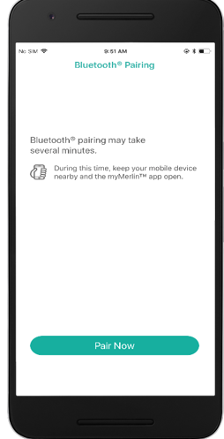
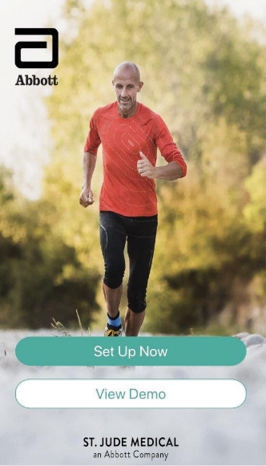
Confirm Rx™ ICM
Enhancements to myMerlin™ Mobile App
For simplicity, this presentation will use myMerlin™ app instead of myMerlin™ for Confirm Rx™ ICM mobile app.

Slide 2
4 Major Improvements to the myMerlin™ Mobile App with Confirm Rx™ ICM
THE myMERLIN™ MOBILE APP ENSURES PATIENTS ARE CONNECTED WHEN IT MATTERS MOST
The new mobile app enhancements include:
Updates to patient notifications and prompts, helping patients stay connected
Improving compatibility with new Android^{ǂ} and iOS^{ǂ} operating systems
1
2
The workflow has been optimized for a better patient experience
The look and feel of some screens within the myMerlin™ app have been updated
3
4

Slide 3
Patient Notifications and Prompts
1
2
3
4
UPDATES TO THE PATIENT NOTIFICATIONS AND PROMPTS HELPING PATIENTS STAY CONNECTED
Improved frequency of app notifications.
More automatic retries of incomplete transmissions and device checks.
Requests to keep the app open or running.
New notifications to assist with maintaining appropriate battery optimization settings.

Slide 4
Patient Notifications and Prompts
1
2
3
4
The myMerlin™ mobile app will now display local notifications to the patient whenever an activity is not completed as scheduled.
For example:
If data is not sent to clinic for two consecutive days.
If app is not able to connect to the device to perform a daily device check for two consecutive days.
These notifications will appear even if the patient has “hard closed” the app!
If multiple issues occur, the notifications will appear concurrently on the same screen.
No SIM
7:44

Slide 5
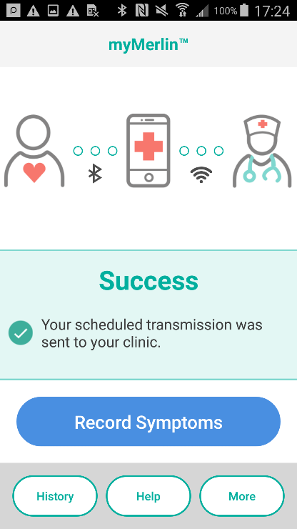
Patient Notifications and Prompts
1
2
3
4
The local notification appears on the 2nd day after the problem was identified and will appear daily until resolved – even if the app is terminated!
Upon seeing the notification, the user should tap the local notification to open the myMerlin™ app.
When the user selects the local notification, this will launch the myMerlin™ app.
When the app is launched, it will automatically attempt to complete any overdue workflows.
This new behavior, called “Automatic Retry”, will perform the same functions that previously required the user to tap the “Try Now” or “Send Data Now” buttons.

Slide 6
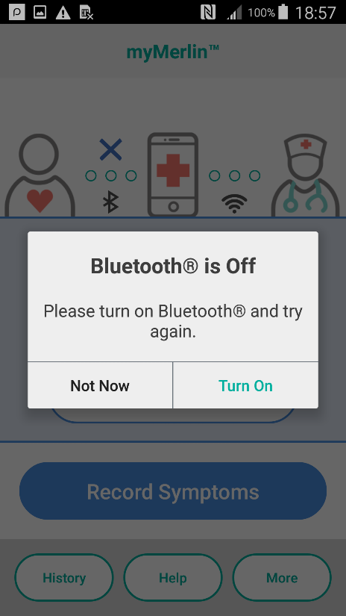
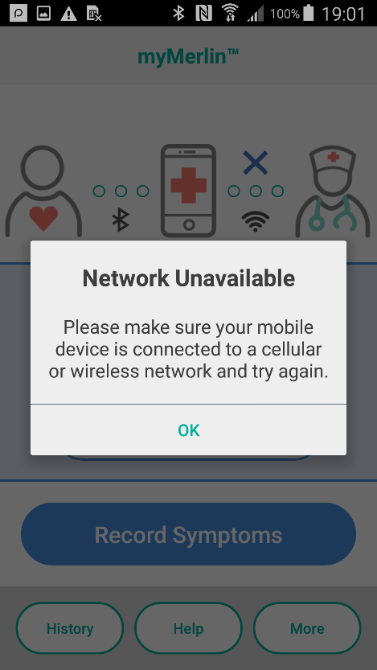
Patient Notifications and Prompts
1
2
3
4
Before attempting to automatically connect to the device, the app will also check to ensure the phone is set up correctly.
If the phone’s Bluetooth® or Wi-Fi‡ (internet connectivity) is turned OFF when the app attempts to automatically reconnect to the device, it will prompt the user to address the set-up issue.
As a reminder:
Bluetooth® must be “ON.”
Internet/Wi-Fi must be connected.

Slide 7
Patient Notifications and Prompts
1
2
3
4
With the app enhancements, there are new notifications to assist with maintaining appropriate battery optimization settings.
Ensure battery optimization is disabled for Android^{ǂ} devices (Android 6.0 and later).
If battery optimization is enabled, a dialog notification is generated by the Android phone.
The dialog will re-appear every 24 hours while the setting remains enabled!
Do not optimize battery usage.
Confirm Rx™ will be able to run in the background and its battery usage will stop being optimized.
NO YES
If battery optimization is enabled, a dialog notification is generated by the Android phone, and text may vary, depending on the phone.
Stop optimizing battery usage?
Confirm Rx™ will be able to run in the background. Its battery usage won’t be restricted.
NO YES
Let app always run in background?
Allowing Confirm Rx™ to always run in the background may reduce battery life.
You can change this later from Settings > Apps & notifications.
Deny Allow

Slide 8
Operating System Compatibility
1
2
3
4
Improving compatibility with new Android^{ǂ} and iOS^{ǂ} operating systems.
Better connection via Bluetooth® wireless technology.
More frequent requests to wake up the myMerlin™ app by Merlin.net™ Patient Care Network.

Slide 9
Operating System Compatibility
1
2
3
4
Merlin.net™ PCN now sends hourly “silent push notifications” to each iOS^{ǂ} app from approximately 2 a.m. –7 a.m. every day.
The goal is to “wake up” the app and to give it more opportunities to try to complete the overnight activities.
(The previous behavior, was one nightly push notification at 4 a.m. to each iOS‡ app.)

Slide 10
Workflow Improvements
1
2
3
4
The workflow has been optimized for a better patient experience.
In the new app software, if the last step in pairing the device to the myMerlin™ mobile app is unsuccessful, it can be re-attempted once internet connectivity is more reliable without repeating the entire set-up process from the beginning.
There is also now a six-hour window to complete the set-up process.

Slide 11
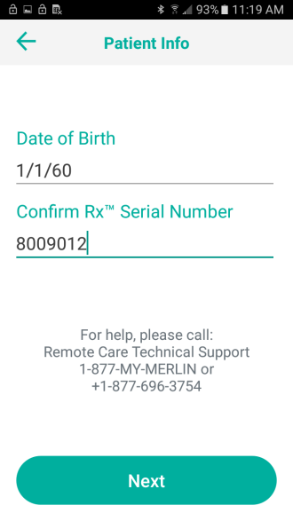
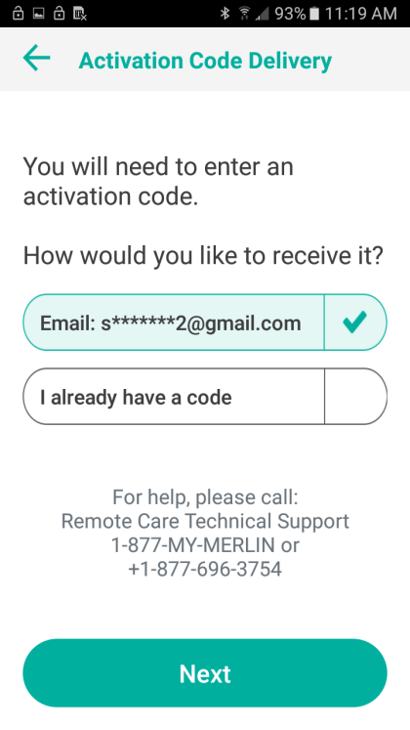
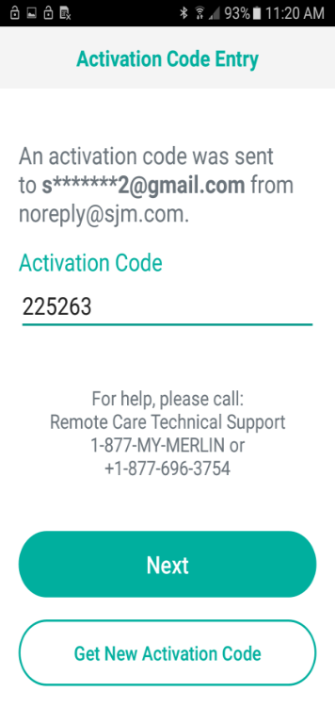
Workflow Improvements
1
2
3
4
The setup and pairing of the myMerlin™ mobile app now completes in three main phases:
VALIDATION
The user enters date of birth and serial number in the myMerlin™ mobile app.
The app receives validation and secure credentials back from Merlin.net™ PCN.
BONDING
The app uses secure credentials to create a Bluetooth® bond with the Confirm Rx™ ICM.
PROFILE SYNC
The app receives profiles (follow-up schedules, DirectAlert™ settings, etc.) from Merlin.net™ PCN.
The app configures the DirectAlert™ settings in the ICM device.

Slide 12
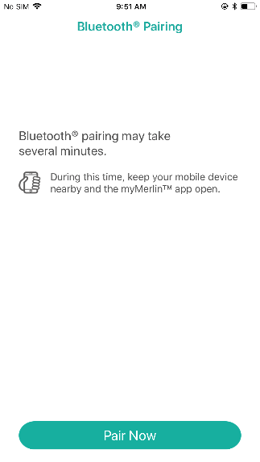
Workflow Improvements
1
2
3
4
The setup and pairing of the myMerlin™ mobile app now completes in three main phases:
If any stage successfully completes – it does not need to be repeated.
The third stage fails most frequently – it can now be completed outside the hospital. It most frequently fails due to 1 of 3 reasons:
“Connection Problem”
“Network Problem”
“Unable to Complete Set-up”
You now will also have 6 hours to complete the pairing once the process is initiated.
If unable to connect within the 6-hour window the app will go back to the “Set-Up Now” screen.
If you are unable to complete pairing at the clinic, instruct the patient to select the “Pair Now” button, when they are in an area of good internet connectivity. They will have 6 hours to complete the process.

Slide 13
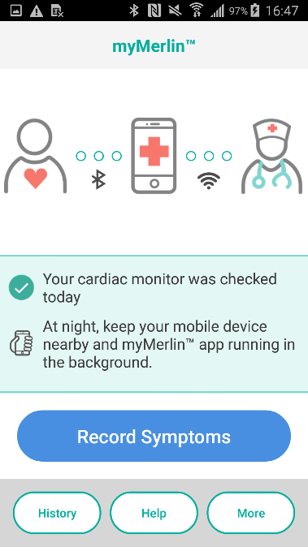
Improving the Look and Feel of the App
1
2
3
4
The look and feel of some screens within the myMerlin™ app have been updated.
The look and feel of some screens has been updated and the user interface is now optimized for an even better patient experience.
Friendlier language of app notifications.

Slide 14
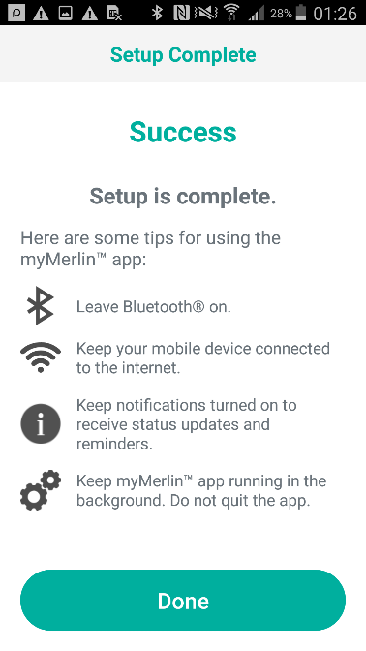
Tips and Tricks for Successful Use of the myMerlin™ App
TIPS AND TRICKS
Do not disable app permissions for the myMerlin™ mobile app.
Allow notifications from the myMerlin™ mobile app.
Stay connected to the internet.
Do not force quit the app.
Keep app running in the background.
KEEP THE APP OPEN DURING ACTIVITIES SUCH AS:
“Set-Up”
“Pair Now”
“Connect Now”
“Automatic Retry”

Slide 15
RX ONLY
Brief Summary: This product is intended for use by or under the direction of a physician. Prior to using these devices, please review the Instructions for Use for a complete listing of indications, contraindications, warnings, precautions, potential adverse events and directions for use.
Indications: The Confirm Rx™ ICM is indicated for the monitoring and diagnostic evaluation of patients who experience unexplained symptoms such as: dizziness, palpitations, chest pain, syncope, and shortness of breath, as well as patients who are at risk for cardiac arrhythmias. It is also indicated for patients who have been previously diagnosed with atrial fibrillation or who are susceptible to developing atrial fibrillation. The Confirm Rx™ ICM has not been specifically tested for pediatric use.
Contraindications: There are no known contraindications for the insertion of the Confirm Rx™ ICM. However, the patient’s particular medical condition may dictate whether or not a subcutaneous, chronically inserted device can be tolerated.
Adverse Events: Possible adverse events (in alphabetical order) associated with the device, include the following: Allergic reaction, Bleeding, Chronic nerve damage, Erosion, Excessive fibrotic tissue growth, Extrusion, Formation of hematomas or cysts, Infection, Keloid formation and Migration. Refer to the User’s Manual for detailed indications, contraindications, warnings, precautions and potential adverse events.
Additional information: Clinicians must log onto Merlin.net™ Patient Care Network to view transmissions from patient’s Confirm Rx™ ICM. On Merlin.net™ PCN they can configure transmission schedules and enable or disable features on a patient’s myMerlin™ for Confirm Rx™ ICM mobile app. Review of transmissions is dependent on the clinician and may not happen immediately following delivery of such transmissions.
Limitations: Patients may use their own Apple‡ or Android‡ mobile device to transmit information from their Confirm Rx™ ICM using the myMerlin™ for Confirm Rx™ mobile app. To do so the device must be powered on, app must be installed, Bluetooth® wireless technology enabled and data coverage (cellular or WiFi‡) available. The myMerlin™ for Confirm Rx™ mobile app provides periodic patient monitoring based on clinician configured settings. Data is resent if the transmission was not sent successfully. However, there are many internal and external factors that can hinder, delay, or prevent acquisition and delivery of ICM and patient information as intended by the clinician. These factors include: patient environment, data services, mobile device operating system and settings, ICM memory capacity, clinic environment, schedule/configuration changes, or data processing.
An Abbott mobile transmitter is available for patients without their own compatible mobile device.
One St. Jude Medical Dr., St. Paul, MN 55117 USA, Tel: 1 651 756 2000
Abbott.com
™ Indicates a trademark of the Abbott group of companies.
‡ Indicates a third-party trademark, which is property of its respective owner.
Bluetooth® and the Bluetooth® logo are registered trademarks of Bluetooth SIG, Inc.
© 2020 Abbott. All Rights Reserved. MAT-2002575 v 1.0| Item approved for U.S. use only.

