Slide 1
Module 4: Merlin.net™ Patient Care Network (PCN)
CardiomemS™ HF System
Heart Failure Management Portal

Slide 2
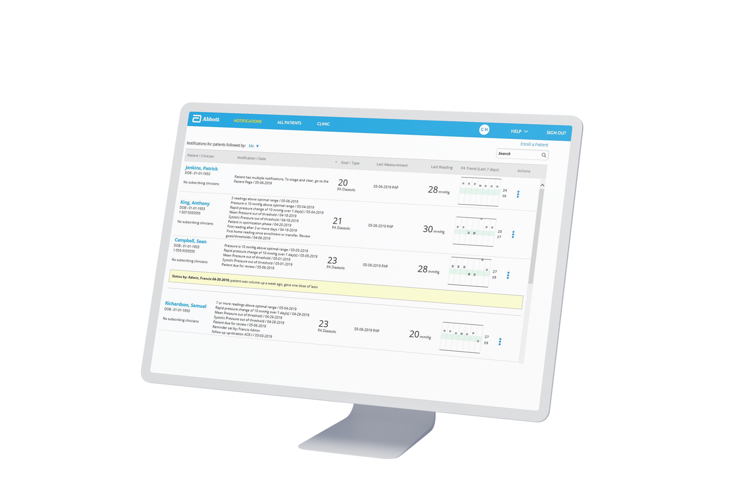
Effective, Efficient Remote Monitoring of CardioMEMS™ HF System Patients
Notes:
The Merlin.net™ Patient Care Network (PCN) is a remote follow-up system that displays information from a patient’s CardioMEMS™ PA Sensor. Using the Patient Electronics System (PES), patients transmit their CardioMEMS HF System readings to Merlin.net PCN on a schedule set by the clinic (usually daily). From within the heart failure management portal of Merlin.net PCN, you can efficiently assess a patient’s status and easily make interventions.

Slide 3
Tools to Drive Efficiency
The Merlin.net™ Patient Care Network and myCardioMEMS™ patient application allows you to:
Triage patients effectively with web-based notifications
Easily assess patients in a single view
Document interventions
Reduce patient phone calls with custom messaging
Notes:
Merlin.net™ PCN is designed to help you work smarter, not harder. Recent upgrades to the site are based on research conducted with CardioMEMS™ HF System customers across the country, and address specific needs and requests made by clinicians who remotely monitor CardioMEMS HF System patients.
Within the heart failure management portal of Merlin.net PCN, you are able to:
Triage CardioMEMS HF System patients efficiently. Notifications direct you to the patients who need your attention, and not to those who don’t.
Assess CardioMEMS HF System patients in single view.
Take actions to make interventions on patients and document your work.
Send custom messages to patients who use the myCardioMEMS™ smartphone application, reducing back and forth phone calls.

Slide 4
Topics
Getting Started with Merlin.net™ PCN
Setting up a Patient for Monitoring
Managing by Exception
Reviewing Patients
Taking Actions
Other Patient Settings
Clinic-Wide Settings
User Settings
Administrative Tasks
Notes:
This training addresses basic use of the Merlin.net system. If follows the process of setting up a clinic, enrolling patients for monitoring, managing patients, and modifying the site’s settings to maximize efficiency.

Slide 5
1. Getting Started with Merlin.net™ PCN
Notes:
Let’s begin with a basic introduction to the system—reviewing how to log in to the heart management portal, and how to navigate the site’s major sections.

Slide 6
Merlin.net™ PCN Overview
1. Getting Started with Merlin.net™ PCN

Slide 7
Heart Failure Management Portal Access
For HF-only clinics:
The Heart Failure Management portal will be your clinic’s landing page.
SE
For clinics with both CRM and HF portal access:
Use the “Switch to” link to navigate between portals.
Notes:
The heart failure management portal may be accessed at www.merlin.net.
After you’ve logged in, you may be directed immediately to the heart failure portal. If your clinic also manages CRM patients, you may be directed to the CRM portal. You can use the “Switch To” link at the top of the site to switch between the two portals. (Note that if your clinic does not manage any CRM patients, you will not have the “Switch To” link at the top.)

Slide 8
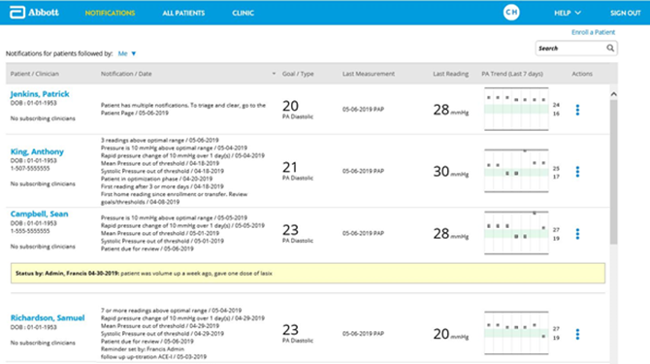
Notifications
Is the default landing page for an HF-enabled clinic
Shows only the CardioMEMS™ HF System patients with active notifications
Serves as your “inbox” for managing CardioMEMS HF System patients
Provides enough detail to quickly intervene and take action
Notes:
After you log in, the first screen you’ll see is called the Notifications List. You can see the link is highlighted in yellow at the top to indicate your location in the site’s hierarchy.
The Notifications List triages your CardioMEMS™ HF System patients by showing you only the patients who need your attention rather than all of your patients. In other words, it only shows patients with some kind of notification. Later in the presentation, we’ll talk about how patients appear on this list.
The Notifications List is intended to serve as your “inbox” for managing CardioMEMS HF System patients. If you are a current Merlin.net™ PCN user, the new Notifications List replaces email notifications. Research with customers indicated that clinicians are overwhelmed with the number of email notifications they receive. As such, all of those notifications have been consolidated into this list.
The Notifications List also contains just enough detail about each patient that you can quickly assess them and take action. More details will be shared shortly.

Slide 9
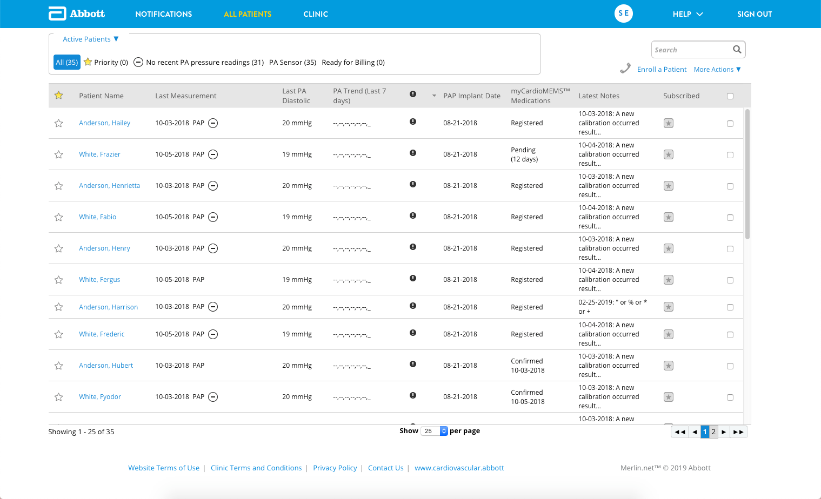
All Patients
Shows all of the patients in your clinic:
Active
Inactive
Scheduled
Implanted
Notes:
Navigation at the top allows you to get to other areas of the site, including the All Patients list. This list displays all of the CardioMEMS™ HF System patients in your clinic. The list can be filtered to show patients who are active, inactive, scheduled or implanted.
Active patients are those belonging to your center whom you are actively managing.
Inactive patients are those belonging to your site who you have marked as inactive. A patient may be marked as inactive, for example, if they have passed away or are no longer sending readings.
Scheduled patients are those who have been created in the system but who have not yet been implanted.
Implanted patients are those who their sensor implanted, but do not belong to your site center. Only patients with referring physicians from other Treating Sites will show up in this list. You will have limited visibility with these patients.

Slide 10
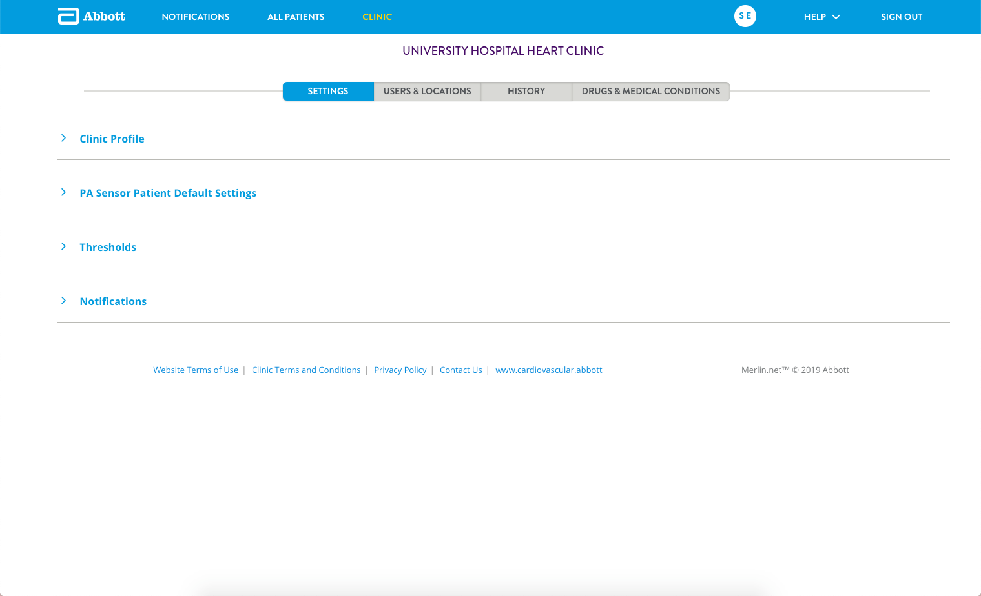
Clinic
Is available only to users with administrative access
Allows you to establish clinic-level settings for all patients
Allows you to manage your clinic’s users
Includes detailed history for all patients
Includes drug and condition lists
Notes:
As we continue to navigate through the site, here you’ll find the Clinic page. This area of the site allows you to establish various options for your clinic and clinic-level defaults for your patients. This page is available only to users with administrative access, so depending on your access level it might not be an area of the site you’ll use.

Slide 11
Utility Navigation
SE
Provides access to your individual user settings
Links to Help resources
Allows you to switch between Merlin.net™ PCN portals
Notes:
And finally, the right-hand area of the navigation menu includes utility links. Your initials will be displayed here; clicking on them will give you access to your individual user settings. You can also access help resources here.

Slide 12
Setting Up Your Clinic
1. Getting Started with Merlin.net™ PCN
Notes:
This section outlines the most important settings to review and update immediately after your clinic’s account has been established. Other settings are described in the Clinic-Wide Settings section later in this training.

Slide 13
Settings
In SETTINGS > Clinic Profile, complete:
Clinic Details
Clinic Regional Settings
Notifications List Report
Patients of Interest Report
Patient Messaging
Login Adherence
TIP: Enable delivery of reports for your clinic as a whole on specific days. Users can then choose whether or not to receive the reports from their user profile.
Notes:
Within the Settings section, verify or complete information about the clinic. This includes the clinic contact details that will be used for patient messaging.
Also within this section, select the days that users in your clinic will receive the Notifications List Report and Patients of Interest Report, delivered by email. After clinic-wide subscription settings have been established, individual users can elect to receive these reports from their user profile.

Slide 14
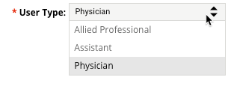
Settings
In USERS & LOCATIONS > USERS, add users and assign roles as appropriate.
User Roles control the user’s patient viewing access and read/write abilities
Physician User Roles (only shown if User Type is Physician) do not control read/write abilities
Notes:
Within the Users and Locations section, add users so that they can access Merlin.net.
After you have added a user, select the user type and user role. User roles control users’ access to viewing and modifying patient data or changing clinic settings.

Slide 15
Settings
Tips for USER TYPES:
Tips for USER ROLES:
For clinical roles, select PHYSICIAN or ALLIED PROFESSIONAL.
For non-clinical roles, select ASSISTANT.
To allow a user to make changes to global clinic settings or add/remove users, select ADMINISTRATOR.
To allow a user read-only access to patient data, select CONSULTING.
Notes:
When assigning user types, elect Allied Professional or Physician for clinical users. Select Assistant for non-clinical users.
When assigning user roles, consider what you want the user to be able to do within the site:
• Administrators can make changes to global clinic settings as well as add and remove other users. Ensure that at least two users in your clinic are given the Administrator role.
• Implanting and treating users can view and modify patient data.
• Consulting users have read-only access to patient data. A consulting user role is ideal for clinicians who do not directly manage CardioMEMS patients in Merlin.net but rather want to keep tabs on their patients’ data.

Slide 16
2. Setting up a Patient for Monitoring
Notes:
After a clinic’s account has been established and basic settings verified or updated, patients can then be enrolled in the system and set up for monitoring.

Slide 17
Enrolling a Patient
2. Setting up a Patient for Monitoring
Notes:
Let’s discuss how to enroll a patient in Merlin.net.

Slide 18
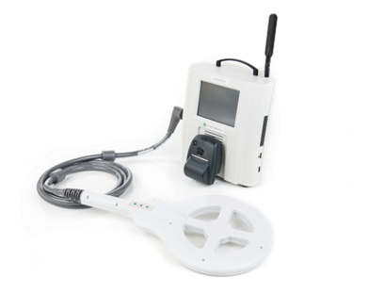
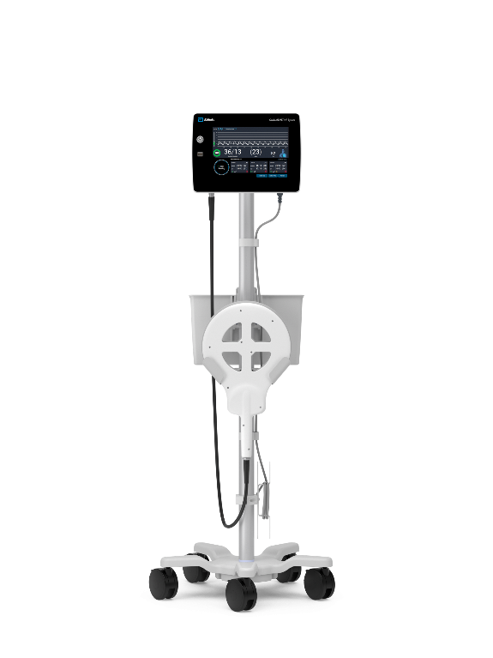
Enrolling a Patient
1. At implant, patients should be enrolled using the HOSPITAL ELECTRONICS SYSTEM (HES) or HOSPITAL SYSTEM (HS). Enter minimal information on the HES or HS to create a basic profile:
Last name
First name
Date of birth
2. Post-implant, complete the patient’s profile on Merlin.net™ PCN.
Notes:
Patients who are to be implanted with a CardioMEMS sensor can be enrolled using Merlin.net or the Hospital Electronics System (or HES) which is used to calibrate the CardioMEMS sensor at implant.
However, it is strongly recommended that the patients be enrolled at the time of implant using the Hospital System.

Slide 19
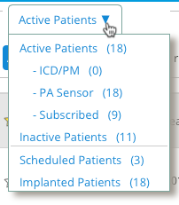
For Centers With Connectivity
After implant, find the patient on the ALL PATIENTS list under SCHEDULED.
In SETTINGS > PA SENSOR:
Associate the patient with a clinic
Assign a treating physician
Select consulting users, if desired
Notes:
After a patient has been enrolled on the Hospital System, their profile may be updated in Merlin.net.
If your center has adequate connectivity in the cath lab, information will have been transferred wirelessly from the Hospital System to Merlin.net. The patient’s profile can be found on the All Patients list under Scheduled.
Click on the patient’s name and verify or update patient demographic information. Additionally, ensure the patient is assigned to the appropriate clinic for follow-up. Treating physicians and consulting users may also be assigned.

Slide 20
For Centers Without Connectivity
After implant, navigate to the All Patients or Notifications page and click on Enroll a patient.
Select PA SENSOR and enter patient’s details.
Scroll to PA SENSOR and enter sensor serial number.
Insert USB drive from implant, and click IMPORT FROM FLASH DRIVE.
Notes:
If your center does NOT have the ability to transmit information wirelessly from the Hospital System to Merlin.net, you will need to complete the enrollment process manually by using the USB drive that came with your patient’s CardioMEMS sensor.
From the All Patients or Notifications Page, click on the Enroll a Patient link. Follow the prompts to complete required information. Then insert the USB drive to import implant data to Merlin.net.

Slide 21
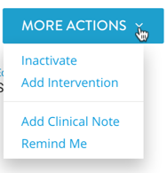
Dealing With Duplicate Patients
You may experience duplicate patients in two cases:
If the patient is already enrolled as a Cardiac Rhythm Management patient. Continue to enroll the patient as a CardioMEMS™ HF System patient.
If the patient was enrolled in Merlin.net™ PCN rather than the HES or HS. Click on the duplicate profile. From the MORE ACTIONS menu, select INACTIVATE.
Notes:
In some instances, you may experience duplicate patients in Merlin.net.
Patients who have an Abbott CRM device may already be enrolled in Merlin.net.
You will also experience duplicate patients if you enroll them using both Merlin.net and the HES. Navigate to the duplicate profile and select Inactivate from the More Actions menu to remove the un-needed profile.

Slide 22
Setting Up a Patient’s Profile
2. Setting up a Patient for Monitoring
Notes:
This section outlines most important settings to review and update after implant and enrollment to ensure successful remote monitoring and communication.

Slide 23
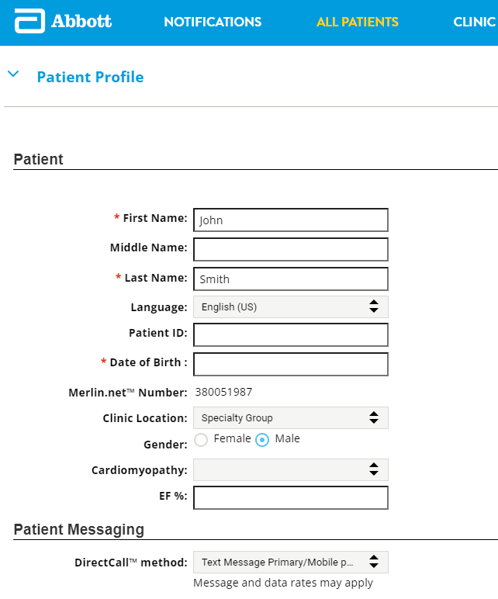
Finishing the Patient’s Profile
A patient will move automatically from the Scheduled list to the Active list after their first transmission from the Patient Electronics System and if the patient has been associated with a clinic.
In SETTINGS > PATIENT PROFILE > Patient, complete:
Name
Contact information
Ejection fraction (EF) %
Patient messaging preferences
Notes:
Once a patient has been associated with a clinic and has sent their first transmission from the Patient Electronics System, they are considered an Active patient. You can then continue setting up other aspects of their profile, including their name, contact information, and EF prior to implant.
It is important to discuss with your patients how they wish to be contacted as part their care.
Merlin.net allows you to send messages to your patient via phone or text message, or the myCardioMEMS™ Patient Application—all from within the Merlin.net interface.
If the patient wishes to use the myCardioMEMS patient app to receive messages, they must be registered. Once a patient has registered to use the app, it will become their primary communications vehicle and they will not be able to receive messages via phone or text.

Slide 24
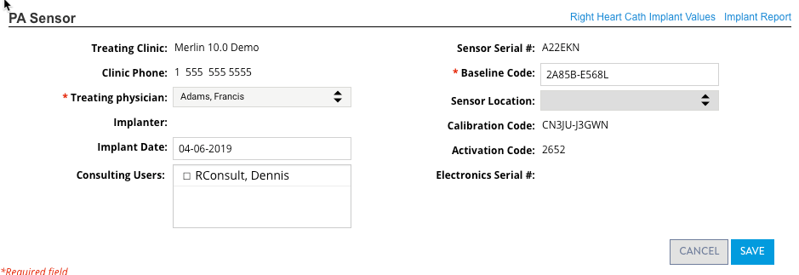
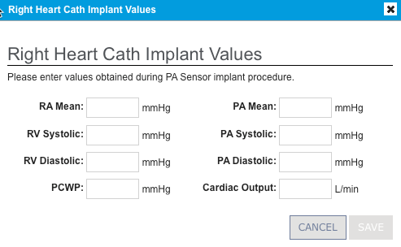
Entering Right Heart Cath Values
In SETTINGS > PATIENT PROFILE > PA SENSOR, enter values from implant.
TIP: Entering this information can provide guidance for setting PA pressure goal and threshold.
Notes:
You may also find it useful to enter a patient’s right heart cath implant values from the implant procedure. This data can help you effectively establish a PA pressure goal and threshold for the patient.

Slide 25
Setting Goals and Thresholds
In SETTINGS > GOALS AND THRESHOLDS:
Select a primary metric (default = PA Diastolic)
Select the phase that the patient is in (default = Optimization)
Notes:
As part of the PA Pressure Optimization phase, you will establish an ideal PA pressure goal and optimal range (threshold) by which to monitor the patient. A patient’s goal and threshold should be entered into Merlin.net so that you can be notified when a patient is trending out of page.
Select the primary metric by which you wish to monitor the patient: either PA Diastolic or PA Mean. Research has shown that a majority of CardioMEMS™ HF System customers use PA Diastolic.
Then, select the phase that the patient is in: either the optimization phase (generally the first 30 to 90 days after implant) or the maintenance phase (when the patient’s pressures and medications have stabilized). Selecting a phase allows you to be notified to take certain actions at certain times. For example, you may wish to evaluate and adjust a patient’s PA pressure goal and thresholds more closely while they are being optimized; by placing the patient in the optimization phase, the system will notify you to do so.

Slide 26
Establishing a Goal and Optimal Range
In SETTINGS > GOALS AND THRESHOLDS:
Enter a PA pressure goal – the target PA pressure for patient management (optional).
Enter a patient’s optimal range (which, when exceeded, will trigger a notification).
DEFAULTS PRIOR TO GOAL BEING SET
Clinic-level values
DEFAULTS UPON SETTING THE GOAL: ± 4 from PAD goal (optimization)
± 2 from PAD goal (maintenance)
± 5 from PAM goal (optimization)
± 3 from PAM goal (maintenance)
Notes:
After you have established a primary metric and phase, you can set a specific number PA pressure goal for your patient. This goal is optional; you may choose not to set a goal for a patient until you understand them a bit better.
However, it is important to enter an optimal range for the patient. This is the acceptable range in which the patient “lives.” Because many notifications are based on this range, it is important that this range is established so that the notifications you receive are relevant.
Note that after you have entered a PA goal, a range will automatically populate for you based on clinic-wide defaults. You can adjust this range if you want. You may wish to set an initial goal and wide threshold during the optimization phase, and then finalize the goal and tighten up the threshold as the patient stabilizes and moves into the maintenance phase.

Slide 27
3. Managing by Exception
Notes:
The next section of this presentation provides a closer look at the Notifications List and how to manage by exception.

Slide 28
Notifications List
The Notifications List helps you focus on patients who need your attention.
Shows only patients who have active notifications, based on an out-of-range PA pressure reading or other clinical or administrative setting.
Notes:
The Notifications List is designed to help you manage by exception. As previously mentioned, this list shows a sub-set of your clinic’s patients — in particular, patients who have a notification.
By default, the list is sorted by patients with the most recent reading at the top.

Slide 29
Notification types
3. Managing by Exception

Slide 30
Notification Types
Type | Sub-type | Examples
Clinical Notifications based on PA pressure or other clinical metric (e.g., heart rate) | Primary Notifications Related to the patient’s primary metric (PA Diastolic or PA Mean) | 3 readings above optimal range Rapid pressure change of <n> over 1 day
 | Other Notifications Related to the non-primary metric thresholds | Heart rate out of threshold Systolic pressure out of threshold
Administrative Notifications associated with administrative-level considerations |  | No pressure readings for <n> days Pressure reading is suspect
Notes:
There are two main types of notifications: Clinical and Administrative.
Clinical notifications include Primary notifications — those related to the patient’s Primary Metric, either PA Diastolic or PA Mean. Clinical notifications also include other notifications that are not related to the patient’s primary metric.
Administrative notifications include those related to a patients’ compliance or other concerns that are not of clinical nature.

Slide 31
Clinical > Primary Notifications
Notifications related to the the primary metric (PA Diastolic or PA Mean)
NOTIFICATION | DEFAULT
High pressure reading greater than <n> from optimal range | OFF
Low pressure reading less than <n> from optimal range | OFF
Rapid pressure change of <n> over 1 day | ON, N = 10
Pressure reading transition from High to Low range (without patient returning to optimal state) | OFF
Pressure reading transitions from Low to High range (without patient returning to optimal state) | OFF
1 reading above optimal range | OFF
1 reading below optimal range | OFF
3 readings above optimal range | ON
3 readings below optimal range | ON
7 or more readings above optimal range | ON
7 or more readings below optimal range | ON
Patient returns to optimal state after medication change | OFF
Notes:
Twelve different Primary notifications are available. In general, these are triggered when a patient’s primary metric reading is above or below the optimal range. Several of these notifications are on by default, but this can be customized at the patient level for a single patient, or at the clinic-level for all newly enrolled patients.

Slide 32
Clinical > Other Notifications
Notifications related to non-primary metric thresholds
Note: These notifications will only trigger if corresponding thresholds are defined and active.
NOTIFICATION | DEFAULT
Diastolic pressure out of threshold * | OFF
Diastolic pressure trend out of threshold | OFF
Mean pressure out of threshold * | OFF
Mean pressure trend out of threshold | OFF
Heart rate out of threshold | ON
Pulse pressure out of threshold | OFF
Systolic pressure out of threshold | OFF
Systolic pressure trend out of threshold | OFF
*Only applicable as an “other” notification if it is NOT the primary metric. (For example: If a patient’s primary metric = PA Diastolic, then the “Diastolic pressure out of threshold” notification would not be triggered as an “other” notification.)
Notes:
Eight other clinical notifications are also available. These are related to other metrics you may wish to follow for your patient, such as heart rate.

Slide 33
Administrative Notifications
NOTIFICATION | DEFAULT
No pressure readings for <n> days | ON, N = 3
First pressure reading after <n> days | OFF, N = 3
Pressure reading is suspect | ON
Patient has not been reviewed for 30 days | OFF
Patient does not have a pressure goal established | OFF
Patient is in Optimization phase | OFF
First home reading from a patient after enrollment or transfer | OFF
Systolic pressure trend out of threshold | OFF
Notes:
And seven administrative notifications are available. As previously mentioned, these are related to concerns that don’t involve a patient’s PA pressure or heart-related metrics.

Slide 34
Using the Notifications List
3. Managing by Exception
Notes:
Now that you have learned about the notifications available, let’s move on to using the Notifications List itself.

Slide 35
Using the Notifications List
Notifications filter
Allows you to see patients you or other clinicians are subscribing to
Includes patients who do not have a subscribing clinician
TIP: Use the “subscribe” (green star: ) feature to follow specific patients and ensure they appear on your Notifications List. Subscribe to patients from the All Patients list or the individual patient profile.
Notes:
The Notifications List can be filtered using the dropdown at the top of the page. By default, it displays the patients you are subscribing to (or, in other words, patients whom you are “following”). As such, everyone’s Notifications List will look a bit different.
You may subscribe to a patient by clicking on the green star next to the patient’s name throughout the site. Subscribing means that you, personally, will be alerted to that patient if he or she has some kind of notification. Subscribing to patients is helpful in practices in which more than one clinician is following patients, or in clinics where patients are “assigned” to different clinicians for management.
Note that if no one in your practice is subscribed to a patient, that patient will appear on everyone’s Notifications List so as not to be missed.
You may also filter this list to view patients who are being followed by other clinicians in your practice.
Moving on, let’s break down the Notifications List.

Slide 36
Using the Notifications List
Patient/Clinician column
Displays patient name, date of birth, phone and subscribing clinician(s)
Notes:
The patient’s name, date of birth, and phone number are shown here. Clicking on the patient’s name takes you to the patient’s detail-level page, where you can assess him or her more closely. We’ll take a look at that later.
The name of the subscribing clinician is shown here.

Slide 37
Using the Notifications List
Notification/Date column
Provides the reason(s) the patient is on the Notifications List and the date the notification was triggered
REMINDER: A patient may have more than one notification, with “clinical” notifications at the top. Review all notifications, but treat the notifications (and the patient) as a whole.
Notes:
The notification is presented here. It provides you with the reason the patient is on the Notification List.
In this example, Holly Anderson is on the list because she hasn’t sent any readings lately, among other reasons. Note that the date that the notification occurred is shown by the notification itself. Sometimes the patient might have only one notification; at other times the patient might have multiple notifications. Notifications related to clinical matters — such as those related to PA pressure — are shown first. Other notifications, such as a missed reading, are shown next.

Slide 38
Using the Notifications List
Goal/Type column
Displays the patient’s PA pressure goal and the Primary Metric (type of goal) by which they are being monitored (PA Diastolic or PA Mean)
REMINDER: It is not a requirement that patients have a PA pressure goal. In these cases, “No Goal Set” displays.
Notes:
The patient’s PA goal is shown here.
Research with CardioMEMS™ HF System customers revealed that many clinicians like to target a specific PA pressure goal for a patient. However, it is not required that each patient have a goal. If a patient does not have a goal, “No Goal Set” will be displayed.
The type of goal is also shown here. Merlin.net™ PCN allows you to monitor a patient by either PA Diastolic or PA Mean. This is called the patient’s Primary Metric.

Slide 39
Using the Notifications List
Last Measurement and Last Reading columns
Displays the date that the patient last took a reading
Displays the last reading value sent by the patient
Notes:
The patient’s last measurement value and the date it was taken are shown here. Note that this measurement value might be different than the measurement value that triggered the notification.

Slide 40
Using the Notifications List
PA Trend column
Displays readings from the past seven days in relation to the patient’s optimal range
REMINDER:
If multiple readings are sent in one day, only the most recent one is shown.
A suspect reading will be shown in orange.
Notes:
This small graph displays that last seven days of readings from the patient.
If a patient took more than one reading in a day, the graph displays only the latest one.
If a patient did not submit a reading for the day, there would be a blank.
If a patient submitted a suspect reading, the reading would appear in orange.
Note that this graph also displays a shaded band, which indicates a patient’s “optimal range,” or threshold. This is the range in which a patient’s PA pressure readings are considered “acceptable” and do not trigger notifications. We’ll discuss how to set this range in the next in the next section of this presentation.

Slide 41
Getting Notified
3. Managing by Exception
Notes:
You will likely wish to customize when and how you are notified, since not all notification types are appropriate for all types of patients.
Or, you may wish to receive notifications by email in addition to the Notifications List on Merlin.net.

Slide 42
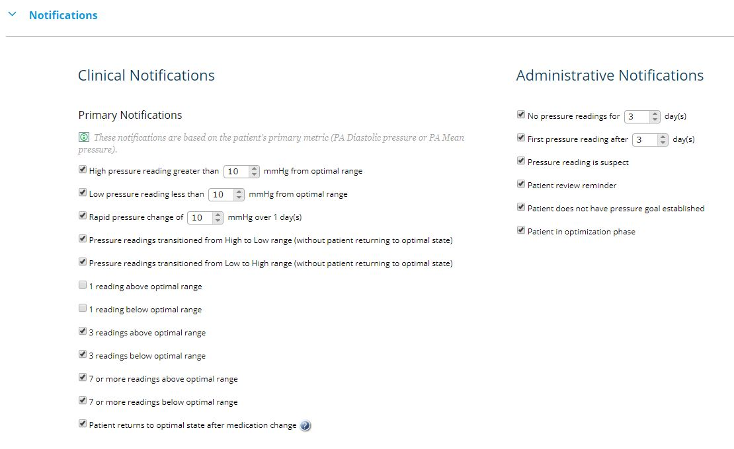
Notifications List Settings
Notes:
To modify notifications for an individual patient, click on the patient’s Settings tab and scroll to the Notifications section. Check the appropriate boxes.
Notification defaults are set at a clinic level for all patients but should be customized on an individual patient level. For example, for patients who are sicker, you may wish to receive a notification if they have just one reading out of range. For others, you may not want to know until they have had at least three readings out of range.

Slide 43
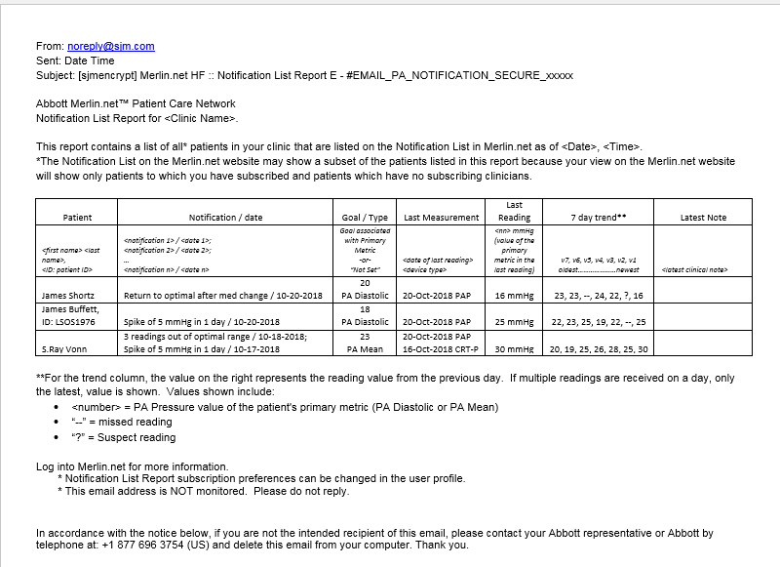
Notifications List Report
Contains list of all patients currently on clinic’s Notification List
Runs at 12 p.m. local time – a snapshot in time
Can be subscribed to by individual users
Distribution days set at clinic-level
Subscription on/off set at a user-level
Notes:
If you would also prefer to be notified via email, you may subscribe to the Notifications List Report or the Patients of Interest Report.
The Notifications List report is similar to the Notifications List on Merlin.net itself. It is generated overnight and distributed on a schedule set by your clinic. Note that the report is a snapshot in time; it is important to remember that the Notifications List on the website contains the most up-to-date information about your patients.

Slide 44
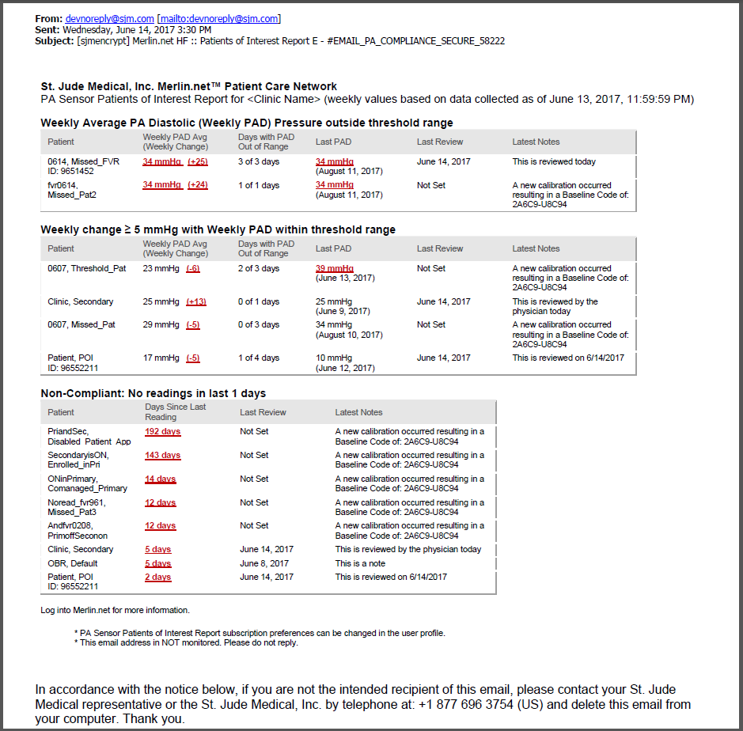
Patients of Interest Report
Focuses on PA Diastolic, regardless of primary metric selected
Includes patients who have …
A running average of seven days of PAD pressure outside threshold
Weekly PAD pressure average change ± 5 mmHg from previous week’s
Not transmitted a reading for more than seven days in a row
Notes:
The Patients of Interest Report focuses primarily on changes in PA Diastolic pressure, regardless of a patient’s Primary Metric. It looks at weeklong averages versus discrete readings. It also includes patient who have not transmitted readings for more than seven days in a row.

Slide 45
4. Reviewing Patients
Notes:
The next section discusses how to assess your patients — whether you are assessing them based on a notification or reviewing their information at some other time.

Slide 46
Patient Data Review
4. Reviewing Patients
Notes:
To review a patient’s data, click on their name from either the Notifications List or the All Patients list. Here you’ll see the patient’s most recent activity.

Slide 47
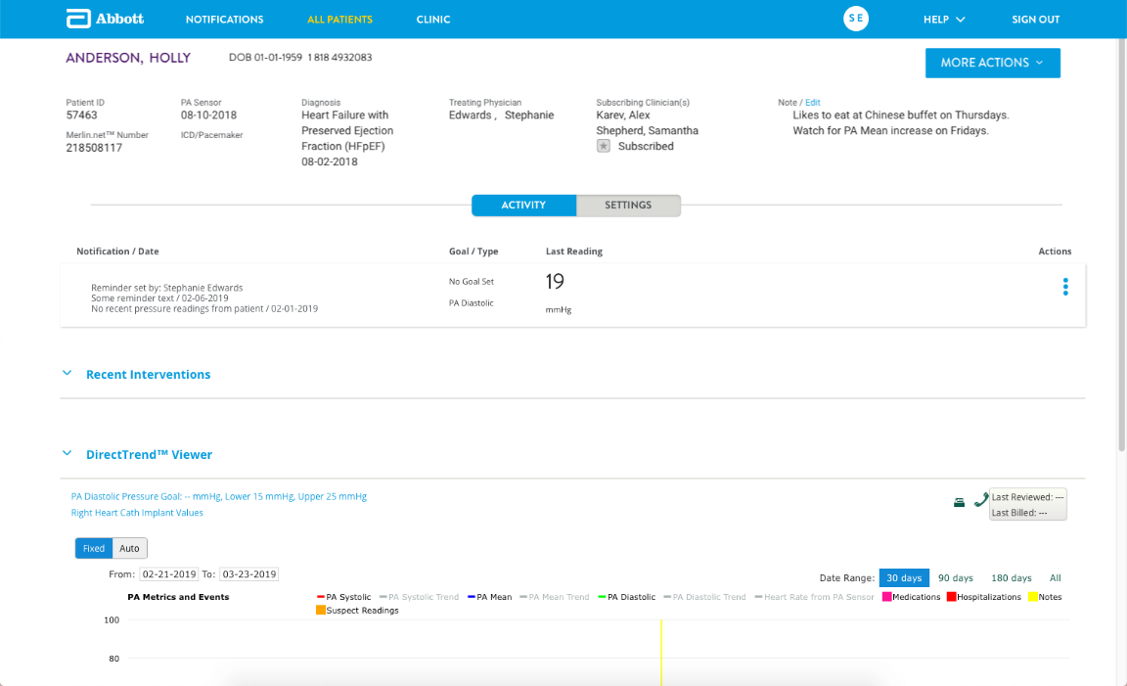
Patient Activity
The ACTIVITY tab displays recent activity for a patient.
Patient header
Current notifications
Recent interventions
DirectTrend™ Viewer
Readings
Notes:
The patient’s Activity tab includes five sections:
The patient header
Current notifications
Recent interventions
The DirectTrend™ Viewer
Readings
We’ll review each of these sections next.

Slide 48
Patient Data Review
Patient header
Includes key information about patient
Includes editable “post-it” note for extraneous details and/or clinic communication
Notes:
At the top of the patient’s detail page is summary information for your patient, including their name, date of birth, phone, and other pertinent information.
A “post-it” note feature in the upper right allows you to document extraneous details about a patient, such as lifestyle habits, or other information that’s useful for others in your practice to know about.

Slide 49
Patient Data Review
Notifications
Mirrors current notifications for patient shown on Notifications List
Notes:
As you scroll down the page, you’ll see a list of the patient’s active Notifications, if he or she has any. These notifications mirror those shown on the Notifications List.

Slide 50
Patient Data Review
Recent Interventions
Includes medication adjustments and/or messages sent to the patient in the last 30 days
Displays a green checkmark for interventions acknowledged by the patient on the myCardioMEMS™ app
Notes:
The recent interventions section displays the last 30 days of interventions that have been made on a patient. The most recent interventions are shown on the right, and you can “scroll back in time” to view older ones. In the next section, we’ll discuss how to document these interventions so that they appear here.

Slide 51
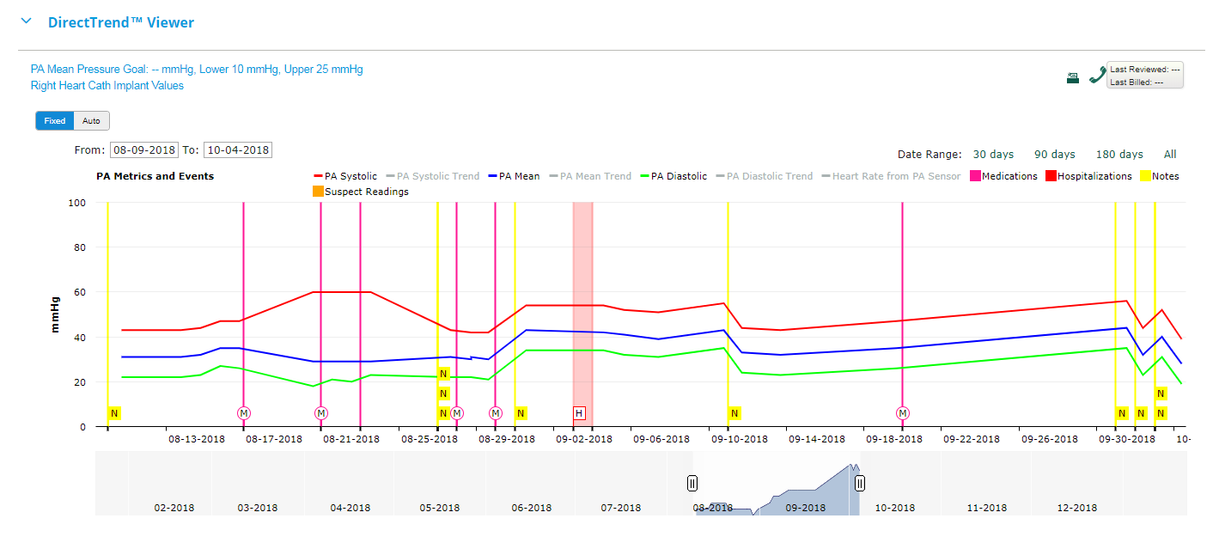
Patient Data Review
DirectTrend™ Viewer
Displays Mean, Systolic and Diastolic pressures over time
Can be customized to display various trends over time
Displays hospitalizations or notes entered in patient’s record
Notes:
Moving down the page, you’ll see a feature called the DirectTrend™ Viewer. This is an interactive chart that displays the patient’s PA readings, trended over time. Features may be turned on or off to display different information based on your preferences.

Slide 52
Patient Data Review
Readings
Displays readings in list format, with ability to page through previous readings
Includes summary block with number of days with readings, number of days missed and number of suspect readings
Notes:
At the bottom of the page is another view of the patient’s readings, shown in list format. From the list, you may click the waveform icon to view the specific PA waveform associated with the reading.

Slide 53
Suspect Readings
4. Reviewing Patients
Notes:
As part of patient data review, it is important that readings that have been marked as suspect by the system be regularly reviewed and either accepted or ignored.

Slide 54
Managing Suspect Readings
Marked by the Patient Electronics System
Indicated with an orange “Suspect” tag on the Readings List
Notes:
Waveforms that the system believes are suspect will be marked with an orange “Suspect” tag on the readings list or on the DirectTrend Viewer. Click on the reading to view the waveform in detail.

Slide 55
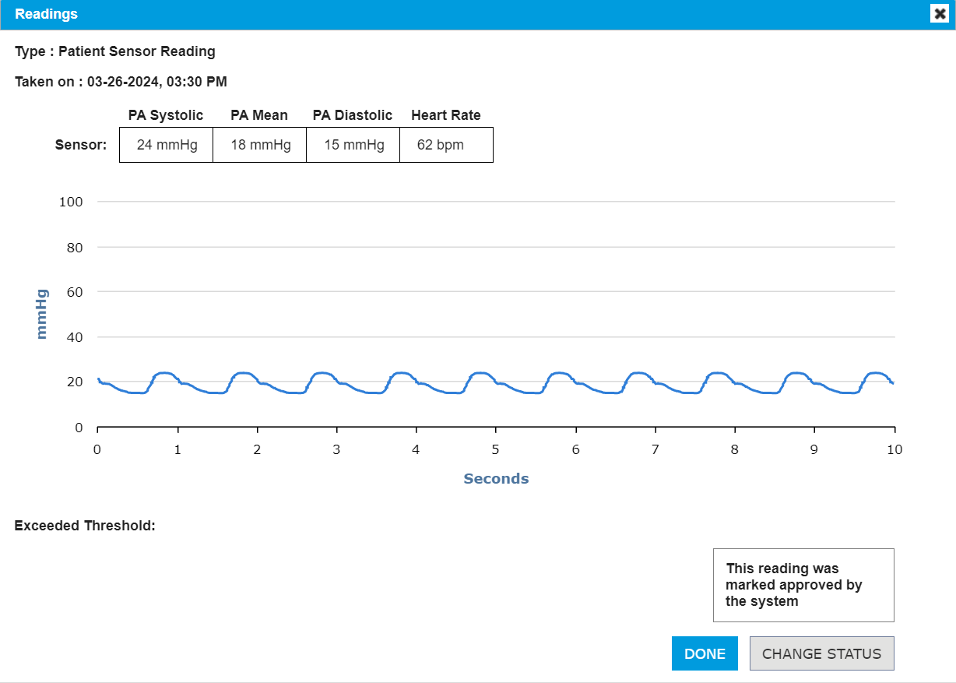
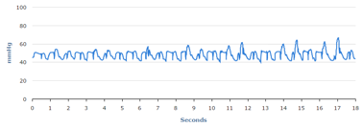
Reviewing Suspect Readings
When reviewing suspect readings, it is important to determine if the waveform is physiologic.
If the waveform is not physiologic, select Ignore.
If the waveform is, select Approve.
Notes:
If the waveform appears to be physiologic, click Change Status and then Accept.
If the waveform appears non-physiologic or affected by interference, click Ignore.

Slide 56
Finishing Your Review
4. Reviewing Patients
Notes:
The final step in reviewing patient activity is marking your review as complete.

Slide 57
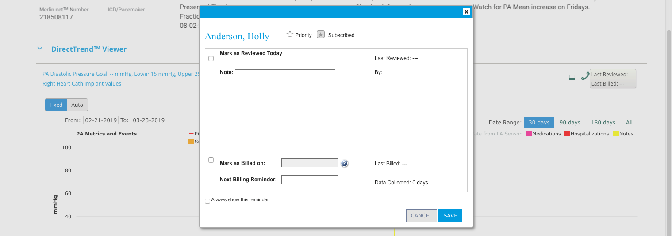
Finishing Your Review
From the LAST REVIEWED/LAST BILLED BUTTON above the DirectTrend™ Viewer:
Check the Mark as Reviewed box and enter a note (optional)
Enter a Mark as Billed on date (if applicable)
Notes:
Directly above the DirectTrend™ Viewer is a button labeled Last Reviewed/Last Billed. Clicking on this button allows to you to enter the date you completed a review of the patient, as well as enter billing dates and reminders. Notifications will be triggered and appear on the Notifications List based on the details you enter here. If you do not enter any information here, you will automatically be notified to review the patient every 30 days.

Slide 58
5. Taking Actions
Notes:
During the next part of this presentation, we’ll discuss taking action on your patients based on their activity — which includes both documenting and communicating interventions.

Slide 59
Taking Actions
ACTIONS BUTTON
Is available from the patient’s notification or on the patient’s detail page
Allows you to add an intervention (send a message), add a note, update a patient’s status, clear the notification, set a reminder or subscribe to a patient
Notes:
For day-to-day patient management, most actions can be taken by using the Actions button, which is displayed as these three dots on the Notifications List.
Clicking on it displays a list of actions you can take on a patient.

Slide 60
Taking Actions
ADD INTERVENTION
Shows current notifications
Provides method to send a message to a patient
Allows for clinical note
Links to Medication List for a Medication Intervention
Notes:
The first option in the list is the Add Intervention feature. Adding an intervention is the primary method to document and communicate interventions to the patient.
The Add Intervention screen includes:
Any current notifications for the patient
A place to document a clinical note
A patient’s preferred communication methods
A link to the patient’s Medication List
The Add Intervention screen also allows you to send a message to a patient.

Slide 61
Intervention Types
Type | Sub-type | Examples
Message Intervention A pre-written or custom message delivered to the patient. | Standard Message Short, pre-written or pre-recorded messages set at the clinic-level | Text (SMS) Voice myCardioMEMS™ app
 | Custom Messages Short, pre-written or pre-recorded messages set at the clinic-level | myCardioMEMS app
Medication Intervention A change to a medication in a patient’s medication list in Merlin.net™ PCN. |  | myCardioMEMS app (if medication management is enabled)
Notes:
There are two different types of messages.
Standard messages are short, pre-written or pre-recorded messages. These messages can be customized for your clinic in the Clinic Settings area of the site, and then can be delivered to a patient via text message or voice, or the myCardioMEMS™ patient app (if the patient is registered to use the app)
Custom messages are free-form messages written at the time of the intervention. They can be used to send a lifestyle reminder to a patient, or even a medication change.

Slide 62
Sending a Message Intervention
REMINDER: Custom messages should not be used with patients for whom medication list management is enabled in the patient app (a warning message will appear).
Notes:
Here is the area of the add intervention screens that allows you to select a standard message or write a custom message.
There are two important points to consider when using the custom message feature:
Custom messages can only be used for patients who have registered to use the myCardioMEMS™ smartphone application. If the patient to whom you are sending a message is not registered to use the app, then the custom message feature will be disabled.
Custom messages should not be used for medication changes if a patient’s medications are being maintained in the Medication List area of the site and shown to the patient in the myCardioMEMS™ app. A warning message will appear here to prevent you from writing a custom message that may conflict with a patient’s Medication List.
After you have selected as message type and/or composed your message, click send to deliver the message to the patient via their preferred method.

Slide 63
Taking Actions
ADD CLINICAL NOTE
Allows you to document notes about patient
REMINDER: Notes are shown on patient detail page (Setting > Notes) and “Latest Notes” column on All Patients list.
Notes:
Let’s look at other possible actions you might take.
The “Add Clinical Note” option allows to document a note about a patient. The information is stored only in Merlin.net™ PCN and not sent to a patient. Patient notes can be accessed by clicking on the yellow notes icon on the DirectTrend™ Viewer, so they can easily be correlated to dates of specific readings.

Slide 64
Taking Actions
UPDATE STATUS
Allows you to document “work in progress” on patient
Useful as a reminder of where a you “left off,” or communicating with other clinicians about the status of a patient’s notification
Notes:
The “Update Status” action allows you to write a status note about the current state of the patient who is on the Notifications List. For example, let’s say you called a patient about a medication change but the patient was not available to take your call. You may wish to create a status note to indicate that.
The status is then displayed on the Notifications List and can serve as a helpful reminder to you or others in your clinic that you are “working on” the patient.

Slide 65
Taking Actions
CLEAR NOTIFICATION(S)
Allows you to remove a notification from the Notifications List and patient activity page
Clears all notifications associated with patient, as well as any status notes associated with that patient
REMINDER: Some notifications may clear automatically. For example, an “out of range” notification will clear automatically if the patient returns to the optimal state.
Notes:
The “Clear Notification” action allows you to remove the patient from the Notification List. Once you have assessed the patient and no longer need to see the patient on the list, you may remove it.
When you clear the notification, any status that you have written for the patient also is removed. Note that you will not receive a warning when you clear the patient; the action takes place immediately.

Slide 66
Taking Actions
REMIND ME
Allows you to write a reminder about the notification itself, which will be displayed when the reminder comes due
Useful for checking in on a patient after a medication change
TIP: Make sure your reminder is clear enough to understand next steps, as the reminder will not display previous notifications associated with the patient.
Notes:
The “Remind Me” action allows you to set a reminder to be associated with a patient. For example, if you recently changed a patient’s medications and want to check in on the patient a few days later, this feature allows you to create a reminder for yourself to do so. The original notification will be removed, and the reminder will appear when you tell it to.

Slide 67
Taking Actions
SUBSCRIBE
Allows you to subscribe to (or “follow”) specific patients
Ensures patients you are interested in are made known to you on the Notifications List
Notes:
Finally, the Subscribe feature allows you to more closely follow specific patients. If you subscribe to a patient, the patient will show up on your Notifications List. This feature is helpful in practices in which more than one clinician is managing patients, and each clinician has her own set of patients.

Slide 68
6. Other Patient Settings
Notes:
Taking advantage of other features in Merlin.net will help drive efficiency in your management of CardioMEMS patients. Here and in the following sections we’ll discuss other settings you may wish to review or or update.

Slide 69
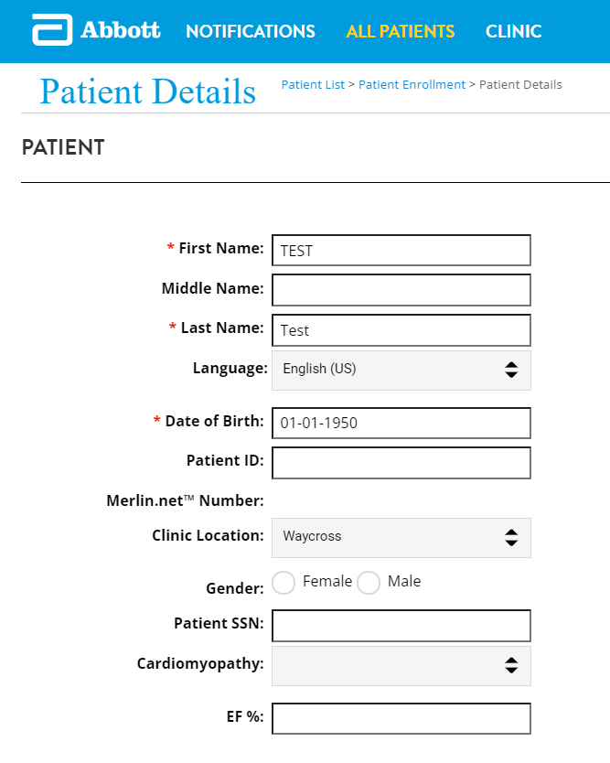
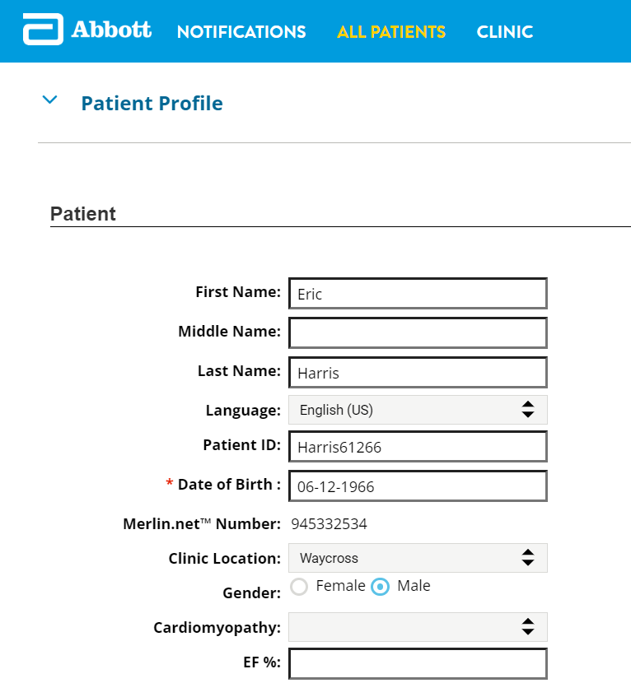
Ejection Fraction (EF)
EF can be entered for each patient during or after enrollment in merlin.netTM pcn
During enrollment > PATIENT DETAILS
After enrollment > PATIENT PROFILE
Notes:
Ejection fraction is to be documented for all patients. EF% can be entered during OR after enrollment in Merlin.netTM PCN. During enrollment, EF% is documented in the PATIENT DETAILS section. If entering EF% after enrollment, choose a patient from the NOTIFICATIONS or ALL PATIENTS list and document EF% in the PATIENT PROFILE section.

Slide 70
Other Patient Settings
DIAGNOSES
Allows you to enter one or more diagnoses for a patient
Is displayed in patient header
NYHA classification and natriuretic peptide (BNP or NT-proBNP) indications for sensor implant are documented here
Notes:
Within the Settings tab for an individual patient, you may wish to enter a diagnosis. This diagnosis will be shown at the top of the patient’s profile page.

Slide 71
NYHA Class and BNP/NT-proBNP Data Entry
DIAGNOSES
Select a patient from the NOTIFICATIONS or ALL PATIENTS tab by clicking on the patient’s name
Below the patient header, choose SETTINGS

Slide 72
NYHA Class and BNP/NT-proBNP Data Entry
Once in SETTINGS, navigate to the DIAGNOSES subsection then choose ADD DIAGNOSIS to add NYHA and BNP/NT-proBNP data
Notes:
After selecting a patient from the NOTIFICATIONS or ALL PATIENTS tab, click on the SETTINGS tab and then select DIAGNOSES.

Slide 73
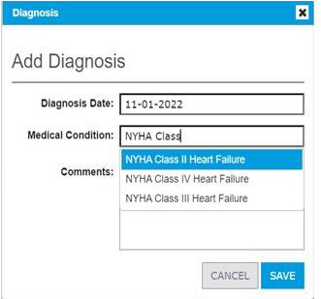
NYHA Class Data Entry
After choosing ADD DIAGNOSIS option, a window will open with additional fields
The information is organized into table columns
Diagnosis Date
Medical Condition
Comments
DIAGNOSIS DATE
Date of NYHA classification assessment (prior to or the day of CardioMEMSTM PA Sensor implant)
MEDICAL CONDITION
Start typing “NYHA Class” and a list of options will appear
Select the NYHA class used for CardioMEMS implant qualification then click SAVE
Notes:
To document the patient’s NYHA class, ADD DIAGNOSIS then enter the date of the NYHA assessment (the date must be prior to or the day of the implant). Under MEDICAL CONDITION start typing “NYHA” and a list of options will appear. Choose the NYHA class that qualified the patient for the CardioMEMSTM PA Sensor implant (NYHA Class II, NYHA Class III). The Comments section may be left blank.

Slide 74
BNP/NT-proBNP Data Entry
If a patient qualifies for CardioMEMSTM HF System based on elevated natriuretic peptides, follow the same steps as NYHA Class documentation
SETTINGS > DIAGNOSES > ADD DIAGNOSIS
DIAGNOSIS DATE
Date of BNP/NT-proBNP lab draw (prior to or the day of CardioMEMSTM PA Sensor implant)
MEDICAL CONDITION
Start typing “Elevated” and a list of options will appear
Select the appropriate natriuretic peptide lab used for CardioMEMS implant qualification
COMMENTS
Enter the lab value for BNP/NT-proBNP in pg/ml followed by the BMI in kg/m2 in parentheses
Round all numbers to the nearest integer and do not include decimal points
Once completed click SAVE
Notes:
After choosing ADD DIAGNOSIS, enter the BNP or NT-proBNP data used to qualify the patient for CardioMEMS PA Sensor implant. The date of the BNP/NT-proBNP lab draw must be prior to or the day of implant. In the MEDICAL CONDITION field, type “Elevated” and a list of options will appear (choose either Elevated NT-proBNP or Elevated BNP). In the COMMENTS section enter the BNP or NT-proBNP lab value in pg/ml. Lastly, enter the patient’s BMI in parenthesis. Both the lab value and the BMI are to be rounded to the nearest integer; do not use decimal points. If a patient qualifies for CardioMEMS PA Sensor implant due to a HF hospitalization, do not enter BNP/NT-proBNP data.

Slide 75
Other Patient Settings
MEDICATIONS
Not required, but of benefit if patient is enrolled to use the myCardioMEMS™ app and medication management is “on”
Notes:
While not required, you may also enter a patient’s heart failure medications. Entering medications will be of benefit if the patient is enrolled to use the myCardioMEMS app. If medication management is turned “on,” a list of the patient’s medications will be shown in the app.

Slide 76
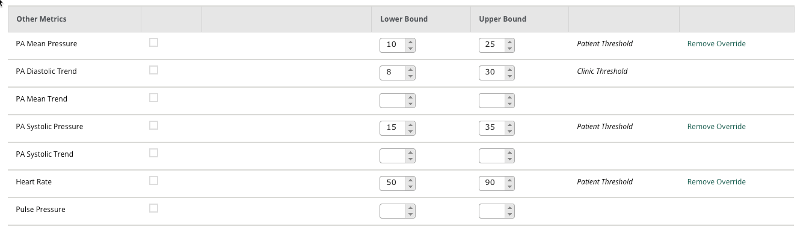
Other Patient Settings
GOALS AND THRESHOLDS (OTHER METRICS)
Notes:
In the Goals and Thresholds area, you may also enter other clinical measures you wish to monitor for an individual patient—such as heart rate.

Slide 77
Other Patient Settings
RETURN TO OPTIMAL STATE THRESHOLD
A patient is considered in the “optimal state” when they have had at least two consecutive readings in the optimal range (or other number set by the clinic)
Notes:
A particular threshold to pay attention to is the Return to Optimal State threshold. A patient is considered in the “optimal state” when they have had a specific number of consecutive readings in their optimal range. The optimal state threshold allows a patient to “settle in” to their optimal range for a set number of days before they are actually considered “in range.” This default is set to two days but can be adjusted.

Slide 78
How Do We Count Out-of-Range Readings?
n
= out of range reading count (colored flag indicates notification triggered)
PATIENT RETURNS TO OPTIMAL STATE (TWO CONSECUTIVE READINGS IN OPTIMAL RANGE). READING COUNT IS RE-SET.
PATIENT DOES NOT RETURN TO OPTIMAL STATE.
PATIENT SEE-SAWS IN AND OUT OF OPTIMAL RANGE, BUT DOES NOT RETURN TO OPTIMAL STATE. COUNT NOT RE-SET.
1
2
3
1
2
1
2
3
4
5
6
7
1
2
3
-upper
-upper
-upper
-lower
-lower
-lower
In optimal state, count re-set
Not in optimal state, count not re-set
Notifications received:
1 reading above optimal range
3 readings above optimal range
1 reading above optimal range
Notifications received:
1 reading above optimal range
3 readings above optimal range
7 readings above optimal range
Notifications received:
1 reading above optimal range
3 readings above optimal range
1
1
1
3
3
3
1
7
Notes:
To emphasize, a patient’s ”optimal state” depends on the number of consecutive readings in the optimal range. By default, this is set at two, and may be adjusted on a patient-by-patient basis.
That being said, it is important to understand how Merlin.net counts out-of-range readings. Depending on a patient’s notification settings, the system will trigger notifications when a patient has one reading out of range, three readings out of range, and again at seven readings out of range. The reading count starts over once a patient has returned to the optimal state, or if the patient’s readings transition between the high and low range without returning to the optimal state.
Here are three examples. In each example, the patient’s optimal range threshold is represented by the gray shaded bar.
In the first example, the patient returns to the optimal range for two consecutive readings, and is therefore considered to be in the optimal state. The out-of-range reading count starts over, and the next out-of-range reading is counted as the first reading out of range.
In the second example, the patient never returns to the optimal range, and is therefore never considered to be in the optimal state. The out-of-range reading count continues to progress, with notifications potentially triggering on the third and seventh out-of-range reading.
In the third example, the patient does return to to the optimal range, but only for one reading. Because the optimal state threshold is set at two consecutive readings, the patient is never considered to be in the optimal state. As such, the out-of-range reading count progresses. A ”three readings out of range” notification could trigger, even though it appears that the patient has only had one reading out of range after being in the optimal range.

Slide 79
Other Patient Settings
HOSPITALIZATIONS
Hospitalizations will appear in a pink shaded band on the DirectTrend™ Viewer
Notes:
Enter the dates of any hospitalizations for the patient. Once a hospitalization has been entered, that period will be shaded pink on the DirectTrend Viewer. It may help assess any changes in their PA pressures during this time.

Slide 80
Other Patient Settings
NOTES
Displays a running list of all notes entered here and through other Add Clinical Note actions throughout the site
Notes:
Finally, here you can add or view notes entered for a patient.

Slide 81
7. Clinic-Wide Settings
Notes:
Based on recommended best practices, Merlin.net comes with default clinic-wide settings. However, you may customize these based on your clinic’s preferences.

Slide 82
Clinic-Wide Settings
PATIENT MESSAGING
Allows you to customize (at a clinic-level) phone and text messages sent to patients
TIP: Record messages in the voice of the clinician or physician who most commonly contacts patients.
Notes:
Messages sent to patients by phone or text can be customized on a clinic-wide basis. Here you can record a custom voice message or write a custom text message. Make sure to refer to the name of your clinic or CardioMEMS program so that your patient can recognize who the message is from and what it is about.

Slide 83
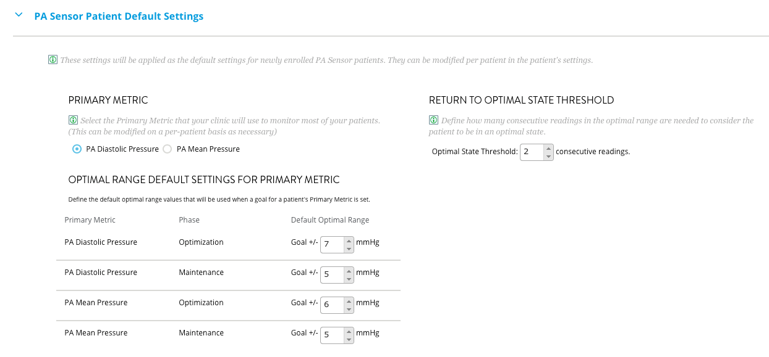
Clinic-Wide Settings
PA SENSOR PATIENT DEFAULT SETTINGS
Allows you to set (at a clinic-level) defaults for the primary metric, optimal range, and return to optimal state threshold
Notes:
While it is important that each patient’s PA pressure goal and threshold be set individually, here you can set clinic-wide defaults as a “starting point” for newly enrolled patients.

Slide 84
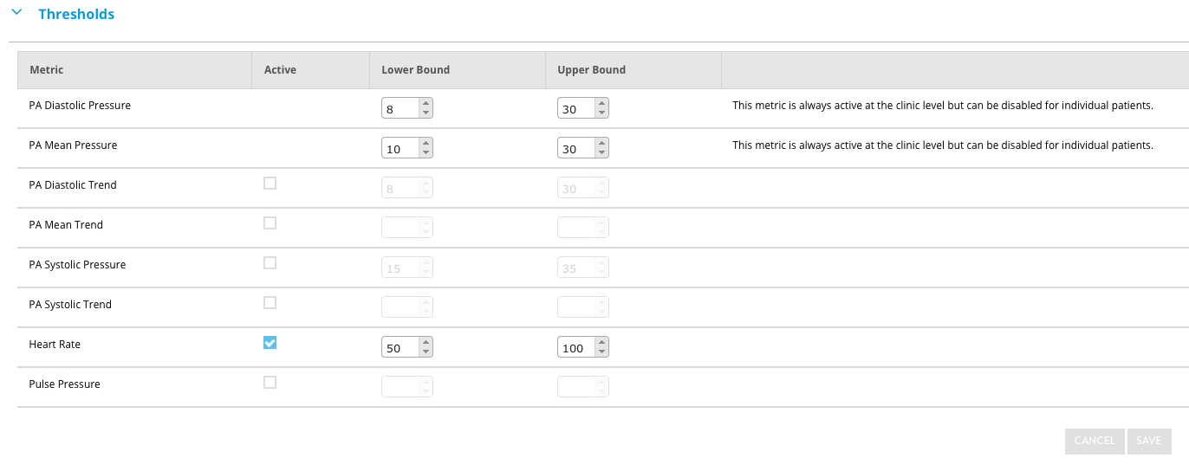
Clinic-Wide Settings
THRESHOLDS
Allows you to set (at a clinic-level) defaults for other clinical thresholds, such as heart rate
Notes:
The same goes for other clinical thresholds …

Slide 85
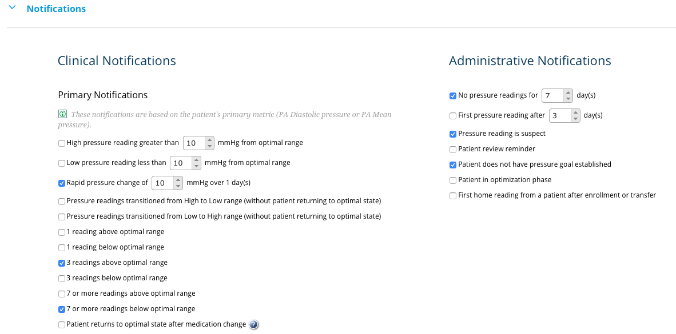
Clinic-Wide Settings
NOTIFICATIONS
Allows you to set default notifications for patients
Notes:
… or notifications. All newly enrolled patients will receive these settings, which can then be modified on an individual patient basis.

Slide 86
8. User Settings
Notes:
As an individual Merlin.net user, you may also wish to update your personal settings.

Slide 87
User Settings
Is accessed by clicking on user’s initials in navigation bar
Allows user to:
Change password
Update contact information
Set preferences for displays throughout the site
Subscribe to reports
Retrieve a temporary HES/HS password
Notes:
Click on your initials in the navigation bar to change your password, update your contact information, set display preferences, or subscribe to reports. And, if you need a temporary password to your clinic’s Hospital Electronics System, you can retrieve one here.

Slide 88
9. Administrative Tasks
Notes:
The final part of this presentation discusses some common administrative tasks related to patient management.

Slide 89
Billing Reminders
From the LAST REVIEWED/LAST BILLED BUTTON above the DirectTrend™ Viewer:
Enter a Mark as Billed on date (if applicable)
Enter Billing Reminder date
TIP: Use the Ready for Billing feature on the All Patients list to see a list of patients ready to be billed.
Notes:
While you cannot bill a patient directly from Merlin.net, you can set up reminders to do so. Past pilling dates and reminders for future billing dates can be entered when you mark a patient as reviewed.
Billing reminders appear on the All Patients list.

Slide 90
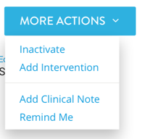
Inactivating a Patient
From the Patient Profile > More Actions button:
Click on Inactivate
Notes:
If a patient has passed away or chosen to no longer have their heart failure managed using the CardioMEMS HF System, they should be inactivated. From a patient’s profile, click on the More Actions button at the top of the page and select Inactivate.

Slide 91
Abbott​
6101 Stoneridge Dr., Pleasanton, CA 94588 USA, Tel: 1 925 847 8600​
Cardiovascular.Abbott/CardioMEMS​
​
Rx Only​
Brief Summary: Prior to using these devices, please review the Instructions for Use for a complete listing of indications, contraindications, warnings, precautions, potential adverse events and directions for use.​
​
CardioMEMS™ HF System Indications and Usage: The CardioMEMS™ HF System is indicated for wirelessly measuring and monitoring pulmonary artery pressure and heart rate in NYHA Class II or III heart failure patients who either have been hospitalized for heart failure in the previous year and/or have elevated natriuretic peptides. The hemodynamic data are used by physicians for heart failure management with the goal of controlling pulmonary artery pressures and reducing heart failure hospitalizations.​
​
CardioMEMS™ HF System Contraindications: The CardioMEMS HF System is contraindicated for patients with an inability to take dual antiplatelet or anticoagulants for one month post implant.​
​
CardioMEMS™ HF System Potential Adverse Events: Potential adverse events associated with the implantation procedure include, but are not limited to, the following: air embolism, allergic reaction, infection, delayed wound healing, arrhythmias, bleeding, hemoptysis, hematoma, nausea, cerebrovascular accident, thrombus, cardiovascular injury, myocardial infarction, death, embolization, thermal burn, cardiac perforation, pneumothorax, thoracic duct injury and hemothorax.​
myCardioMEMS™ Mobile App Limitations: Patients must use their own Apple‡ or Android‡ mobile device to receive and transmit information to the myCardioMEMS™ Mobile App. To do so​
the device must be powered on, app must be installed and data coverage (cellular or Wi-Fi‡) available. The myCardioMEMS™ App can provide notification of medication adjustments and reminders, requests for lab work and acknowledgement that the PA pressure readings have been received. However there are many internal and external factors that can hinder, delay, or prevent acquisition and delivery of the notifications and patient information as intended by the clinician. These factors include: patient environment, data services, mobile device operating system and settings, clinic​
environment, schedule/configuration changes, or data processing.​
​​
™ Indicates a trademark of the Abbott group of companies. ​
‡ Indicates a third party trademark, which is property of its respective owner.​
© 2024 Abbott. All Rights Reserved.​
MAT-1901214 v5.0 | Item approved for U.S. use only.

Slide 92
Notes:
This concludes our presentation of the basic features of the Merlin.net system.

