Slide 1
Image Interpretation & Morphology Assessment
Optimized with OCT

Slide 2
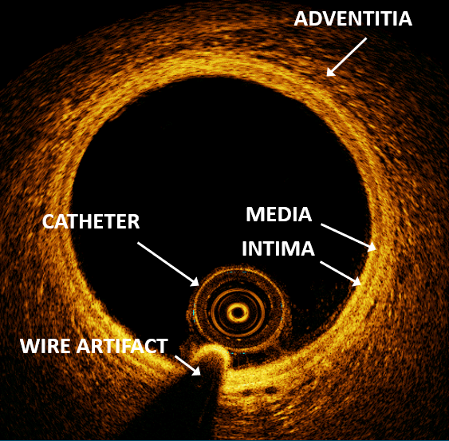
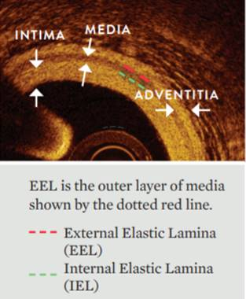
Normal Artery Morphology on OCT
Intima - Hard sponge
IEL - Rubber band
Media - Soft rope
EEL - Rubber band
Adventitia - Mesh
Shlofmitz, E. et al. Algorithmic Approach for OCT Guided Stent Implantation During PCI. Intervent Cardiol Clin 7 (2018) 329-344.

Slide 3
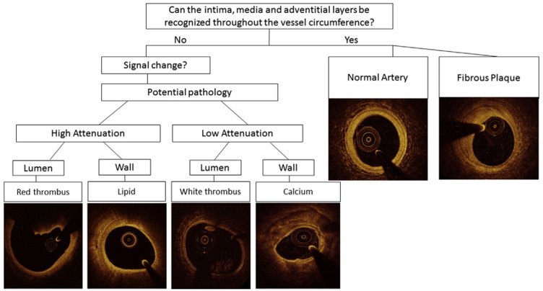
OCT Image Interpretation
Shlofmitz, E. et al. Algorithmic Approach for OCT Guided Stent Implantation During PCI. Intervent Cardiol Clin 7 (2018) 329-344.

Slide 4
OCT Signal Attenuation
HIGH ATTENUATION
LOW ATTENUATION
Light
refracted
(bent)
Light
Blocked
Courtesy of Dr. Ziad A. Ali.
NOTE: High attenuation= loss of light in the deep tissue for dark deep tissue visualization. Low attenuation= light penetration in the deep tissue for brighter deep tissue visualization

Slide 5
OCT Image Interpretation
Can the EEL and Adventitia be visualized?
YES
Normal Artery, Fibrous Plaque
NORMAL
Courtesy of Dr. Ziad A. Ali.

Slide 6
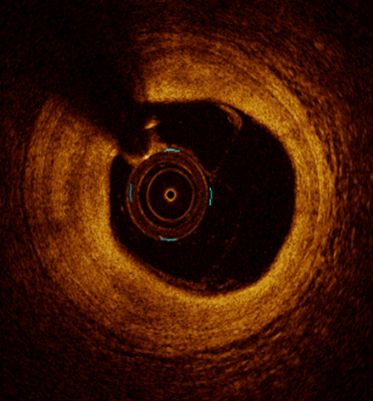
OCT Image Interpretation
Can the EEL and Adventitia be visualized?
YES
Normal Artery, Fibrous Plaque
FIBROUS PLAQUE
Courtesy of Dr. Ziad A. Ali.

Slide 7
OCT Image Interpretation
Is the signal change in the lumen or the wall?
LIPID
Wall
High Attenuation
Lipid
FIBROLIPIDIC PLAQUE
Courtesy of Dr. Ziad A. Ali.

Slide 8
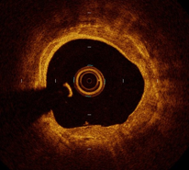
OCT Image Interpretation
Is the signal change in the lumen or the wall?
Wall
Low Attenuation
Calcium
Courtesy of Dr. Ziad A. Ali.

Slide 9
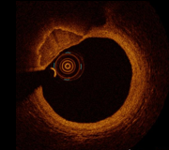
OCT Image Interpretation
Is the signal change in the lumen or the wall?
Wall
Low Attenuation
Nodular Calcium
Courtesy of Dr. Ziad A. Ali.

Slide 10
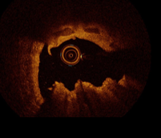
OCT Image Interpretation
Is the signal change in the lumen or the wall?
Lumen/Wall
Low & High Attenuation
Eruptive Nodular Calcium
Courtesy of Dr. Ziad A. Ali.

Slide 11
OCT Image Interpretation
Is the signal change in the lumen or the wall?
Lumen
Low Attenuation
White Thrombus
WHITE THROMBUS
Courtesy of Dr. Ziad A. Ali.

Slide 12
OCT Image Interpretation
Is the signal change in the lumen or the wall?
Lumen
High Attenuation
Red Thrombus
RED THROMBUS
Courtesy of Dr. Ziad A. Ali.

