Slide 1
Calcium Assessment: Autodetection
Optimized with OCT

Slide 2
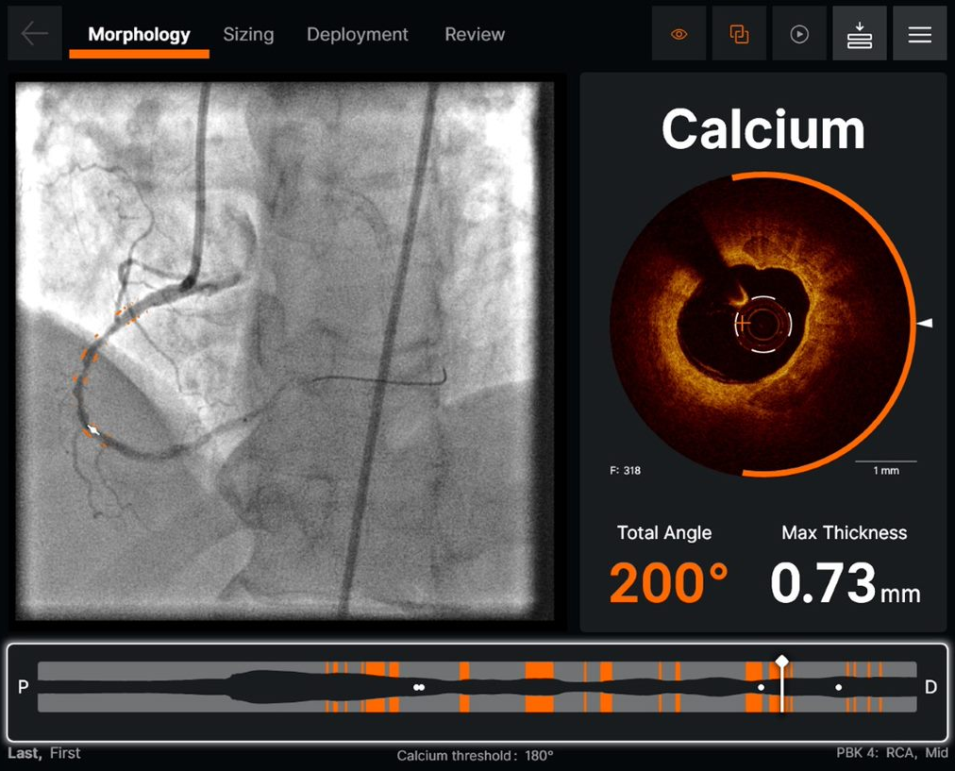
Calcium Augmentation Enabled
CALCIUM AUTODETECTION
Calcium is indicated in orange
Orange arc around the cross-sectional view indicates calcium in the current frame
Arc is calculated from the lumen center (orange crosshair)
Arc is displayed when calcium angle is at or above 60 degrees of circumferential calcium
Ultreon™ 1.0 Software Instructions For Use (IFU). Refer to IFU for additional information.
Information contained herein for DISPLAY in Australia and New Zealand ONLY.
©2022 Abbott. All rights reserved. MAT-2212892 v1.0

Slide 3
Calcium Augmentation Enabled (cont.)
CALCIUM AUTODETECTION (cont.)
Maximum thickness of calcium in the current frame indicated by white triangle
Lumen profile highlights frames with total calcium angle that exceeds user-defined threshold
Co-registration view allows user to visualize calcium on angio still-frame
Note: Physician threshold preference for calcium detection is available under System Settings - Physician Profiles
Ultreon™ 1.0 Software Instructions For Use (IFU). Refer to IFU for additional information.
Information contained herein for DISPLAY in Australia and New Zealand ONLY.
©2022 Abbott. All rights reserved. MAT-2212892 v1.0

Slide 4
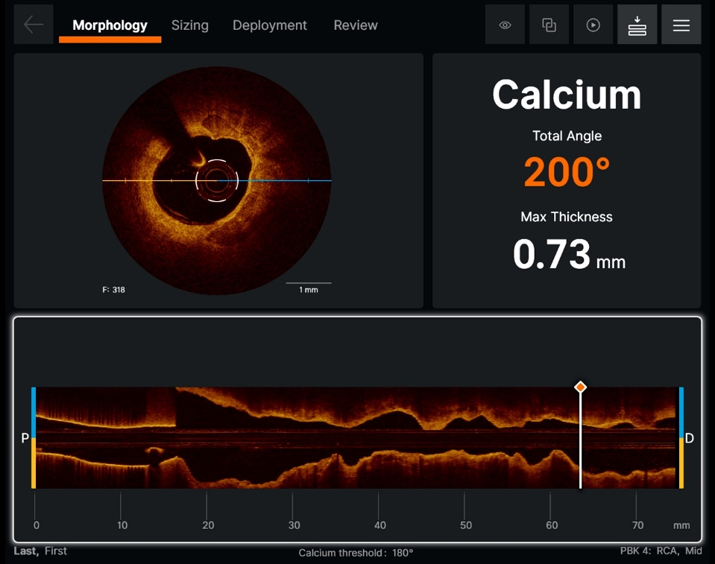
Calcium Augmentation Disabled
CALCIUM AUTODETECTION Disabled
Turning off Augmentation will remove the highlighted overlays displays on the images
The cut plane on the 2D cross sectional image is now displayed with augmentation off, which allows the user to rotate the longitudinal view
Total angle of calcium and thickness value remains
Ultreon™ 1.0 Software Instructions For Use (IFU). Refer to IFU for additional information.
Information contained herein for DISPLAY in Australia and New Zealand ONLY.
©2022 Abbott. All rights reserved. MAT-2212892 v1.0

Slide 5
Calcium Autodetection Assessment
VIDEO
Ultreon™ 1.0 Software Instructions For Use (IFU). Refer to IFU for additional information.
Information contained herein for DISPLAY in Australia and New Zealand ONLY.
©2022 Abbott. All rights reserved. MAT-2212892 v1.0

Slide 6
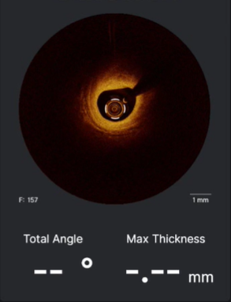
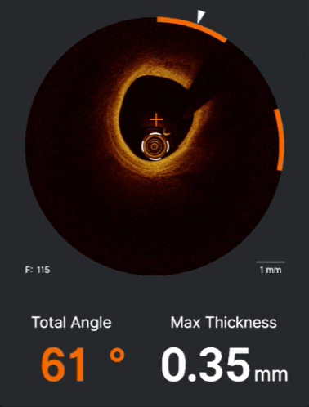
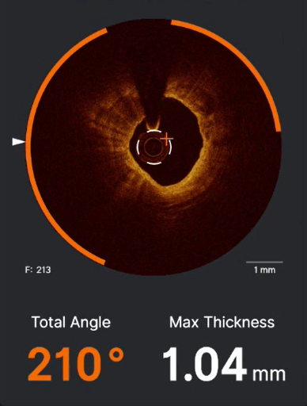
Treatment Strategy¹⁻⁴
NO CALCIUM
LOW CALCIUM
HIGH CALCIUM
Use clinical judgment to evaluate best strategy for non-calcific plaque.
If calcium length is also > 5 mm, consider vessel preparation with NC Balloon; Cutting/Scoring Balloon; Atherectomy, or IVL^{1,4}
All references available on slide 7.
Information contained herein for DISPLAY in Australia and New Zealand ONLY.
©2022 Abbott. All rights reserved. MAT-2212892 v1.0
Page 6 of 9

Slide 7
References
Taylor, A., et al. Efficacy and Safety of Direct Stenting in Coronary Angioplasty, J. Invasive Cardiology, 2000; 12(11).
Romagnoli, E., et al. Drug Eluting Stenting, JACC Cardiovascular Interventions, 2008; 1(1): 21-31.
Seyithan Oglu, B., Compliant vs Non-compliant balloons. A Prospective Randomised Study, 1998; 39(1): 45-54.
Tomey, M., Current Status of Rotational Atherectomy, JACC Cardiovascular Interventions, 2014; 7(4): 345-354.
Information contained herein for DISPLAY in Australia and New Zealand ONLY.
©2022 Abbott. All rights reserved. MAT-2212892 v1.0
Page 7 of 9

Slide 8
CAUTION: This product is intended for use by or under the direction of a physician. Prior to use, reference the Instructions for Use, inside the product carton (when available) or at vascular.eifu.abbott or at medical.abbott/manuals for more detailed information on Indications, Contraindications, Warnings, Precautions and Adverse Events. This material is intended for use with healthcare professionals only.
Illustrations are artist’s representations only and should not be considered as engineering drawings or photographs. Photos on file at Abbott.
Information contained herein for DISPLAY in Australia and New Zealand ONLY.
Abbott Vascular division of Abbott Medical New Zealand Ltd, Grd Flr, Bldg. D, 4 Pacific Rise Mt Wellington, Auckland 1060 Tel: 0800 827 285
Abbott Vascular division of Abbott Medical Australia Pty Ltd, 299 Lane Cove Road, Macquarie Park NSW 2113, Tel: 1800 550 939
™ Indicates a trademark of the Abbott Group of Companies
www.cardiovascular.abbott/au/en
©2022 Abbott. All rights reserved. MAT-2212892 v1.0
Page 8 of 9

