Slide 1
AVEIR™ VR Leadless Pacemaker (LP) :
Patient Selection and Implant Considerations
Case based Approach
Devi G. Nair, MD, FACC, FHRS
Director of Cardiac Electrophysiology & Research
St. Bernard’s Medical Center, AR
Arrhythmia Research Group, AR
White River Medical Center, AR
Associate Professor , UAMS
@drdevignair

Slide 2
Disclosures
Advisory Board, Consultant, Honoraria
  Medtronic Inc, Boston Scientific Corporation, Abbott, Biosense Webster, Adagio Medical
Research Grants & Support
Medtronic Inc, Boston Scientific Corporation, Abbott, Biosense Webster, Adagio Medical

Slide 3
58 yo female with Persistent left SVC, s/p left-sided dual pacer implanted for intermittent AV Block. V pacing <20%
Develops Ischemic CM, EF 30-35%, undergoes upgrade to left sided dual ICD with removal of old RV pacing lead, NYHA class 1 symptoms, on GDMT
Admitted with Sepsis, MRSA bacteremia
TEE with vegetations on the lead, EF now 50% on GDMT
Scheduled for Extraction

Slide 4
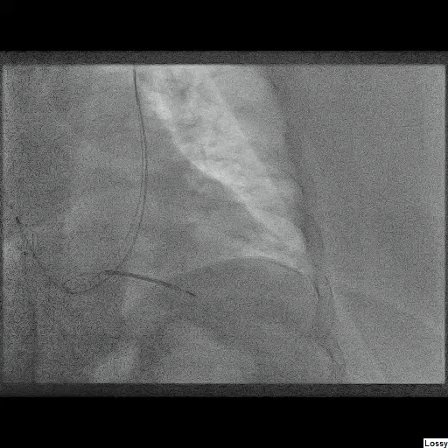
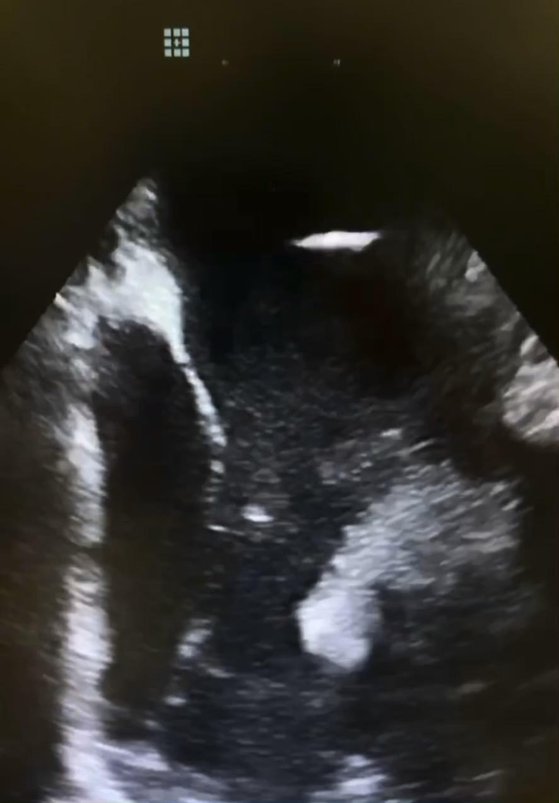

Slide 5
Treatment Considerations
Leadless pacing
  Septic patient with bacteremia
  h/o need for intermittent / infrequent pacing
  Desire to preserve vasculature - Concern with externalized pacing systems, PLSVC
Aveir™ VR LP
  Need for chronic retrievability
  Potential for upgrade to dual in the future*
*The LP device electronics are designed to be enabled by future software, upon regulatory approval, to support dual chamber pacing in the future. Dual chamber pacing system is currently in clinical trial (ClinicalTrials.gov NCT #05252702) and limited to investigational use only.

Slide 6
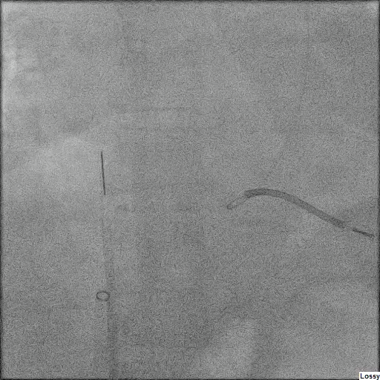

Slide 7
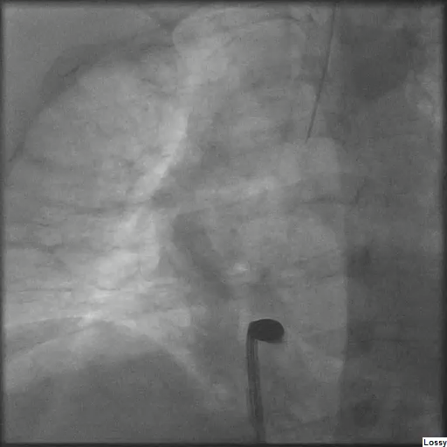
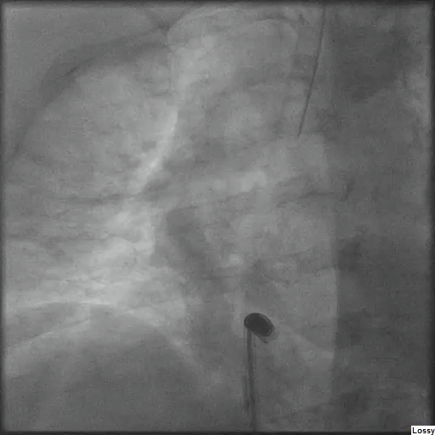

Slide 8
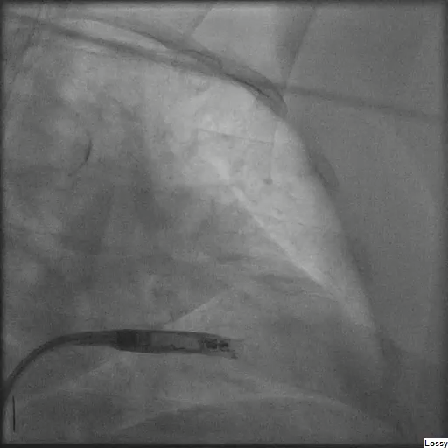
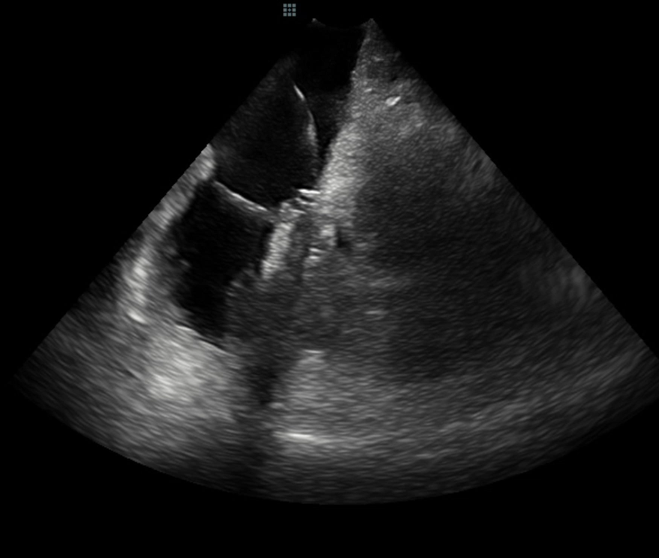

Slide 9
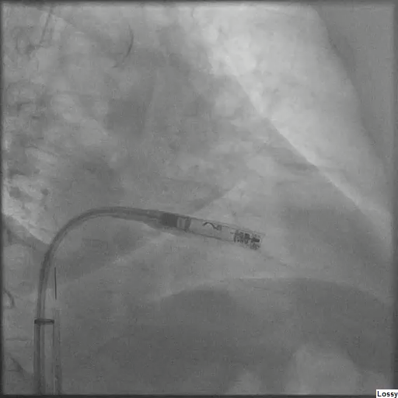
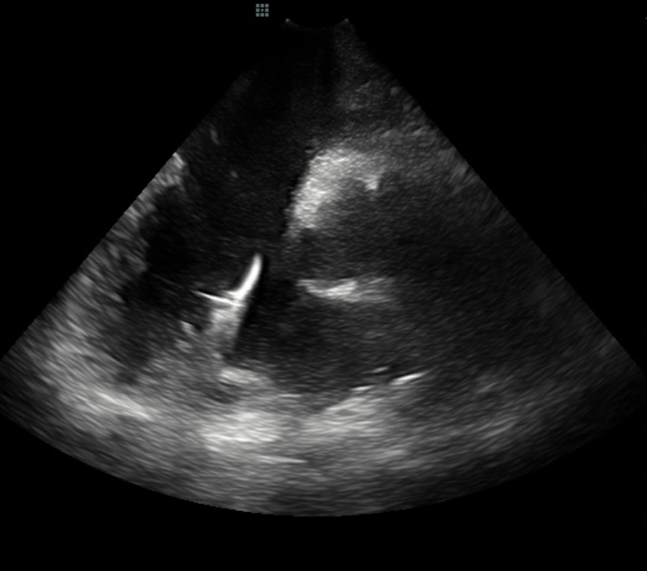

Slide 10
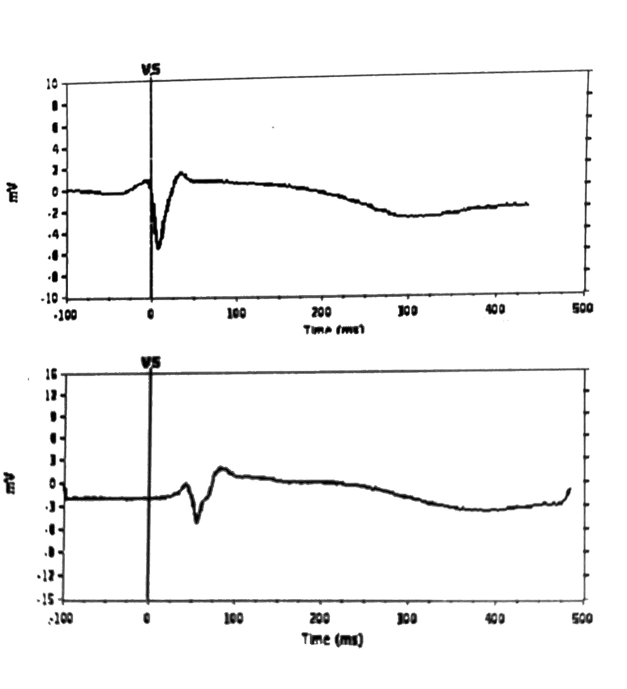
MAPPING
Acute mapping parameters
Sensing 6.0mV
Threshold 0.75 V @ 0.5 ms
Impedance 410 ohms

Slide 11
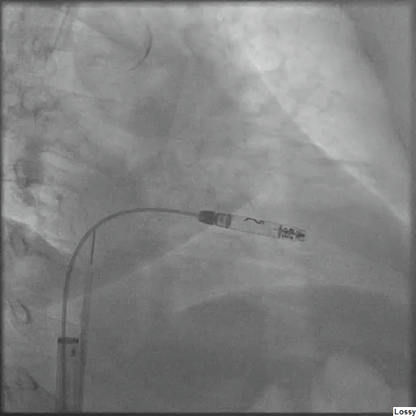

Slide 12
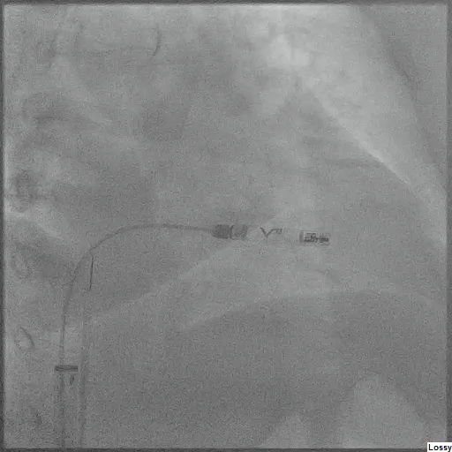

Slide 13
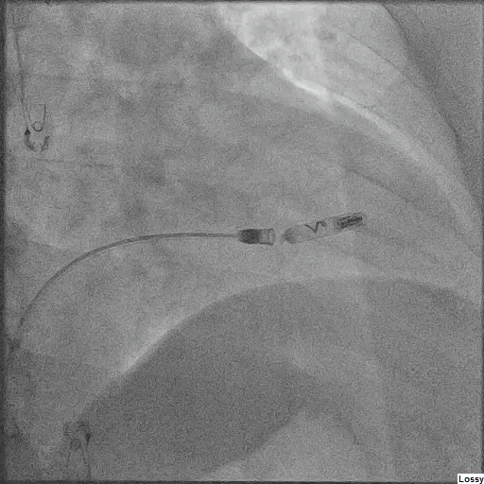
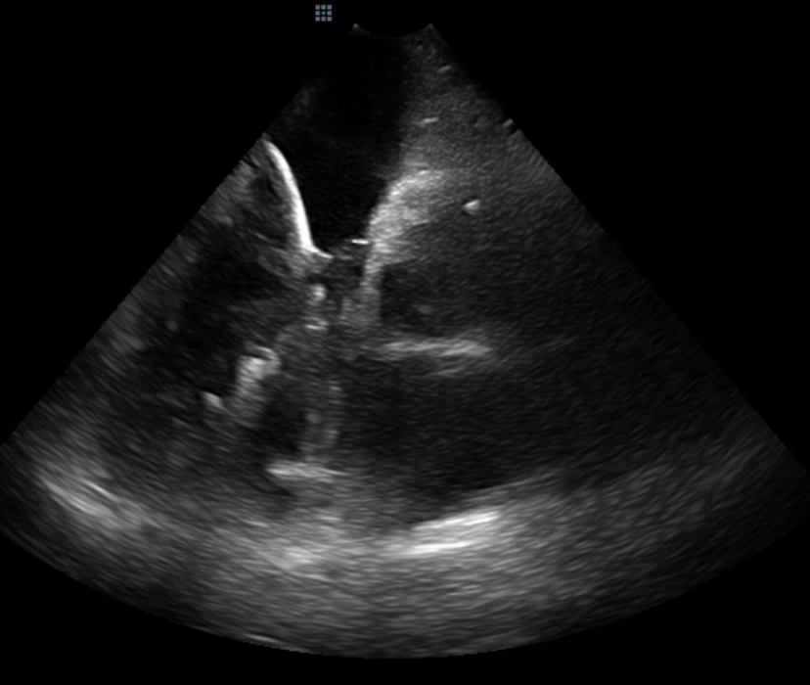

Slide 14
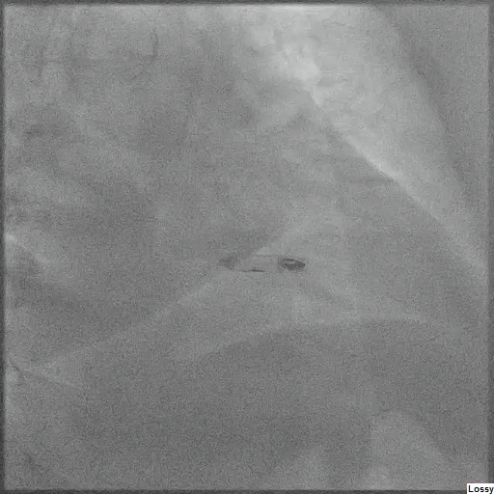
Implant Characteristics and Follow-up
Acute mapping parameters
Sensing 6.0 mV
Theshold 0.75 V@ V 0.5 ms ,
Impedance 410 ohms
During implant
Sensing 8.0 mV
Threshold 2.0 V 0.5 ms
Impedance 580 ohms
2 Hrs post op
Sensing 9 mV
Threshold 1.5 V @ 0.5ms
Impedance 510 ohms

Slide 15
THANK YOU

Slide 16
Rx Only
Brief Summary: Prior to using these devices, please review the Instructions for Use for a complete listing of indications, contraindications, warnings, precautions, potential adverse events and directions for use.
Indications: The Aveir™ Leadless Pacemaker system is indicated for patients with significant bradycardia and:
▪ Normal sinus rhythm with rare episodes of A-V block or sinus arrest
▪ Chronic atrial fibrillation
▪ Severe physical disability
Rate-Modulated Pacing is indicated for patients with chronotropic incompetence, and for those who would benefit from increased stimulation rates concurrent with physical activity.
Intended Use: The Aveir™ Leadless Pacemaker (LP) is designed to provide bradycardia pacing as a pulse generator with built-in battery and electrodes for implantation in the right ventricle. The LP is intended to provide sensing of intrinsic cardiac signals and delivery of cardiac pacing therapy to the target patient population.
The Aveir™ Delivery Catheter system is intended to be used in the peripheral vasculature and the cardiovascular system to deliver and manipulate an LP. Delivery and manipulation includes implanting an LP within the target chamber of the heart.
Contraindications: Use of the Aveir™ Leadless Pacemaker is contraindicated in these cases:
Use of any pacemaker is contraindicated in patients with a co-implanted ICD because high-voltage shocks could damage the pacemaker and the pacemaker could reduce shock effectiveness.
Single-chamber ventricular demand pacing is relatively contraindicated in patients who have demonstrated pacemaker syndrome, have retrograde VA conduction, or suffer a drop in arterial blood pressure with the onset of ventricular pacing.
Programming of rate-responsive pacing is contraindicated in patients with intolerance of high sensor-driven rates.
Use is contraindicated in patients with an implanted vena cava filter or mechanical tricuspid valve because of interference between these devices and the delivery system during implantation.
Persons with known history of allergies to any of the components of this device may suffer an allergic reaction to this device. Prior to use on the patient, the patient should be counseled on the materials (listed in Product Materials section in IFU) contained in the device and a thorough history of allergies must be discussed.
Adverse Events: Potential complications associated with the use of the Aveir™ Leadless Pacemaker system are the same as with the use of single chamber pacemakers with active fixation pacing leads including, but not limited to: Cardiac perforation, Cardiac tamponade, Pericardial effusion, Pericarditis, Valve damage and/or regurgitation, Heart failure, Pneumothorax/hemothorax, Cardiac arrhythmias, Diaphragmatic/phrenic nerve stimulation / extra-cardiac stimulation, Palpitations, Hypotension, Syncope, Cerebrovascular accident, Infection, Hypersensitivity reaction to device materials, medications, or direct toxic effect of contrast media on kidney function, Pacemaker syndrome, Inability to interrogate or program the LP due to programmer or LP malfunction, Intermittent or complete loss of pacing and/or sensing due to dislodgement or mechanical malfunction of the LP (non-battery related), Loss of capture or sensing due to embolization or fibrotic tissue response at the electrode, Increased capture threshold, Inappropriate sensor response, Interruption of desired LP function due to electrical interference, either electromyogenic or electromagnetic, Battery malfunction/ premature battery depletion, Device-related complications (Premature deployment, Device dislodgement/embolization of foreign material, Helix distortion), Death.
As with any percutaneous catheterization procedure, potential complications include, but are not limited to: Vascular access complications (such as perforation, dissection, puncture, groin pain), Bleeding or hematoma, Thrombus formation, Thromboembolism, Air embolism, Local and systemic infection, Peripheral nerve damage, General surgery risks and complications from comorbidities (such as hypotension, dyspnea, respiratory failure, syncope, pneumonia, hypertension, cardiac failure, reaction to sedation, renal failure, anemia, and death)
Abbott
15900 Valley View Court Sylmar, CA 91342, Tel: +1 818 362 6822
Cardiovascular.Abbott
™ indicates a trademark of the Abbott group of companies.
‡ Indicates a third-party trademark, which is property of its respective owner.
© 2022 Abbott. All Rights Reserved.
MAT-2213447 v1.0 | Item approved for US use only.

